Slide 1
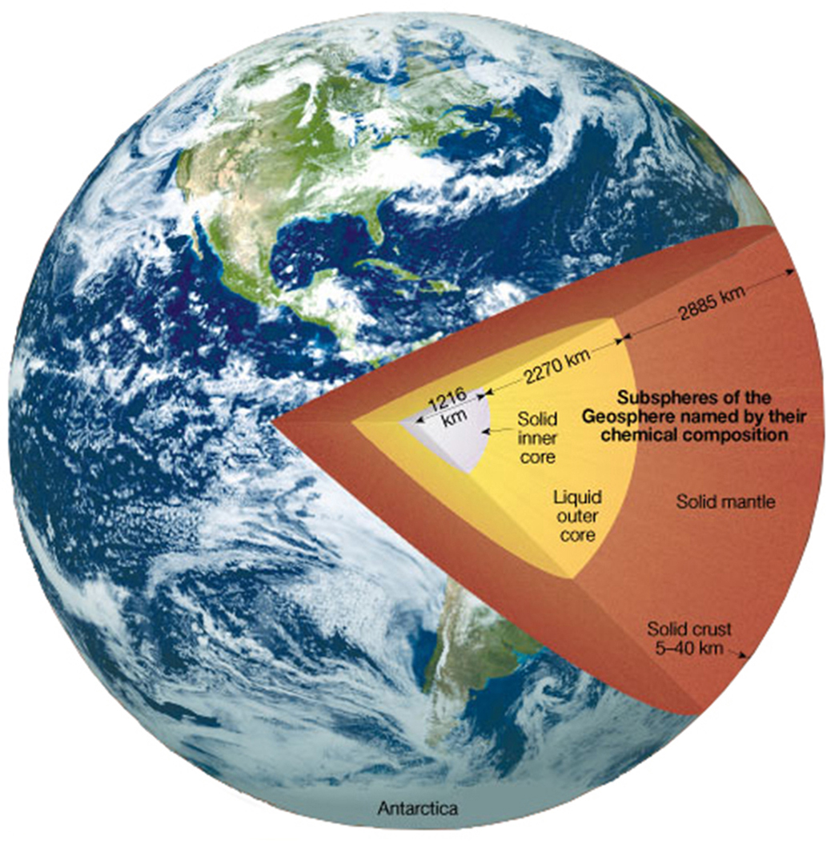
Earth’s Crust
5 km / 6,371 km = 0.0008
40 km / 6,371 km = 0.006
McIntosh Apple Skin
0.3 mm / 70 mm = 0.004
Notes:
Figure 1.5aa

Slide 2
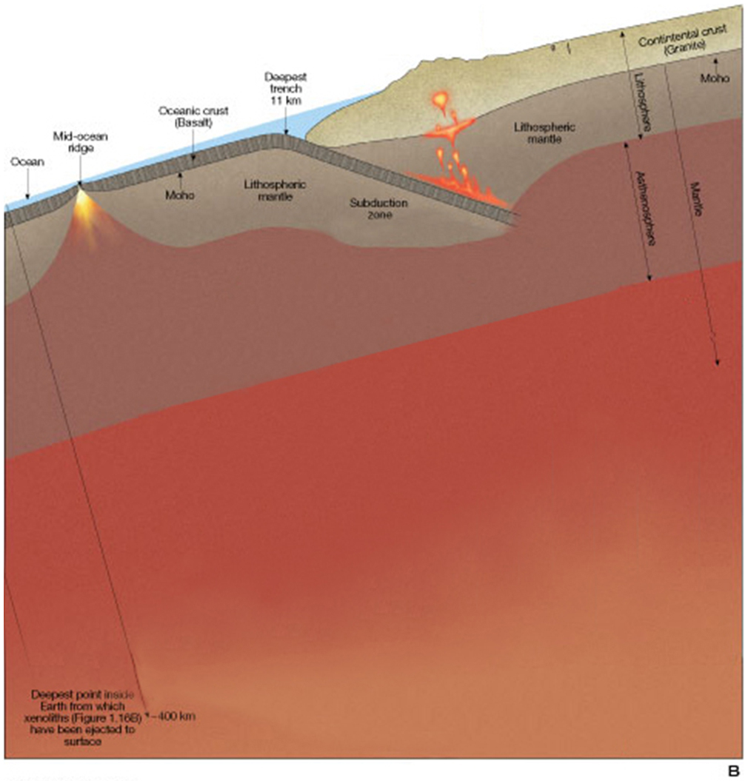
Notes:
Figure 1.5ab

Slide 3
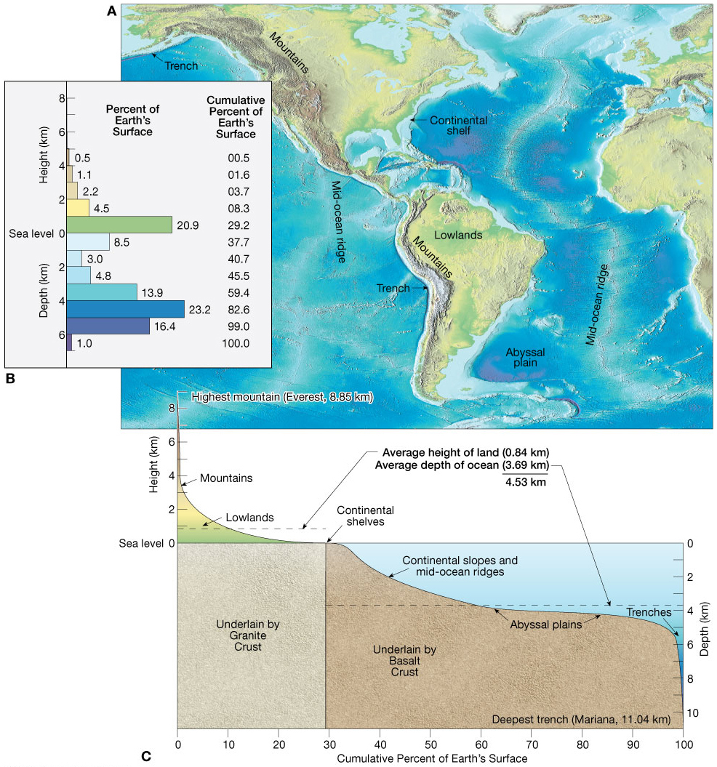
Notes:
Figure 1.11

Slide 4
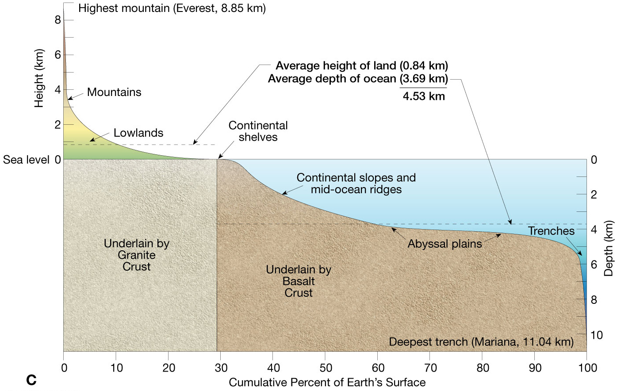
Notes:
Figure 1.11c

Slide 5
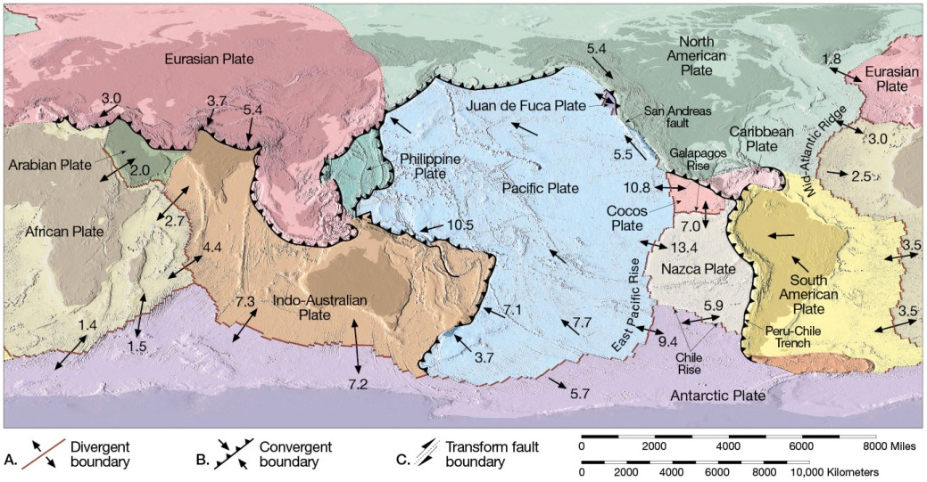
Notes:
Figure 2.5

Slide 6
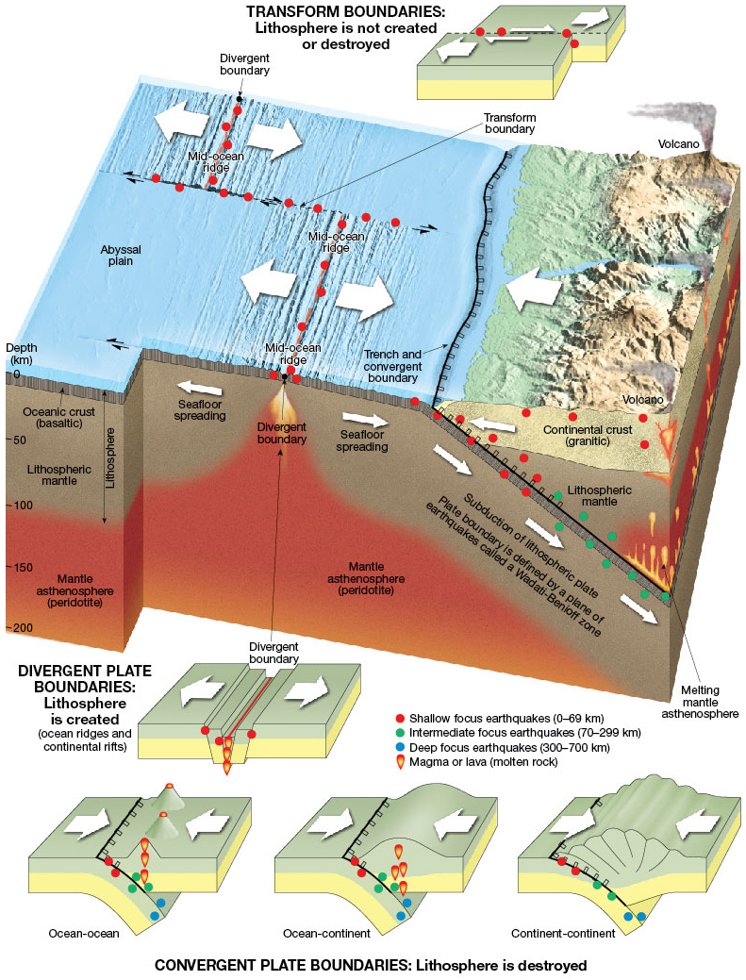
Notes:
Figure 2.2

Slide 7
Notes:
Figure 2.2a

Slide 8
Notes:
Figure 2.2b

Slide 9
CONVERGENT PLATE BOUNDARY
Notes:
Figure 2.2c

Slide 10
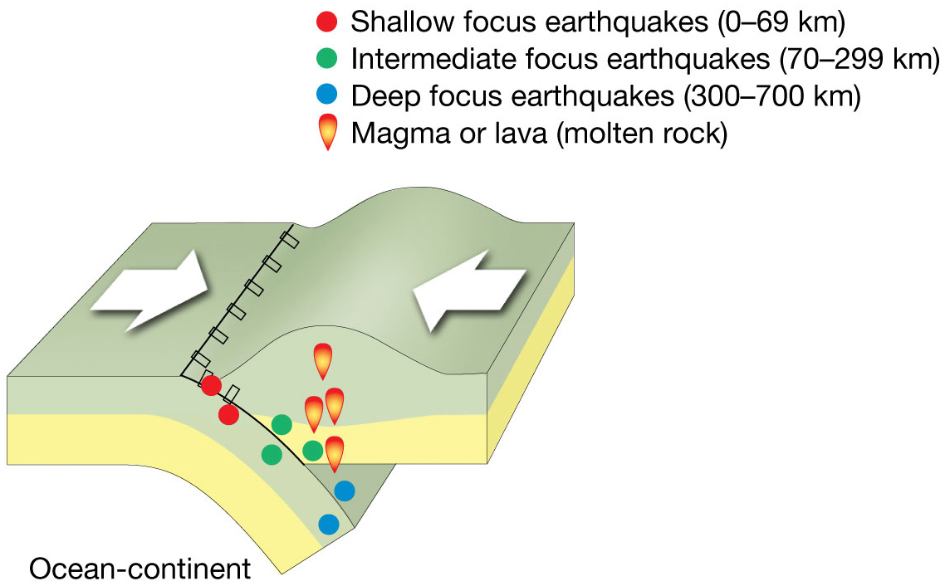
CONVERGENT PLATE BOUNDARY
Notes:
Figure 2.2d

Slide 11
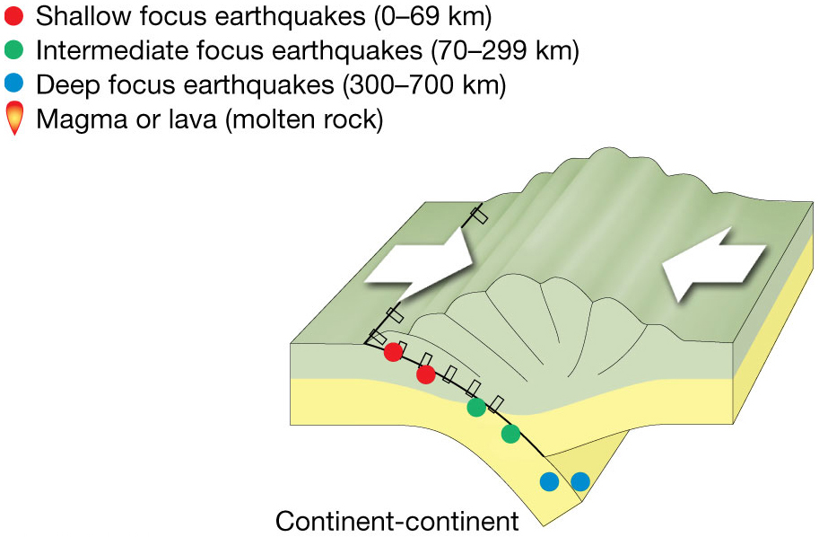
CONVERGENT PLATE BOUNDARY
Notes:
Figure 2.2e

Slide 12
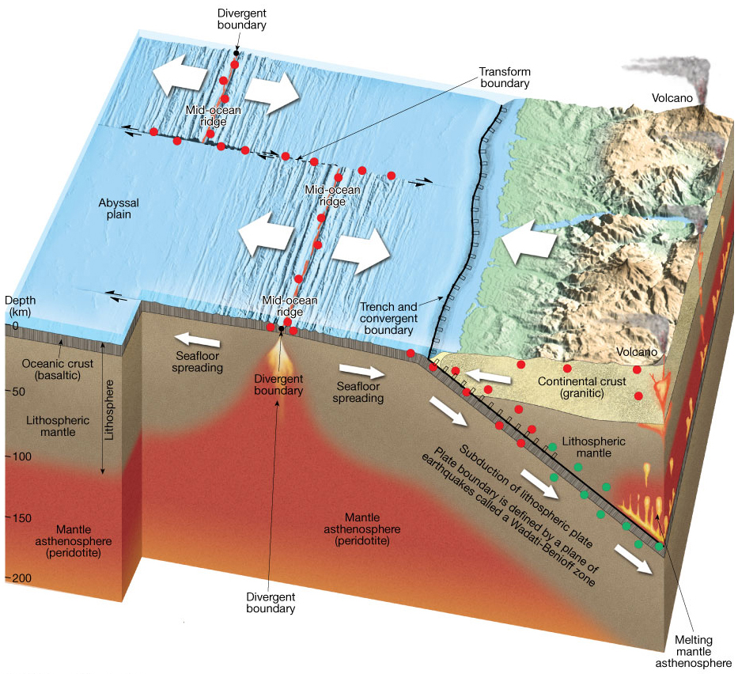
Notes:
Figure 2.2f

Slide 13
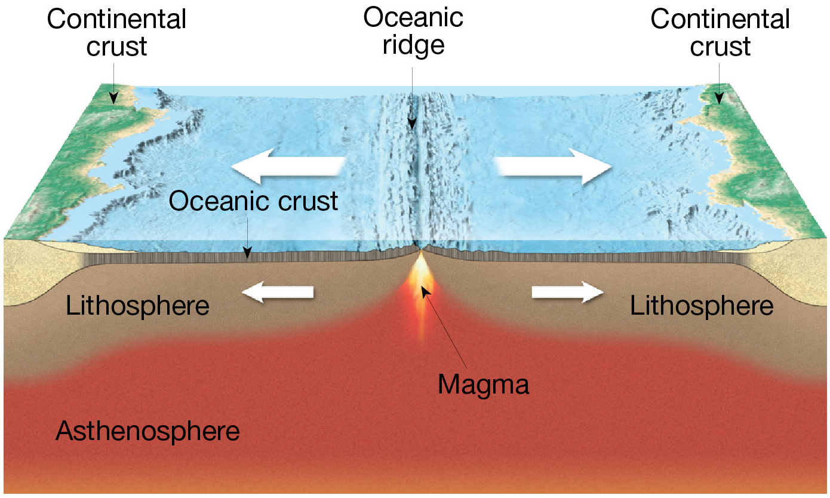
Notes:
UnFigure Pg71

Slide 14
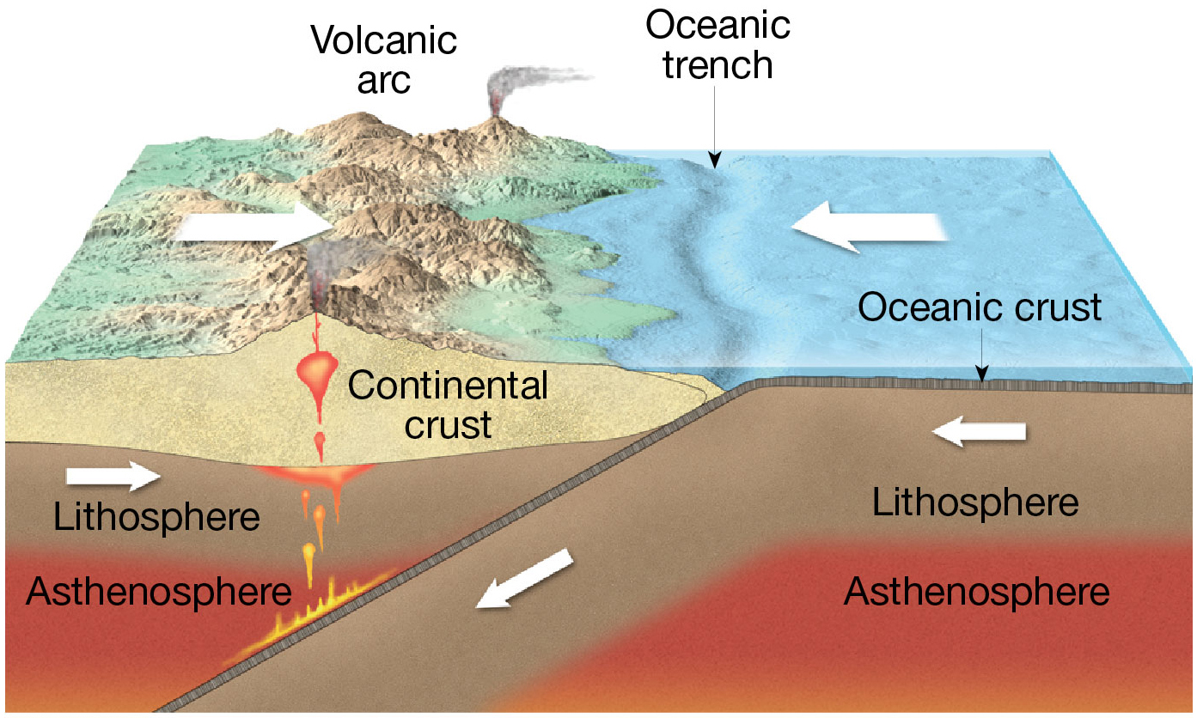
Trench, deepest part of ocean. Descending Oceanic crust drags sediment and water into mantle.
Notes:
UnFigure Pg72

Slide 15
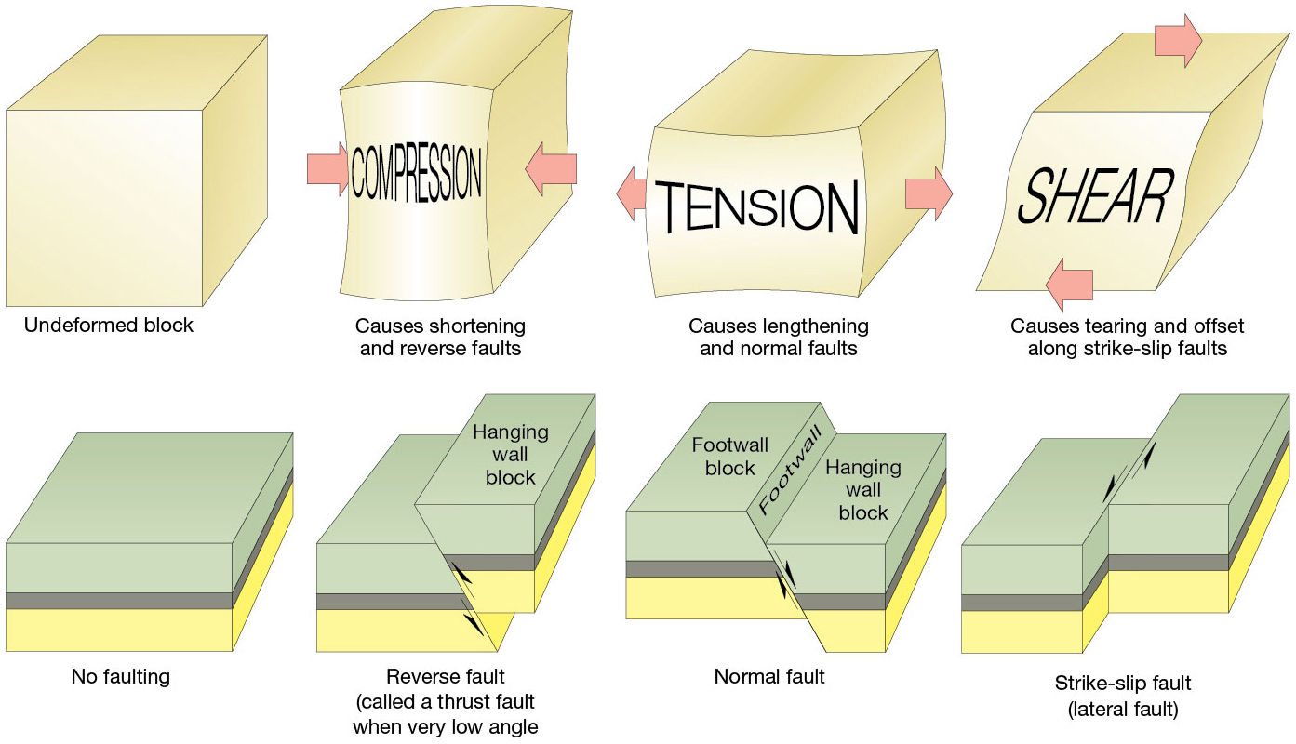
Notes:
Figure 2.4

Slide 16
Notes:
Figure 2.5

Slide 17
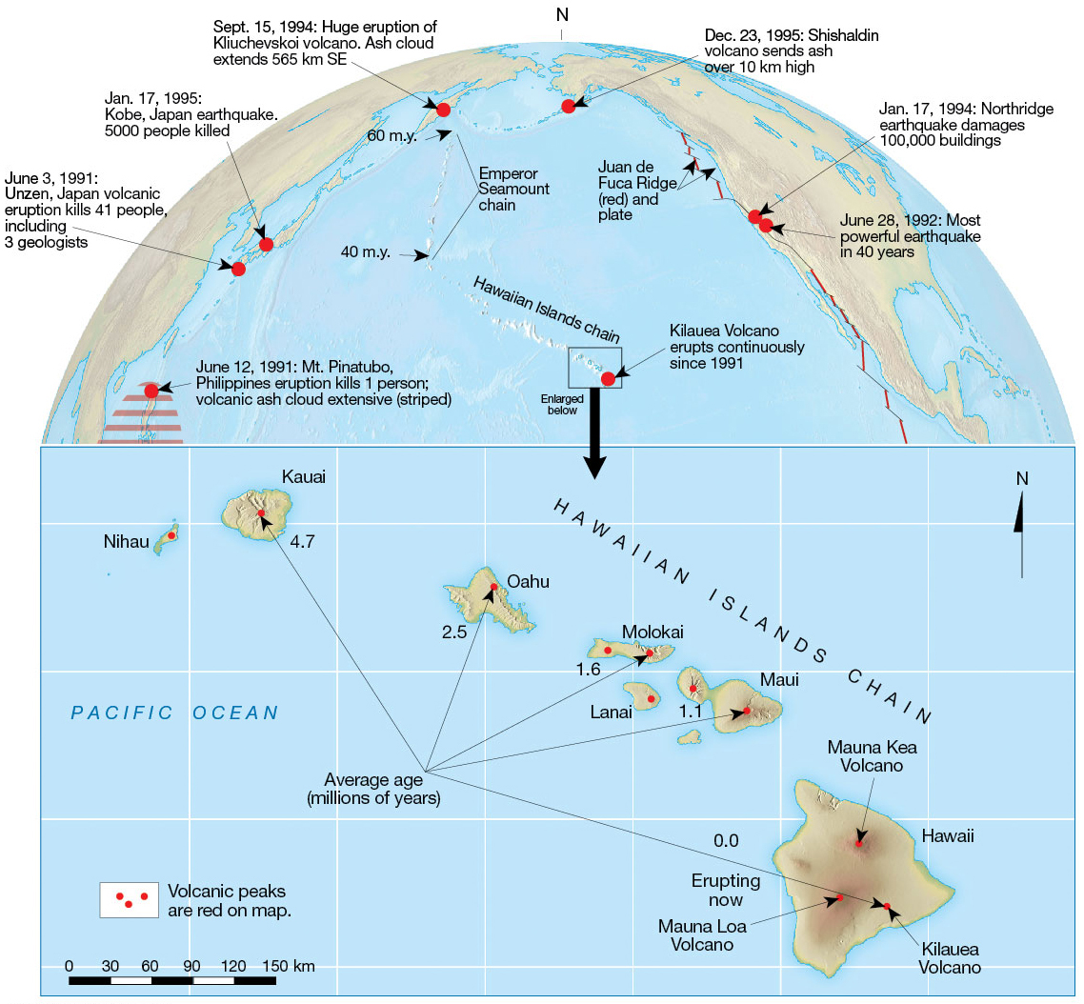
Notes:
Figure 2.7

Slide 18
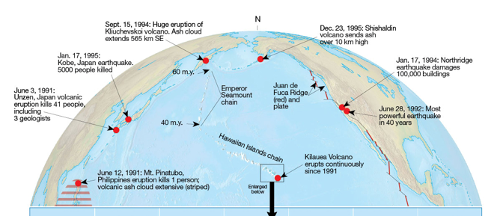
Hawaiian Island Chain and Emperor Seamount Chain, 0-40 MY and 40-60 MY.
See 2.8.A.2: Change 20 to 40 MY to 60 to 40 MY (Page 68)
Notes:
Figure 2.7

Slide 19
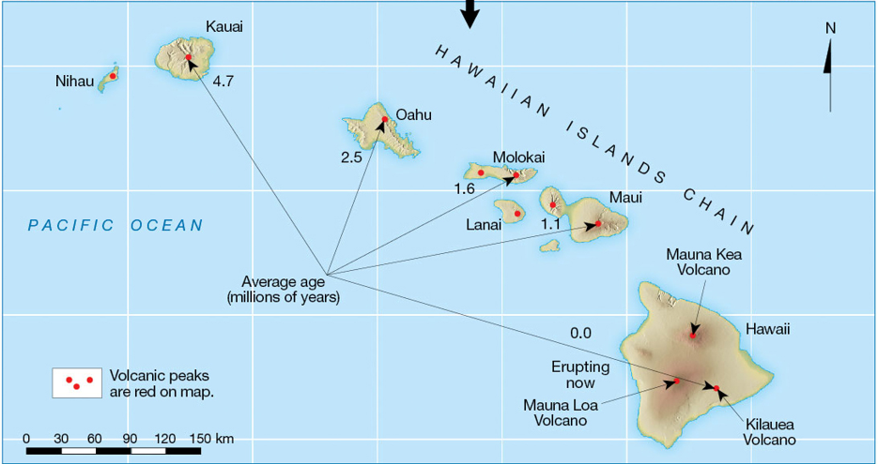
Plate Motion:
Distance/Time
1.6 MY to 0 MY (current) (red dots)
5.3 cm ruler * 47 km/cm = 250 km
250 km / 1.6 MY = 160 km/MY
Convert to cm/yr (board)
Correction Factor
1 km/MY * (0.1 cm/yr)/(km/MY)
160 km/MY * 0.1 = 16 cm/yr
Scale:
Bar scale 0 – 150 km is 3.2 cm long as measured by a ruler.
Thus, 150 km / 3.2 cm = 47 km
Significant figures (2)
Notes:
Figure 2.7

Slide 20
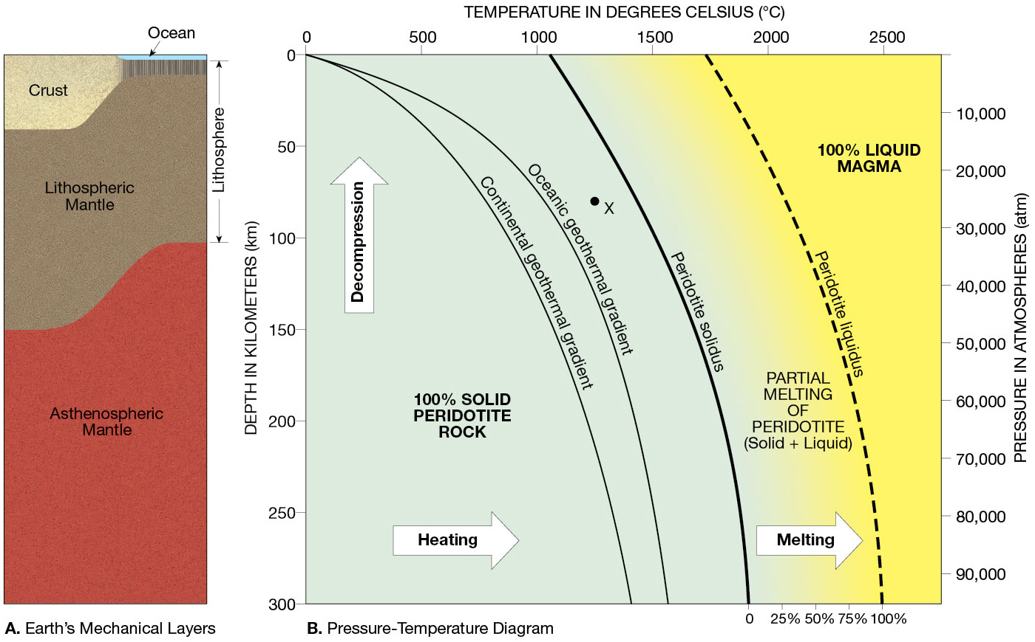
Notes:
Figure 2.8

Slide 21
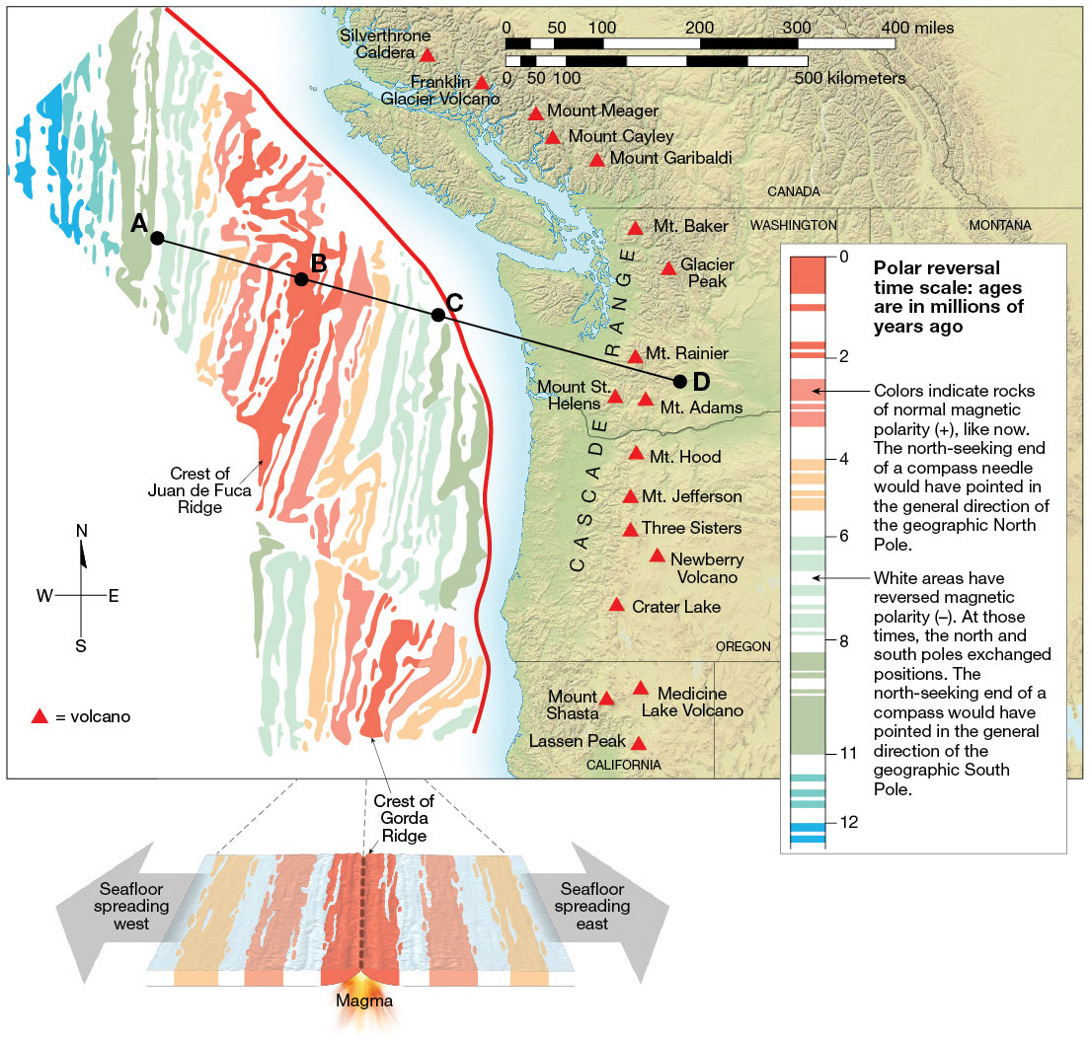
Notes:
UnFigure Pg61_1

Slide 22
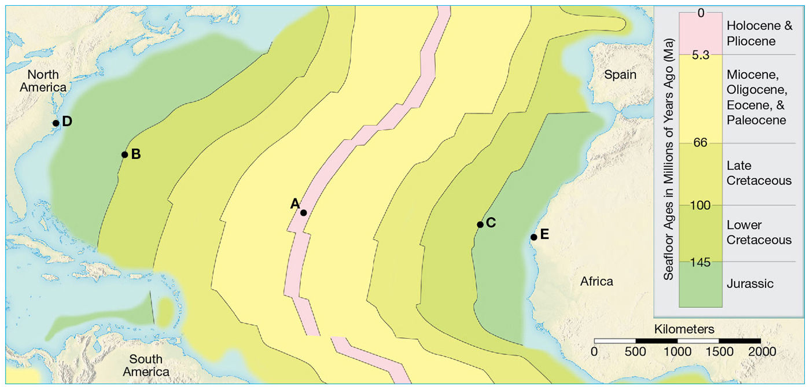
Notes:
UnFigure Pg63

Slide 23
EXERCISES
2.3 B
2.4 A. 1-5
2.5
2.8 A 1-4
2.9 A, B, C
See Lab Manual Page xi and xii for units and conversion factors

