Slide 2
Age Dating
Relative Age Dating
Relationships between geologic features and formations
Absolute Age Dating
Numerical age of formation based on radioactive isotopes and their decay rates

Slide 3
Relative Age Dating
Uniformitarianism
Principles of correlation
Original horizontality
Superposition
Inclusion
Cross-cutting relationships
Biostratigraphy

Slide 4
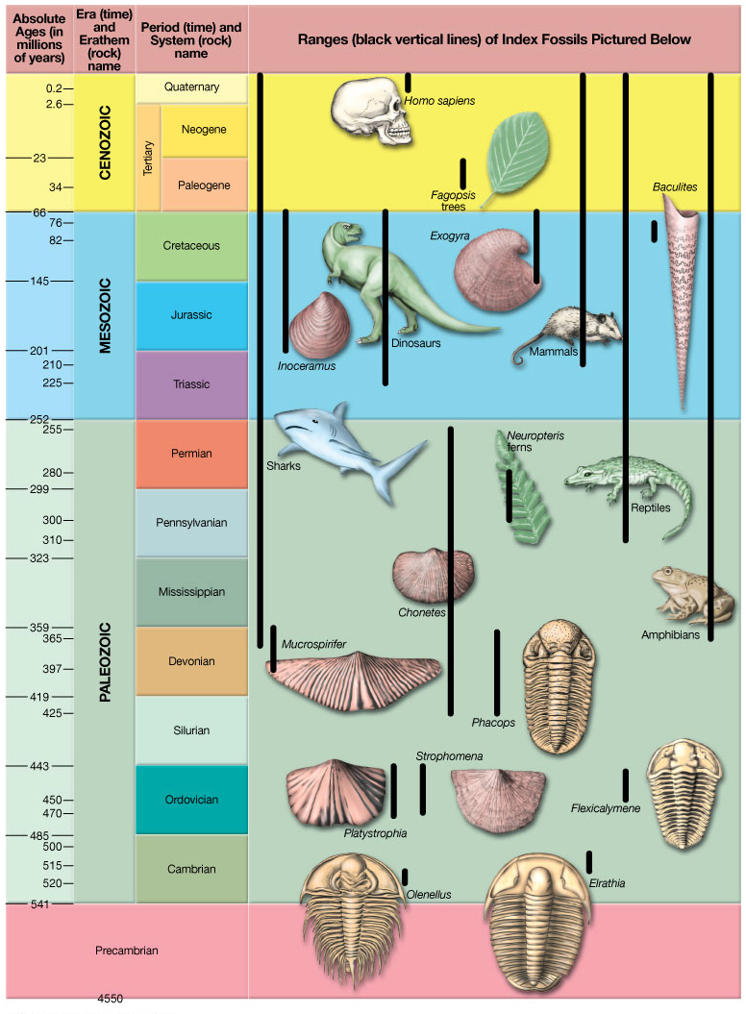
Notes:
Figure 8.10

Slide 5
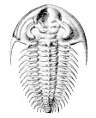
Biostratigraphy
More Recent
X
Extinction - last appearance of species in fossil record
Time
Fossil A
O
Origination - evolution of species
More Ancient

Slide 6
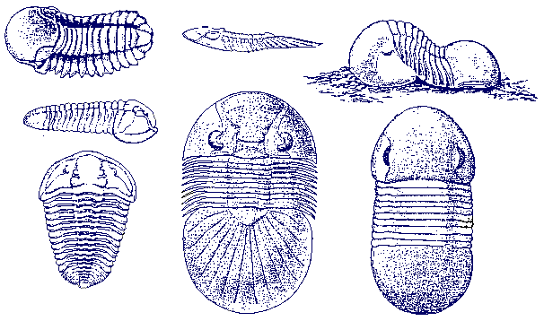
Biostratigraphy
A
B
Time
C
A
B
C
Overlap zone

Slide 7
Principle of Original Horizontality
Sedimentary rocks were deposited in primarily horizontal beds
deposited last - youngest
gravity
deposited first - oldest
Principle of Superposition
In an undisturbed sedimentary sequence, the oldest rocks are on the bottom of the stack

Slide 8
Principle of Superposition
In an undisturbed sedimentary sequence, the oldest rocks are on the bottom of the stack
Youngest
gravity
Oldest

Slide 9
Principle of Inclusion
When clasts of one rock are found in another, the rock from which the clasts were derived is the older rock, since it must have already existed in order to be included in the new rock
igneous rock
igneous intrusion
Inclusions - pieces of older rock incorporated into younger rock

Slide 10
Principle of Inclusion
When clasts of one rock are found in another, the rock from which the clasts were derived is the older rock, since it must have already existed in order to be included in the new rock
Inclusions - pieces of older rock (clasts) incorporated into younger rock

Slide 11
(a scene from Jurassic Park)
Principle of Cross-Cutting Relationships

Slide 12
Principle of Cross-Cutting Relationships
Older features are cut or crossed by younger features.

Slide 13
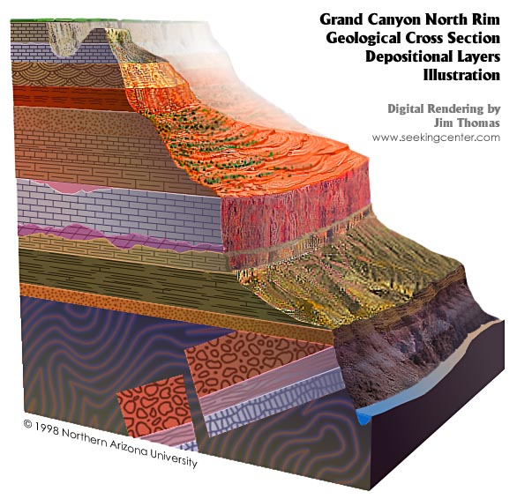
Contact – surface separating two formations
Hermit Shale
Supai Group
Redwall Limestone
Formation – bodies of rock with recognizable characteristic that are thick enough to map
Muav Limestone
Bright Angel Shale
Tapeats Sandstone

Slide 14
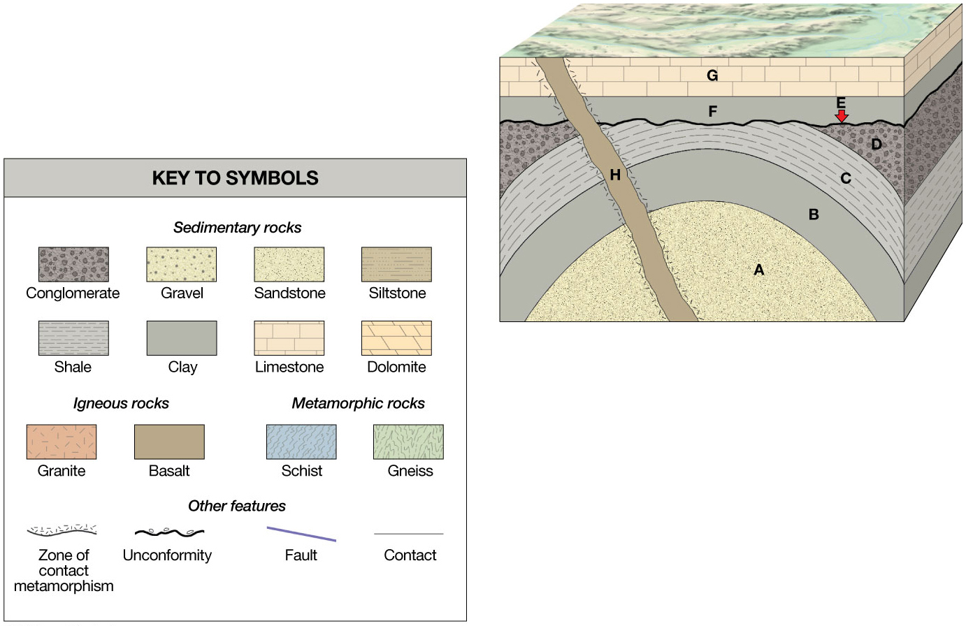
Notes:
Figure 8.5

Slide 15
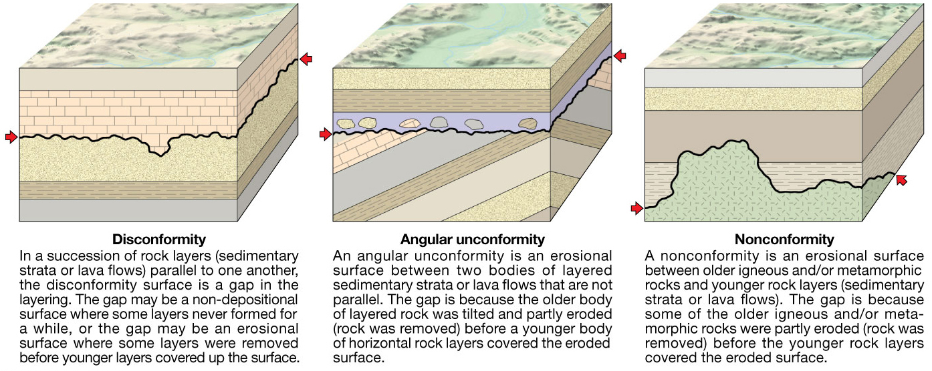
Unconformities: represent periods of missing time in the geologic record, either by no deposition or by erosion.
Notes:
Figure 8.1

Slide 16
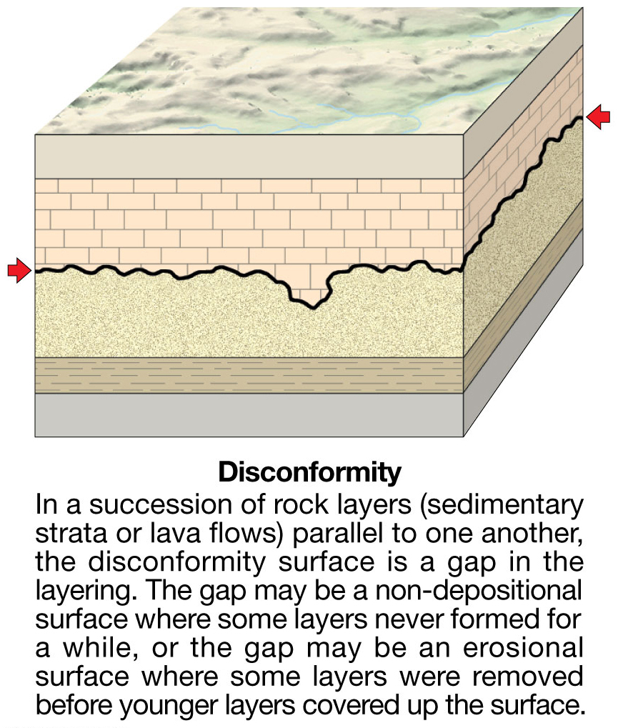
Notes:
Figure 8.1a

Slide 17
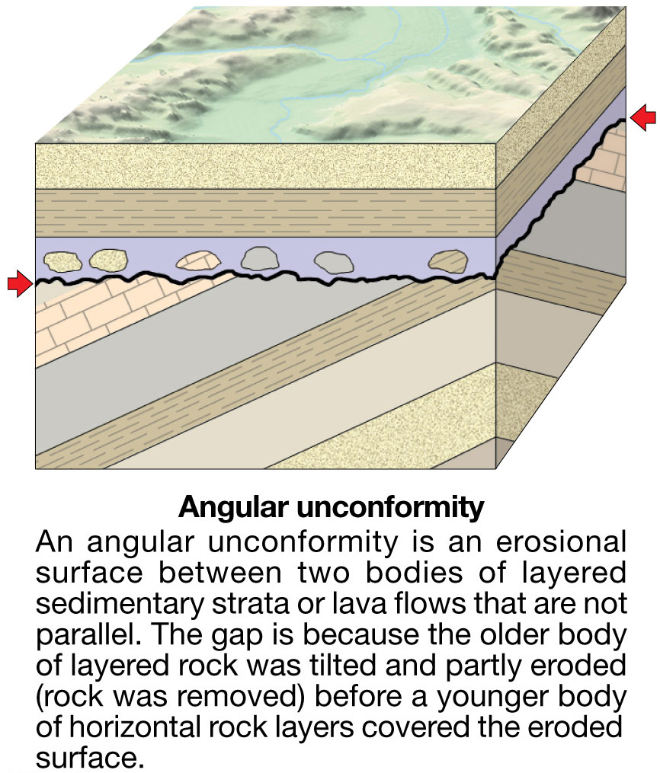
Notes:
Figure 8.1b

Slide 18
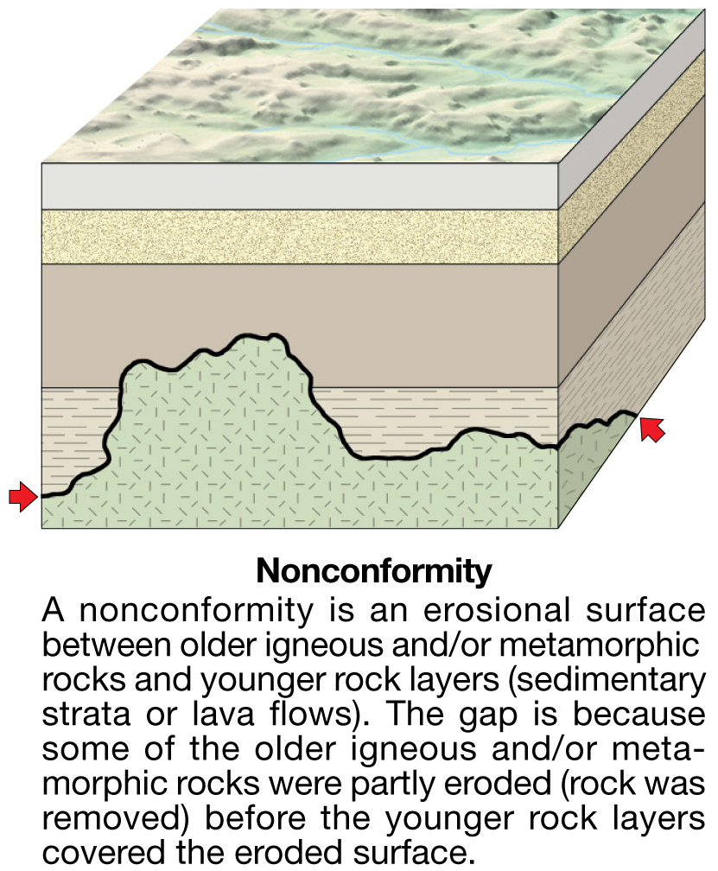
Notes:
Figure 8.1c

Slide 19
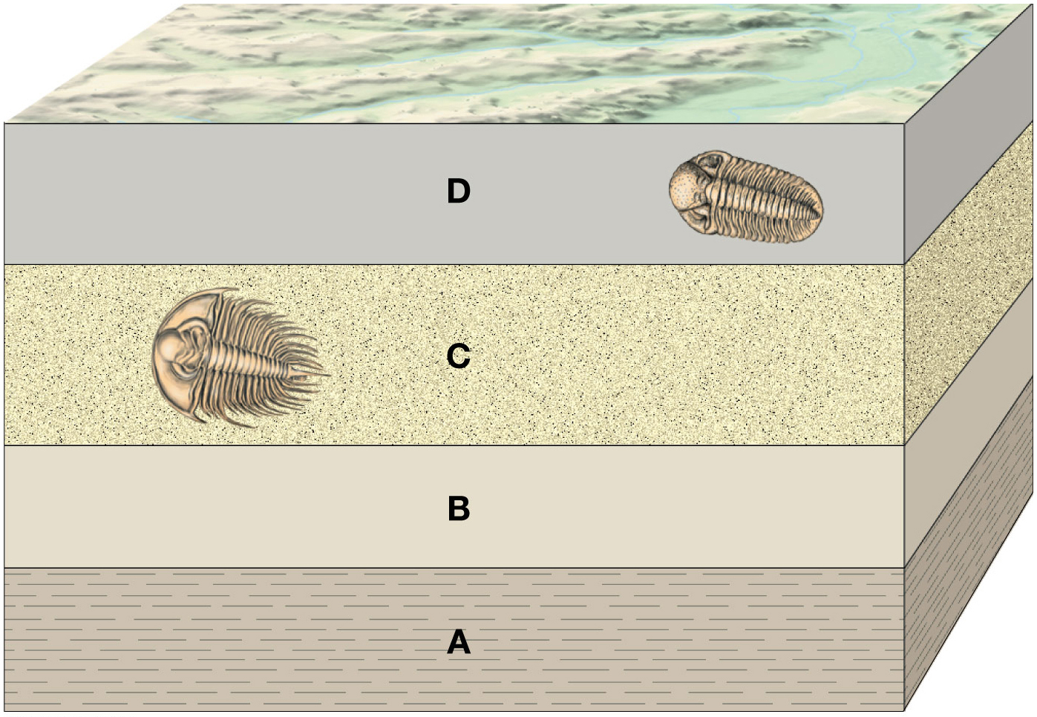
Notes:
Figure 8.2

Slide 20
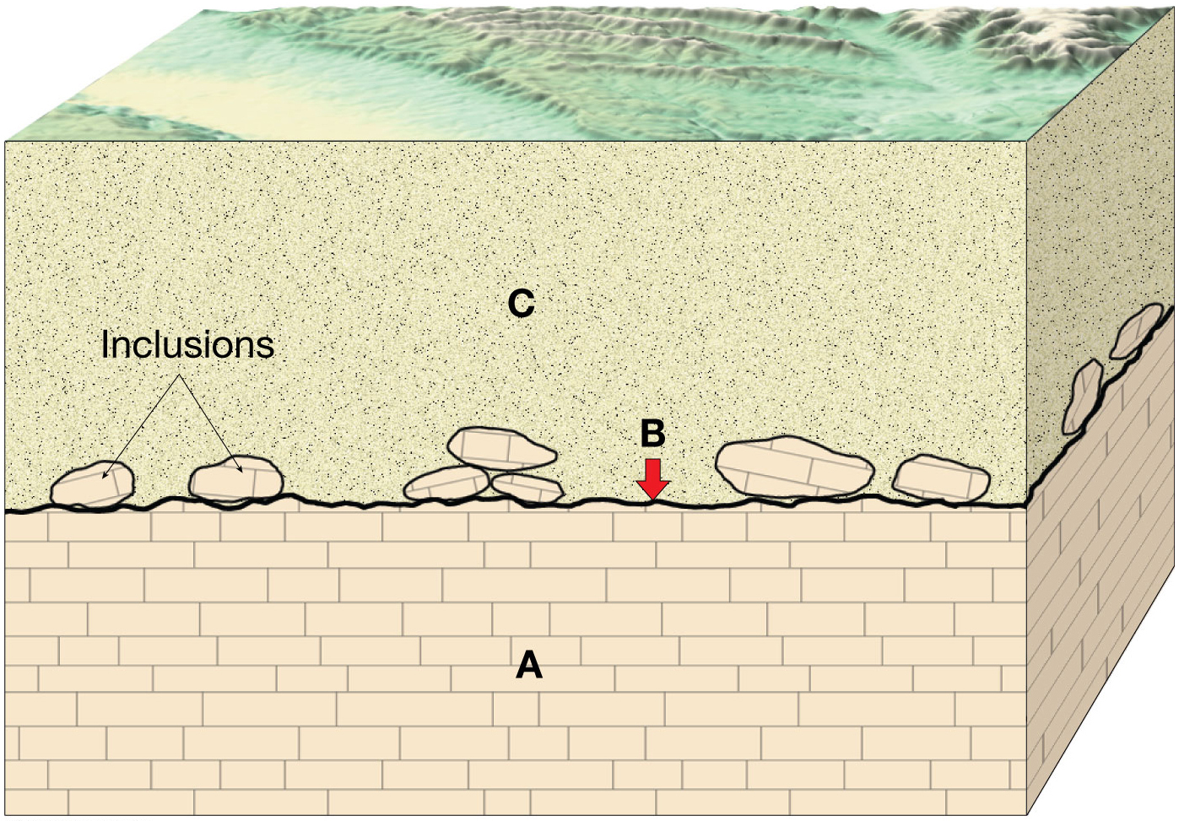
Notes:
Figure 8.3

Slide 21
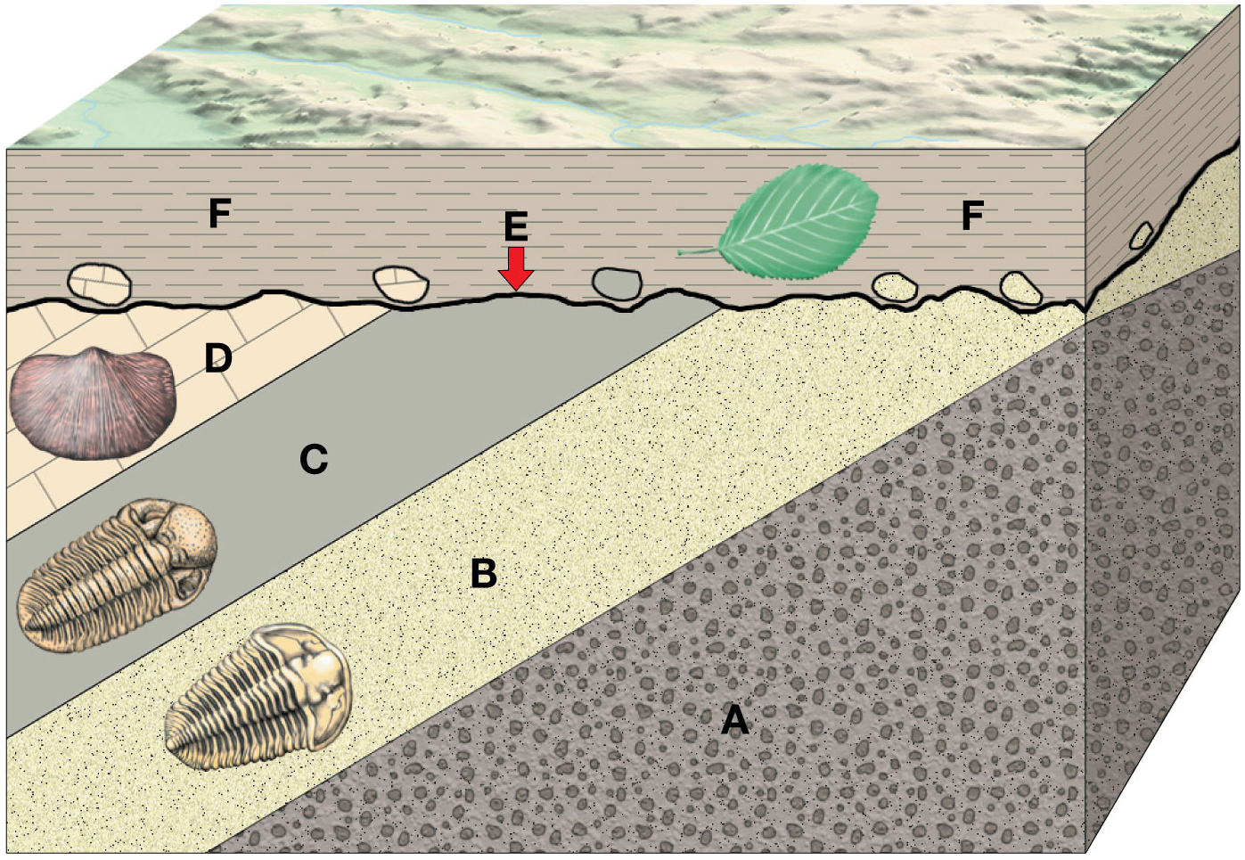
Notes:
Figure 8.4

Slide 22
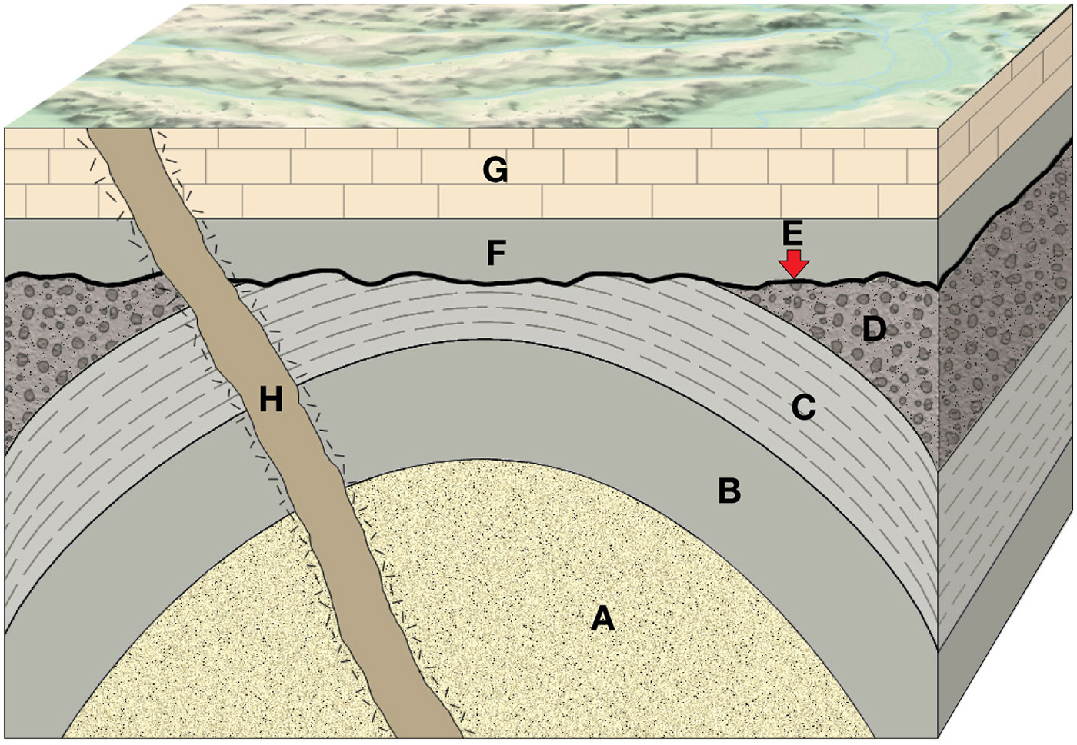
Notes:
Figure 8.5b

Slide 23
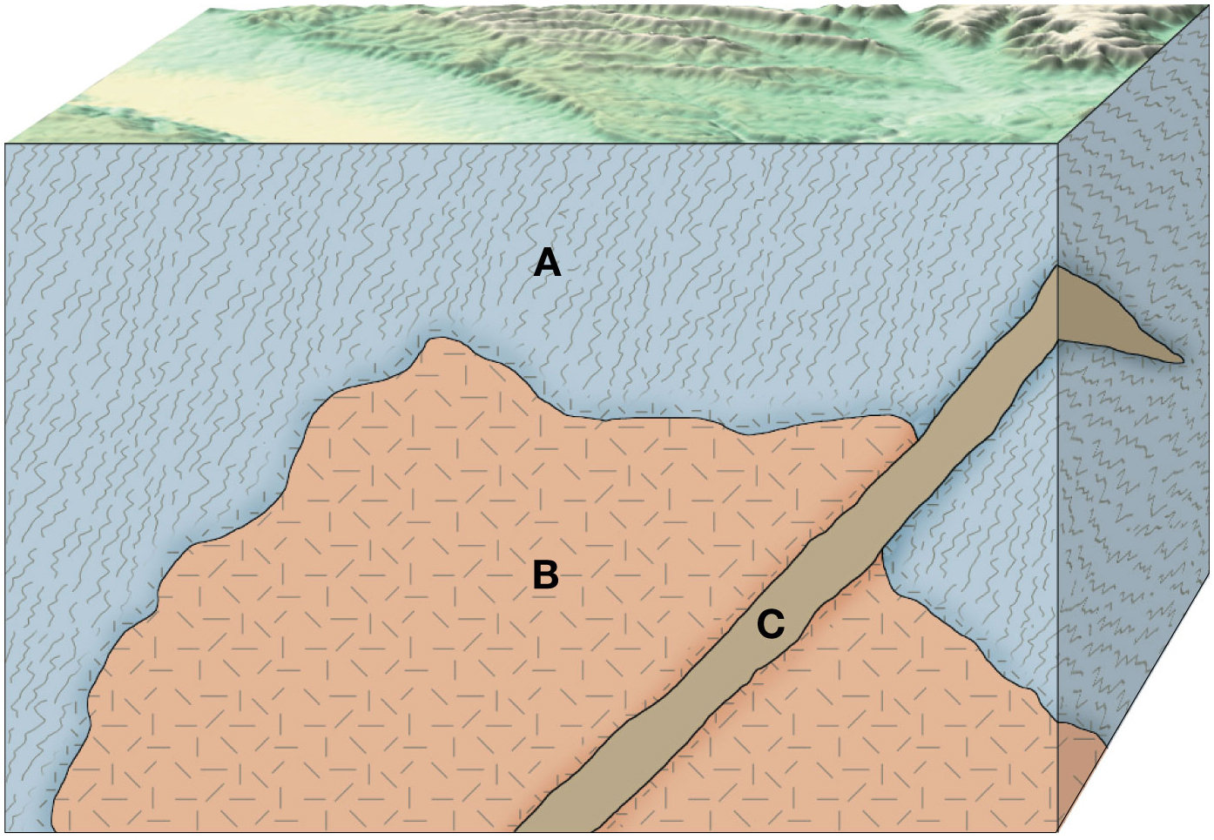
Notes:
Figure 8.6

Slide 24
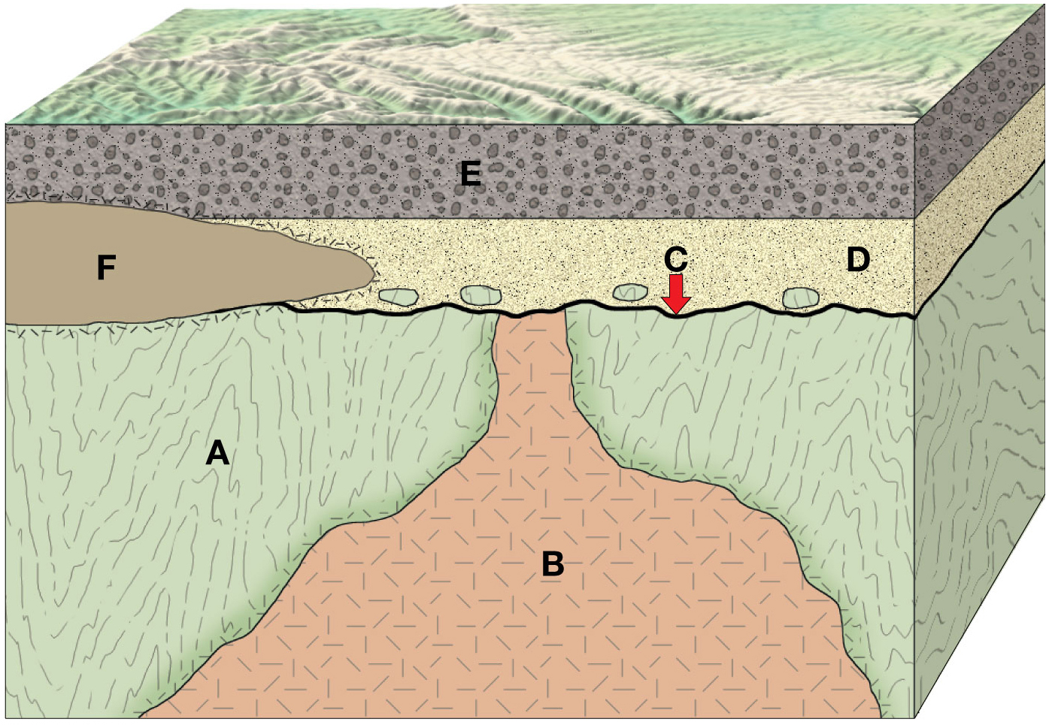
Notes:
Figure 8.7

Slide 25
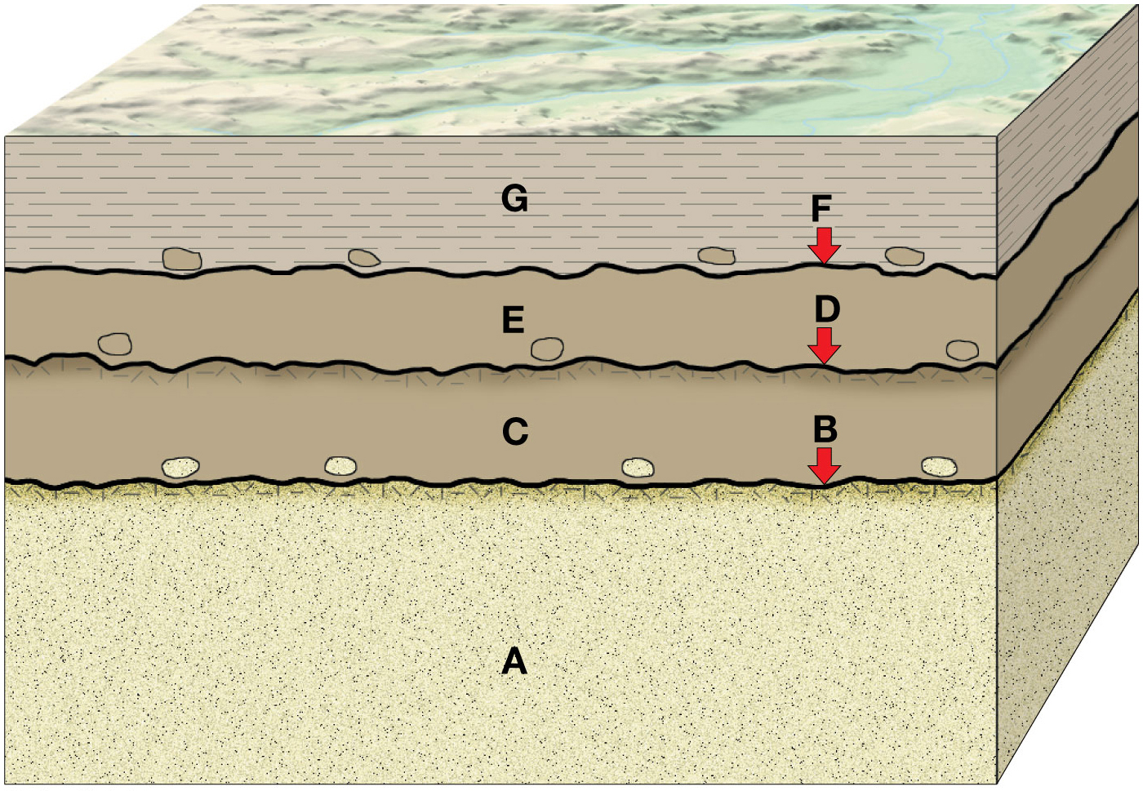
Notes:
Figure 8.8

Slide 26
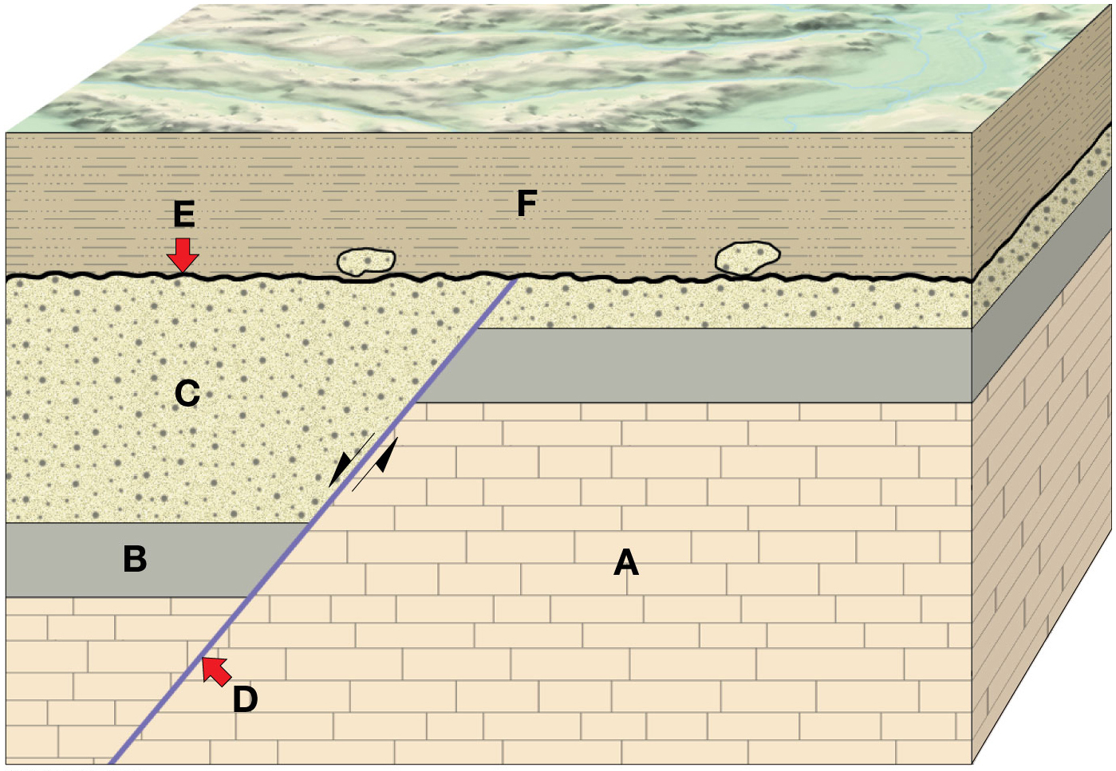
Notes:
Figure 8.9

Slide 27
Absolute Age Dating
Absolute Ages
Radiometric Dating
Radioactive isotopes
Radioactive decay
Half-life

Slide 28
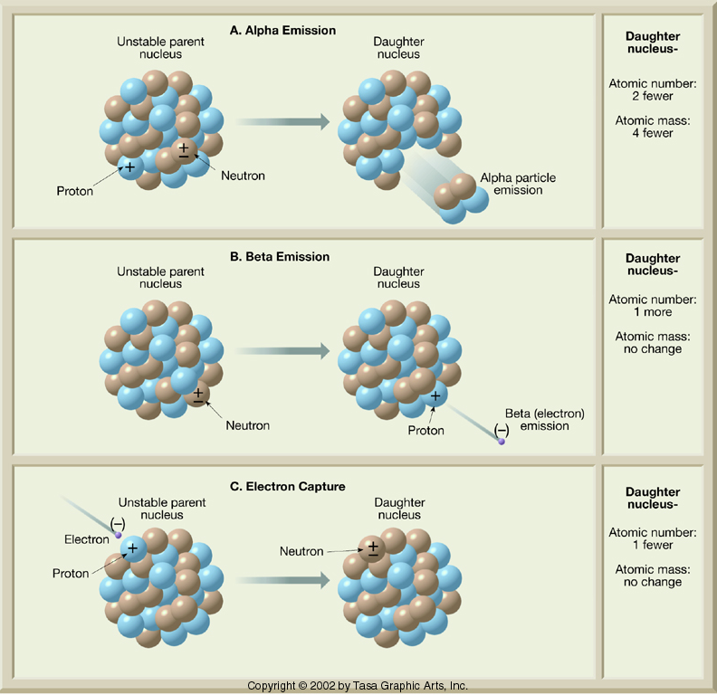
Alpha Emission
Beta Emission
Electron Capture

Slide 29
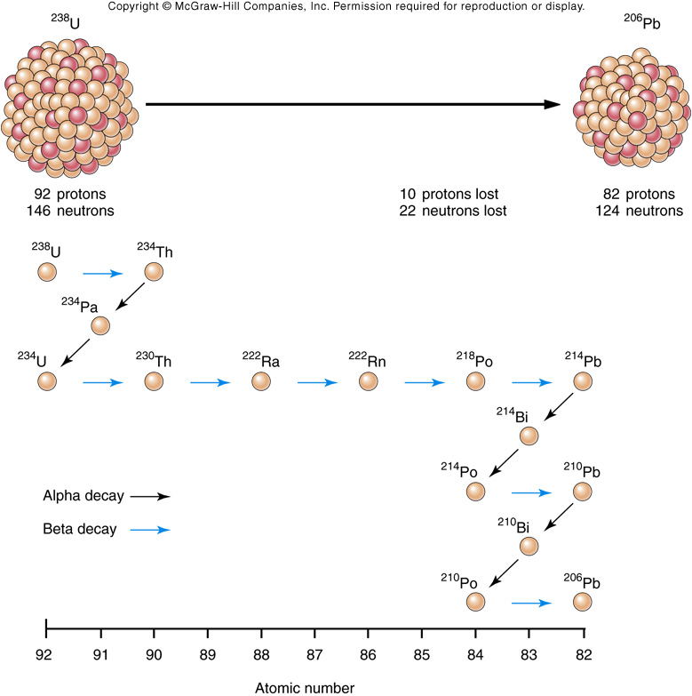
Decay of ²³⁸U
Alpha emission
General Decay Rules
Atomic mass number
No change
Decrease
Atomic number
Decrease
Increase
Beta emission
Fig. 08.23

Slide 30
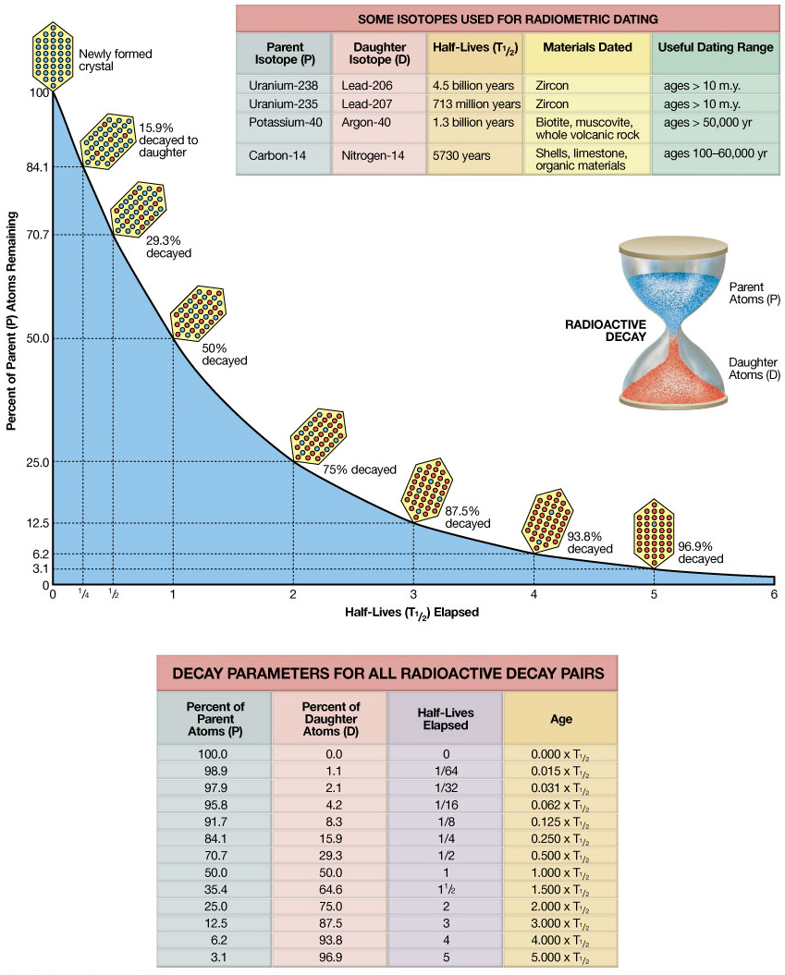
Notes:
Figure 8.11

Slide 31
Notes:
Figure 8.11a

Slide 32
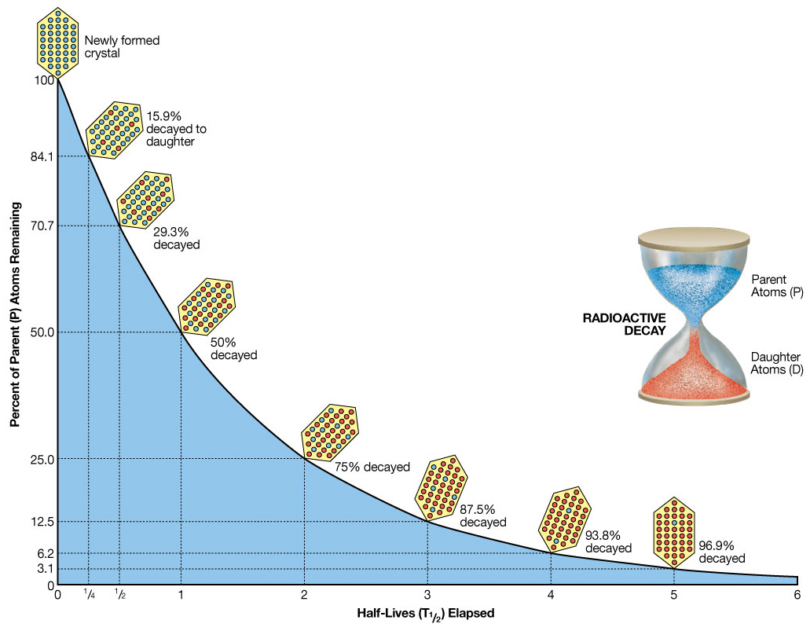
Notes:
Figure 8.11b

Slide 33
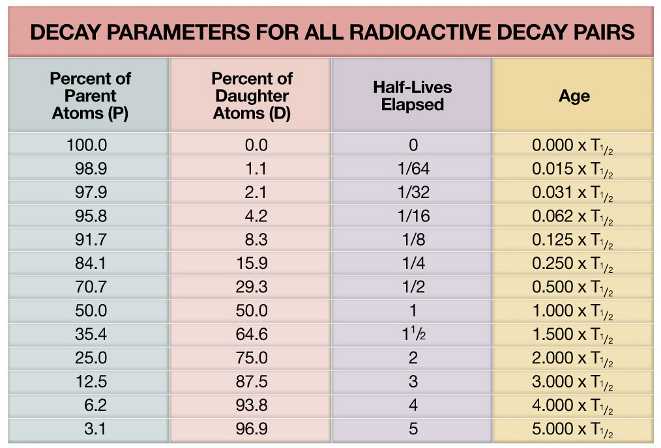
Notes:
Figure 8.11c

Slide 34
Parent
Daughter
Half-life (yrs)
Useful Range (yrs)
²³⁸U
²³⁵U
²⁰⁶Pb
²⁰⁷Pb
4,500,000,000
713,000,000
10,000,000 - formation of Earth
10,000,000 - formation of Earth
An analysis of a zircon crystal in a rock reveals that it contains:
50.0% ²³⁸U and 50.0% ²⁰⁶Pb
1.6% ²³⁵U and 98.4% ²⁰⁷Pb
How many half-lives of ²³⁸U have passed since the formation of the zircon?
How many half-lives of ²³⁵U have passed since the formation of the zircon?
What is the age of the zircon?

Slide 35
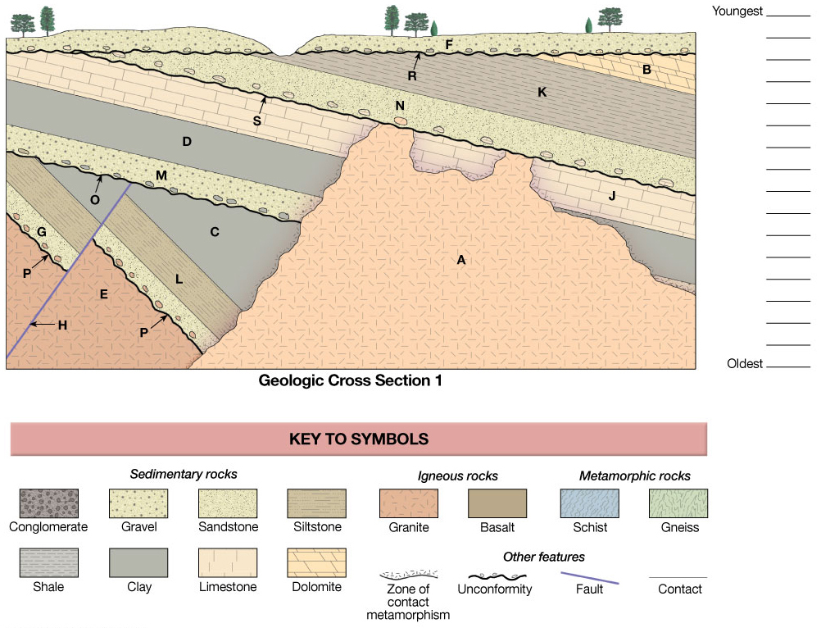
F
R
B
K
N
S
A
J
D
M
H
O
C
L
G
P
E
Notes:
UnFigure Pg219_1a

Slide 36
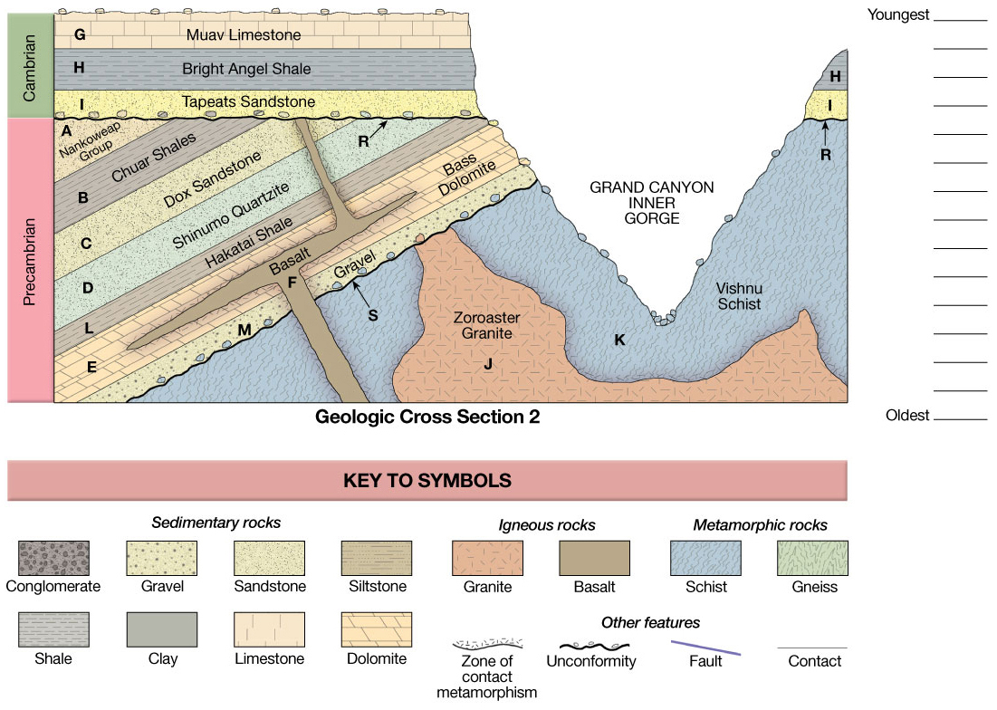
G
H
I
R
F
A
B
C
D
L
E
M
S
J
K
Notes:
UnFigure Pg219_1b

Slide 37
Notes:
Figure 8.10

Slide 38
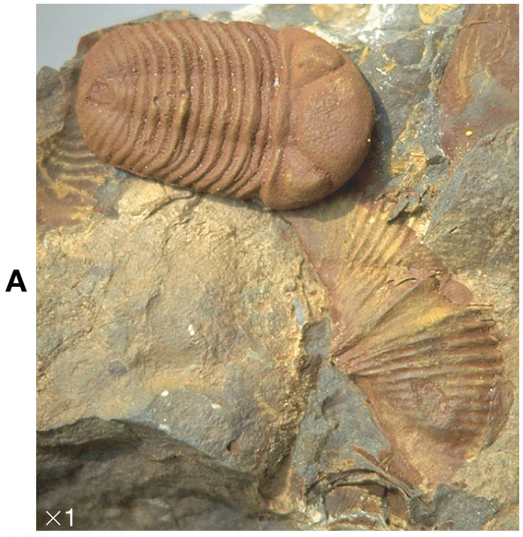
Phacops
425-359 Ma
Mucrospirifer
397-359 Ma
Late Devonian
Overlap
397-359 Ma
Notes:
UnFigure Pg221_1a

