Slide 1
CHEMISTRY: ATOMS FIRST 2e
Chapter 15 Equilibria of Other Reaction Classes
PowerPoint Image Slideshow
With Contributions by Joe DePasquale, Northeastern University

Slide 2
Chapter Outline
15.1 Precipitation and Dissolution
15.2 Lewis Acids and Bases
15.3 Coupled Equilibria

Slide 3
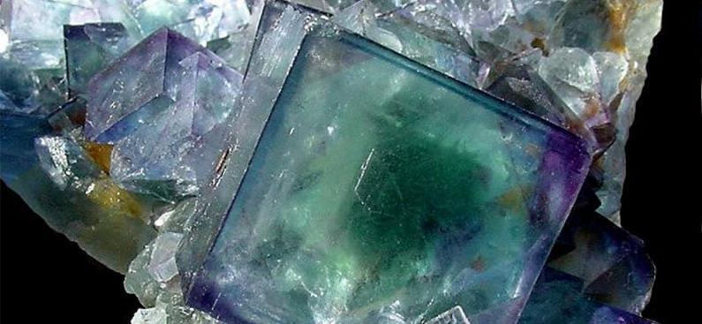
Figure 15.1
The mineral fluorite (CaF₂) is deposited through a precipitation process. Note that pure fluorite is colorless, and that the color in this sample is due to the presence of other metals in the crystal.

Slide 4
Learning Objectives
15.1 Precipitation and Dissolution
Write chemical equations and equilibrium expressions representing solubility equilibria
Carry out equilibrium computations involving solubility, equilibrium expressions, and solute concentrations

Slide 5
Revisiting Solubility and Precipitation
Previously you learned that some ionic compounds do not dissolve in water.
These are called insoluble compounds.
They do b dissociate into ions when placed in water.
Compounds that do dissolve by dissociating into their ions are called soluble.
In reality, even insoluble compounds dissolve to a small extent. They are “sparingly soluble.”
An equilibrium exists between the precipitate and its ions.
Example: AgCl(s) ⇌ Ag⁺(aq) + Cl–(aq) K << 1

Slide 6
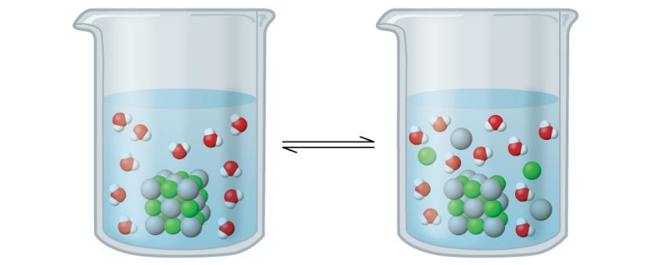
Figure 15.2
Silver chloride is a sparingly soluble ionic solid. When it is added to water, it dissolves slightly and produces a mixture consisting of a very dilute solution of Ag⁺ and Cl– ions in equilibrium with undissolved silver chloride.

Slide 7
Solubility Product Constant, K_{sp}
Consider the compound SrCrO₄
SrCrO₄(s) ⇌ Sr²⁺ (aq) + CrO₄^{2–}(aq)
K_{sp} is called the solubility product constant.
At equilibrium, the solution is saturated with dissolved ions.

Slide 8
Interpreting the Solubility Expression and K_{sp}
SrCrO₄(s) ⇌ Sr²⁺ (aq) + CrO₄^{2–}(aq)
Like all equilibrium constants, K_{sp} has a fixed value at a given temperature.
The product of the two ion concentrations at equilibrium must have this value regardless of the direction from which equilibrium is approached.

Slide 9
K_{sp} and Water Solubility
One way to establish a solubility equilibrium
Add a sparingly soluble solid to water and stir.
Eventually the solution becomes saturated with ions.
In other words, the compound reaches its solubility.
In a saturated solution, an equilibrium exists between the dissolved ions and undissolved solid.
We can calculate the solubility of a compound from its K_{sp} value.
The solubility will have units of moles per liter (M) and is called the molar solubility.

Slide 10
Calculating K_{sp} Given Solubility
Instead of calculating solubility from K_{sp}, it is possible to calculate K_{sp} of a compound from its solubility.
There are many sources listing the solubility of sparingly soluble compounds.
Depending on the source, these solubility values are expressed in many different units.
We must always make sure that the solubility is the molar solubility (units of M) when using the K_{sp} expression.

Slide 11
K_{sp} and the Common Ion Effect
BaSO₄ (s) ⇌ Ba²⁺ (aq) + SO₄^{2–} (aq)
How would you expect the solubility of barium sulfate in pure water to compare with its solubility in 0.10 M Na₂SO₄?
Solubility in 0.10 M Na₂SO₄ must be less than it is in pure water.
Recall Le Châtelier’s Principle
The presence of the common ion, SO₄^{2–}, will drive the equilibrium to the left.
Common ions reduce solubility.

Slide 12
K_{sp} and the Common Ion Effect
BaSO₄ (s) ⇌ Ba²⁺ (aq) + SO₄^{2–} (aq)
How would you expect the solubility of barium sulfate in pure water to compare with its solubility in 0.10 M NaCl?

Slide 13
Example 15.3

Slide 14
Example 15.4

Slide 15
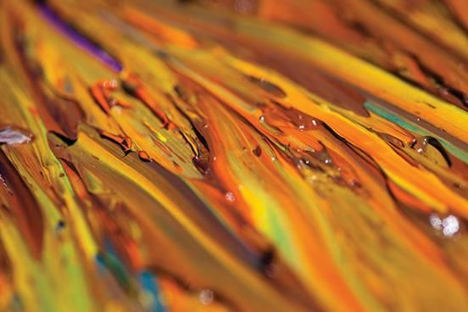
Figure 15.3
Oil paints contain pigments that are very slightly soluble in water. In addition to chrome yellow (PbCrO₄), examples include Prussian blue (Fe₇(CN)₁₈), the reddish-orange color vermilion (HgS), and green color veridian (Cr₂O₃). (credit: Sonny Abesamis)

Slide 16
Example 15.6

Slide 17
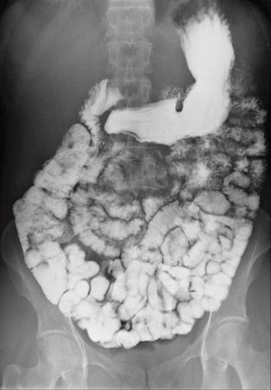
Figure 15.4
The suspension of barium sulfate coats the intestinal tract, which allows for greater visual detail than a traditional X-ray. (credit modification of work by “glitzy queen00”/Wikimedia Commons)

Slide 18
Solubility and Precipitates
Recall, equilibrium can be approached from either direction.
SrCrO₄(s) ⇌ Sr²⁺ (aq) + CrO₄^{2–}(aq)
Starting with just reactants—Add solid compound to water.
Starting with just products—Add ions to water.

Slide 19
Precipitate Formation
Consider mixing two solutions:
Sr(NO₃)₂ (aq) and K₂CrO₄ (aq)

Slide 20
K_{sp} and Precipitate Formation
K_{sp} values can be used to predict whether a precipitate will form when ions (from solutions) are added to water.
Recall the use of Q, the reaction quotient.
Q is of the same form as K_{sp}, only difference is the concentrations at any particular moment can be used with Q and only equilibrium concentrations can be used with K_{sp}.
SrCrO₄(s) ⇌ Sr²⁺ (aq) + CrO₄^{2–}(aq)

Slide 21
K_{sp} and Precipitate Formation
The relative magnitude of Q vs. K_{sp} will indicate whether or not a precipitate will form.
SrCrO₄(s) ⇌ Sr²⁺ (aq) + CrO₄^{2–}(aq)
If Q > K_{sp}, a precipitate will form, decreasing the ion concentrations until equilibrium is established.
If Q < K_{sp}, the solution is unsaturated, no precipitate will form, and if desired more compound can be dissolved.
If Q = K_{sp}, the solution is saturated, just at the point of precipitation.

Slide 22
Selective Precipitation
Consider a solution of two cations.
One way to separate the cations is to add an anion that will form a precipitate with only one of them.
The precipitate can then be removed by filtration.
The other cation will remain in the filtrate.
This approach is called selective precipitation, and is often used as a method of purification.

Slide 23
Selective Precipitation
Example: Solution of magnesium and sodium ions.
Most sodium compounds are soluble in water.
Magnesium can form a compound with CO₃^{–2}, which is only sparingly soluble. K_{sp} MgCO₃ = 6.8 × 10^{–6}

Slide 24
Selective Precipitation
Now, consider a solution of magnesium and barium ions at the same concentration. CO₃^{2–} ions are slowly added.
K_{sp} BaCO₃ = 1.6 × 10^{–9}
K_{sp} MgCO₃ = ~1 × 10^{–5}
The difference in solubility can still be used to separate the cations if CO₃^{2–} ions are added very carefully.
Which carbonate complex will precipitate first?
We can’t always just compare K_{sp} values to answer this question…

Slide 25
Selective Precipitation
When can K_{sp} values alone be used to predict which compound will precipitate first?
Both ions to be separated must be at the same initial concentration.
Both complexes must have the same cation : anion ratio.
Both of these criteria must be met. If not then calculations must be done to determine which compound will precipitate first.

Slide 26
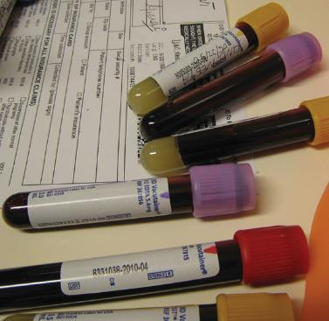
Figure 15.5
Anticoagulants can be added to blood that will combine with the Ca²⁺ ions in blood serum and prevent the blood from clotting. (credit: modification of work by Neeta Lind)

Slide 27
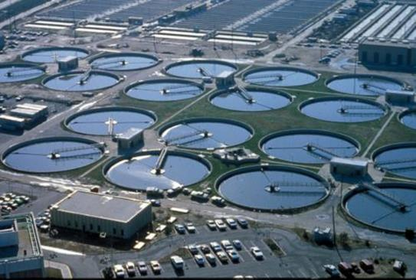
Figure 15.6
Wastewater treatment facilities, such as this one, remove contaminants from wastewater before the water is released back into the natural environment. (credit: “eutrophication&hypoxia”/WikimediaCommons)

Slide 28
Example 15.13

Slide 29
Learning Objectives
15.2 Lewis Acids and Bases
Explain the Lewis model of acid-base chemistry
Write equations for the formation of adducts and complex ions
Perform equilibrium calculations involving formation constants

Slide 30
Lewis Acids and Bases
The Brønsted-Lowry Model is only applicable to reactions involving proton (H⁺) transfer.
G.N. Lewis (1923) – Less restricting model
A Lewis acid accepts a pair of electrons
A Lewis base donates a pair of electrons
A Lewis acid-base reaction produces a product with a coordinate covalent bond.
We now must think in terms of what the electrons are doing in a reaction.

Slide 31
Coordinate Covalent Bond
Coordinate Covalent Bond (or dative bond): A type of bond that forms when one of the atoms in the bond provides both bonding electrons.

Slide 32
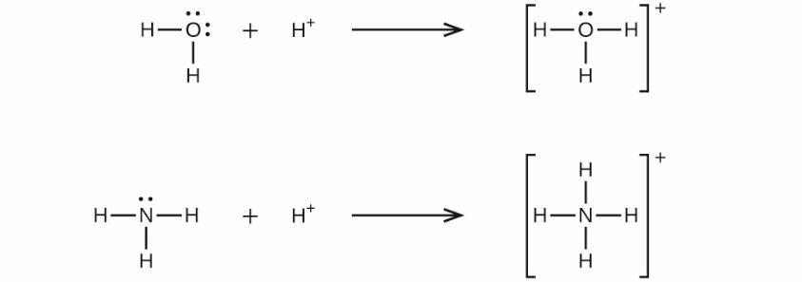
Unfigure 15.1

Slide 33
Lewis Base: Electron Pair Donor
Many species that can behave as a Brønsted-Lowry base also have the ability to behave as a Lewis base.
For a species to accept a proton, it must contain an atom that possesses a lone pair of electrons.
Anions and neutral molecules with lone pairs (amines, water, etc.) can serve as Lewis bases.

Slide 34
Lewis Acid: Electron Pair Acceptor
A proton (H⁺) can serve as both a Brønsted-Lowry acid and a Lewis acid.
But most Lewis acids are not Brønsted-Lowry acids.
Cations and electron deficient molecules can serve as Lewis acids.
The Lewis model greatly expands the number of species considered to be acids.

Slide 35
Lewis Acid-Base Adduct
Lewis acid-base adduct: A compound that contains a coordinate covalent bond formed between a Lewis acid and a Lewis base.

Slide 36
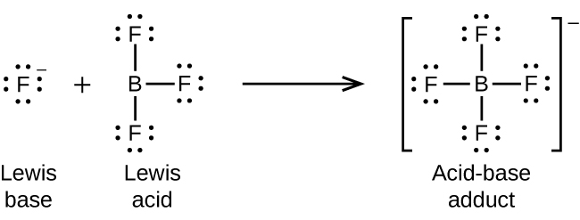
Unfigure 15.2

Slide 37
Unfigure 15.3

Slide 38
Unfigure 15.4

Slide 39
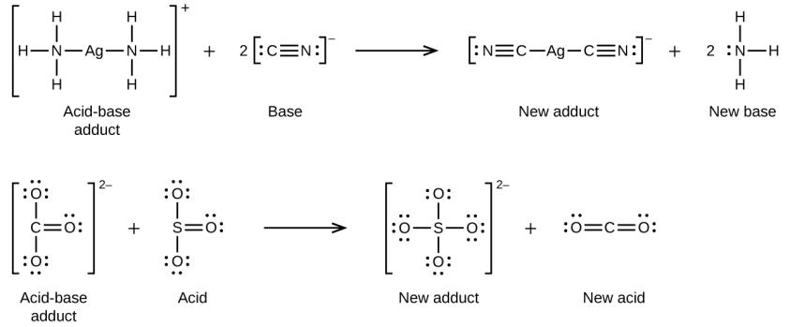
Unfigure 15.5

Slide 40
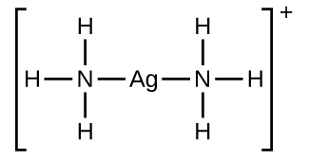
Complex Ions
Many Lewis acid-base adducts are complex ions.
Complex ions are polyatomic ions that consist of a central atom, usually a transition metal surrounded by ions, or molecules called ligands.
These ligands are Lewis bases.

Slide 41
Complex Ions
The charge of the complex ion equals the sum or the charges of the ligands and central atom.
The formula of a complex ion cannot be predicted; it must be determined by experiment.
The central atom-ligand bonds are coordinate covalent bonds.
Complex ions are sometimes called coordination complexes.

Slide 42
Complex Ion Equilibria, Formation Constant (K_{f})
Cu⁺ (aq) + 2CN– (aq) ⇌ Cu(CN)₂– (aq)
Complex ion
Formation constant (K_{f}): The equilibrium constant for the formation of a complex ion directly from its components.
These K_{f} values are generally very large.

Slide 43
Dissociation Constant (K_{d})
The inverse of the formation constant (K_{f}) is the dissociation constant (K_{d}).
The dissociation constant (K_{d}) is the equilibrium constant for the decomposition of a complex ion into its components in solution.
Cu(CN)₂– (aq) ⇌ Cu⁺ (aq) + 2CN– (aq)

Slide 44
Example 15.14

Slide 45
Learning Objectives
15.3 Coupled Equilibria
Describe examples of systems involving two (or more) coupled chemical equilibria
Calculate reactant and product concentrations for coupled equilibrium systems

Slide 46
Coupled Equilibria
Sometimes more than one equilibrium is needed to describe a process.
Examples:
Dissolving an ionic solid with strong acid.
Dissolving a sparingly soluble solid by complex ion formation.
The carbonate chemistry in our oceans…

Slide 47
Dissolving Precipitates
Two methods of dissolving compounds that are sparingly soluble (precipitates).
Add a strong acid to react with basic anions or ammonia in the compound.
Add a ligand (Lewis base) that can react with the metal cation and form a complex ion.

Slide 48
Dissolving Precipitates with Strong Acid
As we all now know, strong acids produce H₃O⁺ when in water.
If this H₃O⁺ can react with the anion (or NH₃) of the complex, then strong acids can be used to dissolve compounds that would otherwise have very low water solubility.
The following types of compounds tend to have increased water solubility in the presence of a strong acid:
All complexes that contain hydroxide (OH–) as an anion.
Many complexes that contain NH₃ or an anion that is a weak base.

Slide 49
Dissolving Hydroxide Containing Compounds with Strong Acids
Example: Dissolving Zn(OH)₂(s) in a strong acid solution.
This reaction takes place as two equilibria:
Zn(OH)₂(s) ⇌ Zn²⁺(aq) + 2OH–(aq) Dissolving of Zn(OH)₂
+ 2H⁺(aq) + 2OH–(aq) ⇌ 2H₂O Neutralizing OH–
Zn(OH)₂(s) + 2H⁺(aq) →Zn²⁺(aq) + 2H₂O(l)

Slide 50
Dissolving Hydroxide Containing Compounds with Strong Acids
This process of dissolving can be explained in terms of Le Châtelier’s Principle.
By protonating OH–(aq) with H₃O⁺(aq) to form H₂O(l), a product is effectively being removed from the first equilibrium.
Le Châtelier’s Principle states that if a product is removed, then the equilibrium will proceed to the right to make more product. This results in more dissolving of Zn(OH)₂(s).

Slide 51
Complex Formation
Some Lewis bases can dissolve ionic compounds if they contain metal cations that form complex ions with these species.
As with the addition of a strong acid, multiple equilibria are at work:
Zn(OH)₂ (s) ⇌ Zn²⁺ (aq) + 2OH– (aq) K_{sp} = 4 × 10^{–17}
+ Zn²⁺ (aq) + 4NH₃ (aq) ⇌ Zn(NH₃)₄²⁺ (aq) K_{f} = 3.6 × 10⁸
Zn(OH)₂ (s) + 4NH₃ (aq) ⇌ Zn(NH₃)₄²⁺ (aq) + 2OH– (aq)

Slide 52
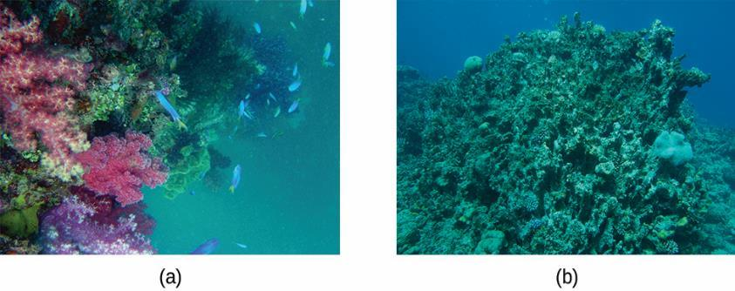
Figure 15.7
Healthy coral reefs (a) support a dense and diverse array of sea life across the ocean food chain. But when coral are unable to adequately build and maintain their calcium carbonite skeletons because of excess ocean acidification, the unhealthy reef (b) is only capable of hosting a small fraction of the species as before, and the local food chain starts to collapse. (credit a: modification of work by NOAA Photo Library; credit b: modification of work by “prilfish”/Flickr)

Slide 53
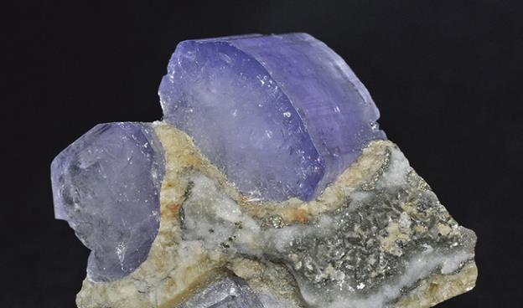
Figure 15.8
Crystal of the mineral hydroxylapatite, Ca₅(PO₄)₃OH, is shown here. Pure apatite is white, but like many other minerals, this sample is colored because of the presence of impurities.

Slide 54
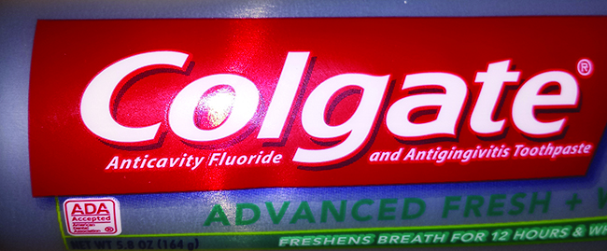
Figure 15.9
Fluoride, found in many toothpastes, helps prevent tooth decay (credit: Kerry Ceszyk).

Slide 55
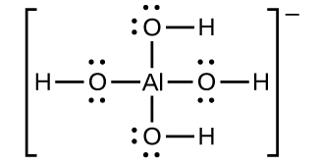
Unfigure 15.7

Slide 56
Example 15.16

Slide 57
This OpenStax ancillary resource is © Rice University under a CC-BY 4.0 International license; it may be reproduced or modified but must be attributed to OpenStax, Rice University and any changes must be noted.

