Slide 1


CHEMISTRY: ATOMS FIRST 2e
Chapter 14 Acid-Base Equilibria
PowerPoint Image Slideshow
With Contributions by Joe DePasquale, Northeastern University

Slide 2
Chapter Outline
14.1 Brønsted-Lowry Acids and Bases
14.2 pH and pOH
14.3 Relative Strengths of Acids and Bases
14.4 Hydrolysis of Salts
14.5 Polyprotic Acids
14.6 Buffers
14.7 Acid-Base Titrations

Slide 3
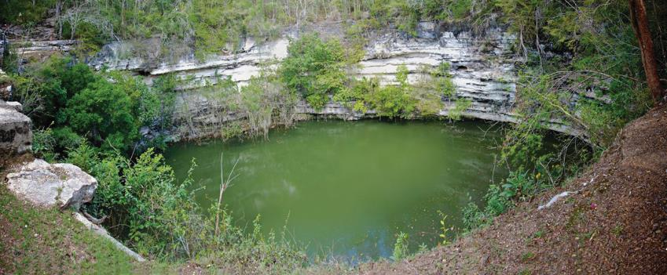
Figure 14.1
Sinkholes such as this are the result of reactions between acidic groundwaters and basic rock formations, like limestone. (credit: modification of work by Emil Kehnel)

Slide 4
Learning Objectives
14.1 Brønsted-Lowry Acids and Bases
  Identify acids, bases, and conjugate acid-base pairs according to the Brønsted-Lowry definition
  Write equations for acid and base ionization reactions
  Use the ion-product constant for water to calculate hydronium and hydroxide ion concentrations
  Describe the acid-base behavior of amphiprotic substances

Slide 5
Arrhenius acids
Most common, but also most restrictive definition:
Acids: produce hydronium ions in water:
HCl (aq) → H⁺ (aq) + Cl⁻ (aq)
Bases: produce hydroxide ions in water:
NaOH (aq) → Na⁺ (aq) + OH⁻ (aq)
Hydronium ion: H⁺ or H₃O⁺
H⁺ (aq) + H₂O (aq) → H₃O⁺ (aq)

Slide 6
Acid and Base Definitions
Johannes Brønsted and Thomas Lowry (1923) definition:
  Focused on the reactions that take place between acids and bases.
  Brønsted-Lowry Acid: A compound that donates a proton to another compound.
  Brønsted-Lowry Base: A compound that accepts a proton from another compound.

Slide 7
What Types of Compounds are Acids and Bases?
Acids:
Molecules: Both organic and inorganic
Cations that contain H
Anions that contain H

Slide 8
What Types of Compounds are Acids and Bases?
Bases:
Ionic compounds that contain OH-
Molecules - Primarily amines
Anions – With and without H
Cations – Few examples

Slide 9
Brønsted-Lowry Acid/Base Theory
The species formed when a proton is removed from an acid is the conjugate base of that acid.
The species formed when a proton is added to a base is the conjugate acid of that base.

Slide 10
Amphiprotic Species
A species that can either accept or donate a proton is called amphiprotic.
An amphiprotic species can serve as an acid or a base.
  Example: Water
  In the presence of an acid, water acts as a base.
  In the presence of a base, water acts like an acid.

Slide 11
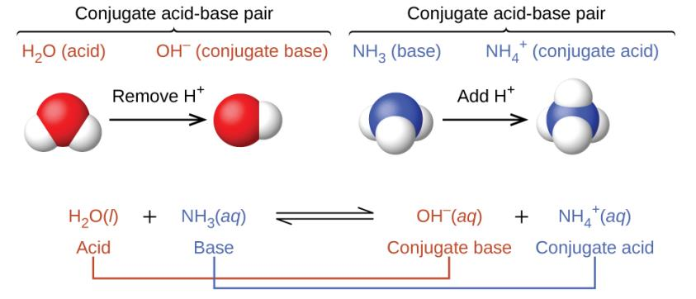
UNFIGURE 14.1

Slide 12
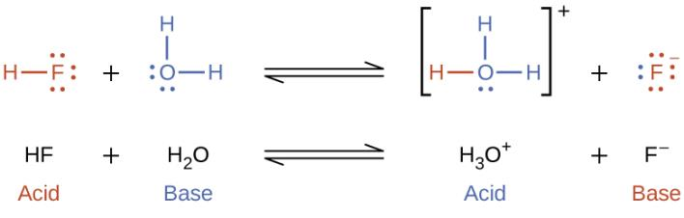
Water as a Base
The reaction between a Brønsted-Lowry Acid and water is called acid ionization.

Slide 13
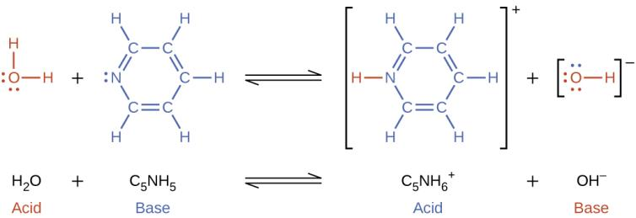
Water as an Acid
The reaction between a Brønsted-Lowry Base and water is called base ionization.

Slide 14
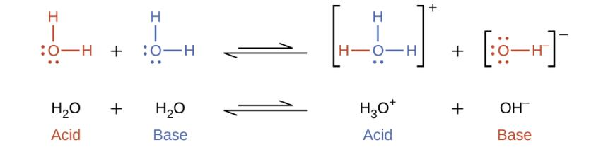
The Autoionization of Water
In pure water, water also acts both as an acid and a base.
Autoionization of water:
  The equilibrium constant for this reaction is called the ion product constant for water, K_{w}.
  At 25 °C, K_{w} = 1.0 × 10^{–14}

Slide 15
Learning Objectives
14.2 pH and pOH
  Explain the characterization of aqueous solutions as acidic, basic, or neutral
  Express hydronium and hydroxide ion concentrations on the pH and pOH scales
  Perform calculations relating pH and pOH

Slide 16
pH and pOH
K_{w} = [H₃O⁺][OH–]
In pure water:
both hydroxide and hydronium ions are present in equal amounts, but in extremely low concentrations.
This is called a neutral solution
If the hydroxide concentration increases, the hydronium concentration drops.
This solution would be basic, since the hydroxide concentration is higher.
If the hydronium concentration increases, the hydroxide concentration drops.
This solution would be acidic, since the hydronium concentration is higher.

Slide 17
H₃O⁺ and OH– Concentration
In pure water, [H₃O⁺] and [OH–] are equal to each other.
When an acid or base is dissolved in water, [H₃O⁺] and [OH–] are not equal to each other.
    K_{w} = [H₃O⁺] [OH–] = 1.0 × 10^{–14}
    [H₃O⁺] and [OH–] are inversely related to each other.
  If [H₃O⁺] > 1.0 × 10^{–7}, then [OH–] < 1.0 × 10^{–7} and the solution is called acidic.
  If [OH–] > 1.0 × 10⁻⁷, then [H₃O⁺] < 1.0 × 10^{–7} and
the solution is called basic.

Slide 18
pH
The acidity and basicity of a solution can be expressed in terms of its [H₃O⁺] or [OH–].
These concentrations can span many orders of magnitude, therefore logarithmic values are commonly used.
pH = -log [H₃O⁺]

Slide 19
pOH
[H⁺] [OH⁻] = 1.00E-14 at 25°C
pH = -log [H⁺]
pOH = -log [OH⁻]
pH + pOH = 14.00

Slide 20
pH and pOH in a Neutral Solution
  If [H₃O⁺] = [OH–] = 1.0 × 10^{–7} then the solution is considered neutral.
  If [H₃O⁺] > 1.0 × 10^{–7}, then [OH–] < 1.0 × 10^{–7} and the solution is considered acidic.
  If [OH–] > 1.0 × 10^{–7}, then [H₃O⁺] < 1.0 × 10^{–7} and the solution is considered basic.

Slide 21
Table 14.1 Summary of Relations for Acidic, Basic, and
Neutral Solutions
Classification | Relative Ion Concentrations | pH at 25 °C
acidic | [H₃O⁺] > [OH–] | pH < 7
neutral | [H₃O⁺] = [OH–] | pH = 7
basic | [H₃O⁺] < [OH–] | pH > 7

Slide 22
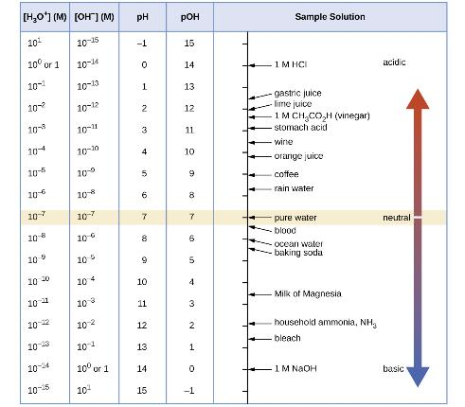
Figure 14.2
The pH and pOH scales represent concentrations of H₃O⁺ and OH⁻, respectively. The pH and pOH values of some common substances at 25 °C are shown in this chart.

Slide 23
pH of Strong Acid Solutions
Recall from Chapter 7 that some acids are strong.
  HCl, HBr, HI, HClO₄, HNO₃, H₂SO₄
    These acids essentially ionize completely in water.
    For example: HCl (aq) → H⁺ (aq) + Cl⁻ (aq)

Slide 24
pH of Strong Bases
Recall as well that some bases are strong:
  LiOH, NaOH, KOH, Ca(OH)₂, Sr(OH)₂, Ba(OH)₂
    These bases dissociate completely into OH–
    Soluble metal hydroxides are strong bases.
    For example: NaOH (aq) → Na⁺ (aq) + OH⁻ (aq)

Slide 25
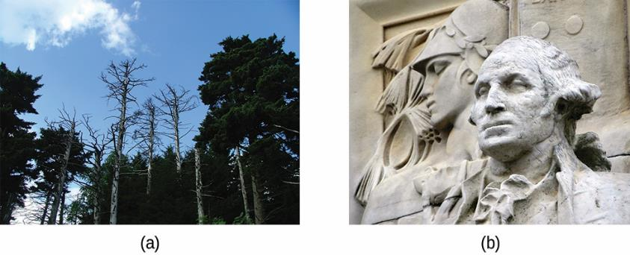
Figure 14.3
(a) Acid rain makes trees more susceptible to drought and insect infestation, and depletes nutrients in the soil. (b) It also is corrodes statues that are carved from marble or limestone. (credit a: modification of work by Chris M Morris; credit b: modification of work by “Eden, Janine and Jim”/Flickr)

Slide 26
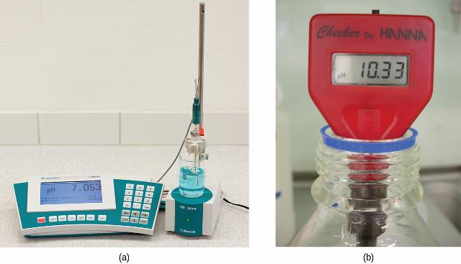
Figure 14.4
(a) A research-grade pH meter used in a laboratory can have a resolution of 0.001 pH units, an accuracy of ± 0.002 pH units, and may cost in excess of $1000. (b) A portable pH meter has lower resolution (0.01 pH units), lower accuracy (± 0.2 pH units), and a far lower price tag. (credit b: modification of work by Jacopo Werther)

Slide 27
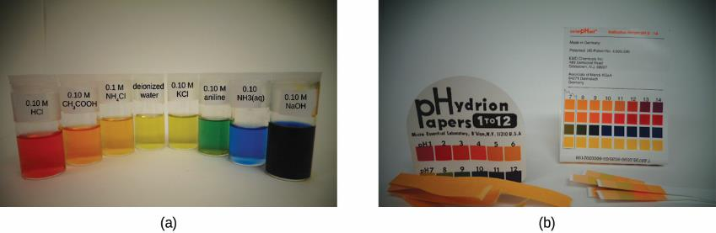
Figure 14.5
(a) A solution containing a dye mixture, called universal indicator, takes on different colors depending upon its pH. (b) Convenient test strips, called pH paper, contain embedded indicator dyes that yield pH-dependent color changes on contact with aqueous solutions.(credit: modification of work by Sahar Atwa)

Slide 28
Learning Objectives
14.3 Relative Strengths of Acids and Bases
  Assess the relative strengths of acids and bases according to their ionization constants
  Rationalize trends in acid–base strength in relation to molecular structure
  Carry out equilibrium calculations for weak acid–base systems

Slide 29
Relative Strengths of Acids and Bases
  Brønsted-Lowry Acids are H⁺ donors.
  The strength of an acid is measured by the extent to which it forms H₃O⁺ in water.
HA_{(aq)} + H₂O_{(l)} ⇌ H₃O⁺_{(aq)} + A– _{(aq)}
Strong acids yield nearly 100% H₃O⁺.
Weak acids yield much less than 100% H₃O⁺.

Slide 30
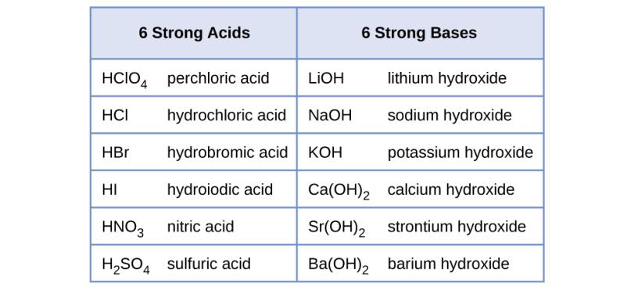
Figure 14.6
Some of the common strong acids and bases are listed here.

Slide 31
Acid-Ionization Constant, K_{a}
The relative strengths of weak acids can be determined by measuring their equilibrium constants.
The equilibrium constant for an acid is called the acid-ionization constant (K_{a}).
HA_{(aq)} + H₂O_{(l)} ⇌ H₃O⁺_{(aq)} + A –_{(aq)}

Slide 32
Acid-Ionization Constant, K_{a}
HA_{(aq)} + H₂O_{(l)} ⇌ H₃O⁺_{(aq)} + A –_{(aq)}
K_{a} values are related to the strength of the acid.
  The larger the K_{a} of an acid, the stronger the acid.
  The smaller the K_{a} of an acid, the weaker the acid.

Slide 33
Relative Strength of Bases
  Brønsted-Lowry Bases are H⁺ acceptors.
  The strength of a base is measured by the extent to which it forms hydroxide ions in water.
B_{(aq)} + H₂O_{(l)} ⇌ HB⁺_{(aq)} + OH–_{(aq)}
  Strong bases yield nearly 100% OH–.
  Weak bases yield much less than 100% OH–.

Slide 34
Base-Ionization Constant, K_{b}
The relative strengths of weak bases can be determined by measuring their equilibrium constants.
The equilibrium constant for a base is called the base-ionization constant (K_{b}).
B_{(aq)} + H₂O_{(l)} ⇌ HB⁺_{(aq)} + OH–_{(aq)}

Slide 35
Base-Ionization Constant, K_{b}
B_{(aq)} + H₂O_{(l)} ⇌ HB⁺_{(aq)} + OH–_{(aq)}
K_{b} values are related to the strength of the base.
  The larger the K_{b} of the base, the stronger the base.
  The smaller the K_{b} of the base, the weaker the base.

Slide 36
Acid/Base Strength Notes
HB_{(aq)} + H₂O_{(l)} ⇌ H₃O⁺_{(aq)} + B –_{(aq)}
K_{a} and K_{b} are inversely related.
  The larger K_{a} is of an acid, the smaller the K_{b} is of its conjugate base.
  The larger K_{b} is of a base, the smaller the K_{a} is of its conjugate acid.

Slide 37
Acid/Base Strength Notes
HA_{(aq)} + H₂O_{(l)} ⇌ H₃O⁺_{(aq)} + A–_{(aq)}
Whether the reaction is
  reactant favored (for a weak acid)
  or
  product favored (for a strong acid)
depends on the relative strengths of the acid and its conjugate base.
Strong acids have weak conjugate bases, so are product favored.
Weak acids have strong conjugate bases, so are reactant favored.

Slide 38
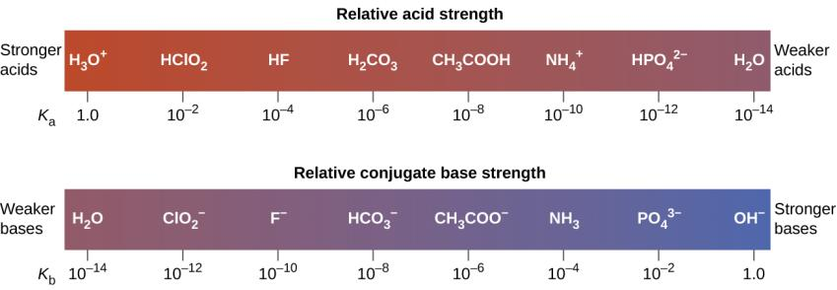
Figure 14.7
Relative strengths of several conjugate acid-base pairs are shown.

Slide 39
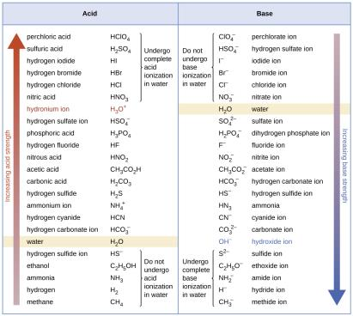
Figure 14.8
This figure shows strengths of conjugate acid-base pairs relative to the strength of water as the reference substance.

Slide 40
Percent Ionization
For, HA_{(aq)} + H₂O_{(l)} ⇌ H₃O⁺_{(aq)} + A–_{(aq)}
The percent ionization of a weak acid is defined as

Slide 41
Determining K_{a} or K_{b}
There are several ways to determine the K_{a} or K_{b} value of a weak acid or weak base.
One approach is to measure the pH of a solution prepared by dissolving a known amount of the weak acid or base. In these problems…
  Measure pH
  Calculate hydronium or hydroxide concentration from the pH
  Calculate K_{a} or K_{b} using the ICE technique for equilibrium processes.

Slide 42
Calculating the pH of a Weak Acid or Weak Base Solution
The process is similar to that used to calculate equilibrium concentrations or pressures.
In these problems…
  Given K_{a} or K_{b}
  Given some information that can be used to find the initial concentration of the acid or base.
  Calculate [H₃O+]_{eq} or [OH–] _{eq} using the ICE method for equilibrium reactions.
  Calculate pH

Slide 43
Molecular Structure and Acid Strength
As you can start to see, some acids are stronger than other acids.
Brønsted-Lowry Acids are proton donors.
Consider binary compounds of hydrogen (H–A).
  The strength of the acid depends on how easily the bond between the hydrogen and nonmetal (A) is broken.
  Acid strength increases as bond strength decreases.

Slide 44
Acid Strength of Binary Hydrogen Compounds
This is a periodic property in terms of nonmetal, A.
Down a group (top to bottom), acid strength increases.
  Orbitals of similar size form strong bonds—Good orbital overlap.
  Orbitals of different size form weak bonds—Poor orbital overlap.
  Hydrogen is the smallest element.
  Atoms get larger down a group.
  The H–A bond weakens as A changes down a group.
  Acid strength increases.

Slide 45
Acid Strength of Binary Hydrogen Compounds
This is a periodic property in terms of nonmetal, A.
Across a period (left to right), acid strength increases.
  The more polar the bond, the easier an H⁺ ion is produced.
  Electronegativity increases across a period.
  The H–A bond becomes more polar as A changes across a period.
  The H–A bond weakens across a period.
  Acid strength increases.

Slide 46
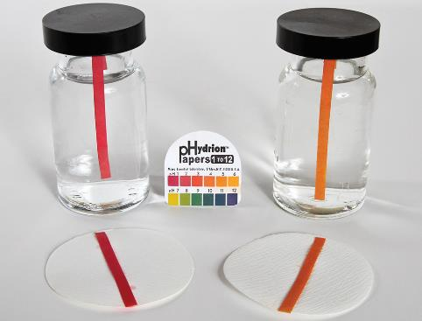

Slide 47
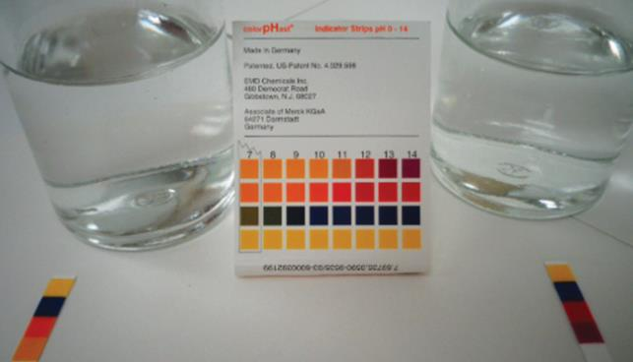

Slide 48
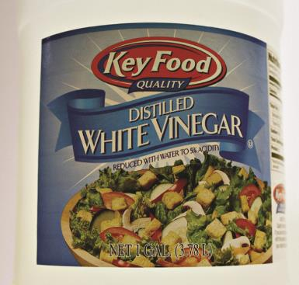
Figure 14.9
Vinegar contains acetic acid, a weak acid. (credit: modification of work by “HomeSpot HQ”/Flickr)

Slide 49
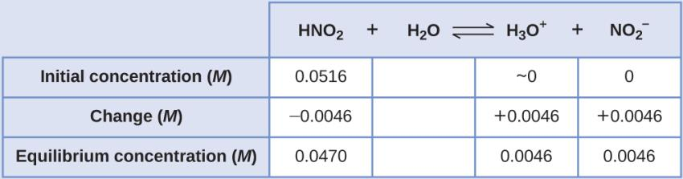
Example 14.11

Slide 50
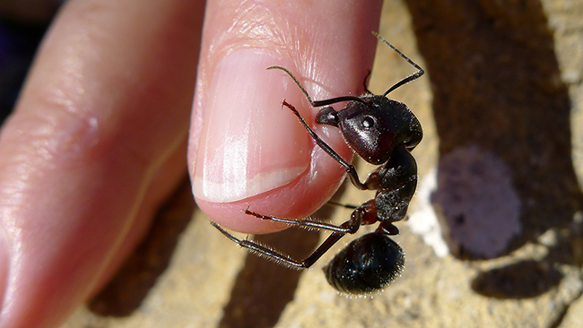
Figure 14.10
The pain of an ant’s sting is caused by formic acid. (credit: John Tann)

Slide 51
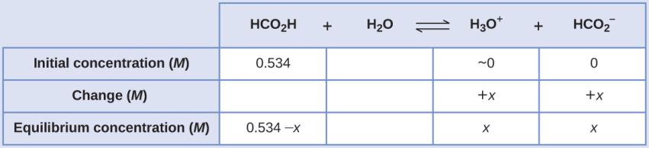
Example 14.12

Slide 52
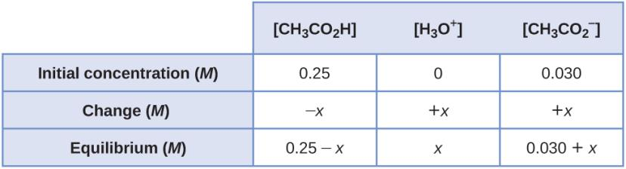
Example 14.13

Slide 53
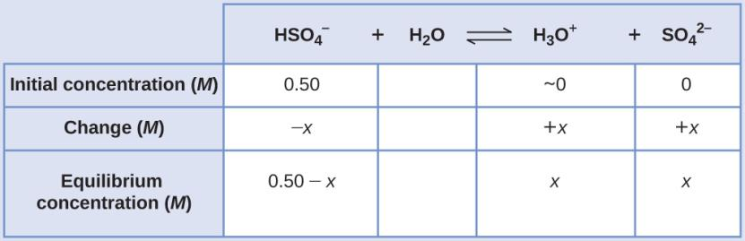
Example 14.14

Slide 54
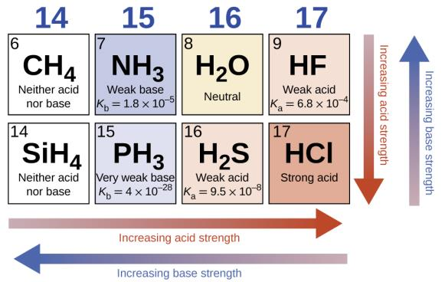
Figure 14.11
The figure shows trends in the strengths of binary acids and bases.

Slide 55
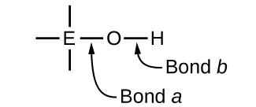
Compounds Containing Oxygen and One or More Hydroxyl
Group (OH)
These compounds can be acidic, basic, or amphiprotic depending on the electronegativity of element, E.

Slide 56
Compounds Containing Oxygen and One or More Hydroxyl
Group (OH)
If EN of E is low then “Bond a” is polar or ionic.
OH– ions are readily released.
The compound is basic.
Metals have low EN.
Metal hydroxides tend to be basic.

Slide 57
Compounds Containing Oxygen and One or More Hydroxyl
Group (OH)
If EN of E is high then “Bond a” is covalent.
Electrons in “Bond b” are pulled toward E.
“Bond b” is polar and weak.
H⁺ ions are readily released.
The compound is acidic.
Nonmetals have high EN.

Slide 58
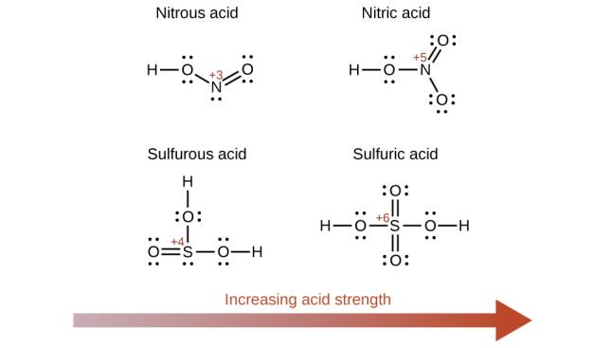
Figure 14.12
As the oxidation number of the central atom E increases, the acidity also increases.

Slide 59
Compounds Containing Oxygen and One or More Hydroxyl
Group (OH)
If EN of E is intermediate then the molecule is usually amphiprotic.
In the presence of strong acid the compound acts as a base.
In the presence of strong base the compound acts as an acid.

Slide 60
Compounds Containing Oxygen and One or More Hydroxyl
Group (OH)
Metalloids and elements near the metalloids have intermediate EN.
Example: Al(H₂O)₃ (OH)₃
In Base:
Al(H₂O)₃ (OH)₃(aq) + OH–(aq) ⇌
In Acid:
Al(H₂O)₃ (OH)₃(aq) + H₃O⁺(aq) ⇌

Slide 61
Learning Objectives
14.4 Hydrolysis of Salts
  Predict whether a salt solution will be acidic, basic, or neutral
  Calculate the concentrations of the various species in a salt solution
  Describe the acid ionization of hydrated metal ions

Slide 62
Hydrolysis of Salts
A neutral solution contains equal concentrations of hydronium and hydroxide ions.
The reaction between an acid and a base is called an acid-base neutralization reaction.
What are always the products of such a reaction?

Slide 63
Hydrolysis of Salts
The resulting solution is not necessarily neutral, even when stoichiometrically equivalent quantities of acid and base are used.
The nature of the salt formed determines whether the solution is acidic, basic, or neutral.

Slide 64
Four Types of Acid-Base Neutralizations
Strong Acid-Strong Base
  A neutral solution forms.
Strong Acid-Weak Base
  A weakly acidic solution forms.
Weak Acid-Strong Base
  A weakly basic solution forms.
Weak Acid-Weak Base
  The solution formed may be acidic or basic.

Slide 65
Strong Acid–Strong Base Reaction
Example:
Consider the salt formed:
Determine the effect that the cation and anion will have on water.

Slide 66
Strong Acid–Weak Base Reaction
Example:
Consider the salt formed:
Determine the effect that the cation and anion will have on water.

Slide 67
Weak Acid–Strong Base Reaction
Example:
Consider the salt formed:
Determine the effect that the cation and anion will have on water.

Slide 68
Weak Acid–Weak Base Reaction
Example:
Consider the salt formed:
Determine the effect that the cation and anion will have on water.

Slide 69
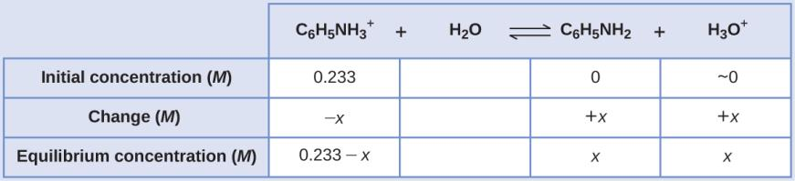
Example 14.15

Slide 70
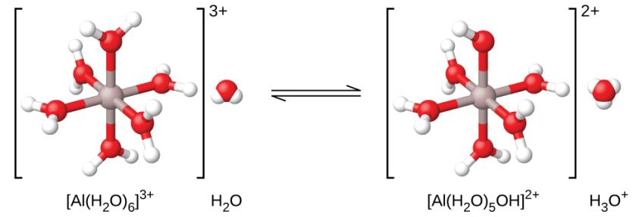
Figure 14.13
When an aluminum ion reacts with water, the hydrated aluminum ion becomes a weak acid.

Slide 71
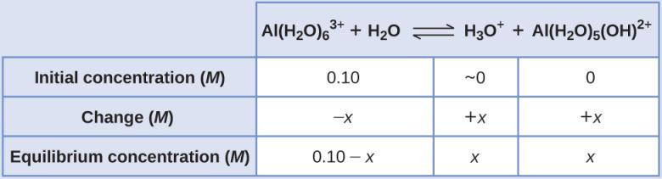
Example 14.18

Slide 72
Learning Objectives
14.5 Polyprotic Acids
  Extend previously introduced equilibrium concepts to acids and bases that may donate or accept more than one proton

Slide 73
Polyprotic Acids
Acids that contain one ionizable hydrogen atom are called monoprotic.
Acids that contain more than one ionizable hydrogen atom are called polyprotic.
Polyprotic acids ionize in steps.
The acid equilibrium constant (K_{a}) becomes smaller with each successive step.

Slide 74
Types of Polyprotic Acids
Diprotic acids
Triprotic acids

Slide 75
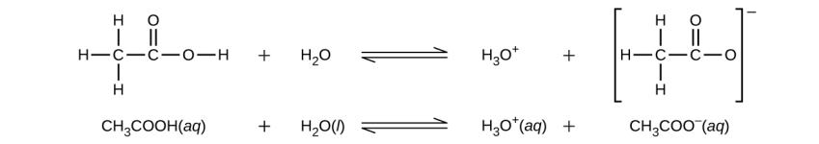
UNFIGURE 14.6

Slide 76
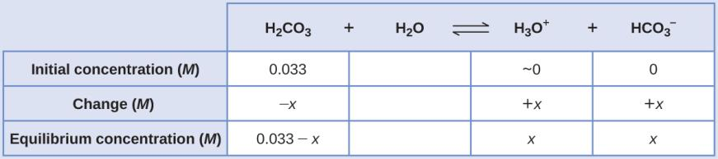
Example 14.19

Slide 77
Learning Objectives
14.6 Buffers
  Describe the composition and function of acid–base buffers
  Calculate the pH of a buffer before and after the addition of added acid or base

Slide 78
Buffers
Buffer: A solution containing appreciable amounts of both a weak acid and its conjugate base (or a weak base and its conjugate acid).
  Buffer solutions resist changes in pH upon addition of a small amount of strong acid or base.
  Examples:

Slide 79
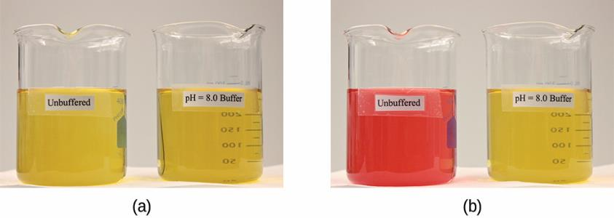
Figure 14.14
(a) The buffered solution on the left and the unbuffered solution on the right have the same pH (pH 8); they are basic, showing the yellow color of the indicator methyl orange at this pH. (b) After the addition of 1 mL of a 0.01-M HCl solution, the buffered solution has not detectably changed its pH but the unbuffered solution has become acidic, as indicated by the change in color of the methyl orange, which turns red at a pH of about 4. (credit: modification of work by Mark Ott)

Slide 80
How Buffers Work
Consider the buffer: HA/A–
Buffers are good at getting rid of strong acids and bases.
  Added OH– or H₃O⁺ are consumed and therefore do not directly affect the pH.
  Any added OH–, is converted into the weak base, A–
HA (aq) + OH– (aq) → A– (aq) + H₂O
  Any added H₃O⁺ , is converted to the weak acid, HA
A– (aq) + H₃O⁺ (aq) → HA (aq) + H₂O
Therefore, buffers can be used to maintain a nearly constant pH!

Slide 81
How Buffers Work
CH₃COOH/ NaCH₃CO₂ Buffer
The change in the amounts of CH₃COOH and CH₃CO₂– does result in a small change in pH.

Slide 82
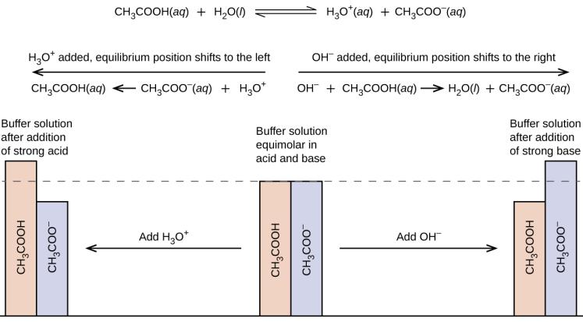
Figure 14.15
Buffering action in a mixture of acetic acid and acetate salt.

Slide 83
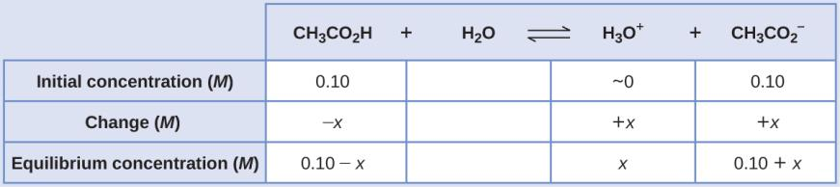
Example 14.20

Slide 84
Buffer Capacity
Buffer capacity: Amount of strong acid or base that can be added to a given volume of a buffer solution before the pH changes significantly.
All buffers have a limited capacity of how much H₃O⁺ or OH– they can “soak up.”
  Eventually, all the HA reacts with the added OH–
  Eventually, all the A– reacts with the added H₃O⁺

Slide 85
Buffer Capacity
Buffer capacity depends on the number of moles of the weak acid and its conjugate base that are in the mixture.
More moles of buffer components leads to a higher buffer capacity.
Once the buffer components near depletion, large changes in pH result.

Slide 86
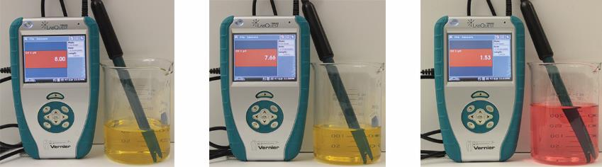
Figure 14.16
The indicator color (methyl orange) shows that a small amount of acid added to a buffered solution of pH 8 (beaker on the left) has little affect on the buffered system (middle beaker). However, a large amount of acid exhausts the buffering capacity of the solution and the pH changes dramatically (beaker on the right). (credit: modification of work by Mark Ott)

Slide 87
Determining the [H₃O+] and pH of a Buffer Solution
The pH of a buffer system can be calculated if we know the concentration of the weak acid [HA] and its conjugate base [A–].
HA_{(aq)} + H₂O_{(l)} ⇌ H₃O⁺_{(aq)} + A–_{(aq)}

Slide 88
Henderson-Hasselbalch Equation
Henderson-Hasselbalch equation can be used to calculate the pH of a buffer.

Slide 89
Compare Two Buffer Solutions
Buffer 1:
  1 L buffer with 1.0 M CH₃CO₂H and 1.0 M NaCH₃CO₂
Buffer 2:
    1 L buffer with 0.1 M CH₃CO₂H and 0.1 M NaCH₃CO₂

Slide 90
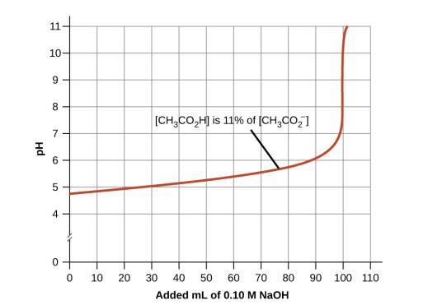
Figure 14.17
Initially [CH₃CO₂H] = [NaCH₃CO₂ ]
Change in pH as an increasing amount of a 0.10-MNaOH solution is added to 100 mL of a buffer solution in which, initially, [CH₃CO₂H] = 0.10 M and [CH₃CO₂⁻]=0.10M. Note the greatly diminished buffering action occurring after the buffer capacity has been reached, resulting in drastic rises in pH on adding more strong base

Slide 91
Learning Objectives
14.7 Acid-Base Titrations
  Interpret titration curves for strong and weak acid-base systems
  Compute sample pH at important stages of a titration
  Explain the function of acid-base indicators

Slide 92
Acid-Base Titrations
Recall that we can analyze an acid or base by reacting it with a known concentration of the other.
Two types of titrations
Strong acid-strong base
Weak acid-strong base
Equivalence Point:

Slide 93
Strong Acid-Strong Base Titration
The pH is initially very low (only strong acid present).
There is a gradual rise in pH as base is added.

Slide 94
Strong Acid-Strong Base Titration
HCl + NaOH → H₂O + NaCl
Eventually the pH rises rapidly.
Midpoint of the vertical part of the curve is the equivalence point.
The pH at the equivalence point is 7.
Excess NaOH controls the pH after the equivalence point.

Slide 95
Weak Acid-Strong Base Titration
CH₃CO₂H + NaOH → H₂O + NaCH₃CO₂
Many features of this titration curve are similar to a strong acid-strong base titration.
But this titration curve is somewhat more complicated.

Slide 96
Weak Acid-Strong Base Titration
CH₃CO₂H + NaOH → H₂O + NaCH₃CO₂
The pH starts off low, but not as low as the strong acid titration.
There is a gradual rise in pH as base is added.

Slide 97
Weak Acid-Strong Base Titration
CH₃CO₂H + NaOH → H₂O + NaCH₃CO₂
Eventually the pH rises rapidly.
Midpoint of the vertical part of the curve is the equivalence point.
The pH at the equivalence point is 8.72
Excess NaOH controls the pH after the equivalence point.

Slide 98
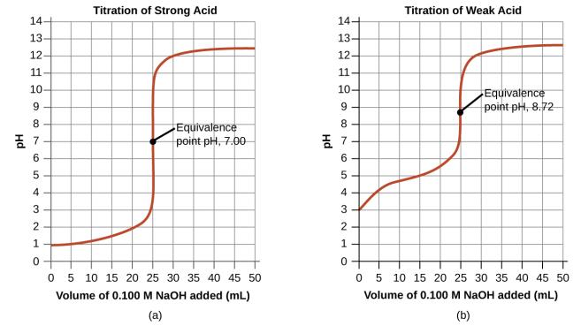
Figure 14.18
(a) The titration curve for the titration of 25.00 mL of 0.100 M CH₃CO₂H (weak acid) with 0.100 M NaOH (strong base) has an equivalence point of 7.00 pH. (b) The titration curve for the titration of 25.00 mL of 0.100 M acetic acid (weak acid) with 0.100 M NaOH (strong base) has an equivalence point of 8.72 pH.

Slide 99
Acid-Base Indicators
One or two drops of indicator are often added to the sample being titrated.
An acid-base indicator is useful in determining the equivalence point in a titration.
  The pH at which the indicator changes color is called the end point.
  You want to choose an indicator that has an end point that coincides with the pH at the equivalence point.

Slide 100
Acid-Base Indicators
Indicators are weak acids.
  The weak acid is a different color than its conjugate base.

Slide 101
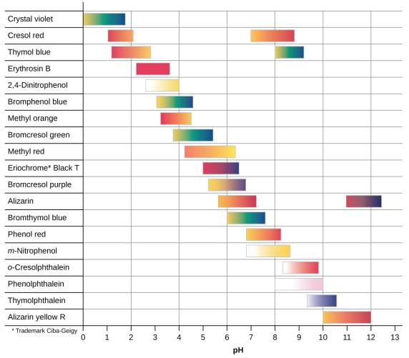
Figure 14.19
This chart illustrates the ranges of color change for several acid-base indicators.

Slide 102
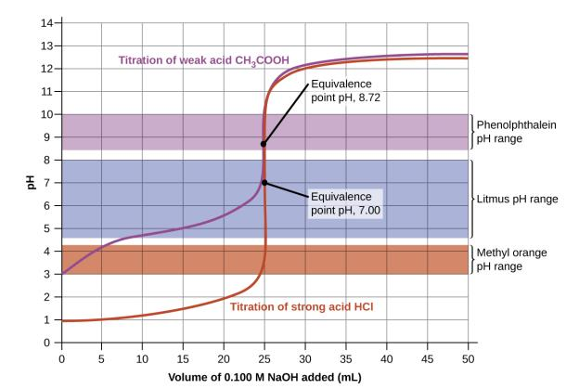
Figure 14.20
Titration curves for strong and weak acids illustrating the proper choice of acid-base indicator. Any of the three indicators will exhibit a reasonably sharp color change at the equivalence point of the strong acid titration, but only phenolphthalein is suitable for use in the weak acid titration.

Slide 103
Indicator Section
Need an indicator that changes color at a pH near the equivalence point.

Slide 104
This OpenStax ancillary resource is © Rice University under a CC-BY 4.0 International license; it may be reproduced or modified but must be attributed to OpenStax, Rice University and any changes must be noted.

