Slide 1
CHEMISTRY: ATOMS FIRST 2e
Chapter 10 LIQUIDS AND SOLIDS
PowerPoint Image Slideshow
With Contributions by Joe DePasquale, Northeastern University

Slide 2
Chapter Outline
10.1 Intermolecular Forces
10.2 Properties of Liquids
10.3 Phase Transitions
10.4 Phase Diagrams
10.5 The Solid State of Matter
10.6 Lattice Structures in Crystalline Solids

Slide 3
Figure 10.1
Solid carbon dioxide (“dry ice”, left) sublimes vigorously when placed in a liquid (right), cooling the liquid and generating a fog of condensed water vapor above the cylinder. (credit: modification of work by Paul Flowers)

Slide 4
Learning Objectives
10.1 Intermolecular Forces
Describe the types of intermolecular forces possible between atoms or molecules in condensed phases (dispersion forces, dipole-dipole attractions, and hydrogen bonding)
Identify the types of intermolecular forces experienced by specific molecules based on their structures
Explain the relation between the intermolecular forces present within a substance and the temperatures associated with changes in its physical state

Slide 5
Liquids and Solids
Recall that the properties of all dilute gases are the same, regardless of the chemical identity of the substance.
The properties of liquid and solids have a dependence on the chemical identity of the substance.

Slide 6
Intermolecular Forces
Intermolecular forces (IMFs): The various forces of attraction that may exist between the atoms and molecules of a substance.
IMFs are a result of electrostatic phenomena.
IMFs are noncovalent forces.
Kinetic energy (KE) provides the energy required to overcome the IMFs.
Intramolecular forces: The forces that hold atoms together in a molecule.
The differences in the properties of a solid, liquid, or gas are a result of differences in strengths of the IMFs that make up each substance.

Slide 7
Figure 10.2
Transitions between solid, liquid, and gaseous states of a substance occur when conditions of temperature or pressure favor the associated changes in intermolecular forces. (Note: The space between particles in the gas phase is much greater than shown.)

Slide 8
Figure 10.3
Condensation forms when water vapor in the air is cooled enough to form liquid water, such as (a) on the outside of a cold beverage glass or (b) in the form of fog. (credit a: modification of work by Jenny Downing; credit b: modification of work by Cory Zanker)

Slide 9
Figure 10.4
Gaseous butane is compressed within the storage compartment of a disposable lighter, resulting in its condensation to the liquid state. (credit: modification of work by “Sam-Cat”/Flickr)

Slide 10
IMFs—Forces between Molecules
The strength of IMFs vary for different substances.
All IMFs are significantly weaker than intramolecular forces (covalent bonds).
Three types of IMFs:
Dispersion Forces
Dipole-Dipole Attractions
Hydrogen Bonding
The intermolecular forces above are sometimes collectively referred to as van der Waals forces.

Slide 11
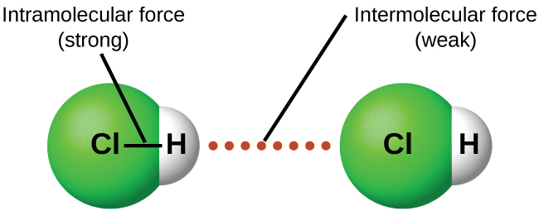
Figure 10.5
Intramolecular forces keep a molecule intact. Intermolecular forces hold multiple molecules together and determine many of a substance’s properties.

Slide 12
Dispersion Forces
All substances (polar and nonpolar) have Dispersion Forces.
Also called London Dispersion Forces.
Constant motion of electrons in molecules and atoms result in instantaneous dipoles.
An instantaneous dipole in one molecule or atom can then distort the electrons in a neighboring atom or molecules, producing an induced dipole.
Both of these fleeting, temporary dipoles result in weak electrostatic forces known as dispersion forces.

Slide 13
Figure 10.6
Dispersion forces result from the formation of temporary dipoles, as illustrated here for two nonpolar diatomic molecules.

Slide 14
Dispersion Forces and Molar Mass
Heavier molecules and atoms exhibit stronger dispersion forces than do lighter molecules and atoms.
This is because larger atoms have greater polarizability due to the valence electrons being farther from the nucleus.
Polarizability: The measure of how easy or difficult it is for another electrostatic charge to distort a molecule’s charge distribution.

Slide 15
Table 10.1 Melting and Boiling Points of the Halogens
Stronger dispersion forces lead to higher melting and boiling points.
Higher temperature and, therefore, more KE is needed to overcome the IMFs.
Halogen | Molar Mass | Atomic Radius | Melting Point | Boiling Point
flourine, F₂ | 38 g/mol | 72 pm | 53 K | 85 K
chlorine, Cl₂ | 71 g/mol | 99 pm | 172 K | 238 K
bromine, Br₂ | 160 g/mol | 114 pm | 266 K | 332 K
iodine, I₂ | 254 g/mol | 133 pm | 387 K | 457 K
astatine, At₂ | 420 g/mol | 150 pm | 575 K | 610 K

Slide 16
Example 10.1

Slide 17
Figure 10.7
The strength of the dispersion forces increases with the contact area between molecules, as demonstrated by the boiling points of these pentane isomers.

Slide 18
Figure 10.8
Geckos’ toes contain large numbers of tiny hairs (setae), which branch into many triangular tips (spatulae). Geckos adhere to surfaces because of van der Waals attractions between the surface and a gecko’s millions of spatulae. By changing how the spatulae contact the surface, geckos can turn their stickiness “on” and “off.” (credit photo: modification of work by “JC*+A!”/Flickr)

Slide 19
Dipole-Dipole Attractions
Molecules with permanent dipoles display dipole-dipole attractions.
Present only in polar molecules.
Dipole-dipole attractions are stronger than dispersion forces.
Polar molecules contain dipole-dipole attractions and dispersion forces.
Adjacent molecules line up such that the partial negative pole of one molecule is as close as possible to the partial positive pole of another molecule.

Slide 20
Figure 10.9
This image shows two arrangements of polar molecules, such as HCl, that allow an attraction between the partial negative end of one molecule and the partial positive end of another.

Slide 21
Dipole-Dipole Attractions
Comparing polar and nonpolar molecules of similar MM.
The presence of the stronger dipole forces in polar molecules leads to a small to moderate increase in boiling point.

Slide 22
Hydrogen Bonding
Hydrogen bonding is only present in certain polar molecules.
Unusually strong type of dipole-dipole attraction.
Hydrogen bonding is the strongest van der Waals force.
Need an H covalently bonded to one of these highly EN elements: N, O, or F.

Slide 23
Figure 10.10
Water molecules participate in multiple hydrogen-bonding interactions with nearby water molecules.

Slide 24
Hydrogen Bonding
Hydrogen bonds are strong IMFs due to highly concentrated partial charges.
Large difference in EN between H and the atom it is bonded to creates a large dipole moment.
Very small size of H and relatively small sizes of F, O, and N

Slide 25
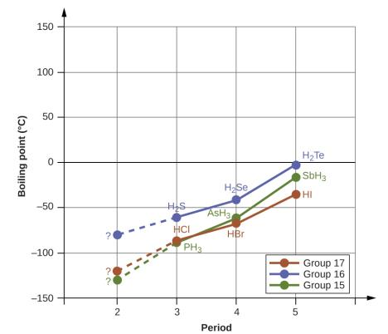
Figure 10.11
For the group 15, 16, and 17 hydrides, the boiling points for each class of compounds increase with increasing molecular mass for elements in periods 3, 4, and 5.

Slide 26
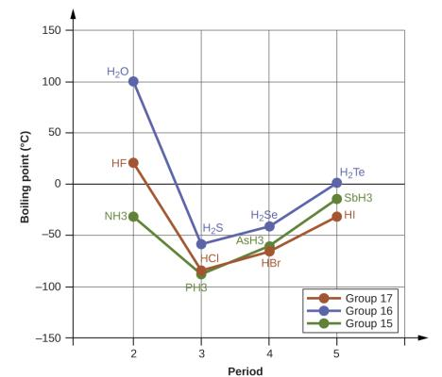
Figure 10.12
In comparison to periods 3−5, the binary hydrides of period 2 elements in groups 17, 16 and 15 (F, O and N, respectively) exhibit anomalously high boiling points due to hydrogen bonding.

Slide 27
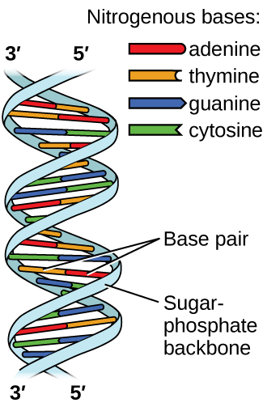
Figure 10.13
Two separate DNA molecules form a double-stranded helix in which the molecules are held together via hydrogen bonding. (credit: modification of work by Jerome Walker, Dennis Myts)

Slide 28
Figure 10.14
The geometries of the base molecules result in maximum hydrogen bonding between adenine and thymine (AT) and between guanine and cytosine (GC), so-called “complementary base pairs.”

Slide 29
Learning Objectives
10.2 Properties of Liquids
Distinguish between adhesive and cohesive forces
Define viscosity, surface tension, and capillary rise
Describe the roles of intermolecular attractive forces in each of these properties/phenomena

Slide 30
Figure 10.15
(a) Honey and (b) motor oil are examples of liquids with high viscosities; they flow slowly. (credit a: modification of work by Scott Bauer; credit b: modification of work by David Nagy)

Slide 31
Figure 10.16
Attractive forces result in a spherical water drop that minimizes surface area; cohesive forces hold the sphere together; adhesive forces keep the drop attached to the web. (credit photo: modification of work by “OliBac”/Flickr)

Slide 32
Figure 10.17
Surface tension (right) prevents this insect, a “water strider,” from sinking into the water.

Slide 33
Figure 10.18
Differences in the relative strengths of cohesive and adhesive forces result in different meniscus shapes for mercury (left) and water (right) in glass tubes. (credit: Mark Ott)

Slide 34
Figure 10.19
Wine wicks up a paper towel (left) because of the strong attractions of water (and ethanol) molecules to the −OH groups on the towel’s cellulose fibers and the strong attractions of water molecules to other water (and ethanol) molecules (right). (credit photo: modification of work by Mark Blaser)

Slide 35
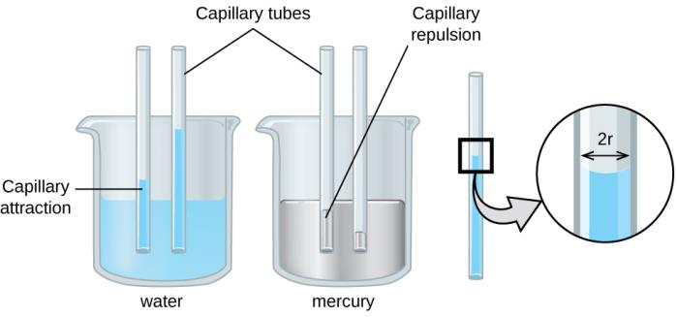
Figure 10.20
Depending upon the relative strengths of adhesive and cohesive forces, a liquid may rise (such as water) or fall (such as mercury) in a glass capillary tube. The extent of the rise (or fall) is directly proportional to the surface tension of the liquid and inversely proportional to the density of the liquid and the radius of the tube.

Slide 36
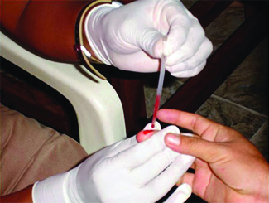
Figure 10.21
Blood is collected for medical analysis by capillary action, which draws blood into a small diameter glass tube. (credit: modification of work by Centers for Disease Control and Prevention)

Slide 37
Learning Objectives
10.3 Phase Transitions
Define phase transitions and phase transition temperatures
Explain the relation between phase transition temperatures and intermolecular attractive forces
Describe the processes represented by typical heating and cooling curves, and compute heat flows and enthalpy changes accompanying these processes

Slide 38
Phase Transitions
Vaporization and condensation
Melting and freezing
Sublimation and deposition

Slide 39
Liquid-Vapor Equilibrium
Vaporization: Liquid is converted into a gas (vapor).
In an open container, vaporization continues until all the liquid is converted into vapor.
Liquid → Vapor
In a closed container, the process of vaporization is countered by the process of condensation:
Liquid ⇌ Vapor
The double arrow indicates a dynamic equilibrium.

Slide 40
Equilibrium
Liquid ⇌ Vapor
When the rate at which the liquid vaporizes is equal to the rate at which the vapor condenses, a dynamic equilibrium is established.
The liquid level in the container does not change after equilibrium is established.
Bromine liquid and vapor in equilibrium
Br₂ (l) ⇌ Br₂ (g)

Slide 41
Vapor Pressure
After equilibrium has been reached, the number of molecules in the gas phase does not change with time.
Therefore, the pressure exerted by the vapor over the liquid remains constant.
The pressure of a vapor in equilibrium with a liquid is called vapor pressure.

Slide 42
Figure 10.22
In a closed container, dynamic equilibrium is reached when (a) the rate of molecules escaping from the liquid to become the gas (b) increases and eventually (c) equals the rate of gas molecules entering the liquid. When this equilibrium is reached, the vapor pressure of the gas is constant, although the vaporization and condensation processes continue.

Slide 43
Vapor Pressure
The vapor pressure of a substance is independent of the volume of the container.
Vapor pressure does depend on the IMFs of the substance.

Slide 44
Example 10.5

Slide 45
Vapor Pressure and Temperature
The vapor pressure of a liquid always increases with increasing temperature.
Example: Water
P is 24 mm Hg at 25 °C
P is 92 mm Hg at 50 °

Slide 46
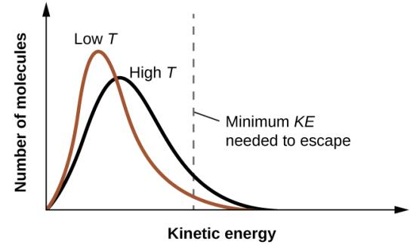
Figure 10.23
Temperature affects the distribution of kinetic energies for the molecules in a liquid. At the higher temperature, more molecules have the necessary kinetic energy, KE, to escape from the liquid into the gas phase.

Slide 47
Boiling Points
When the vapor pressure of a liquid increases enough to equal the external atmospheric pressure, the liquid reaches its boiling point.
The temperature at which a liquid boils depends on the pressure above it.
The normal boiling point of a liquid is the temperature at which the liquid boils when the pressure above the liquid is 1 atm.
During the boiling process, temperature remains constant.

Slide 48
Boiling Point and External Pressure
Variations in atmospheric pressure will change the boiling point.
At high altitude, atmospheric pressure is lower, so the boiling point is lower.

Slide 49
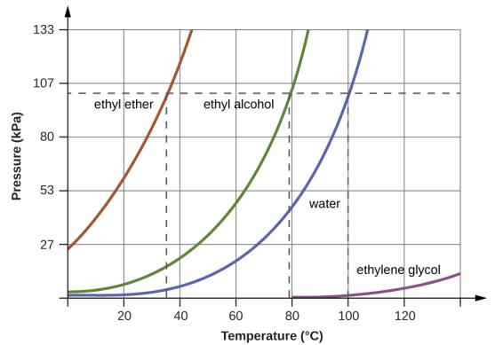
Figure 10.24
The boiling points of liquids are the temperatures at which their equilibrium vapor pressures equal the pressure of the surrounding atmosphere. Normal boiling points are those corresponding to a pressure of 1 atm (101.3 kPa.)

Slide 50
The Clausius-Clapeyron Equation
Relates a substance’s temperature and vapor pressure.
Two pressures
Two temperatures
Notes:
Temperatures must be in Kelvin.
R = 8.31 J/mol·K
ΔH_{vap} must be in J for use with this value of R.

Slide 51
Figure 10.25
Evaporation of sweat helps cool the body. (credit: “Kullez”/Flickr)

Slide 52
Figure 10.26
(a) This beaker of ice has a temperature of −12.0 °C. (b) After 10 minutes the ice has absorbed enough heat from the air to warm to 0 °C. A small amount has melted. (c) Thirty minutes later, the ice has absorbed more heat, but its temperature is still 0 °C. The ice melts without changing its temperature. (d) Only after all the ice has melted does the heat absorbed cause the temperature to increase to 22.2 °C. (credit: modification of work by Mark Ott)

Slide 53
Figure 10.27
Sublimation of solid iodine in the bottom of the tube produces a purple gas that subsequently deposits as solid iodine on the colder part of the tube above. (credit: modification of work by Mark Ott)

Slide 54
Figure 10.28
For a given substance, the sum of its enthalpy of fusion and enthalpy of vaporization is approximately equal to its enthalpy of sublimation.

Slide 55
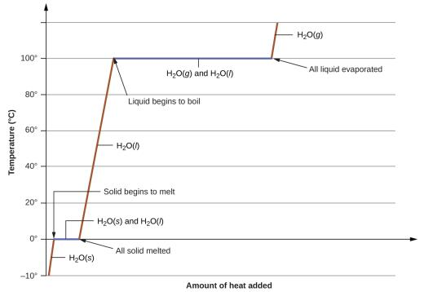
Figure 10.29
A typical heating curve for a substance depicts changes in temperature that result as the substance absorbs increasing amounts of heat. Plateaus in the curve (regions of constant temperature) are exhibited when the substance undergoes phase transitions.

Slide 56
Learning Objectives
10.4 Phase Diagrams
Explain the construction and use of a typical phase diagram
Use phase diagrams to identify stable phases at given temperatures and pressures, and to describe phase transitions resulting from changes in these properties
Describe the supercritical fluid phase of matter

Slide 57
Phase Changes and Temperature
Imagine heating or cooling a substance.
During phase changes, the temperature remains constant.
If energy is being absorbed in the phase change, then all this energy is being used to break the intermolecular forces, not increase the temperature of the substance.
If energy is being released during the phase change, then all this released energy is coming from the formation of intermolecular forces, not from the decrease in temperature of the substance.

Slide 58
Figure 10.30
The physical state of a substance and its phase-transition temperatures are represented graphically in a phase diagram.

Slide 59
Figure 10.31
The pressure and temperature axes on this phase diagram of water are not drawn to constant scale in order to illustrate several important properties.

Slide 60
Figure 10.32
Freeze-dried foods, like this ice cream, are dehydrated by sublimation at pressures below the triple point for water. (credit: “lwao”/Flickr)

Slide 61
Figure 10.33
The immense pressures beneath glaciers result in partial melting to produce a layer of water that provides lubrication to assist glacial movement. This satellite photograph shows the advancing edge of the Perito Moreno glacier in Argentina. (credit: NASA)

Slide 62
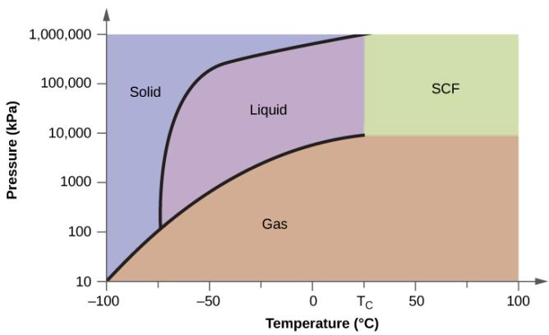
Figure 10.34
A phase diagram for carbon dioxide is shown. The pressure axis is plotted on a logarithmic scale to accommodate the large range of values.

Slide 63
Figure 10.35
(a) A sealed container of liquid carbon dioxide slightly below its critical point is heated, resulting in (b) the formation of the supercritical fluid phase. Cooling the supercritical fluid lowers its temperature and pressure below the critical point, resulting in the reestablishment of separate liquid and gaseous phases (c and d). Colored floats illustrate differences in density between the liquid, gaseous, and supercritical fluid states. (credit: modification of work by “mrmrobin”/YouTube)

Slide 64
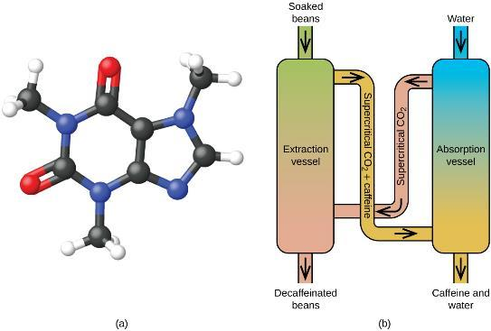
Figure 10.36
(a) Caffeine molecules have both polar and nonpolar regions, making it soluble in solvents of varying polarities. (b) The schematic shows a typical decaffeination process involving supercritical carbon dioxide.

Slide 65
Learning Objectives
10.5 The Solid State of Matter
Define and describe the bonding and properties of ionic, molecular, metallic, and covalent network crystalline solids
Describe the main types of crystalline solids: ionic solids, metallic solids, covalent network solids, and molecular solids
Explain the ways in which crystal defects can occur in a solid

Slide 66
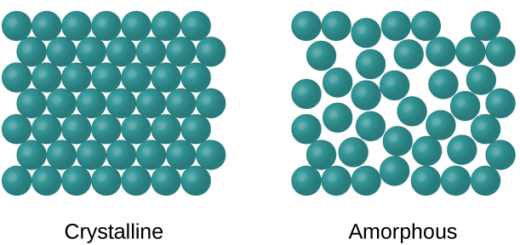
Figure 10.37
The entities of a solid phase may be arranged in a regular, repeating pattern (crystalline solids) or randomly (amorphous).

Slide 67
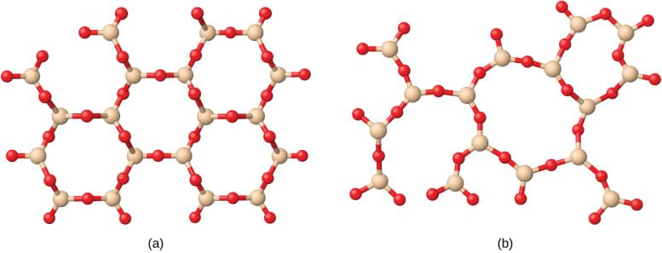
Figure 10.38
(a) Silicon dioxide, SiO₂, is abundant in nature as one of several crystalline forms of the mineral quartz. (b) Rapid cooling of molten SiO₂ yields an amorphous solid known as “fused silica”.

Slide 68
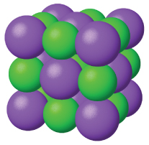
Figure 10.39
Sodium chloride is an ionic solid.

Slide 69
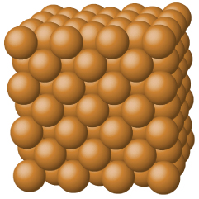
Figure 10.40
Copper is a metallic solid.

Slide 70
Figure 10.41
A covalent crystal contains a three-dimensional network of covalent bonds, as illustrated by the structures of diamond, silicon dioxide, silicon carbide, and graphite. Graphite is an exceptional example, composed of planar sheets of covalent crystals that are held together in layers by noncovalent forces. Unlike typical covalent solids, graphite is very soft and electrically conductive.

Slide 71
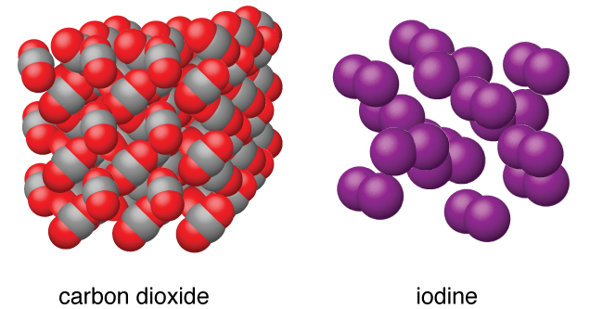
Figure 10.42
Carbon dioxide (CO₂) consists of small, nonpolar molecules and forms a molecular solid with a melting point of −78 °C. Iodine (I₂) consists of larger, nonpolar molecules and forms a molecular solid that melts at 114 °C.

Slide 72
Figure 10.43
Diamond is extremely hard because of the strong bonding between carbon atoms in all directions. Graphite (in pencil lead) rubs off onto paper due to the weak attractions between the carbon layers. An image of a graphite surface shows the distance between the centers of adjacent carbon atoms. (credit left photo: modification of work by Steve Jurvetson; credit middle photo: modification of work by United States Geological Survey)

Slide 73
Figure 10.44
Graphene sheets can be formed into buckyballs, nanotubes, and stacked layers.

Slide 74
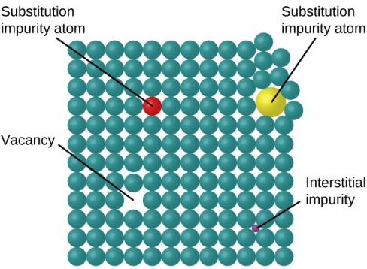
Figure 10.45
Types of crystal defects include vacancies, interstitial atoms, and substitutions impurities.

Slide 75
Learning Objectives
10.6 Lattice Structures in Crystalline Solids
Describe the arrangement of atoms and ions in crystalline structures
Compute ionic radii using unit cell dimensions
Explain the use of X-ray diffraction measurements in determining crystalline structures

Slide 76
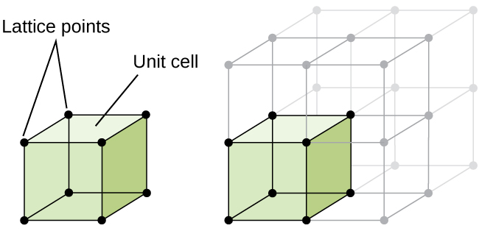
Figure 10.46
A unit cell shows the locations of lattice points repeating in all directions.

Slide 77
Figure 10.47
When metal atoms are arranged with spheres in one layer directly above or below spheres in another layer, the lattice structure is called simple cubic. Note that the spheres are in contact.

Slide 78
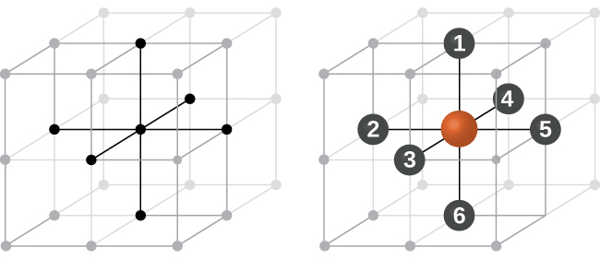
Figure 10.48
An atom in a simple cubic lattice structure contacts six other atoms, so it has a coordination number of six.

Slide 79
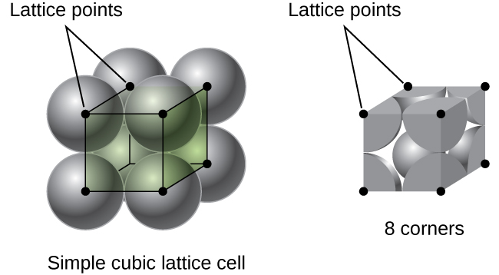
Figure 10.49
A simple cubic lattice unit cell contains one-eighth of an atom at each of its eight corners, so it contains one atom total.

Slide 80
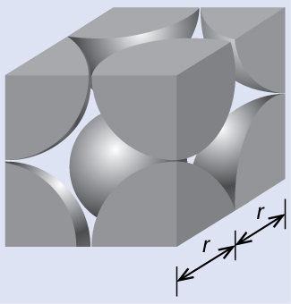
Example 10.14

Slide 81
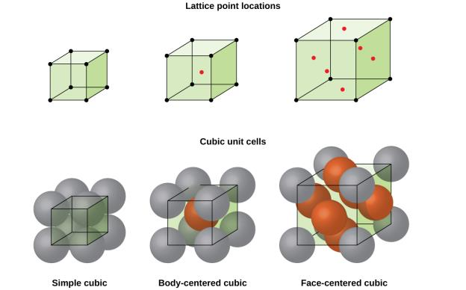
Figure 10.50
Cubic unit cells of metals show (in the upper figures) the locations of lattice points and (in the lower figures) metal atoms located in the unit cell.

Slide 82
Figure 10.51
In a body-centered cubic structure, atoms in a specific layer do not touch each other. Each atom touches four atoms in the layer above it and four atoms in the layer below it.

Slide 83
Figure 10.52
A face-centered cubic solid has atoms at the corners and, as the name implies, at the centers of the faces of its unit cells.

Slide 84
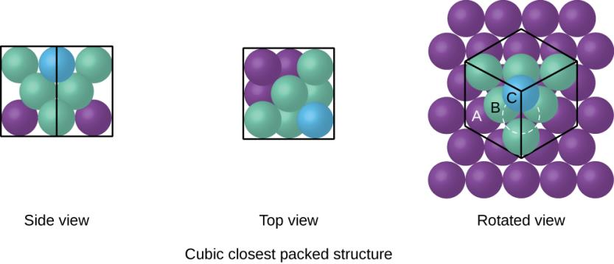
Figure 10.53
A CCP arrangement consists of three repeating layers (ABCABC…) of hexagonally arranged atoms. Atoms in a CCP structure have a coordination number of 12 because they contact six atoms in their layer, plus three atoms in the layer above and three atoms in the layer below. By rotating our perspective, we can see that a CCP structure has a unit cell with a face containing an atom from layer A at one corner, atoms from layer B across a diagonal (at two corners and in the middle of the face), and an atom from layer C at the remaining corner. This is the same as a face-centered cubic arrangement.

Slide 85
Figure 10.54
In both types of closest packing, atoms are packed as compactly as possible. Hexagonal closest packing consists of two alternating layers (ABABAB…). Cubic closest packing consists of three alternating layers (ABCABCABC…).

Slide 86
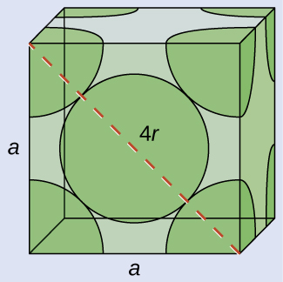
Example 10.15

Slide 87
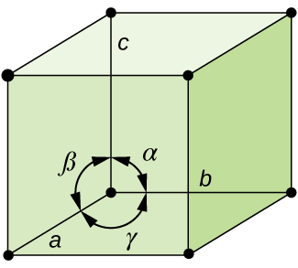
Figure 10.55
A unit cell is defined by the lengths of its three axes (a, b, and c) and the angles (α, β, and γ) between the axes.

Slide 88
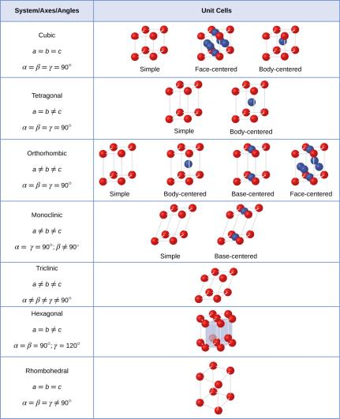
Figure 10.56
There are seven different lattice systems and 14 different unit cells.

Slide 89
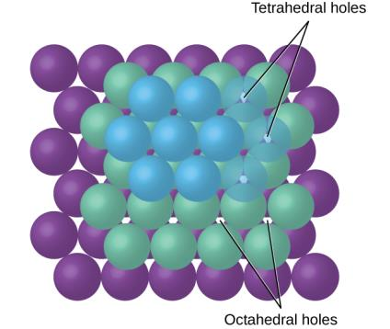
Figure 10.57
Cations may occupy two types of holes between anions: octahedral holes or tetrahedral holes.

Slide 90
Figure 10.58
A cation’s size and the shape of the hole occupied by the compound are directly related.

Slide 91
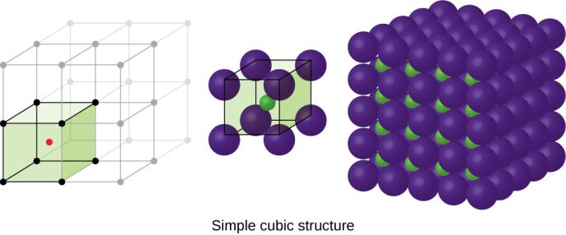
Figure 10.59
Ionic compounds with similar-sized cations and anions, such as CsCl, usually form a simple cubic structure. They can be described by unit cells with either cations at the corners or anions at the corners.

Slide 92
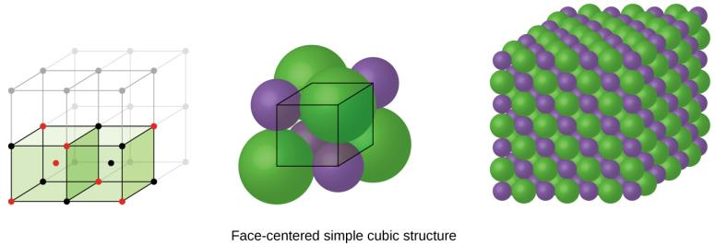
Figure 10.60
Ionic compounds with anions that are much larger than cations, such as NaCl, usually form an FCC structure. They can be described by FCC unit cells with cations in the octahedral holes.

Slide 93
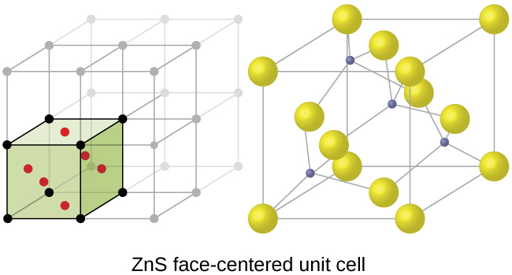
Figure 10.61
ZnS, zinc sulfide (or zinc blende) forms an FCC unit cell with sulfide ions at the lattice points and much smaller zinc ions occupying half of the tetrahedral holes in the structure.

Slide 94
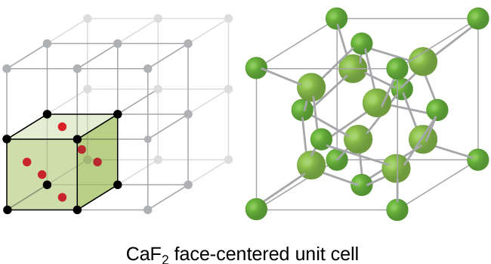
Figure 10.62
Calcium fluoride, CaF₂, forms an FCC unit cell with calcium ions (green) at the lattice points and fluoride ions (red) occupying all of the tetrahedral sites between them.

Slide 95
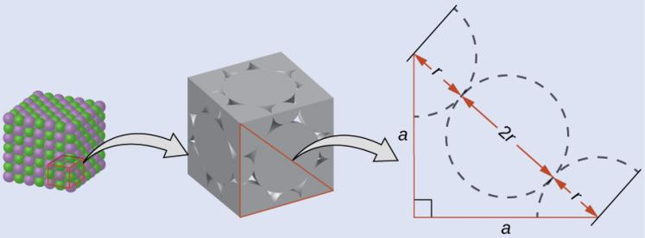
Example 10.18

Slide 96
Figure 10.63
Light waves occupying the same space experience interference, combining to yield waves of greater (a) or lesser (b) intensity, depending upon the separation of their maxima and minima.

Slide 97
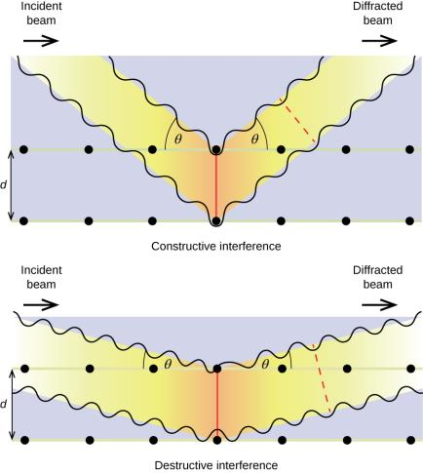
Figure 10.64
The diffraction of X-rays scattered by the atoms within a crystal permits the determination of the distance between the atoms. The top image depicts constructive interference between two scattered waves and a resultant diffracted wave of high intensity. The bottom image depicts destructive interference and a low intensity diffracted wave.

Slide 98
Figure 10.65
(a) In a diffractometer, a beam of X-rays strikes a crystalline material, producing (b) an X-ray diffraction pattern that can be analyzed to determine the crystal structure.

Slide 99
Figure 10.66
This illustration shows an X-ray diffraction image similar to the one Franklin found in her research. (credit: National Institutes of Health)

Slide 100
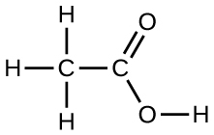
Exercise 18

Slide 101
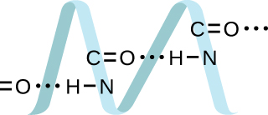
Exercise 19

Slide 102
Exercise 22

Slide 103
Exercise 23
(credit: Cory Zanker)

Slide 104
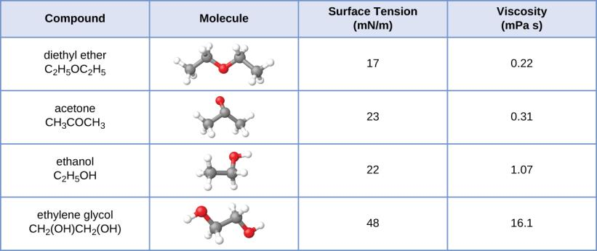
Exercise 24

Slide 105
Exercise 63

Slide 106
This OpenStax ancillary resource is © Rice University under a CC-BY 4.0 International license; it may be reproduced or modified but must be attributed to OpenStax, Rice University and any changes must be noted.

