Slide 1
16
Coordination Compounds
The Colorful Chemistry of Metals

Slide 2
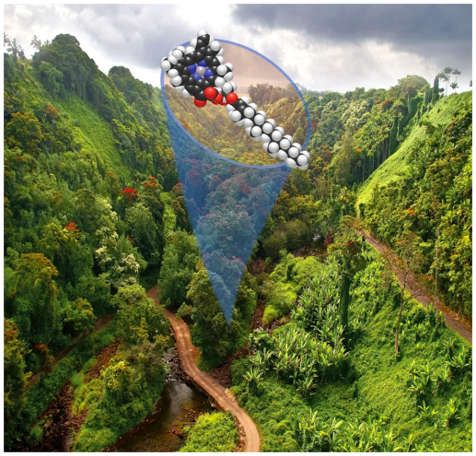
Chapter Outline
16.1 Lewis Acids and Bases
16.2 Complex Ions
16.3 Naming Complex Ions and Coordination Compounds
16.4 Polydentate Ligands
16.5 Ligand Strength and the Chelate Effect
16.6 Crystal Field Theory
16.7 Magnetism and Spin States
16.8 Isomerism in Coordination Compounds
16.9 Complex Ions in Biomolecules
16.10 Complex-Ion Equilibria
16.11 Hydrated Metal Ions as Acids
2

Slide 3
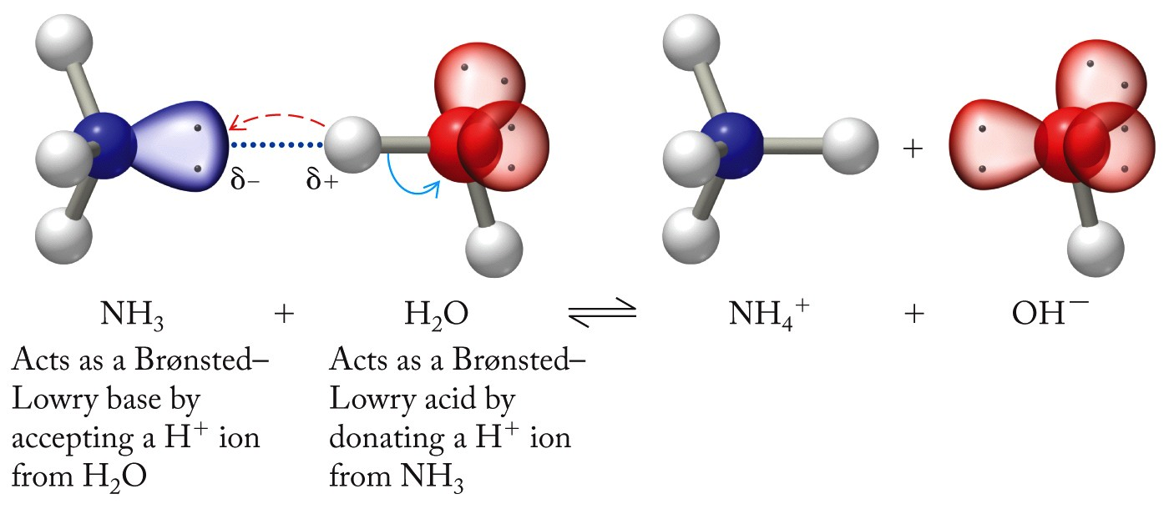
Lewis Acids and Bases
Lewis Base:
Substance that donates a lone pair of electrons
Lewis Acid:
Substance that accepts a lone pair of electrons

Slide 4
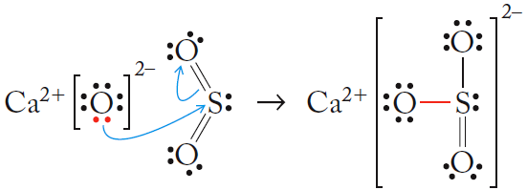
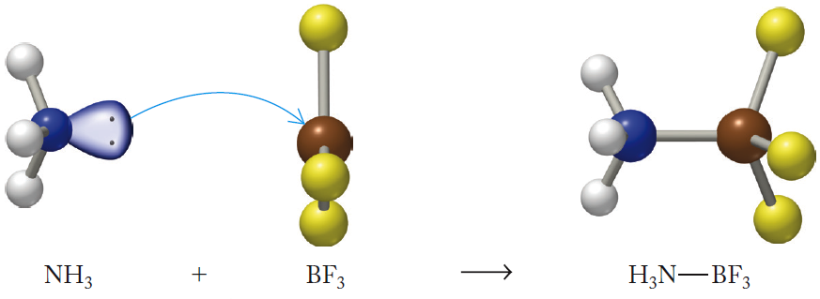
Lewis Acids and Bases

Slide 5
Chapter Outline
16.1 Lewis Acids and Bases
16.2 Complex Ions
16.3 Naming Complex Ions and Coordination Compounds
16.4 Polydentate Ligands
16.5 Ligand Strength and the Chelate Effect
16.6 Crystal Field Theory
16.7 Magnetism and Spin States
16.8 Isomerism in Coordination Compounds
16.9 Complex Ions in Biomolecules
16.10 Complex-Ion Equilibria
16.11 Hydrated Metal Ions as Acids
5

Slide 6
Complex Ions
Coordinate Bond: Bond formed when one anion/molecule donates a pair of electrons to another ion/molecule to form a covalent bond
Ligand: A Lewis base bonded to the central metal ion of a complex ion
Complex Ion: Ionic species consisting of a metal ion bonded to one or more Lewis bases
Inner Coordination Sphere: Ligands that are bound directly to a metal via coordinate covalent bonds

Slide 7
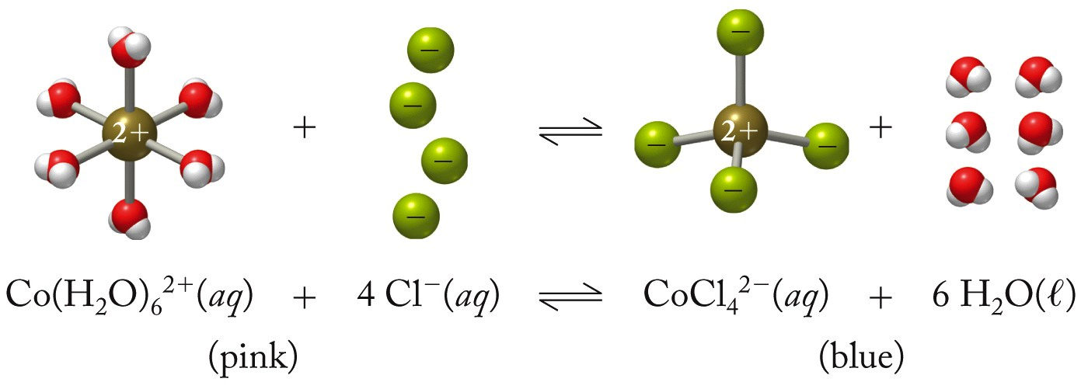
Complex Ion
Coordinate Bonds
(Hydrated Ion)
(Ligands)
(Complex Ion)
Notes:
Animation: add “coordinate bonds” and arrows

Slide 8
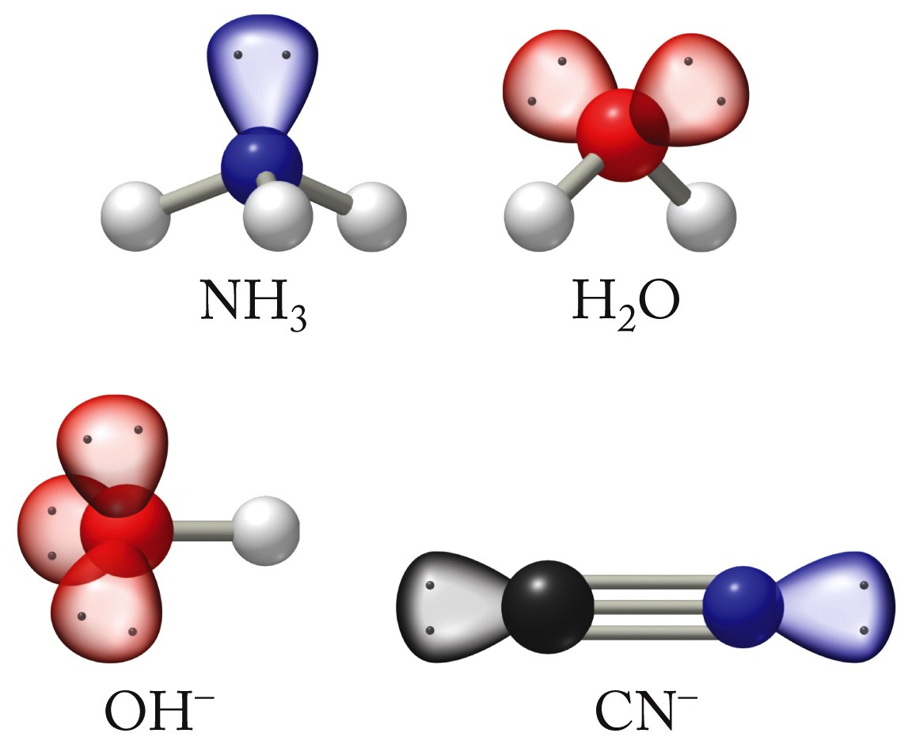
Common Ligands
Anions or molecules with lone pairs of electrons
Lewis bases

Slide 9
Complex Ions
Counter Ions:
Ions that balance the electrical charges of complex ions in coordination compounds
Coordination Compound:
Any compound that contains a complex ion
Coordination Number:
Identifies the number of electron pairs surrounding a metal ion in a complex

Slide 11
Chapter Outline
16.1 Lewis Acids and Bases
16.2 Complex Ions
16.3 Naming Complex Ions and Coordination Compounds
16.4 Polydentate Ligands
16.5 Ligand Strength and the Chelate Effect
16.6 Crystal Field Theory
16.7 Magnetism and Spin States
16.8 Isomerism in Coordination Compounds
16.9 Complex Ions in Biomolecules
16.10 Complex-Ion Equilibria
16.11 Hydrated Metal Ions as Acids
11

Slide 12
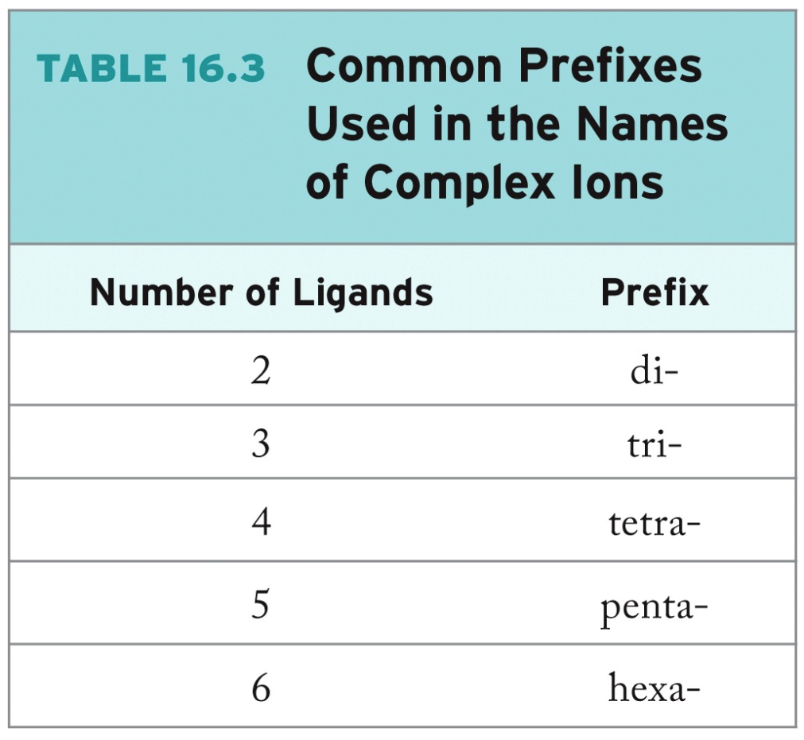
Naming Complex Ions with a Positive Charge
Start with the name of ligand(s), listed alphabetically (see Table 16.2).
Use prefixes to indicate
the number of each
type of ligand.

Slide 13
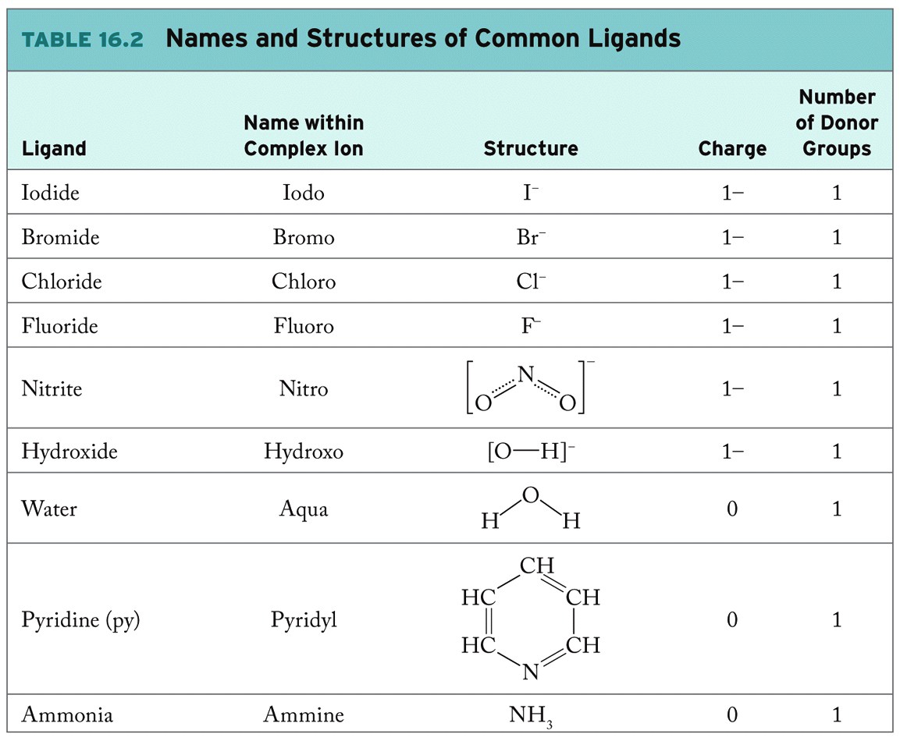

Slide 14
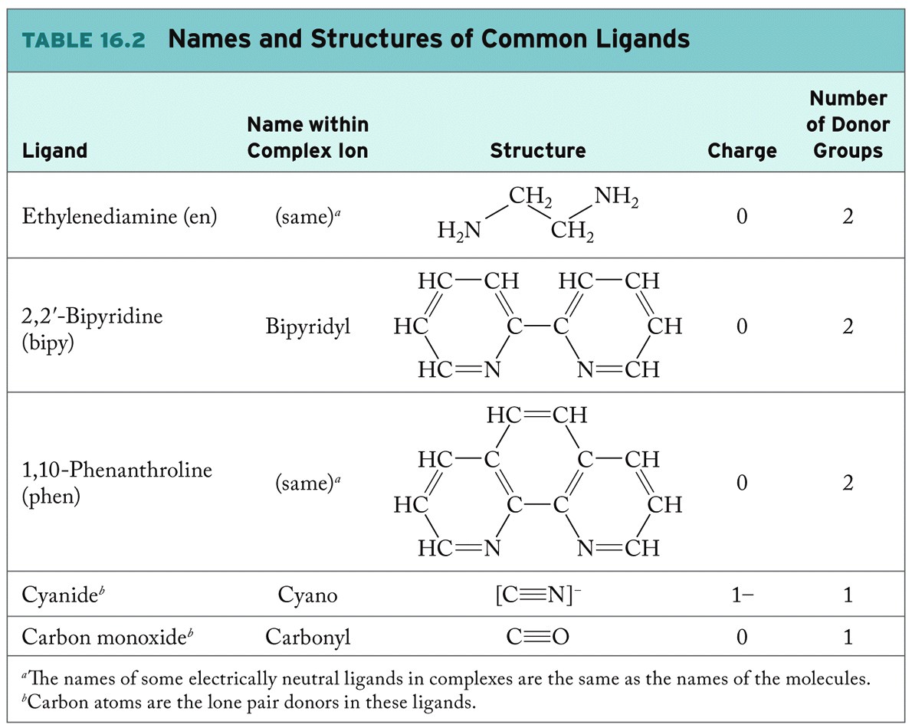

Slide 15
Naming Complex Ions with a Positive Charge
Write the name of the transition metal ion with a Roman numeral indicating the oxidation state.
Examples:

Slide 16
Naming Negatively Charged Complex Ions
Follow the steps for a positively charged complex ion.
Add-ate ending to the name of the central metal ion to indicate that the complex ion carries a negative ion.

Slide 17
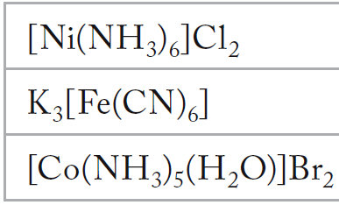
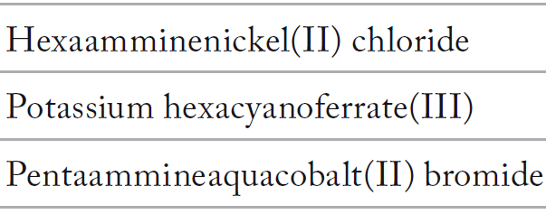
Naming Coordination Compounds
Name cation first, followed by name of anion.
- If cation/anion is a complex ion, follow rules for naming complex ions.

Slide 18
Practice: Naming Coordination Compounds
Name the following coordination compounds:
a. [Zn(NH₃)₄]Cl₂ b. Na₄[Co(CN)₆]
Collect and Organize:
Analyze:
Solve:
Think about It:

Slide 19
Chapter Outline
16.1 Lewis Acids and Bases
16.2 Complex Ions
16.3 Naming Complex Ions and Coordination Compounds
16.4 Polydentate Ligands
16.5 Ligand Strength and the Chelate Effect
16.6 Crystal Field Theory
16.7 Magnetism and Spin States
16.8 Isomerism in Coordination Compounds
16.9 Complex Ions in Biomolecules
16.10 Complex-Ion Equilibria
16.11 Hydrated Metal Ions as Acids
19

Slide 20
Polydentate Ligands
Monodentate Ligand:
Species that forms a single coordinate bond to a metal ion in a complex (NH₃, Cl⁻)
Polydentate Ligand:
Species that can form more than one coordinate bond per molecule
Chelation:
Interaction of a metal ion with a ligand having multiple donor atoms (chelating agent)

Slide 21
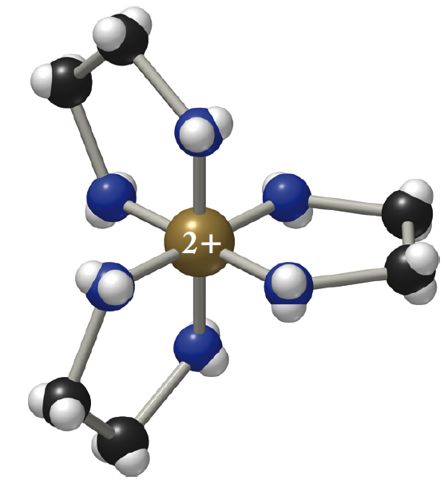
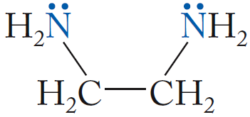
Chelating Agents
(a) ethylenediamine (en)
(bidentate)
(b) [Ni(en)₃]²⁺

Slide 22
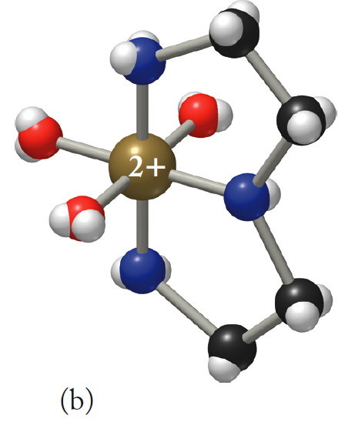
Chelating Agents
diethylenetriamine
(tridentate)
(b) triaqua(diethylenetriamine)nickel (II)

Slide 23
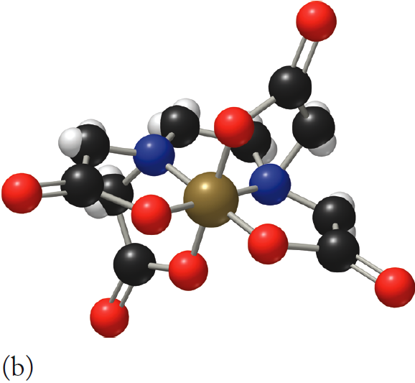
EDTA: A Hexadentate Ligand
Ethylenediaminetetraacetic acid (EDTA):
- Sequestering agent
(b) [Co(EDTA)]³⁺

Slide 24
Chapter Outline
16.1 Lewis Acids and Bases
16.2 Complex Ions
16.3 Naming Complex Ions and Coordination Compounds
16.4 Polydentate Ligands
16.5 Ligand Strength and the Chelate Effect
16.6 Crystal Field Theory
16.7 Magnetism and Spin States
16.8 Isomerism in Coordination Compounds
16.9 Complex Ions in Biomolecules
16.10 Complex-Ion Equilibria
16.11 Hydrated Metal Ions as Acids
24

Slide 25
Ligand Displacement
Ligands with a higher affinity for metal cation will displace ligands with less affinity.
NH₃ is a stronger Lewis base than H₂O.
Ni(H₂O)₆²⁺ + 6NH₃ ⇌ Ni(NH₃)₆²⁺ + 6H₂O
K_{f} = 5 × 10⁸

Slide 26
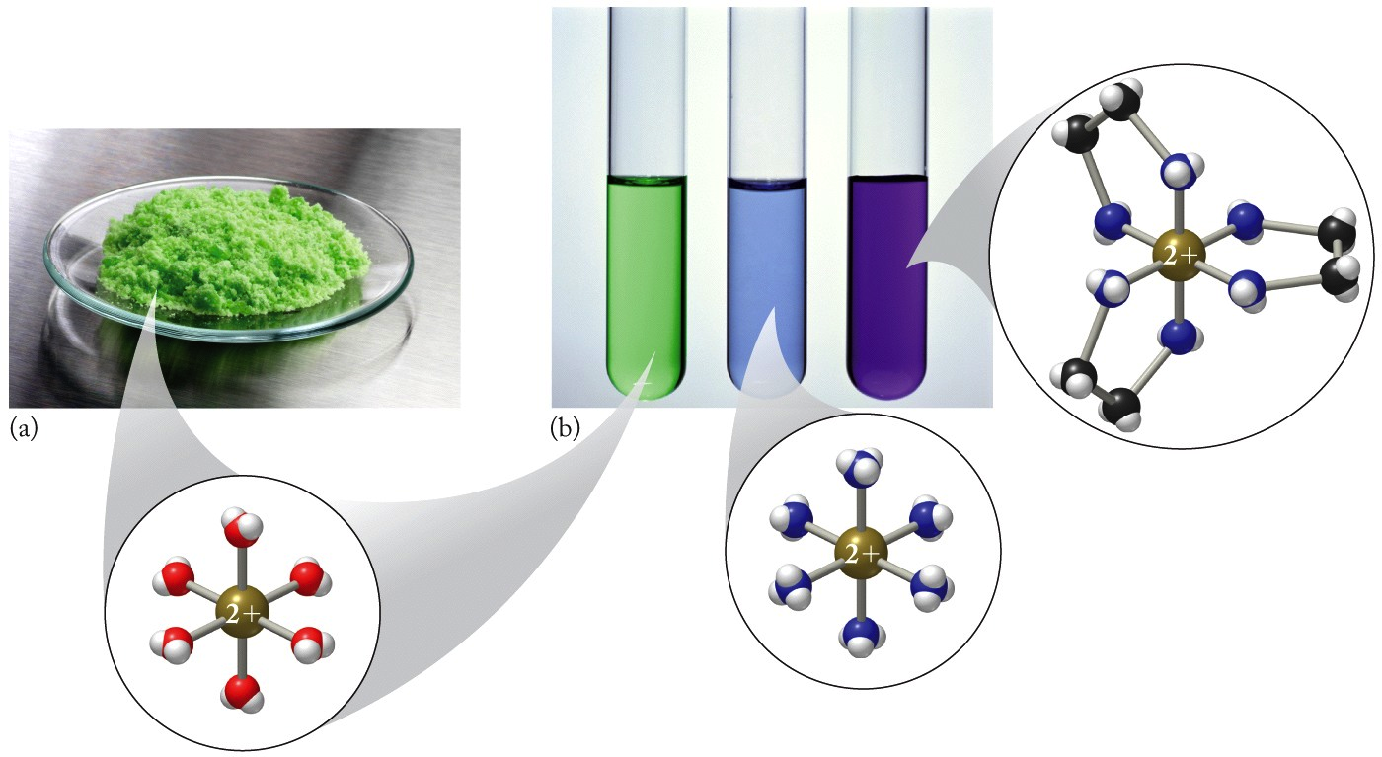
Ligand Displacement
+ NH₃
+ en
Ni(H₂O)₆²⁺
Ni(NH₃)₆²⁺
Ni(en)₃²⁺

Slide 27
Chelate Effect
Chelate Effect:
Greater affinity of metal ions for polydentate ligands than for monodentate ligands
Ni(NH₃)₆²⁺ + 3 en ⇌ Ni(en)₃²⁺ + 6 NH₃
K_{f} = 1.1 × 10¹⁸
Entropy-driven process!

Slide 28
Chapter Outline
16.1 Lewis Acids and Bases
16.2 Complex Ions
16.3 Naming Complex Ions and Coordination Compounds
16.4 Polydentate Ligands
16.5 Ligand Strength and the Chelate Effect
16.6 Crystal Field Theory
16.7 Magnetism and Spin States
16.8 Isomerism in Coordination Compounds
16.9 Complex Ions in Biomolecules
16.10 Complex-Ion Equilibria
16.11 Hydrated Metal Ions as Acids
28

Slide 29
Crystal Field Theory
Crystal Field Splitting:
Separation of a set of d orbitals into subsets with different energies as a result of interactions between electrons in those orbitals with lone pairs of electrons in ligands
Crystal Field Splitting Energy (Δ):
The difference in energy between subsets of d orbitals split by interactions in a crystal field

Slide 30
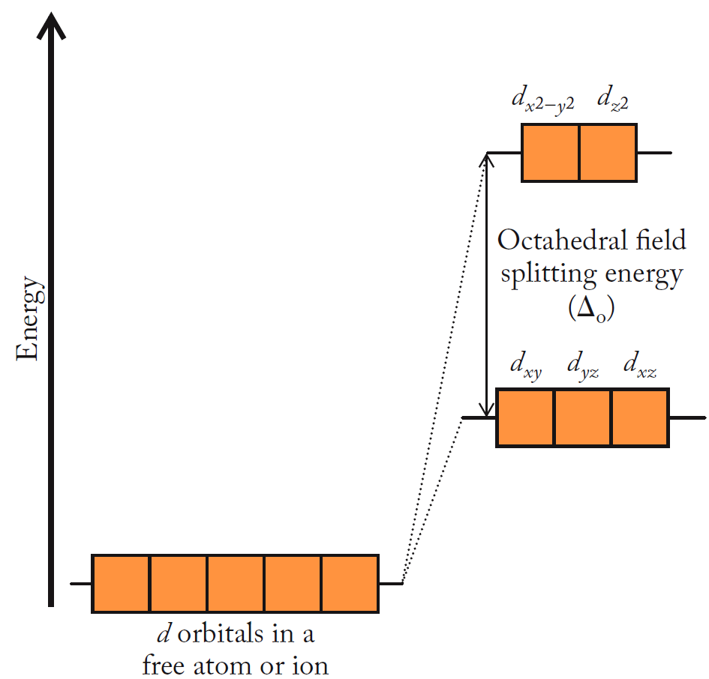
Crystal Field Splitting
Splitting of orbitals by lone pairs from ligands
Degenerate d orbitals (same energy levels)

Slide 31
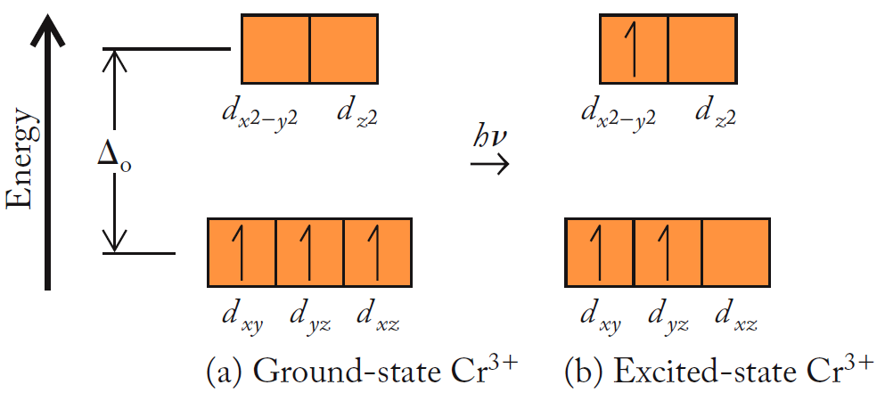
Color of Complex Ions
Absorption of photon, E = hν = ∆_{o}
Cr³⁺ : [Ar]3d³

Slide 32
Color of Complex Ions
Color Wheel:
Color observed is complementary (opposite) of color of absorbed light
Example:
absorbed = red
observed = green

Slide 33
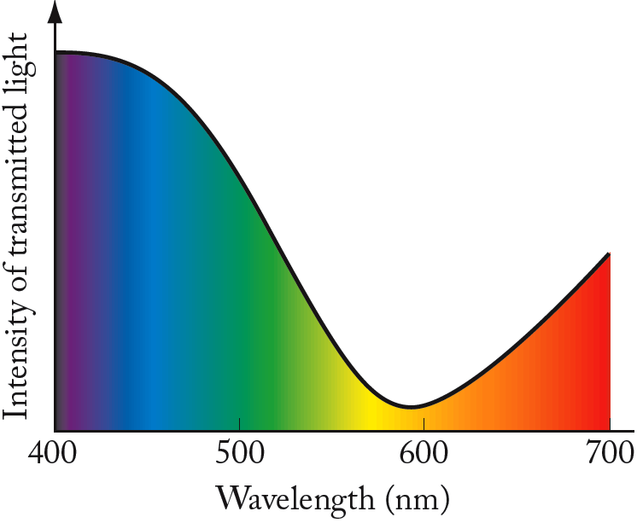
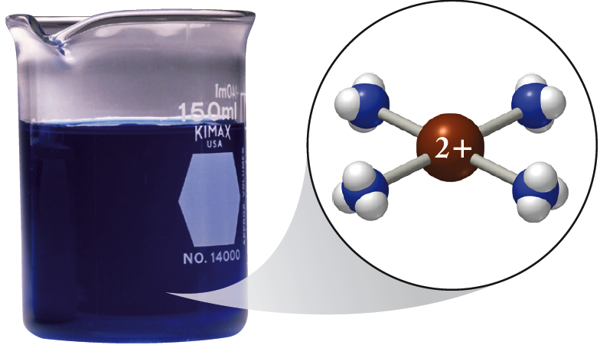
Color of Complex Ions
[Cu(NH₃)₄]²⁺:
Absorbs yellow, orange, and red…
…so observed color of complex is navy blue.

Slide 34
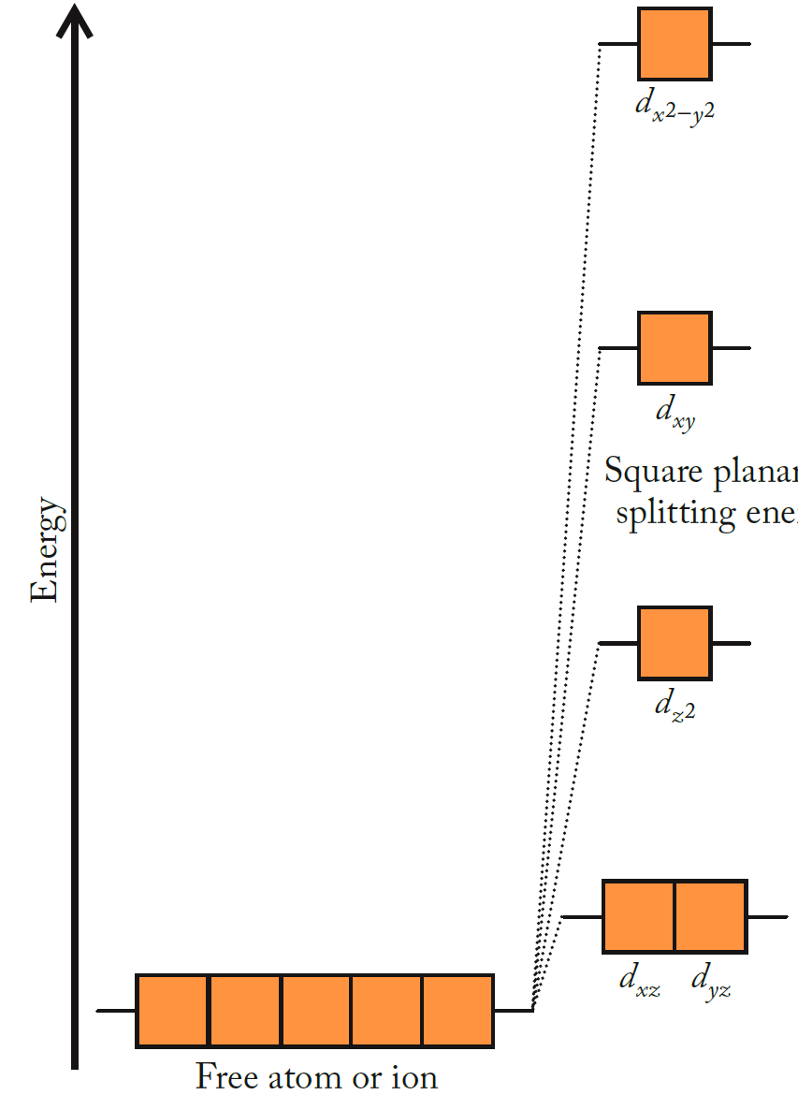
Square-Planar Splitting
Example:
Cu²⁺: [Ar] 3d⁹
[Cu(NH₃)₄]²⁺

Slide 35
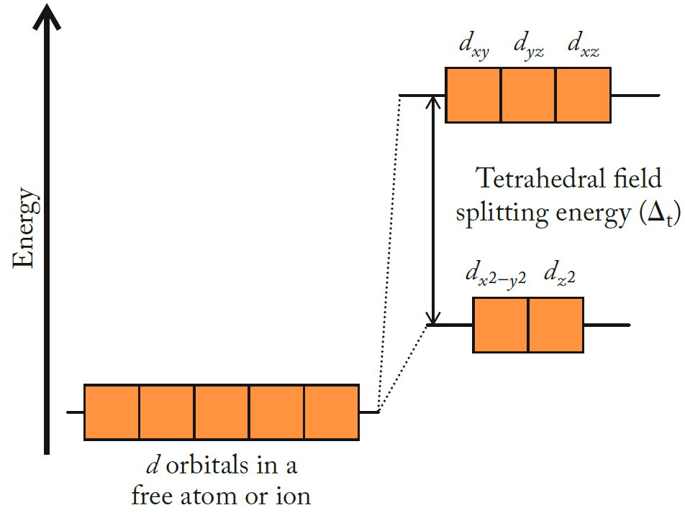
Tetrahedral Splitting
Example:
[Zn(NH₃)₄]²⁺

Slide 36
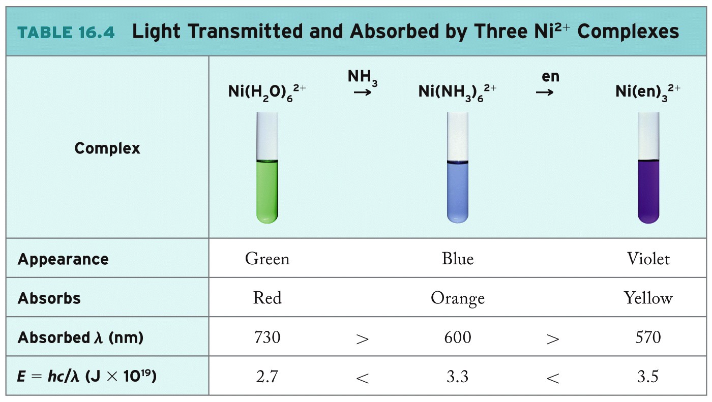
Δ_{o} increases

Slide 37
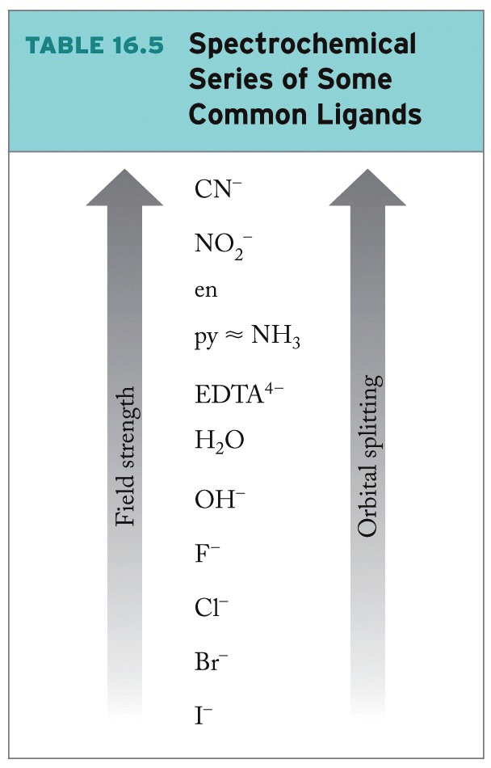
Spectrochemical Series
Spectrochemical Series:
List of ligands rank ordered by their ability to the energies of d orbitals of transition metal ions
Crystal field splitting energy (∆) increases as field strength increases.

Slide 38
Chapter Outline
16.1 Lewis Acids and Bases
16.2 Complex Ions
16.3 Naming Complex Ions and Coordination Compounds
16.4 Polydentate Ligands
16.5 Ligand Strength and the Chelate Effect
16.6 Crystal Field Theory
16.7 Magnetism and Spin States
16.8 Isomerism in Coordination Compounds
16.9 Complex Ions in Biomolecules
16.10 Complex-Ion Equilibria
16.11 Hydrated Metal Ions as Acids
38

Slide 39
Magnetic Properties
Paramagnetism:
Attraction to magnetic field; requires unpaired electrons
High-Spin State:
Low field strength = small ∆
Maximize unpaired electrons
Low-Spin State:
High field strength = large ∆
Minimize unpaired electrons

Slide 40
Magnetism and Spin States
Low field strength
High-spin Fe³⁺
High field strength
Low-spin Fe³⁺

Slide 41
Chapter Outline
16.1 Lewis Acids and Bases
16.2 Complex Ions
16.3 Naming Complex Ions and Coordination Compounds
16.4 Polydentate Ligands
16.5 Ligand Strength and the Chelate Effect
16.6 Crystal Field Theory
16.7 Magnetism and Spin States
16.8 Isomerism in Coordination Compounds
16.9 Complex Ions in Biomolecules
16.10 Complex-Ion Equilibria
16.11 Hydrated Metal Ions as Acids
41

Slide 42
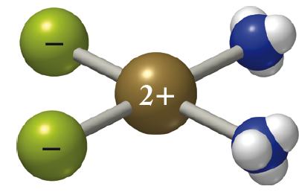
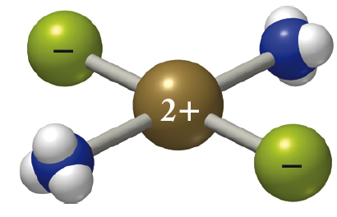
Stereoisomers of Complex Ions
Square Planar Geometric Isomers:
Pt(NH₃)₂Cl₂
cis-diamminedichloro-platinum(II)
trans-diamminedichloro-platinum(II)

Slide 43
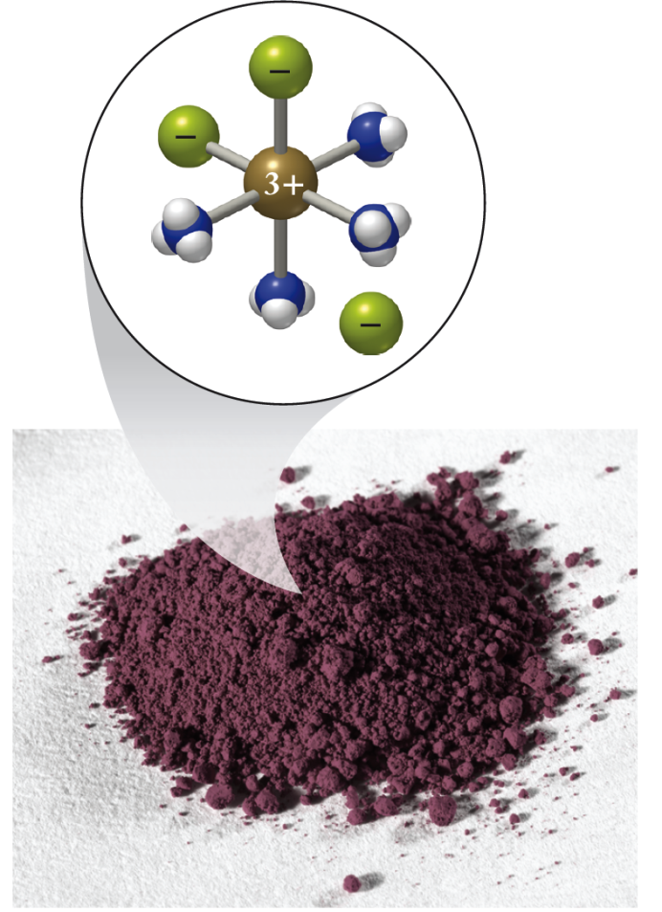
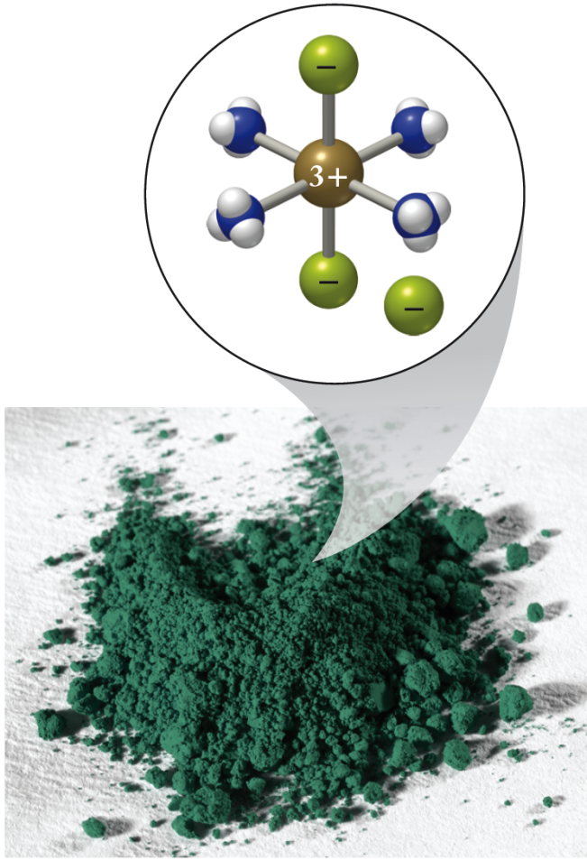
Octahedral Geometric Isomers
[Co(NH₃)₄Cl₂]Cl
(a) cis
(b) trans

Slide 44
Complex Ion Enantiomers
Enantiomers: Geometric isomers; nonsuperimposable mirror images; chiral

Slide 45
Chapter Outline
16.1 Lewis Acids and Bases
16.2 Complex Ions
16.3 Naming Complex Ions and Coordination Compounds
16.4 Polydentate Ligands
16.5 Ligand Strength and the Chelate Effect
16.6 Crystal Field Theory
16.7 Magnetism and Spin States
16.8 Isomerism in Coordination Compounds
16.9 Complex Ions in Biomolecules
16.10 Complex-Ion Equilibria
16.11 Hydrated Metal Ions as Acids
45

Slide 46
Macrocyclic Ligands
Chlorins/Porphyrins:
Tetradentate macrocyclic ligands important in living systems
Function/properties depend on central metal cation.

Slide 47
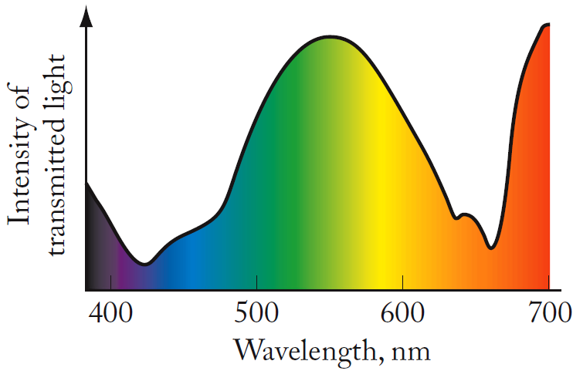
Metal Complexes in Biomolecules
Chlorophyll a structure and transmittance spectra

Slide 48
Heme: Component of Hemoglobin

Slide 49
Cytochrome Protein
Heme Group:
Fe³⁺ + e⁻ ⇄ Fe²⁺

Slide 50
Chapter Outline
16.1 Lewis Acids and Bases
16.2 Complex Ions
16.3 Naming Complex Ions and Coordination Compounds
16.4 Polydentate Ligands
16.5 Ligand Strength and the Chelate Effect
16.6 Crystal Field Theory
16.7 Magnetism and Spin States
16.8 Isomerism in Coordination Compounds
16.9 Complex Ions in Biomolecules
16.10 Complex-Ion Equilibria
16.11 Hydrated Metal Ions as Acids
50

Slide 51
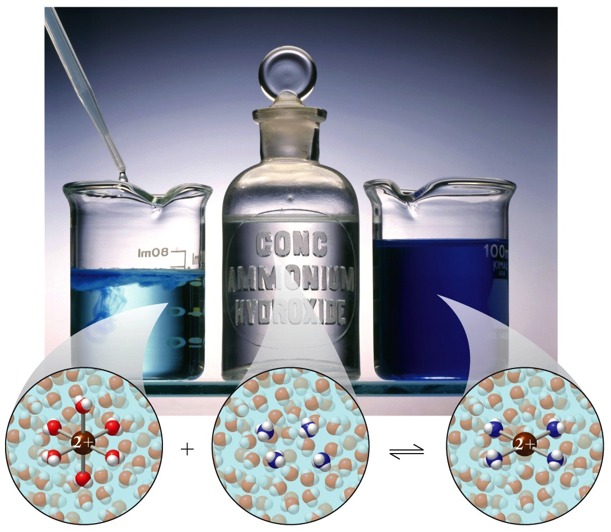
Complex-Ion Equilibria
Cu²⁺(aq) + 4NH₃(aq) ⇌ Cu(NH₃)₄²⁺(aq)

Slide 52
Chapter Outline
16.1 Lewis Acids and Bases
16.2 Complex Ions
16.3 Naming Complex Ions and Coordination Compounds
16.4 Polydentate Ligands
16.5 Ligand Strength and the Chelate Effect
16.6 Crystal Field Theory
16.7 Magnetism and Spin States
16.8 Isomerism in Coordination Compounds
16.9 Complex Ions in Biomolecules
16.10 Complex-Ion Equilibria
16.11 Hydrated Metal Ions as Acids
52

Slide 53
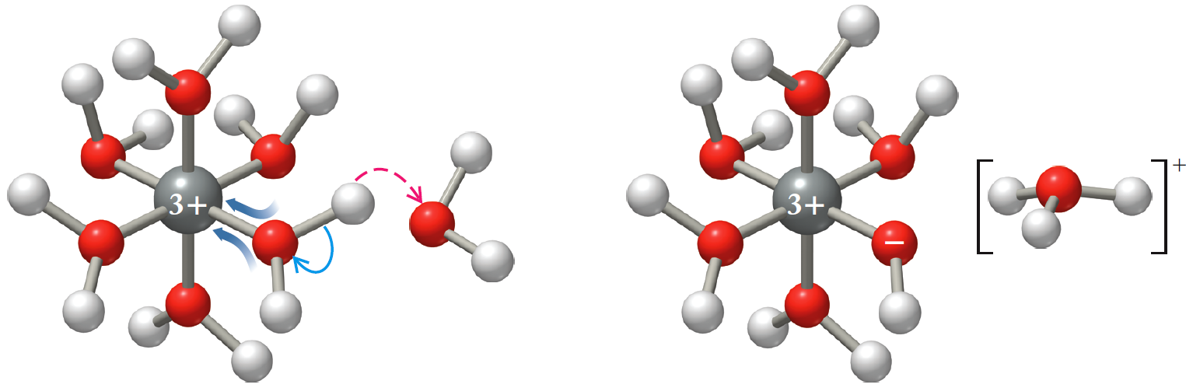
Hydrated Metal Ions as Acids
Aqua ligand ionizes, releasing H⁺ in solution
M(H₂O)₆^{n+}(aq) + H₂O(ℓ) ⇌ M(H₂O)₅(OH)^{n-1}(aq) + H₃O⁺(aq)
Fe(H₂O)₆³⁺ + H₂O ⇄ Fe(H₂O)₅(OH)²⁺ + H₃O⁺

Slide 54
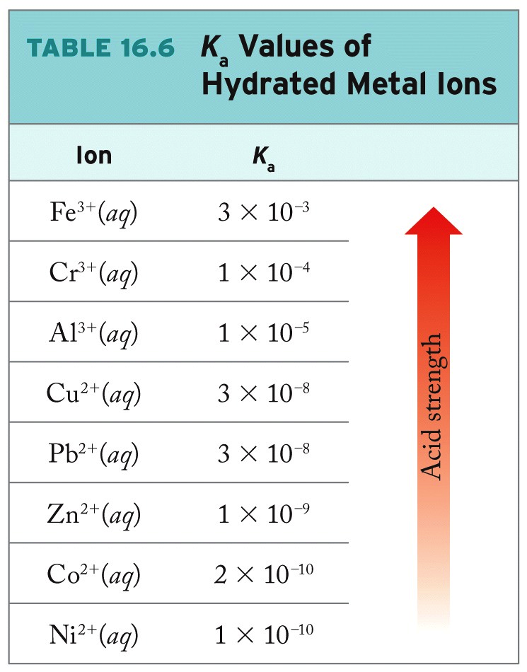
Note: Acid strength increases with cation charge.

Slide 55
Solubilities of Hydrated Complex Ions
Most transition metal cations form insoluble hydroxides:
Fe(OH)₃(s) ⇌ Fe³⁺(aq) + 3OH⁻(aq) K_{sp}= 1.1 × 10⁻³⁶
Al(OH)₃(s) ⇌ Al³⁺(s) + 3OH⁻(aq) K_{sp} = 1.9 × 10⁻³³
For some, solubility increases in strongly basic solution:
Al(H₂O)₃(OH)₃(s)+ OH⁻(aq) ⇌ Al(H₂O)₂(OH)₄⁻(aq)
Similar behavior observed for Sn(II), Sn(IV), Cr(III)

Slide 56
ChemTours: Chapter 16
Click here to launch the ChemTours website

Slide 57
This concludes the Lecture PowerPoint presentation for Chapter 16

