Slide 1
15
Aqueous Equilibrium
Chemistry of the Water World

Slide 2
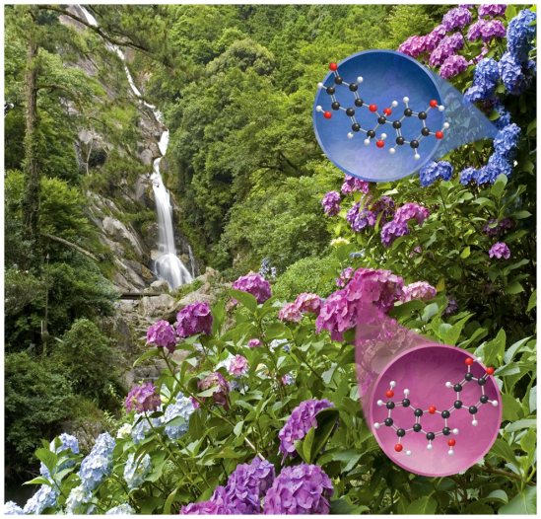
Chapter Outline
15.1 Acids and Bases: The BrØnsted–Lowry Model
15.2 Acid Strength and Molecular Structure
15.3 pH and the Autoionization of Water
15.4 Calculations Involving pH, K_{a}, and K_{b}
15.5 Polyprotic Acids
15.6 pH of Salt Solutions
15.7 The Common-Ion Effect
15.8 pH Buffers
15.9 pH Indicators and Acid–Base Titrations
15.10 Solubility Equilibria

Slide 3
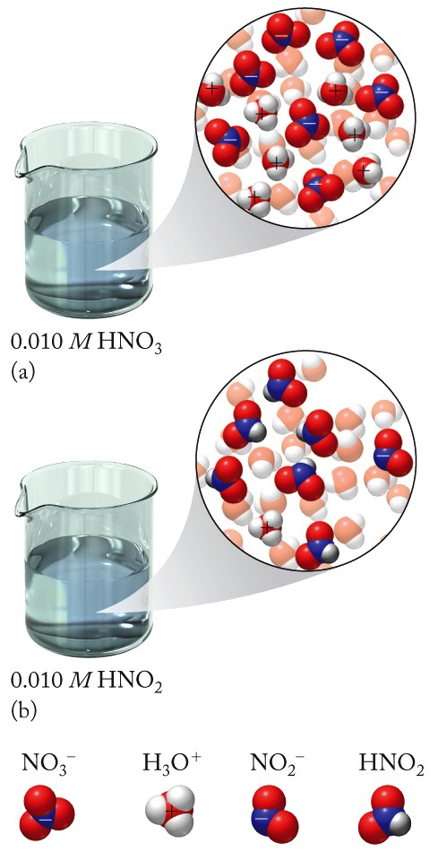
Strong and Weak Acids
Strong Acid: Completely ionized
HNO₃(aq) + H₂O(ℓ) → NO₃⁻(aq) + H₃O⁺(aq)
(H⁺ donor) (H⁺ acceptor)
Weak Acid: Partially ionized
HNO₂(aq) + H₂O(ℓ) ⇌ NO₂⁻(aq) + H₃O⁺(aq)
(H⁺ donor) (H⁺ acceptor)

Slide 6
Weak Acids
Weak Acids: Equilibrium between acid (on left) and ions (on right)
HA(aq) + H₂O(ℓ) ⇌ A⁻(aq) + H₃O⁺(aq)
Strong Acids: K_{a} >>1
Weak Acids: K_{a} < 1

Slide 7
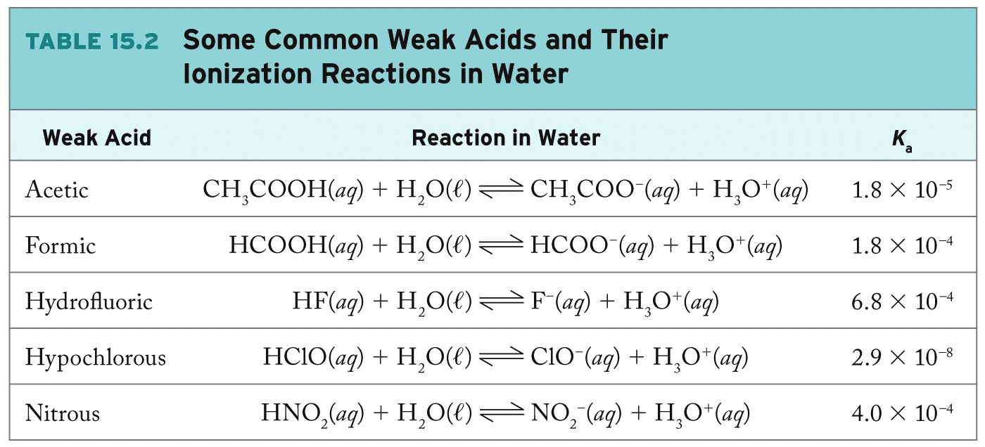
Weak Acids

Slide 8
Brønsted–Lowry Model
Brønsted–Lowry acid: H⁺ ion donor
Brønsted–Lowry base: H⁺ ion acceptor

Slide 9
Conjugate Acid–Base Pairs
Conjugate acid–base pairs:
Differ from each other only by the presence or absence of a proton (H⁺)
Acid donates H⁺ to form base
HNO₂ (aq) + H₂O(ℓ) ⇌ H₃O⁺(aq) + NO₂⁻(aq)
Base accepts H⁺ to form acid

Slide 10
Strong and Weak Bases
Strong Bases: Completely dissociate in solution
Example: Oxides/hydroxides of Groups 1, 2
Weak Bases: Do not completely dissociate in solution
Example: Nitrogen-containing compounds
NH₃(aq) + H₂O(ℓ) ⇌ NH₄⁺(aq) + OH⁻(aq)
(base) (conjugate acid)

Slide 11
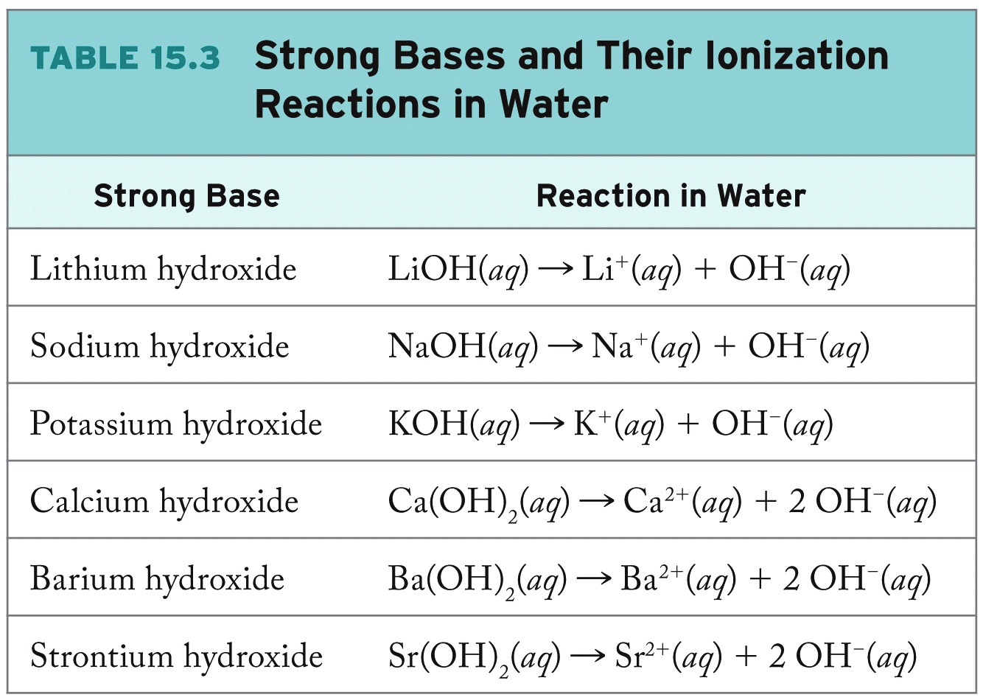

Slide 12
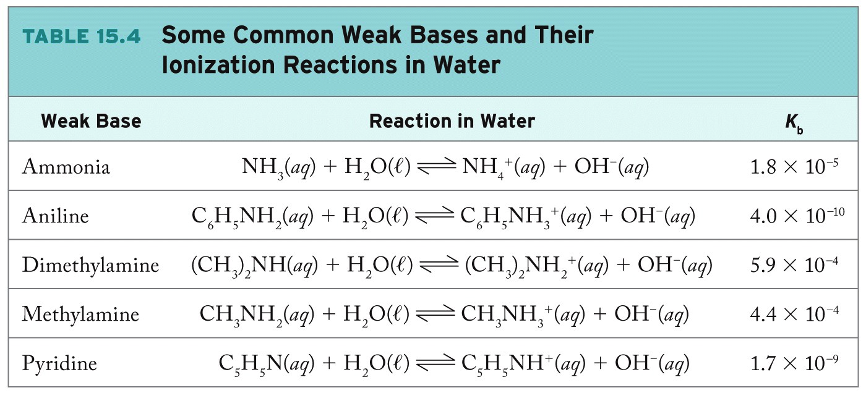
Weak Bases

Slide 13
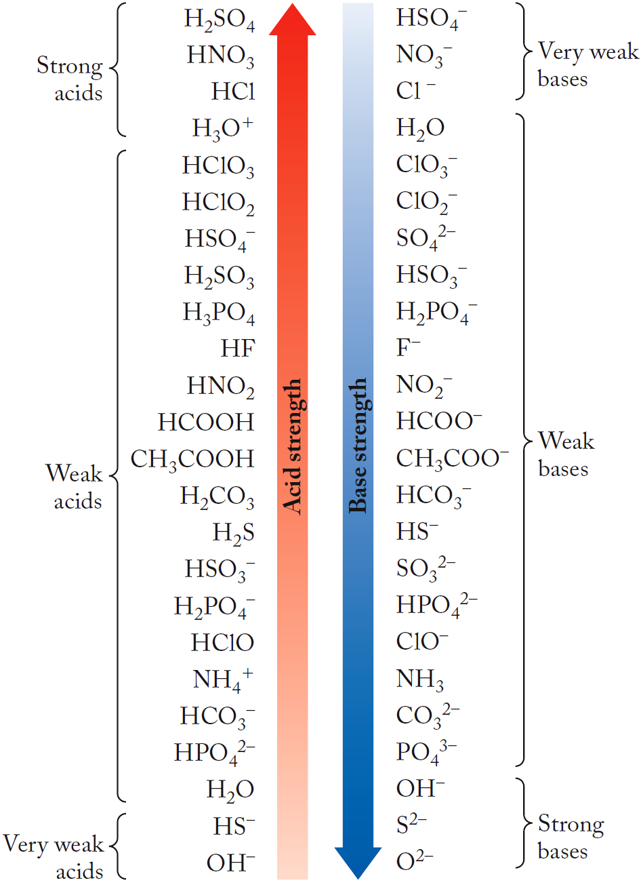
Relative Strengths of Acids/Bases
Leveling Effect:
- H₃O⁺ is the strongest H⁺ donor that can exist in water.
- Strong acids all have the same strength in water; they are completely converted into H₃O⁺ ions.

Slide 14
Chapter Outline
15.1 Acids and Bases: The BrØnsted–Lowry Model
15.2 Acid Strength and Molecular Structure
15.3 pH and the Autoionization of Water
15.4 Calculations Involving pH, K_{a}, and K_{b}
15.5 Polyprotic Acids
15.6 pH of Salt Solutions
15.7 The Common-Ion Effect
15.8 pH Buffers
15.9 pH Indicators and Acid–Base Titrations
15.10 Solubility Equilibria

Slide 15
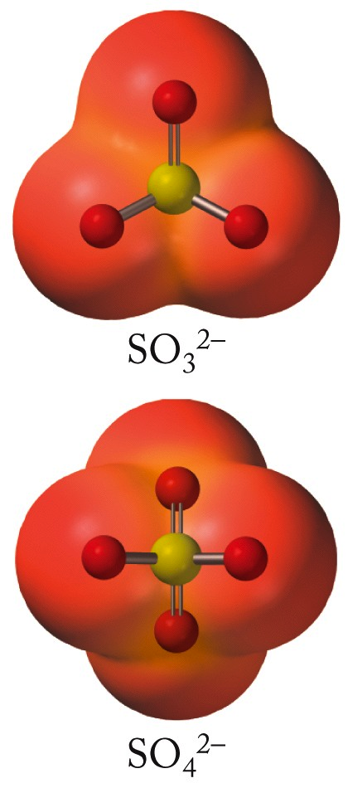
Factors Affecting Acid Strength
Greater number of oxygen atoms in anion provides greater stability due to delocalization of the negative charge over more electronegative atoms

Slide 16
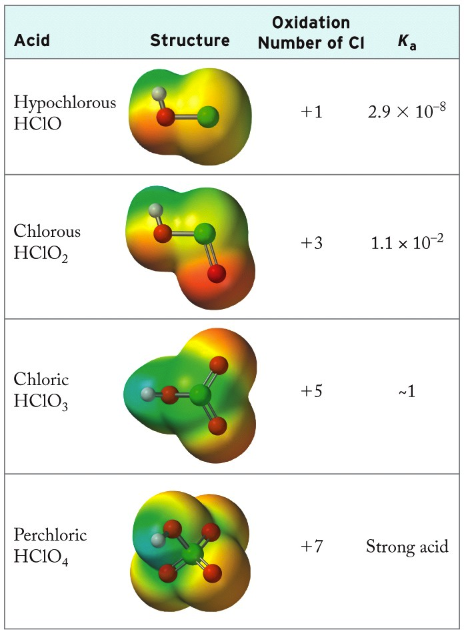
Factors Affecting Acid Strength
Oxidation Number:
The greater the number of oxygen atoms, the stronger the acid

Slide 17
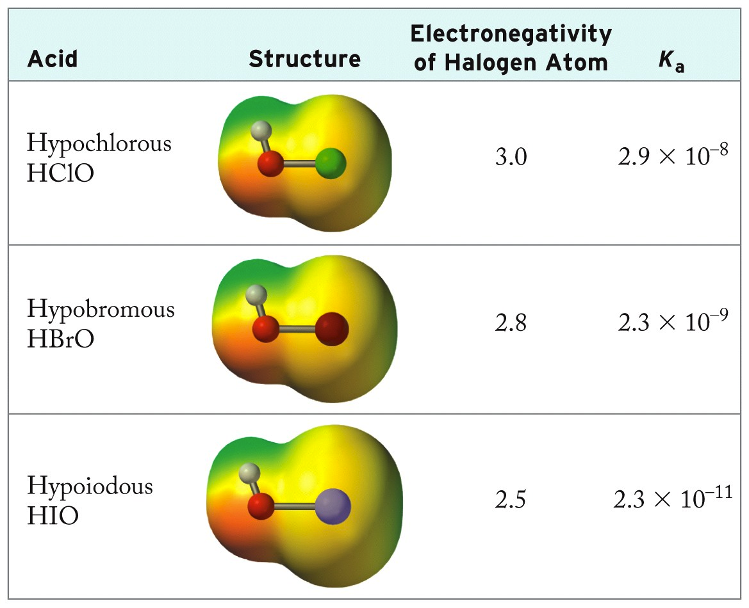
Electronegativity and Acid Strength
Electronegativity / Acid Strength

Slide 18
Chapter Outline
15.1 Acids and Bases: The BrØnsted–Lowry Model
15.2 Acid Strength and Molecular Structure
15.3 pH and the Autoionization of Water
15.4 Calculations Involving pH, K_{a}, and K_{b}
15.5 Polyprotic Acids
15.6 pH of Salt Solutions
15.7 The Common-Ion Effect
15.8 pH Buffers
15.9 pH Indicators and Acid–Base Titrations
15.10 Solubility Equilibria

Slide 19
Autoionization of Water
In absence of other acids or bases at 298 K: [H₃O⁺] = [OH⁻] = 1 × 10⁻⁷ M

Slide 20
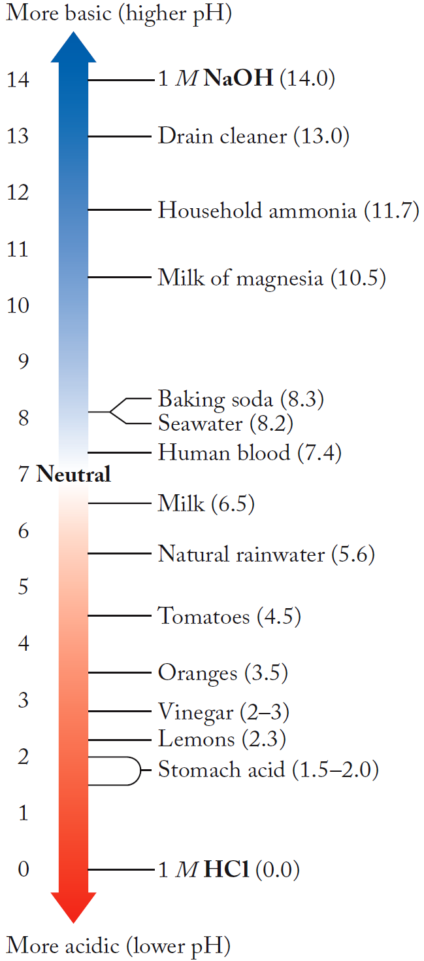
The pH Scale
pH = -log[H⁺]
pOH = -log[OH⁻]
Log form of K_{w}:
-log(K_{w})= -log([H⁺] [OH⁻])
14.00 = pH + pOH

Slide 21
Practice: pH and pOH
What are the [H⁺] and [OH⁻] in household ammonia, an aqueous solution that has a pH of 11.70?
Collect and Organize:
Analyze:
Solve:
Think about It:

Slide 22
Chapter Outline
15.1 Acids and Bases: The BrØnsted–Lowry Model
15.2 Acid Strength and Molecular Structure
15.3 pH and the Autoionization of Water
15.4 Calculations Involving pH, K_{a}, and K_{b}
15.5 Polyprotic Acids
15.6 pH of Salt Solutions
15.7 The Common-Ion Effect
15.8 pH Buffers
15.9 pH Indicators and Acid–Base Titrations
15.10 Solubility Equilibria

Slide 23
Weak Acids
HNO₂(aq) + H₂O(ℓ) ⇌ H₃O⁺(aq) + NO₂⁻(aq)
Using K_{a} equation:
- If pH is known, can calculate K_{a}
- If K_{a} is known, solve equilibrium problem to calculate [H⁺] and pH (see Chapter 14)

Slide 24
Practice: pH of Strong/Weak Acids
Calculate and compare [H⁺] and pH for a 0.100 M solution of HClO₄ and a 0.100 M solution of HClO (K_{a} = 2.9 × 10⁻⁸).
Collect and Organize:
Analyze:
Solve:
Think about It:

Slide 25
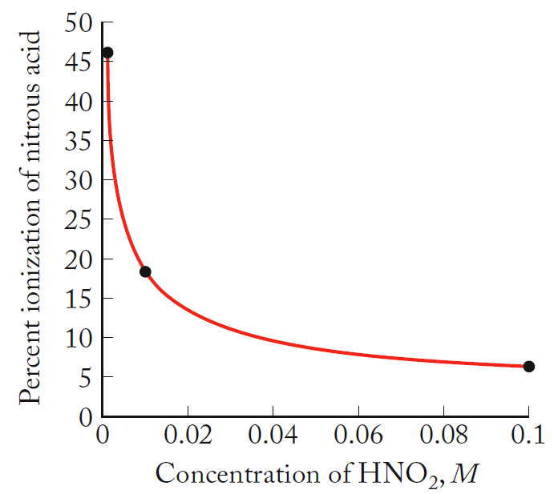
Percent Ionization
Degree of Ionization:
Percent Ionization: Degree of ionization expressed as a percentage
% ionization decreases as [acid]_{o} increases

Slide 26
Practice: Percent Ionization
Calculate the percent ionization for 1.28 M HNO₂ and 0.0150 M HNO₂ solutions.
K_{a} = 4.0 × 10⁻⁴
Collect and Organize:
Analyze:
Solve:
Think about It:

Slide 27
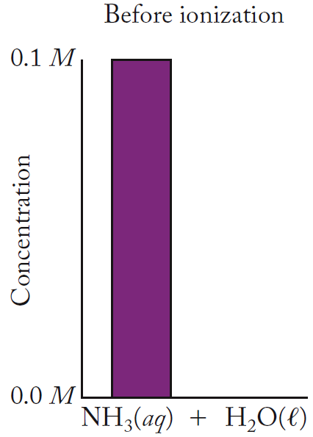
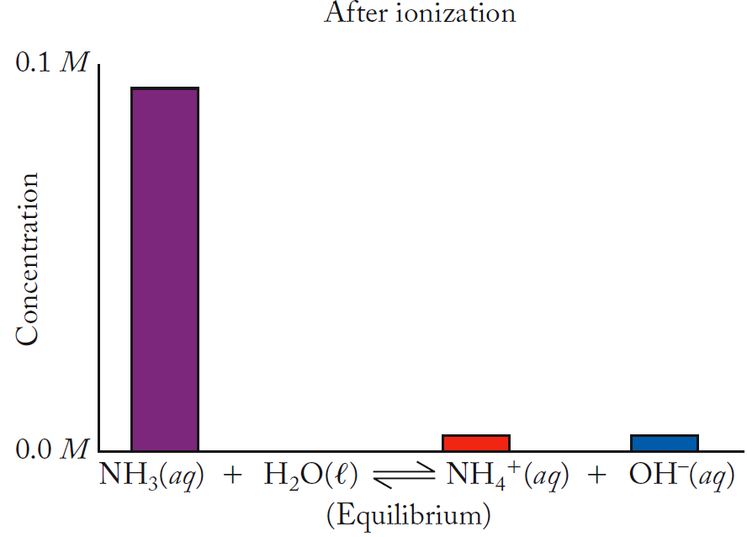
Weak Bases

Slide 28
Weak Base Equilibrium
NH₃(aq) + H₂O(ℓ) ⇌ NH₄⁺(aq) + OH⁻(aq)
To calculate pH: Obtain [OH⁻] at equilibrium, use K_{w} relationship.

Slide 29
Practice: Strong vs. Weak Bases
Calculate and contrast [OH⁻] in 0.200 M LiOH and 0.200 M NH₃ (K_{b} = 1.76 × 10⁻⁵).
Collect and Organize:
Analyze:
Solve:
Think about It:

Slide 30
pH of Very Dilute Solutions
pH of 1.0 × 10⁻⁸ M HCl = ?
Must consider two sources of [H⁺]:
HCl and autoionization of water
H₂O(ℓ) + H₂O(ℓ) ⇌ H₃O⁺(aq) + OH⁻(aq)
(1.0 x 10⁻⁸ + x) (x)
[H⁺] = 1.05 × 10⁻⁷ M pH = 6.98
(cannot approximate; must solve quadratic equation!)

Slide 31
Chapter Outline
15.1 Acids and Bases: The BrØnsted–Lowry Model
15.2 Acid Strength and Molecular Structure
15.3 pH and the Autoionization of Water
15.4 Calculations Involving pH, K_{a}, and K_{b}
15.5 Polyprotic Acids
15.6 pH of Salt Solutions
15.7 The Common-Ion Effect
15.8 pH Buffers
15.9 pH Indicators and Acid–Base Titrations
15.10 Solubility Equilibria

Slide 32
Polyprotic Acids
Polyprotic Acid: Has more than one ionizable H atom / molecule
Example: Acid precipitation
SO₃(g) + H₂O(ℓ) → H₂SO₄(aq)
H₂SO₄(aq) → H⁺(aq) + HSO₄⁻(aq) K_{a1} = large!
HSO₄⁻(aq) ⇌ H⁺(aq) + SO₄²⁻(aq) K_{a2} = 1.2×10⁻²
pH of a 0.100 M H₂SO₄ solution:
[H+] = 0.100 M + 0.00985 M
(from 1st reaction + 2nd reaction)
[H⁺] = 0.110 M; pH = 0.96

Slide 33
Acidification of the Oceans

Slide 34
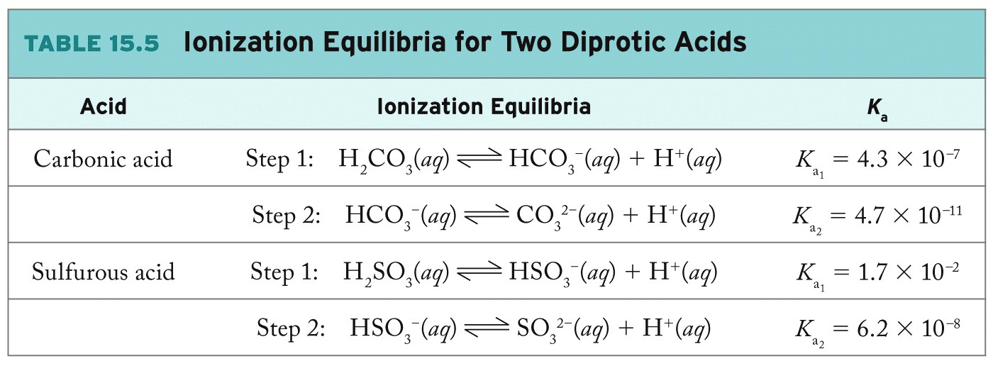
Diprotic Acids
K_{a1} > K_{a2} (more difficult to remove H⁺ ion from negatively charged anion)
Typically only first H⁺ affects pH (K_{a1})

Slide 35
Practice: pH of Diprotic Acid
Calculate the pH of 0.100 M carbonic acid solution (K_{a1} = 4.3 × 10⁻⁷ and K_{a2} = 4.7 × 10⁻¹¹).
Collect and Organize:
Analyze:
Solve:
Think about It:

Slide 36
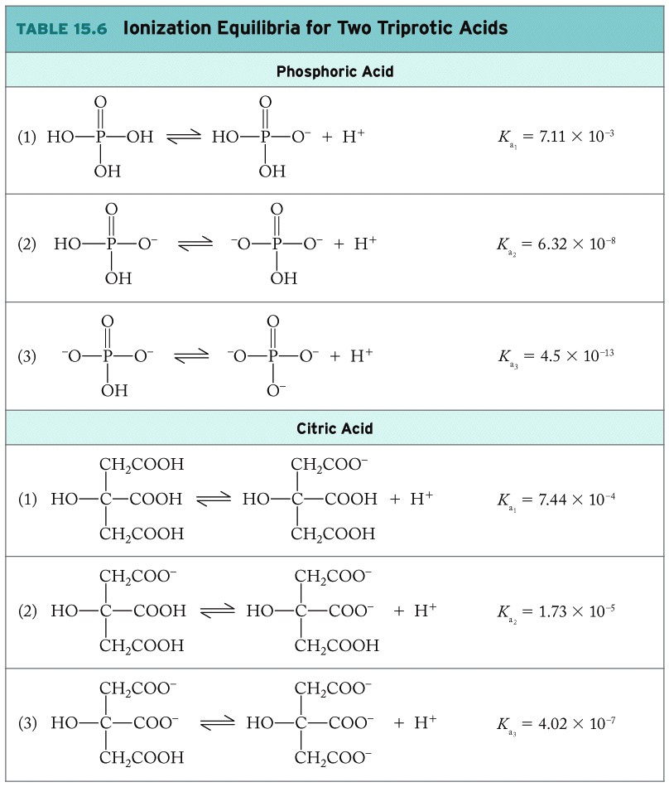
Triprotic Acids: Phosphoric Acid

Slide 37
Triprotic Acids: Citric Acid

Slide 38
Chapter Outline
15.1 Acids and Bases: The BrØnsted–Lowry Model
15.2 Acid Strength and Molecular Structure
15.3 pH and the Autoionization of Water
15.4 Calculations Involving pH, K_{a}, and K_{b}
15.5 Polyprotic Acids
15.6 pH of Salt Solutions
15.7 The Common-Ion Effect
15.8 pH Buffers
15.9 pH Indicators and Acid–Base Titrations
15.10 Solubility Equilibria

Slide 39
Acid–Base Properties of Salts
Weak Acid:
HF(aq) + H₂O(l) ⇌ F⁻(aq) + H₃O⁺(aq)
(acid) (conj. base)
Salt, NaF:
NaF(s) Na⁺(aq) + F⁻(aq)
F⁻(aq) + H₂O(l) ⇌ HF(aq) + OH⁻(aq)
(base) (conj. acid)
F⁻ is a base!

Slide 40
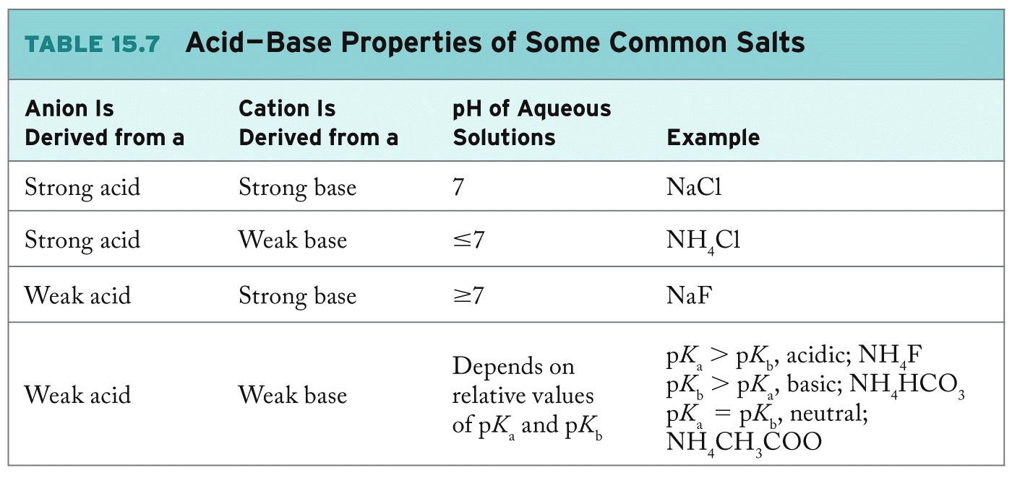
Acid–Base Properties of Salts

Slide 41
pH of Salt Solutions: Na₂CO₃(aq)
Write balanced equilibrium equation for basic anion or acidic cation.
CO₃²⁻(aq) + H₂O(ℓ) ⇌ HCO₃⁻(aq) + OH⁻(aq)
Determine K for equilibrium (in this case, K_{b1}).
Solve equilibrium problem for [H⁺], [OH⁻].

Slide 42
Relationship between K_{a} and K_{b}
HA(aq) + H₂O ⇌ H₃O⁺(aq) + A⁻(aq) K_{a}
A⁻(aq) + H₂O ⇌ OH⁻(aq) + HA(aq) K_{b}
H₂O(ℓ) + H₂O(ℓ) ⇌ H₃O⁺⁽aq) + OH⁻(aq) K_{w}
K_{w} = K_{a}· K_{b}
Notes:
Note: Animation – add arrows to show how species cancel

Slide 43
Practice: pH of Basic Salt
Calculate the pH of a 0.575 M of sodium acetate.
Collect and Organize:
Analyze:
Solve:
Think about It:

Slide 44
Chapter Outline
15.1 Acids and Bases: The BrØnsted–Lowry Model
15.2 Acid Strength and Molecular Structure
15.3 pH and the Autoionization of Water
15.4 Calculations Involving pH, K_{a}, and K_{b}
15.5 Polyprotic Acids
15.6 pH of Salt Solutions
15.7 The Common-Ion Effect
15.8 pH Buffers
15.9 pH Indicators and Acid–Base Titrations
15.10 Solubility Equilibria

Slide 45
Common-Ion Effect
Common-Ion Effect:
Shift in position of an equilibrium caused by the addition of an ion taking part in the reaction
Example:
H₂CO₃ (aq) ⇌ H⁺(aq) + HCO₃⁻(aq)
Adding NaHCO₃:
Presence of HCO₃⁻(aq) would shift carbonic acid equilibrium to the left, decrease ionization

Slide 46
Example: Common-Ion Effect Calculations
What is the pH of solution containing
1.2 × 10⁻⁵ M H₂CO₃ and 1.0 × 10⁻⁴ M HCO₃⁻?
Common ion taken into account in the Initial line of RICE table
Approximation of binomials in equilibrium concentrations
Substitute in equilibrium constant expression
X = [H₃O⁺] = 5.2 × 10⁻⁷ M pH = 7.29

Slide 47
Henderson–Hasselbalch Equation
Weak acid equilibrium:
HA(aq) + H₂O(ℓ) ⇌ H₃O⁺(aq) + A⁻(aq)
Log form of K_{a}:

Slide 48
Practice: Common-Ion Effect
Calculate the pH of a solution containing 0.22 M acetic acid and 0.13 M sodium acetate. (K_{a} of acetic acid = 1.8 × 10⁻⁵)
Collect and Organize:
Analyze:
Solve:
Think about It:

Slide 49
Chapter Outline
15.1 Acids and Bases: The BrØnsted–Lowry Model
15.2 Acid Strength and Molecular Structure
15.3 pH and the Autoionization of Water
15.4 Calculations Involving pH, K_{a}, and K_{b}
15.5 Polyprotic Acids
15.6 pH of Salt Solutions
15.7 The Common-Ion Effect
15.8 pH Buffers
15.9 pH Indicators and Acid–Base Titrations
15.10 Solubility Equilibria

Slide 50
pH Buffers
Buffer: Solution that resists changes in pH when acids or bases are added to it
Typically contains a weak acid or base and its conjugate partner (HA and A-)
HA(aq) + H₂O(ℓ) ⇌ H₃O⁺(aq) + A⁻(aq)
The weak acid (HA) reacts with added base
HA + OH⁻ ⇌ H₂O + A⁻
The weak base (A⁻) reacts with added acid
A⁻ + H₃O⁺ ⇌ HA + H₂O
50
Notes:
2
2

Slide 51
An Environmental Buffer
Presence of carbonate in rivers, lakes protects natural waters from acid rain
H₂CO₃(aq) ⇌ HCO₃⁻(aq) + H⁺(aq) pK_{a1} = 6.37
Acids present in acid rain (HNO_{x}, H₂SO_{x}) are neutralized by bicarbonate (HCO₃⁻):
HCO₃⁻(aq) + H⁺(aq) ⇌ H₂CO₃(aq)
1.0 L pure water + 10 mL 10⁻³ M HNO₃
pH = 5.00
1.0 L HCO₃⁻ buffer + 10 mL 10⁻³ M HNO₃
pH = 7.24

Slide 52
Physiological Buffer
pH of blood ~ 7.4
Must be maintained in narrow range for optimal health
CO₂(aq) + H₂O(ℓ) ⇌ H₂CO₃(aq) ⇌ HCO₃⁻(aq) + H⁺(aq)
Too much CO₂(aq): Reaction shifts right, pH decreases, acidosis
Decrease in blood CO₂ (i.e., hyperventilation): reaction shifts left, pH increases, alkalosis.

Slide 53
Buffer Range and Capacity
Buffer Range:
pH range within which a given buffer can provide pH protection
Buffer range = pK_{a} ± 1;
Buffer Capacity:
Quantity of acid / base that a buffer can neutralize while maintaining pH within desired range
∝ component concentrations

Slide 54
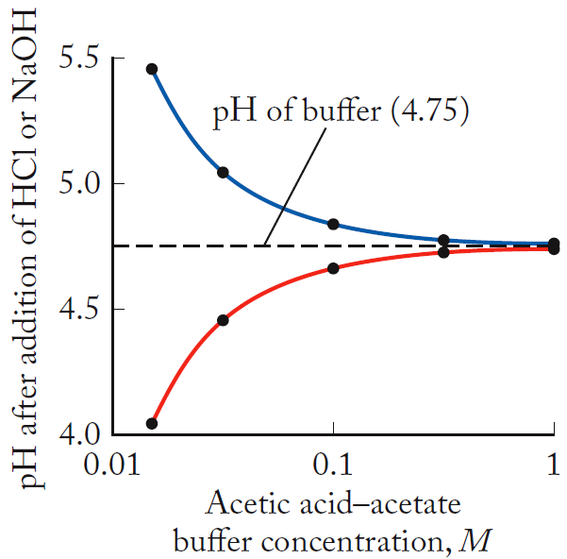
pH Change of Buffer vs. Buffer Concentration
Addition of strong base
The greater the initial concentrations of HA and A⁻, the less the change in pH as acid or base is added to the buffer solution.
Addition of strong acid

Slide 55
Practice: Preparation of Buffer
Determine the number of moles of sodium acetate that must be added to 250.0 mL of 0.16 M acetic acid to prepare a pH 4.70 buffer (K_{a} = 1.76 × 10⁻⁵).
Collect and Organize:
Analyze:
Solve:
Think about It:

Slide 56
Chapter Outline
15.1 Acids and Bases: The BrØnsted–Lowry Model
15.2 Acid Strength and Molecular Structure
15.3 pH and the Autoionization of Water
15.4 Calculations Involving pH, K_{a}, and K_{b}
15.5 Polyprotic Acids
15.6 pH of Salt Solutions
15.7 The Common-Ion Effect
15.8 pH Buffers
15.9 pH Indicators and Acid–Base Titrations
15.10 Solubility Equilibria

Slide 57
pH Indicators
pH Indicator:
Water-soluble, weak organic acid that changes color as pH changes
Example, phenol red (pK_{a} = 8.6):
HIn(aq) + H₂O(ℓ) ⇌ H₃O⁺(aq) + In⁻(aq)
(yellow) (red)
pH = pK_{a} + log ([In⁻]/[HIn])
pH = 8.6 ± 1.0 (pH range of color change)
57

Slide 58
pH Indicators

Slide 59
pH Titrations
Steps in Titration:
Accurately transfer known volume of sample to flask or beaker
Add a few drops of indicator or insert probe of pH meter
Fill buret with solution of known concentration (titrant) to react with solute sample (analyte)
Slowly add titrant until reaction is complete (equivalence point)

Slide 60
pH Titrations
Strong Acid–Strong Base:
HCl(aq) + NaOH(aq) ⇌ H₂O(ℓ) + NaCl(aq)
At equivalence point, M_{a}·V_{a} = M_{b}·V_{b}:
Moles acid added = moles base in sample
NaCl = neutral salt; pH = 7.00
Strong Acid–Weak Base:
HCl(aq) + NH₃(aq) ⇌ H₂O(ℓ) + NH₄Cl(aq)
At equivalence point: NH₄⁺ = acid; pH < 7.00
Midpoint:

Slide 61
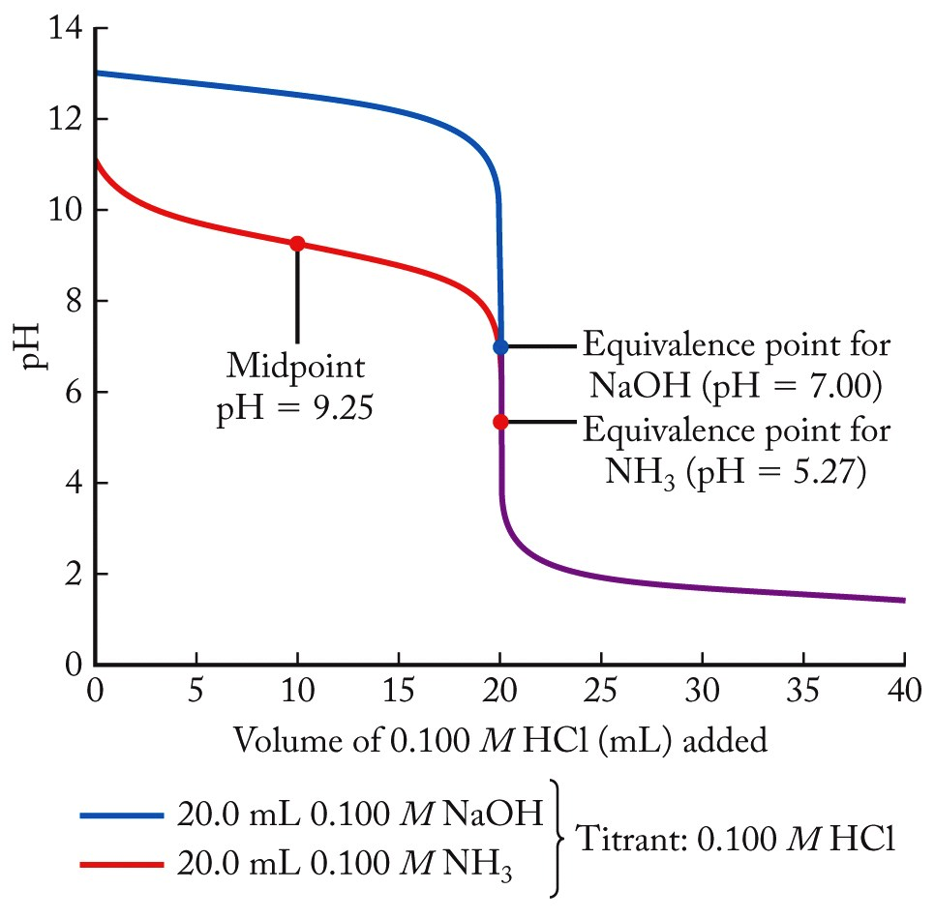
Titration Curves for NH₃ and NaOH
61

Slide 62
Titration Curves for NH₃ and NaOH
Weak Acid–Strong Base:
CH₃COOH(aq) + NaOH(aq) ⇌ H₂O(ℓ) + CH₃COONa(aq)
At equivalence point:
CH₃COONa = basic salt; pH > 7.00
Weak Acid–Base Titrations:
Midpoint in titration: [HA] = [A⁻]

Slide 63
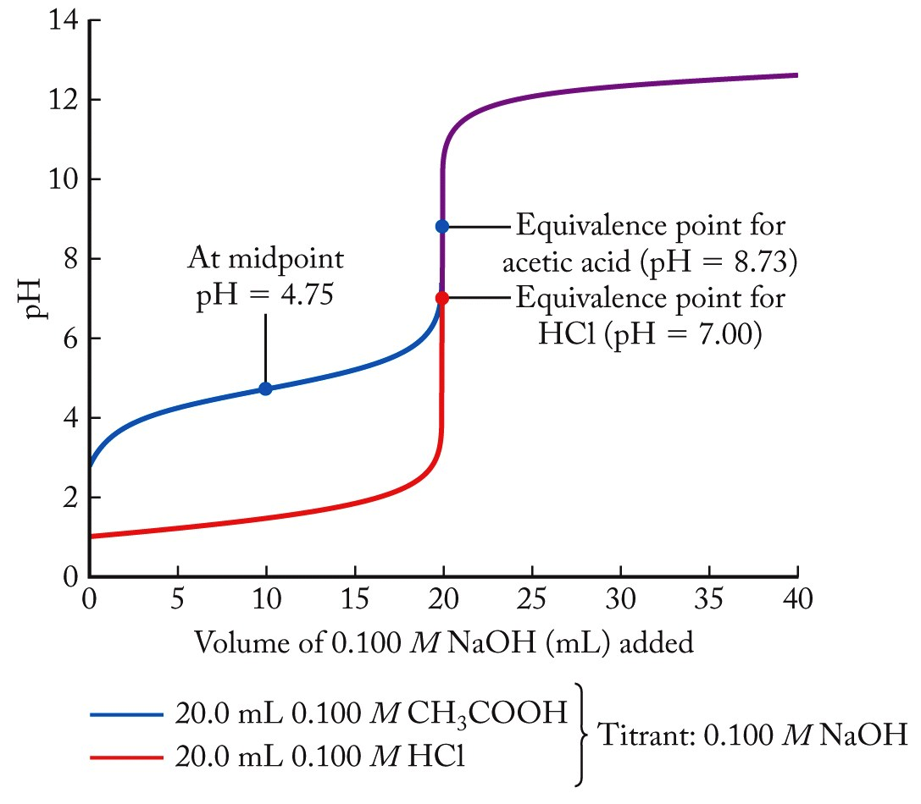
Titration Curves: CH₃COOH, HCl
CH₃COO⁻Na⁺; pH = 8.73
At midpoint
pH = pK_{a} = 4.75
Equivalence point for acetic acid
Equivalence point for HCl
NaCl; pH = 7.00
63

Slide 64
Practice: pH Titration
A 40.0 mL solution of 0.100 M sodium hypochlorite is titrated with a 0.100 M HCl solution. Select an appropriate indicator to detect the equivalence point in this titration.
Collect and Organize:
Analyze:
Solve:
Think about It:
64

Slide 65
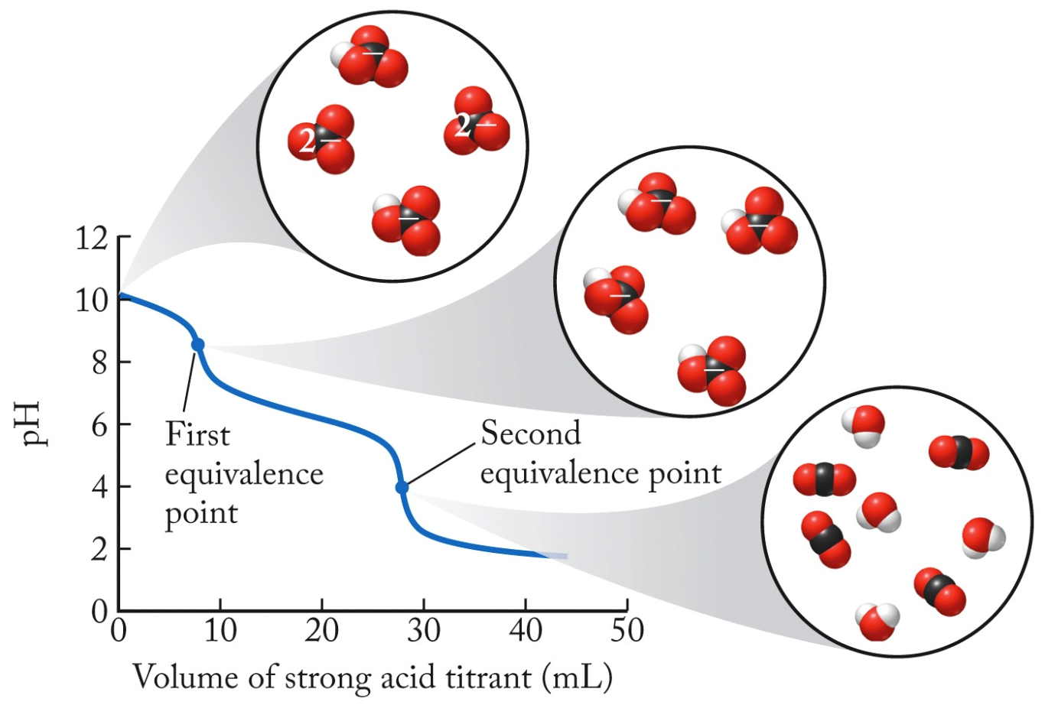
Alkalinity Titration: CO₃²⁻ Ion
(1) CO₃²⁻(aq) + H⁺(aq) ⇌ HCO₃⁻(aq)
(2) HCO₃⁻(aq) + H⁺(aq) ⇌ H₂CO₃(aq)
Second eq. pt.
pH = 4.0
First eq. pt.
pH = 8.5
65

Slide 66
Chapter Outline
15.1 Acids and Bases: The BrØnsted–Lowry Model
15.2 Acid Strength and Molecular Structure
15.3 pH and the Autoionization of Water
15.4 Calculations Involving pH, K_{a}, and K_{b}
15.5 Polyprotic Acids
15.6 pH of Salt Solutions
15.7 The Common-Ion Effect
15.8 pH Buffers
15.9 pH Indicators and Acid–Base Titrations
15.10 Solubility Equilibria

Slide 67
Solubility Equilibria
Mg(OH)₂(s) ⇌ Mg²⁺(aq) + 2OH⁻(aq)
Solubility: Amount of solute that dissolves (g/L)
Molar Solubility (S): Amount of dissolved solute expressed as mol/L
Solubility Product Constant: K_{sp}
67

Slide 68
Calculating Molar Solubility (S)
S calculated by solving equilibrium problem
Mg(OH)₂(s) ⇌ Mg²⁺(aq) + 2OH⁻(aq)
(x) (2x)
x = 1.1 × 10⁻⁴ M (x = S!)
General equation: For salt M_{m}Z_{x} →mM^{n+} + zZ^{y-}
K_{sp} = [M^{n+}]^{m}[Z^{y-}]^{z} → K_{sp} = (m^{m}z^{z}) S^{(m+z)}
68

Slide 69
Factors Affecting Solubility
Common-Ion Effect:
BaSO₄(s) ⇌ Ba²⁺(aq) + SO₄²⁻(aq)
K_{sp} = [Ba²⁺][SO₄²⁻]
Add common ion from another source:
Na₂SO₄(s) → 2Na⁺(aq) + SO₄²⁻(aq)
Presence of “common ion” (SO₄²⁻) will shift BaSO₄ equilibrium to the left, decreasing solubility.
69

Slide 70
Factors Affecting Solubility
pH:
For insoluble salts containing basic anions, solubility increases as pH decreases:
CaF₂(s) ⇌ Ca²⁺(aq) + 2F⁻(aq)
Adding acid (H⁺), reacts with basic anion:
F⁻(aq) + H⁺(aq) ⇌ HF(aq)
As F⁻ is consumed, CaF₂ equilibrium shifts right, solubility of CaF₂ increases
70

Slide 71
Practice: Common Ion
Calculate the molar solubility of Mg(OH)₂ in a solution of 0.050 M MgCl₂ (K_{sp} for Mg(OH)₂ = 5.6 × 10⁻¹²).
Collect and Organize:
Analyze:
Solve:
Think about It:
71

Slide 72
K_{sp} vs. Q: Will Precipitate Form?
Mix two solutions:
275 mL of 0.134 M Pb(NO₃)₂ = 0.03685 mol Pb²⁺
125 mL of 0.0339 M NaCl = 0.004238 mol Cl⁻
Will PbCl₂ precipitate?
After mixing, [Pb²⁺] = 0.0921 M, [Cl⁻] = 0.0106 M
PbCl₂(s) ⇌ Pb²⁺(aq) + 2Cl⁻(aq) K_{sp} = 1.6 × 10⁻⁵
Q = [Pb²⁺][Cl⁻]² = (0.0921)(0.0106)² = 1.03 × 10⁻⁵
Q < K_{sp}, precipitate does not form!

Slide 73
K_{sp} vs. Q: Selective Precipitation
Q > K_{sp}, reaction shifts left (precipitate forms!)
Selective removal of ions from solution:
Ca(OH)₂(s) ⇌ Ca²⁺(aq) + 2OH⁻(aq) K_{sp}= 4.7 × 10⁻⁶
Mg(OH)₂(s) ⇌ Mg²⁺(aq) + 2OH⁻(aq) K_{sp}= 5.6 × 10⁻¹²
Consider: 0.10 M Ca²⁺ and 0.02 M Mg²⁺
[OH⁻] needed to ppt 0.10 M Ca²⁺ = 6.9 × 10⁻³ M
[Mg²⁺] in equilibrium with OH⁻ = 1.2 × 10⁻⁷ M
(0.006% of Mg²⁺ remains when Ca²⁺ starts to ppt!)
73

Slide 74
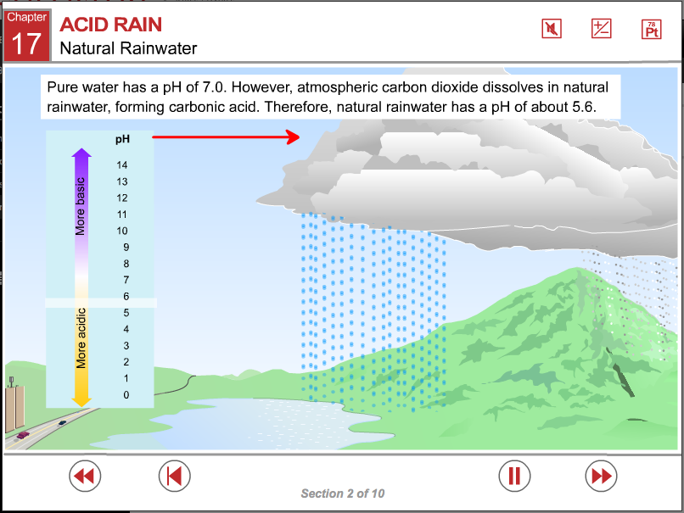
ChemTours: Chapter 15
Click here to launch the ChemTours website

Slide 75
This concludes the Lecture PowerPoint presentation for Chapter 15

