Slide 1
14
Chemical Equilibrium
Equal but Opposite Reaction Rates

Slide 2
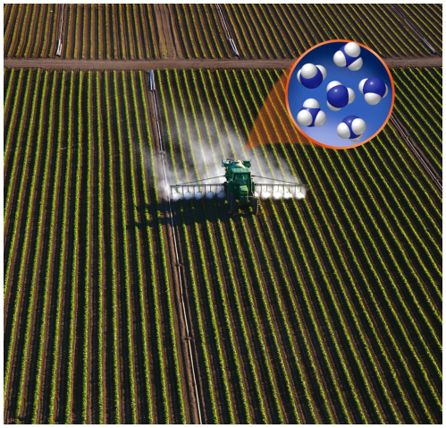
Chapter Outline
14.1 The Dynamics of Chemical Equilibrium
14.2 Writing Equilibrium Constant Expressions
14.3 Relationships between K_{c} and K_{p} Values
14.4 Manipulating Equilibrium Constant Expressions
14.5 Equilibrium Constants and Reaction Quotients
14.6 Heterogeneous Equilibria
14.7 Le Châtelier’s Principle
14.8 Calculations Based on K
14.9 Equilibrium and Thermodynamics
14.10 Changing K with Changing Temperature

Slide 3
Equilibrium
Chemical Equilibrium:
A dynamic process in which concentrations of reactants and products remain constant over time
Rate of a reaction in the forward direction matches the rate in the reverse direction

Slide 4
Equilibrium
H₂O(g) + CO(g) ⇌ H₂(g) + CO₂(g)

Slide 5
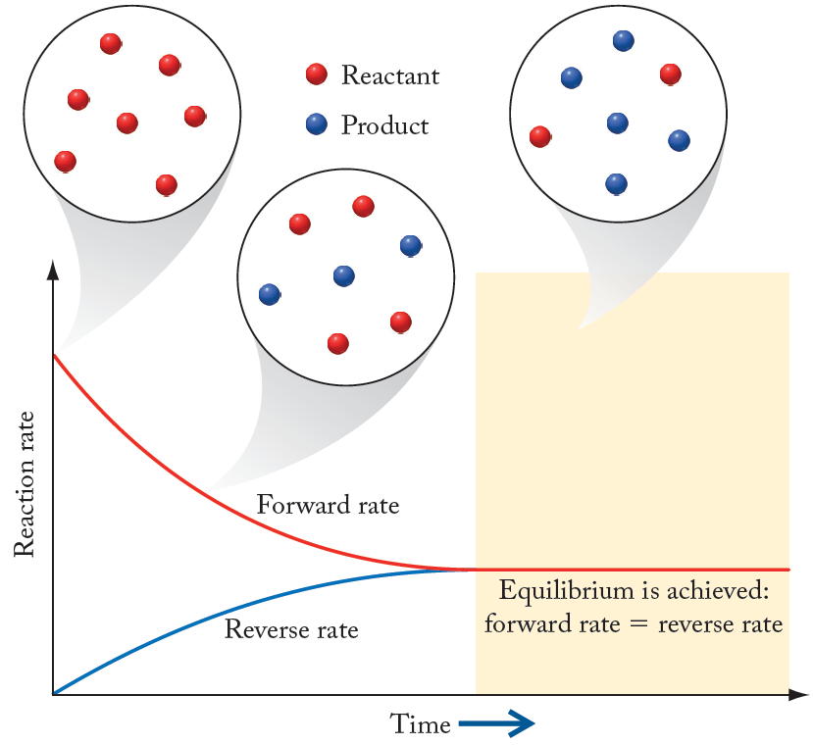
Equilibrium

Slide 6
Equilibrium
Reaction: 2NO₂(g) ⇌ N₂O₄(g)
From experimental data:
Rate_{f} = k_{f} [NO₂]²
Rate_{r} = k_{r} [N₂O₄]
At equilibrium: k_{f} [NO₂]² = k_{r} [N₂O₄]
Rearrange:

Slide 7
Equilibrium Constant
Equilibrium Constant (K):
A unitless value of the ratio of concentration (or partial pressure) terms in the equilibrium constant expression at a specific temperature
Equilibrium Constant Expression:
Ratio of equilibrium concentrations or partial pressures of products to reactants, each term raised to a power equal to the coefficient of that substance in the balanced chemical equation

Slide 8
Chapter Outline
14.1 The Dynamics of Chemical Equilibrium
14.2 Writing Equilibrium Constant Expressions
14.3 Relationships between K_{c} and K_{p} Values
14.4 Manipulating Equilibrium Constant Expressions
14.5 Equilibrium Constants and Reaction Quotients
14.6 Heterogeneous Equilibria
14.7 Le Châtelier’s Principle
14.8 Calculations Based on K
14.9 Equilibrium and Thermodynamics
14.10 Changing K with Changing Temperature

Slide 9
Law of Mass Action
Law of Mass Action:
The ratio of concentrations/partial pressures of products to reactants at equilibrium has a characteristic value at a given temperature
Mass Action Expression:
Equivalent to equilibrium constant expression, but applied to reaction mixtures that may or may not be at equilibrium

Slide 10
The Value of K
H₂O(g) + CO(g) ⇌ H₂(g) + CO₂(g)
Equilibrium Constant
Expression:
Return

Slide 11
The Value of K
Using data from Experiments 1 and 2:
Using data from Experiment 3:
Jump
Jump

Slide 12
Law of Mass Action
Generic reaction: aA + bB ⇌ cC + dD
where [X] = concentration units of moles/liter
where P_{X} = units of partial pressure

Slide 13
The Value of K
Value of K indicates extent of reaction:
2H₂(g) + O₂(g) ⇌ 2H₂O(g) K = 3 × 10⁸¹
Very large K: Favors formation of products
2CO₂(g) ⇌ 2CO(g) + O₂(g) K = 3 × 10⁻⁹²
Very small K: Favors reactants; not much product formed at equilibrium
H₂O(g) + CO(g) ⇌ H₂(g) + CO₂(g) K = 24
Intermediate value of K: Comparable amounts of products and reactants at equilibrium

Slide 14
Practice: Calculating K
Calculate the equilibrium constant for the following system at 500°C.
N₂ + 3H₂ ⇌ 2NH₃
[N₂] = 0.921 M
[H₂] = 0.763 M
[NH₃] = 0.157 M
Collect and Organize:
Analyze:
Solve:
Think about It:
14

Slide 15
Chapter Outline
14.1 The Dynamics of Chemical Equilibrium
14.2 Writing Equilibrium Constant Expressions
14.3 Relationships between K_{c} and K_{p} Values
14.4 Manipulating Equilibrium Constant Expressions
14.5 Equilibrium Constants and Reaction Quotients
14.6 Heterogeneous Equilibria
14.7 Le Châtelier’s Principle
14.8 Calculations Based on K
14.9 Equilibrium and Thermodynamics
14.10 Changing K with Changing Temperature

Slide 16
Equilibrium in the Gas Phase
Ideal Gas Law:
PV = nRT ⇒ P = (n/V)RT
n/V is moles per liter (molarity)
K_{p} = K_{c}(RT)^{Δn}
Δ n = # moles of gaseous products minus the # moles of gaseous reactants.
R = gas constant ; T = temperature (K)

Slide 17
Practice: Expressions for K
Write the equilibrium constant expressions (K_{c} and K_{p}) for the synthesis of NO₂.
4NH₃(g) + 7O₂(g) ⇌ 4NO₂(g) + 6H₂O(g)
Collect and Organize:
Analyze:
Solve:
Think about It:

Slide 18
Practice: Calculating K_{p} from K_{c}
Calculate K_{p} for
PCl₅(g) ⇌ PCl₃(g) + Cl₂(g)
given K_{c} = 4.00 at 425°C
Collect and Organize:
Analyze:
Solve:
Think about It:

Slide 19
Chapter Outline
14.1 The Dynamics of Chemical Equilibrium
14.2 Writing Equilibrium Constant Expressions
14.3 Relationships between K_{c} and K_{p} Values
14.4 Manipulating Equilibrium Constant Expressions
14.5 Equilibrium Constants and Reaction Quotients
14.6 Heterogeneous Equilibria
14.7 Le Châtelier’s Principle
14.8 Calculations Based on K
14.9 Equilibrium and Thermodynamics
14.10 Changing K with Changing Temperature

Slide 20
K for Reverse Reaction
Forward Reaction:
2NO₂(g) ⇌ N₂O₄(g)
Reverse Reaction:
N₂O₄(g) ⇌ 2NO₂(g)
K_{forward} = 1/K_{reverse}

Slide 21
Equation Multiplied by a Number
Reaction 1: 2NO(g) + O₂(g) ⇌ 2NO₂(g)
Reaction 2: NO(g) + ½O₂(g) ⇌ NO₂(g)
Reaction 2 = ½(Reaction 1): K₂ = (K₁)^{1/2}

Slide 22
Combining K Values
(1) N₂(g) + O₂(g) ⇌ 2NO(g)
(2) 2NO(g) + O₂(g) ⇌ 2NO₂(g)
(3) N₂(g) + 2O₂(g) ⇌ 2NO₂(g)
Notes:
Animation in three parts:
1. start with equations 1 and 2, and expressions K₁ and K₂.
2. Add arrows to cancel NO, and show equation 3.
3. show combination of K expressions : K₃ = K₁ x K₂.

Slide 23
Practice: Relationships between K
Given: N₂O₄(g) ⇌ 2NO₂(g) K_{c} = 4.63 × 10⁻³
a) Determine the K_{c} for the reaction:
2NO₂(g) ⇌ N₂O₄(g)
Determine the K_{c} for the reaction:
NO₂(g) ⇌ ½ N₂O₄(g)
Collect and Organize:
Analyze:
Solve:
Think about It:

Slide 24
Chapter Outline
14.1 The Dynamics of Chemical Equilibrium
14.2 Writing Equilibrium Constant Expressions
14.3 Relationships between K_{c} and K_{p} Values
14.4 Manipulating Equilibrium Constant Expressions
14.5 Equilibrium Constants and Reaction Quotients
14.6 Heterogeneous Equilibria
14.7 Le Châtelier’s Principle
14.8 Calculations Based on K
14.9 Equilibrium and Thermodynamics
14.10 Changing K with Changing Temperature

Slide 25
Reaction Quotient
Reaction Quotient (Q):
Numerical value of the mass action expression for any values of concentrations (or partial pressures) of the reactants and products
At equilibrium: Q = K
Value of Q indicates how reaction is proceeding (if at equilibrium, or not)

Slide 26
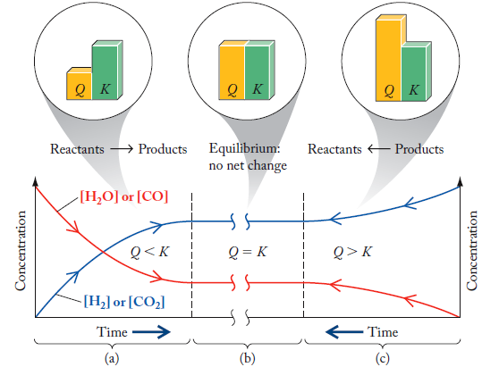
Comparing Q with K
H₂O(g) + CO(g) ⇌ H₂(g) + CO₂(g)
Q < K, reaction proceeds toward products
Q = K, equilibrium
Q > K, reaction proceeds toward reactants

Slide 27
Practice: Comparing Q and K
Is the following reaction at equilibrium at the stated conditions? If not at equilibrium, determine which direction the reaction will proceed. (K_{c} = 5.6)
CH₄ + H₂O ⇌ CO + 3H₂
0.100M 0.200M 0.500M 0.800M
Collect and Organize:
Analyze:
Solve:
Think about It:

Slide 28
Chapter Outline
14.1 The Dynamics of Chemical Equilibrium
14.2 Writing Equilibrium Constant Expressions
14.3 Relationships between K_{c} and K_{p} Values
14.4 Manipulating Equilibrium Constant Expressions
14.5 Equilibrium Constants and Reaction Quotients
14.6 Heterogeneous Equilibria
14.7 Le Châtelier’s Principle
14.8 Calculations Based on K
14.9 Equilibrium and Thermodynamics
14.10 Changing K with Changing Temperature

Slide 29
Types of Equilibria
Homogeneous Equilibria: Involve reactants and products in the same phase
H₂O(g) + CO(g) ⇌ H₂(g) + CO₂(g)
Heterogeneous Equilibria: Involve reactants and products in more than one phase
CaCO₃(s) ⇌ CaO(s) + CO₂(g)

Slide 30
Heterogeneous Equilibria
CaCO₃(s) ⇌ CaO(s) + CO₂(g)
From Law of Mass Action:
Concentrations of solids (CaO, CaCO₃) are constant at a given temperature

Slide 31
Heterogeneous Equilibria
CaCO₃(s) ⇌ CaO(s) + CO₂(g)
Note: Amount of solid product or reactant does not affect the equilibrium

Slide 32
Chapter Outline
14.1 The Dynamics of Chemical Equilibrium
14.2 Writing Equilibrium Constant Expressions
14.3 Relationships between K_{c} and K_{p} Values
14.4 Manipulating Equilibrium Constant Expressions
14.5 Equilibrium Constants and Reaction Quotients
14.6 Heterogeneous Equilibria
14.7 Le Châtelier’s Principle
14.8 Calculations Based on K
14.9 Equilibrium and Thermodynamics
14.10 Changing K with Changing Temperature

Slide 33
Le Châtelier’s Principle
Le Châtelier's Principle: “A system at equilibrium responds to a stress in such a way that it relieves that stress.”
Factors that will change the relative rates of forward/reverse reactions, or change the value of Q compared to K, will cause a shift in the position of equilibrium.

Slide 34
Concentration Stress
H₂O(g) + CO(g) ⇌ H₂(g) + CO₂(g)
Remove CO₂(g):
Rate of reverse reaction decreases; reaction proceeds in forward direction to establish new equilibrium
Q compared to K:
Removing CO₂, Q < K; reaction shifts right (toward products)

Slide 35
Effects of Pressure/Volume
2NO₂(g) ⇌ N₂O₄(g)
Changing volumes will change partial pressures, changes Q relative to K
Decrease volume by factor of 2 will increase partial pressure by 2
Q < K, reaction shifts right toward products

Slide 36
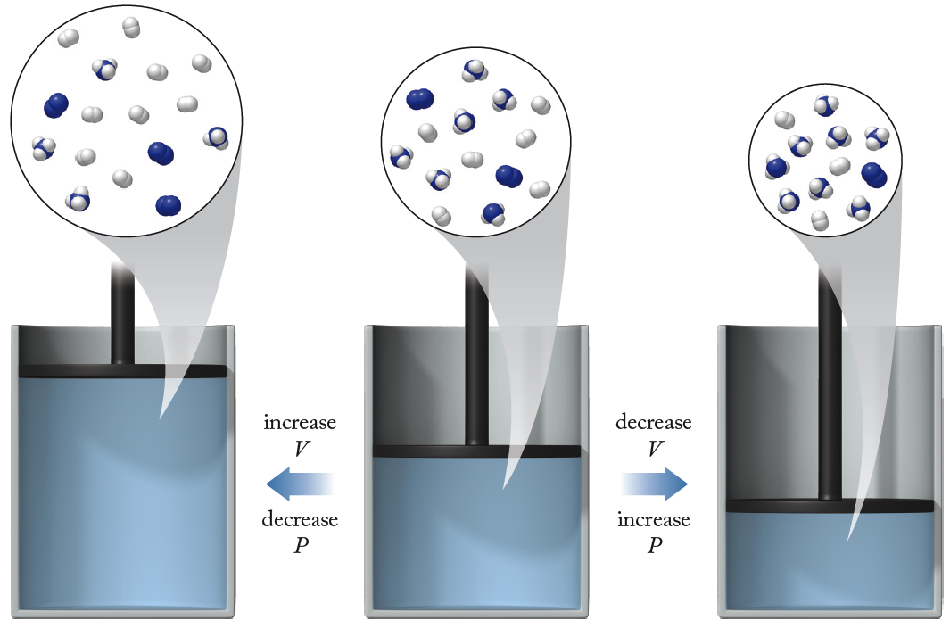
Effects of Pressure/Volume
N₂(g) + 3H₂(g) ⇌ 2NH₃(g)

Slide 37
Effects of Temperature
N₂(g) + 3H₂(g) ⇌ 2NH₃(g) ΔH < 0
Approach:
Treat heat as reactant or product
N₂(g) + 3H₂(g) ⇌ 2NH₃(g) + heat
Increasing temperature adds heat to the product side of equation; reaction shifts left
Note: Changing T changes value of K!

Slide 38
Effects of Temperature
Is this reaction endothermic or exothermic?

Slide 39
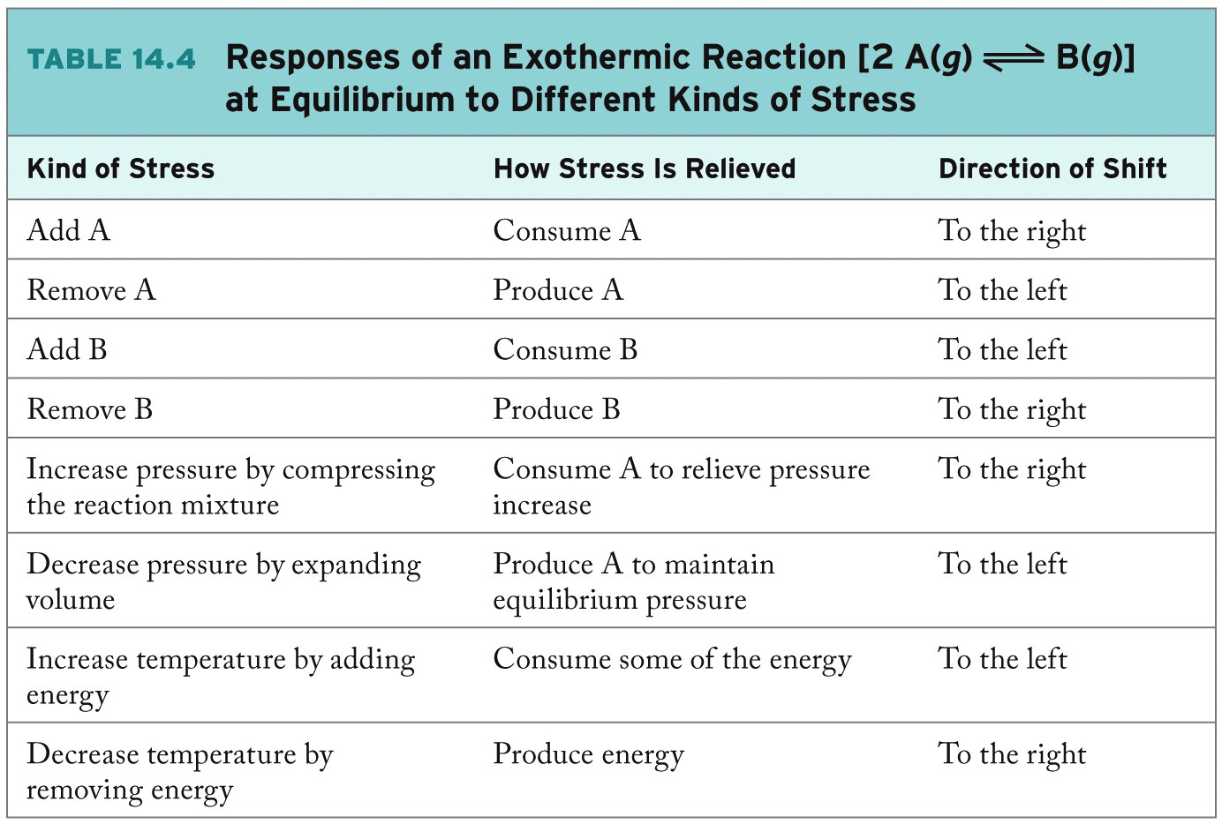

Slide 40
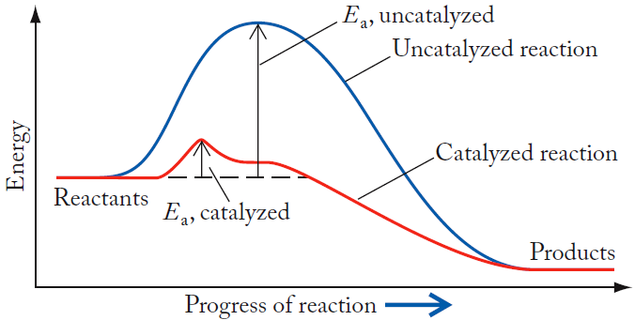
Catalysts and Equilibrium Systems
Systems reach equilibrium faster.
No change in K or position of equilibrium.

Slide 41
Chapter Outline
14.1 The Dynamics of Chemical Equilibrium
14.2 Writing Equilibrium Constant Expressions
14.3 Relationships between K_{c} and K_{p} Values
14.4 Manipulating Equilibrium Constant Expressions
14.5 Equilibrium Constants and Reaction Quotients
14.6 Heterogeneous Equilibria
14.7 Le Châtelier’s Principle
14.8 Calculations Based on K
14.9 Equilibrium and Thermodynamics
14.10 Changing K with Changing Temperature

Slide 42
Calculations Based on K
Determine whether a reaction has reached equilibrium (Q vs. K).
Knowing the value of K and the starting concentrations or partial pressures, one can calculate their equilibrium concentrations, etc.
RICE Table:
R: Balanced chemical equation
I: Initial concentrations (or pressures)
C: Changes as system moves to equilibrium
E: Equilibrium concentrations (or pressures)

Slide 43
RICE Table Example
Reaction: N₂(g) + O₂(g) ⇌ 2NO(g)
Initial N₂ = 0.79 atm
Initial O₂ = 0.21 atm
Initial NO(g) = 0.0 atm
What are the partial pressures of reactants and products when the system achieves equilibrium?

Slide 44
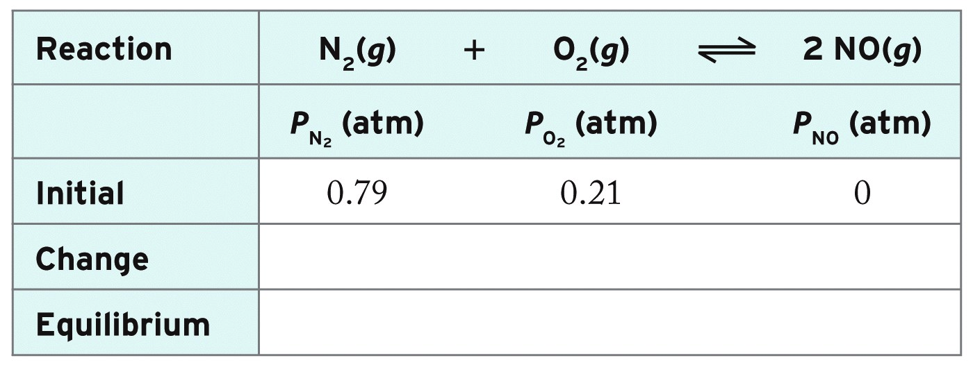
RICE Table Example
Reaction: N₂(g) + O₂(g) ⇌ 2NO(g)
1. List Initial Conditions:

Slide 45
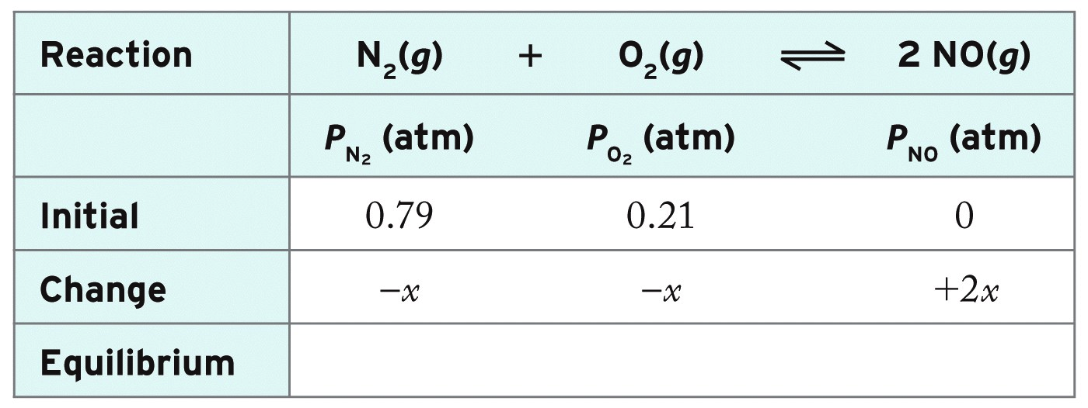
RICE Table Example
Reaction: N₂(g) + O₂(g) ⇌ 2NO(g)
2. Define Changes:
Note: Reaction shifts right; reactants decrease, products increase stoichiometrically

Slide 46
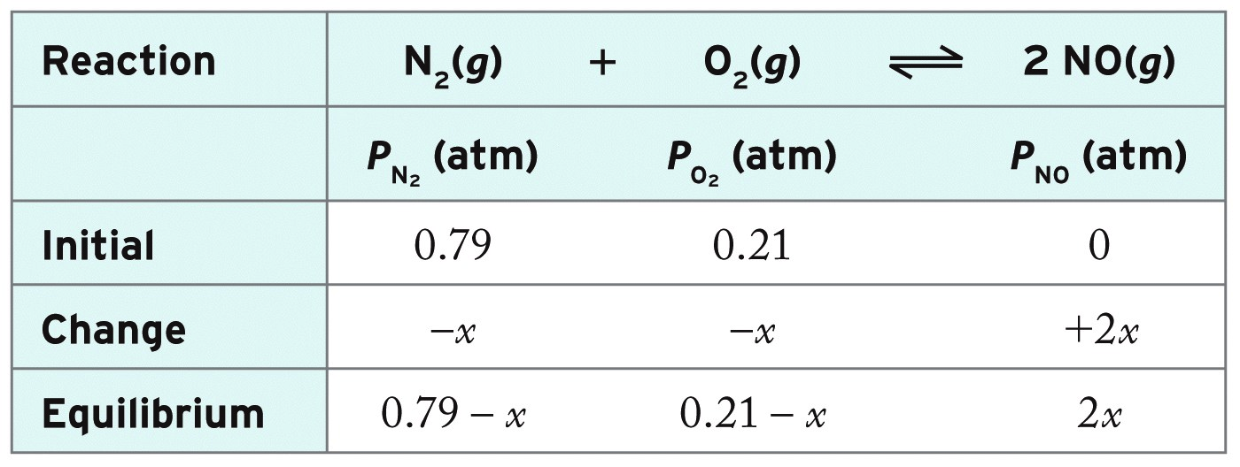
RICE Table Example
Reaction: N₂(g) + O₂(g) ⇌ 2NO(g)
3. Express Equilibrium Conditions:
Equilibrium conditions = Initial + Change

Slide 47
RICE Table Example
Reaction: N₂(g) + O₂(g) ⇌ 2NO(g)
4. Substitute equilibrium conditions into expression for K and solve:
Knowing K, solve for equilibrium pressures:
- Two solutions from quadratic equation, only one is positive x = 6.428×10⁻⁴ atm

Slide 48
RICE Table: Simplifying Math
x = 6.44 × 10⁻⁴ atm

Slide 49
Practice: Calculating Equilibrium Concentrations
Calculate the concentration of all species at equilibrium if the initial concentration of HI is 0.100 M and K_{c} is 0.11.
2HI(g) ⇌ H₂(g) + I₂(g)
Collect and Organize:
Analyze:
Solve:
Think about It:

Slide 50
Chapter Outline
14.1 The Dynamics of Chemical Equilibrium
14.2 Writing Equilibrium Constant Expressions
14.3 Relationships between K_{c} and K_{p} Values
14.4 Manipulating Equilibrium Constant Expressions
14.5 Equilibrium Constants and Reaction Quotients
14.6 Heterogeneous Equilibria
14.7 Le Châtelier’s Principle
14.8 Calculations Based on K
14.9 Equilibrium and Thermodynamics
14.10 Changing K with Changing Temperature

Slide 51
Calculating Free Energy Changes
Free energy change for a reaction:
Δ G°_{rxn} = Σn_{prod.}ΔG⁰_{f, prod.} - Σn_{react.}ΔG⁰_{f, react.}
Depends on reaction conditions relative to standard states:
Δ G_{rxn} = ΔG°_{rxn} + RT ln Q
When reaction is at equilibrium:
Δ G_{rxn} = 0, and Q = K
Δ G°_{rxn} = RT ln K ( K = e^{- ΔG°/RT})

Slide 52
Thermodynamics of Equilibria
N₂O₄(g) ⇌ 2 NO₂(g)

Slide 53
∆G° and K: K >> 1
∆G° < 0; K is large, favors products.
Direction of spontaneous reaction
→

Slide 54
∆G° and K: K > 1
∆G° slightly negative; K slightly favors products
Direction of spontaneous reaction
→

Slide 55
∆G° and K: K << 1
∆G° > 0; K << 1, favors reactants.
Direction of spontaneous reaction
→

Slide 56
Practice: Relationship between K and ΔG°
Using ∆G_{f}° values from Appendix 4, calculate the value of ΔGº and the equilibrium constant K at 298 K for
2NO(g) + Cl₂(g) ⇌ 2NOCl(g)
Collect and Organize:
Analyze:
Solve:
Think about It:

Slide 57
Chapter Outline
14.1 The Dynamics of Chemical Equilibrium
14.2 Writing Equilibrium Constant Expressions
14.3 Relationships between K_{c} and K_{p} Values
14.4 Manipulating Equilibrium Constant Expressions
14.5 Equilibrium Constants and Reaction Quotients
14.6 Heterogeneous Equilibria
14.7 Le Châtelier’s Principle
14.8 Calculations Based on K
14.9 Equilibrium and Thermodynamics
14.10 Changing K with Changing Temperature

Slide 58
Equilibrium and Temperature
From previous sections:
Δ G° = ΔH° - TΔS°
ln K = -ΔG°/RT
Combining and rearranging:
y = ln K; x = 1/T; slope = -ΔH°/R; intercept = ΔS°

Slide 59
ln K vs. 1/T
Assuming ∆S° is independent of T, K will vary with temperature as

Slide 60
Practice: K vs. Temperature
At 2000°C, the value of K_{c} for the reaction
N₂(g) + O₂(g) ⇌ 2NO(g)
is 4.10 × 10⁻⁴. What is the value of K_{c} at 75°C if ΔH° = 180.6 kJ?
Collect and Organize:
Analyze:
Solve:
Think about It:

Slide 61
ChemTours: Chapter 14
Click here to launch the ChemTours website

Slide 62
This concludes the Lecture PowerPoint presentation for Chapter 14

