Slide 1
13
Chemical Kinetics
Clearing the Air

Slide 2
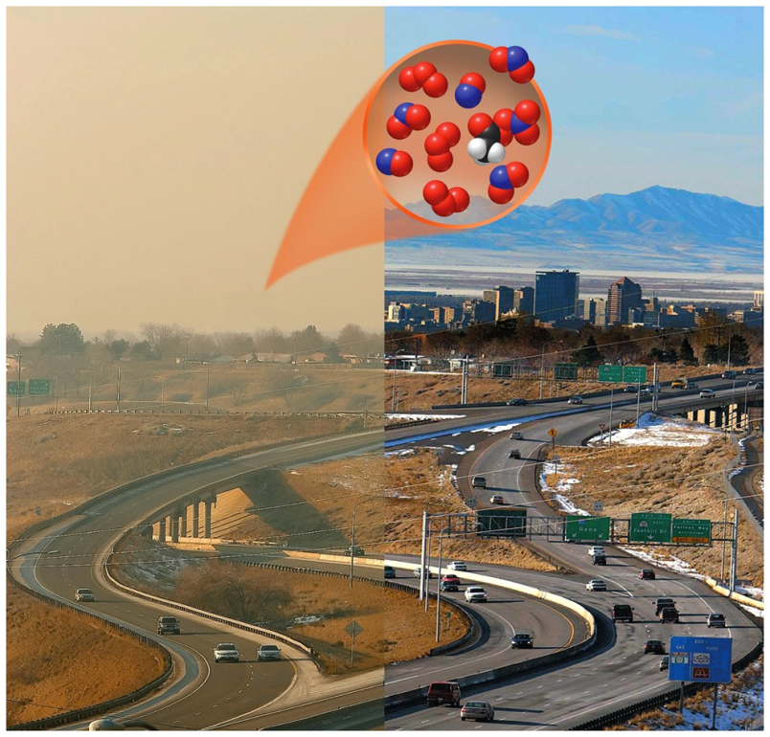
Chapter Outline
13.1 Cars, Trucks, and Air Quality
13.2 Reaction Rates
13.3 Effect of Concentration on Reaction Rates
13.4 Reaction Rates, Temperature, and the Arrhenius Equation
13.5 Reaction Mechanisms
13.6 Catalysts

Slide 3
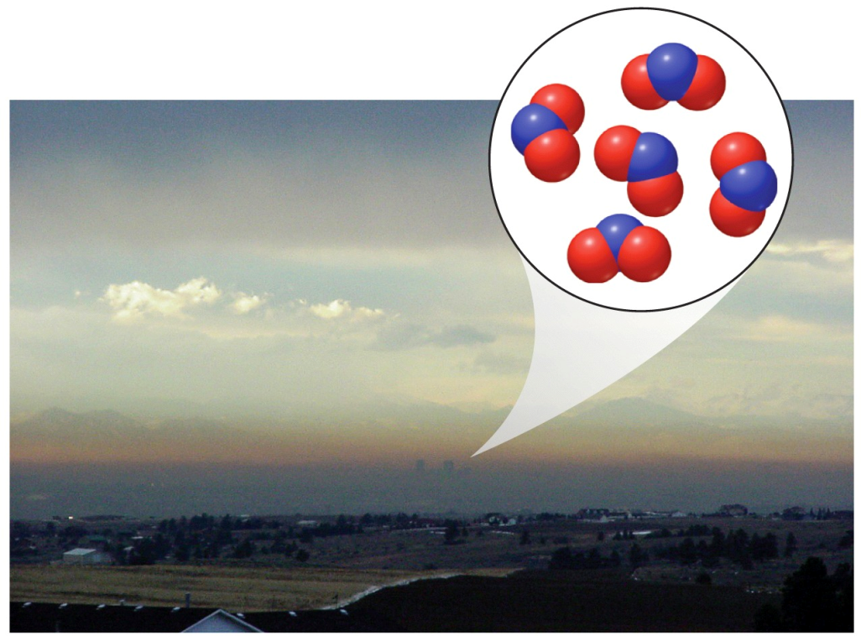
Cars, Trucks, and Air Quality
Photochemical Smog: Mixture of gases formed when sunlight interacts with compounds produced in internal combustion engines
Depends on chemical kinetics

Slide 4
Important Reactions in Smog
N₂(g) + O₂(g) → 2 NO(g) ΔH°= 180.6 kJ
2 NO(g) + O₂(g) → 2 NO₂(g) ΔH°= -114.2 kJ
NO₂(g) NO(g) + O(g)
O₂(g) + O(g) → O₃(g)
O(g) + H₂O(g) → 2 OH(g)
Note: Products of some reactions are reactants in other reactions.

Slide 5
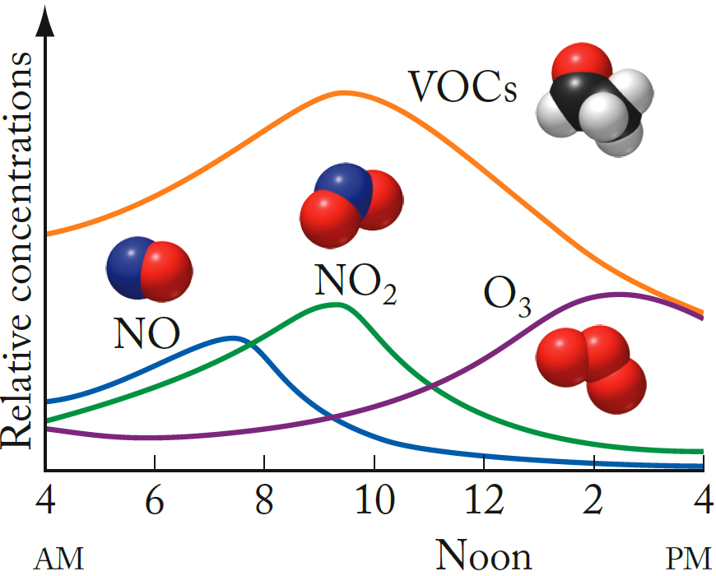
Variations of Smog Components
Photodecomposition of NO₂ leads to high levels of O₃ in the afternoon.

Slide 6
Chapter Outline
13.1 Cars, Trucks, and Air Quality
13.2 Reaction Rates
13.3 Effect of Concentration on Reaction Rates
13.4 Reaction Rates, Temperature, and the Arrhenius Equation
13.5 Reaction Mechanisms
13.6 Catalysts

Slide 7
Chemical Kinetics
Chemical Kinetics:
Study of rate of change of concentrations of substances involved in chemical reactions
Reaction Rate:
How rapidly a reaction occurs; related to rates of change in concentration of reactants and products over time
Factors Affecting Reaction Rates:
Physical state of reactants; concentration of reactants; temperature; presence of a catalyst

Slide 8
Reaction Rates
N₂(g) + O₂(g) → 2 NO(g)

Slide 9
Relative Reaction Rates
N₂(g) + O₂(g) → 2 NO(g)
Relative rates of consumption of reactants and formation of products based on stoichiometry

Slide 10
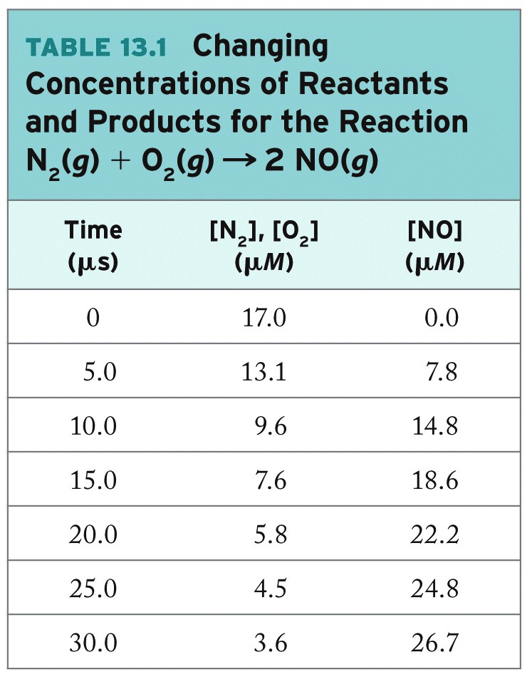
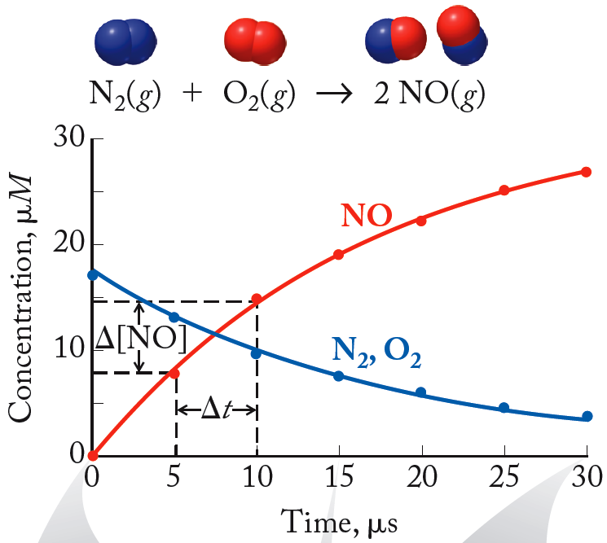
Actual Reaction Rates
N₂(g) + O₂(g) → 2 NO(g)

Slide 11
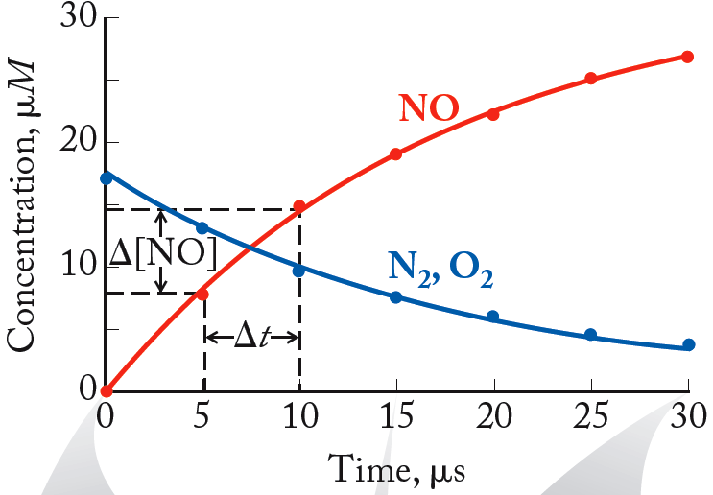
Average Rate
N₂(g) + O₂(g) → 2 NO(g)
Average Rate: Change in concentration of reactant or product over a specific time interval

Slide 12
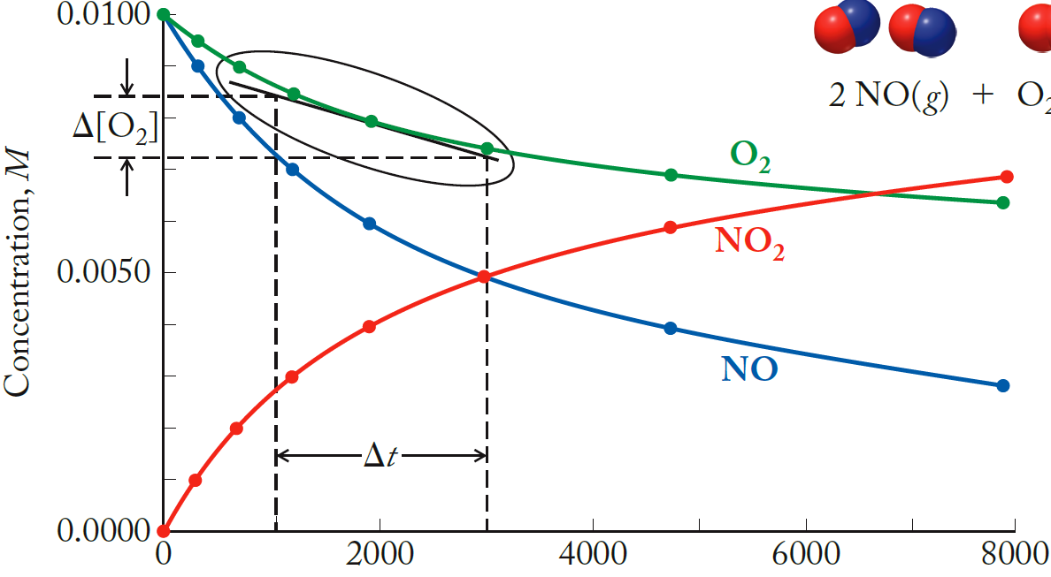
Instantaneous Reaction Rates

Slide 13
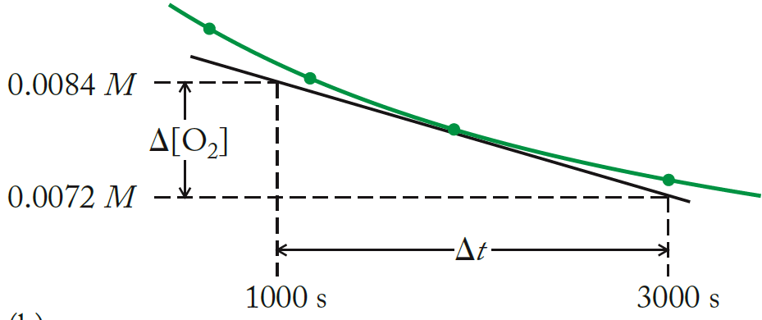
Instantaneous Reaction Rates
Instantaneous Rate:
Reaction rate at a particular instant
Determined graphically as tangential slope of concentration vs. time plot

Slide 14
Practice: Reaction Rates
Calculate the average reaction rate for the time period between 15 μs and 30 μs using the data below: N₂(g) + O₂(g) → 2NO(g)
Time (μs) | [N₂], [O₂] (μM) | [NO] (μM)
0 | 17.0 | 0.0
15 | 7.6 | 18.6
30 | 3.6 | 26.7
Collect and Organize:
Analyze:
Solve:
Think about It:

Slide 15
Chapter Outline
13.1 Cars, trucks, and Air Quality
13.2 Reaction Rates
13.3 Effect of Concentration on Reaction Rates
13.4 Reaction Rates, Temperature, and the Arrhenius Equation
13.5 Reaction Mechanisms
13.6 Catalysts

Slide 16
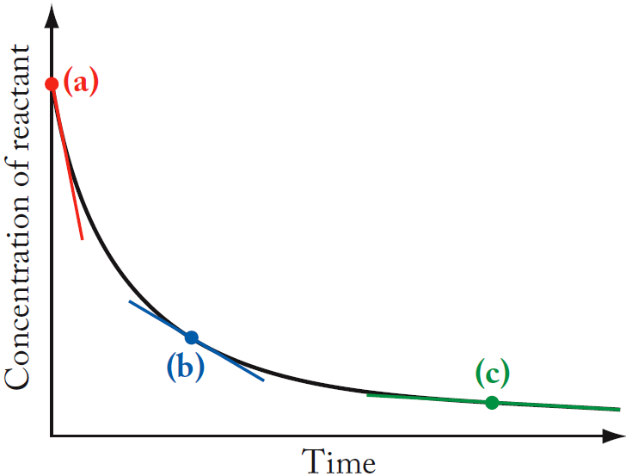
Initial Reaction Rates
Initial Rate: Rate of a reaction at t = 0, immediately after the reactants are mixed
Initial rate
b), c) Instantaneous rates

Slide 17
Reaction Order
Reaction Order:
Experimentally determined number defining the dependence of the reaction rate on the concentration of a reactant
Rate Law:
Equation that defines the experimentally determined relationship between reactant concentrations and the rate of the reaction
Overall Order of Reaction:
Sum of exponents for the concentration terms in the rate law

Slide 18
The Rate Law and Rate Constant
Rate Constant (k):
Proportionality constant that relates the rate of a reaction to the concentration of reactants
Example: A + B → C
Rate Law: Rate = k [A]^{m} [B]^{n}
k = rate constant
m and n are the reaction orders with respect to reactants A and B
(m + n ) = overall order

Slide 19
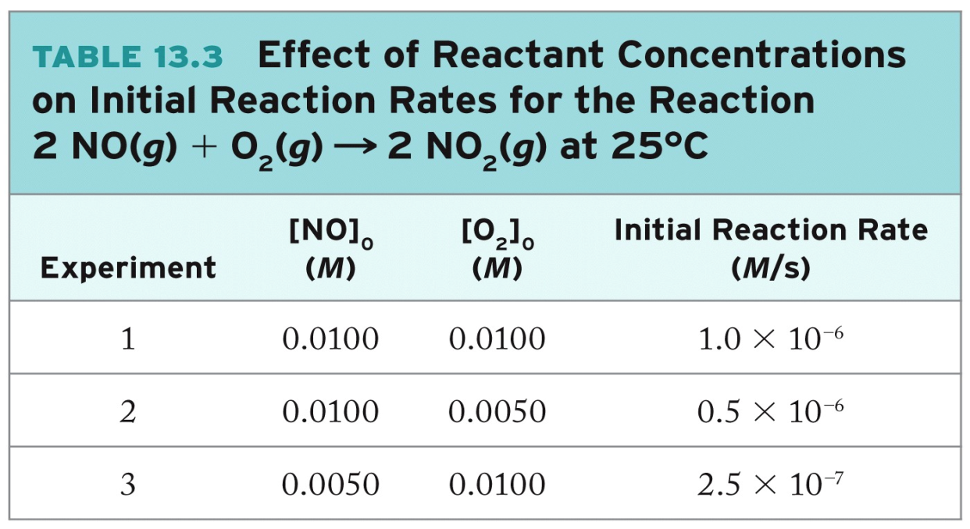
Determination of Rate Laws
2NO(g) + O₂(g) → 2 NO₂(g)
Rate = k[O₂]^{n}[NO]^{m}
Determine values of n, m by measuring initial rate under different conditions
Return

Slide 20
Determining Rate Laws (cont.)
Rate = k[O₂]^{n}[NO]^{m}
To find n:
Compare experiments #1 and #2
[NO] is constant; [O₂] is halved; rate is halved. Rate ∝ [O₂]^{n} ; n = 1
To find m:
Compare experiments #1 and #3
[O₂] is constant; [NO] decreases by ×2; rate decreases by × 4. Rate ∝ [NO]² ; m = 2
Rate = k[O₂] [NO]²; k can be calculated from the rate law using data for any experiment
Jump
Jump
Notes:
Animation in two parts:
1. Show text/link to determine n in rate law.
2. Show text/link to determine m in rate law.

Slide 21
Effects of Concentration on Reaction Rates
NO(g) + O₃(g) → NO₂(g) + O₂(g) Rate = k[NO][O₃]
Increasing concentrations increases collisions between reactants, leading to formation of products.

Slide 22
Practice: Rate Laws/ Rate Constants
Write the rate law and calculate the rate constant k for the reaction given, using the following data:
2NO + 2H₂ → N₂ + 2H₂O
Trial | [NO], M | [H₂], M | Init. Rate, M/s
1 | 0.00570 | 0.140 | 7.01x10⁻⁵
2 | 0.00570 | 0.280 | 1.40x10⁻⁴
3 | 0.0114 | 0.140 | 2.81x10⁻⁴
Collect and Organize:
Analyze:
Solve:
Think about It:

Slide 23
Integrated Rate Law: 1st Order
Integrated Rate Law:
Mathematical expression describing the change in concentration of a reactant with time
Example:
Rate Law:
By Integration:

Slide 24
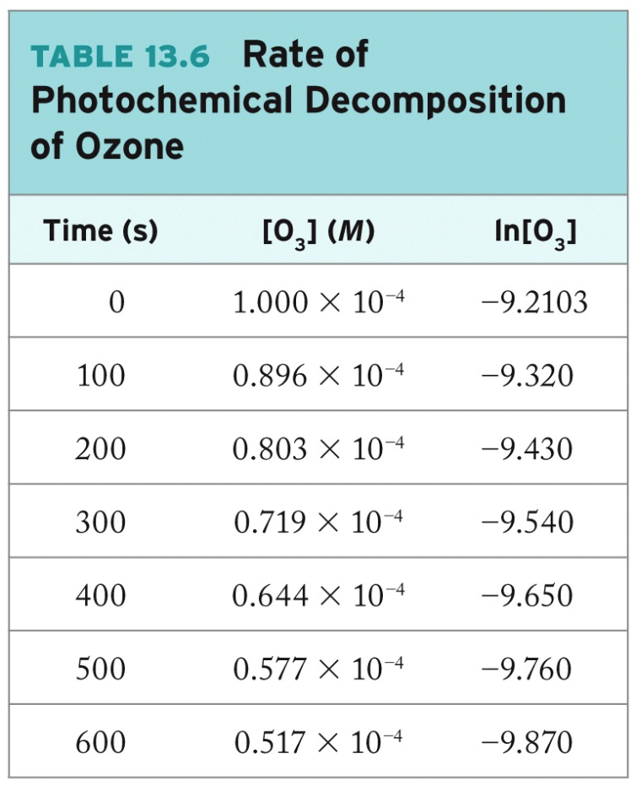
Integrated Rate Law: 1st-Order

Slide 25
Half-Life: 1st Order Reactions
Half-Life (t_{1/2}):
The time in the course of a chemical reaction during which the concentration of a reactant decreases by half
From integrated rate law, when [A]_{t} = ½ [A]_{o}:
Rearrange:

Slide 26
Half-Life: 1st-Order Reactions
t_{1/2} (1) = t_{1/2} (2) = t_{1/2} (3)

Slide 27
Practice: 1st-Order Kinetics
The radioactive isotope ³²P decays by first-order kinetics and has a half-life of 14.3 days. How long does it take for 95.0% of a sample of ³²P to decay?
Collect and Organize:
Analyze:
Solve:
Think about It:

Slide 28
Integrated Rate Law: 2nd-Order Reactions
2 NO₂(g) → 2 NO(g) + O₂(g)
Rate Law:
After Integration:
Straight Line: Plot of 1/[NO₂] vs. t
Half-Life:

Slide 29
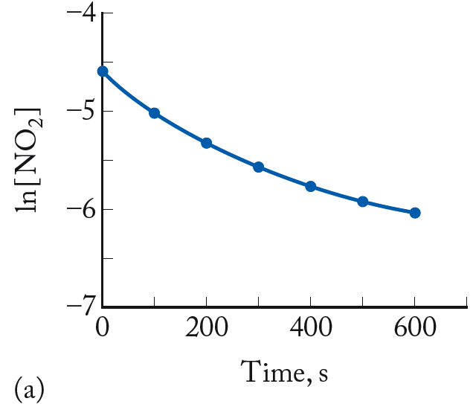
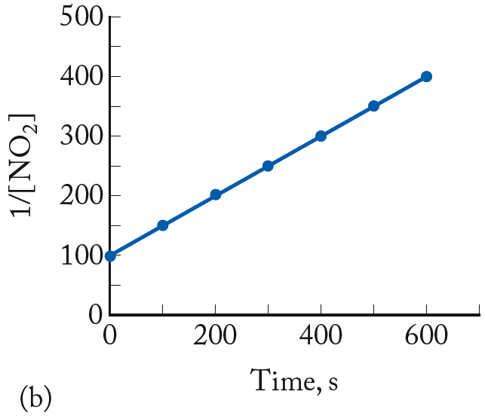
Integrated Rate Law: 2nd-Order
2NO₂(g) → 2NO(g) + O₂(g)
ln [NO₂] plot: curved 1/[NO₂] plot: straight line
slope = k; intercept = 1/[NO₂]_{o}

Slide 30
Other Reaction Orders
Pseudo-First-Order:
All reactants but one are present at such high concentrations that they do not decrease significantly during the course of reaction; reaction rate is controlled by the concentration of the limiting reactant
Zero-Order:
Rate of reaction is independent of concentration
Rate = -Δ[A]/Δt = k[A]º = k
integrated rate law: [A] = -kt + [A]_{o} , t_{1/2} = [A]_{o}/2k

Slide 31
Chapter Outline
13.1 Cars, Trucks, and Air Quality
13.2 Reaction Rates
13.3 Effect of Concentration on Reaction Rates
13.4 Reaction Rates, Temperature, and the Arrhenius Equation
13.5 Reaction Mechanisms
13.6 Catalysts

Slide 32
Factors Affecting Rate
Temperature:
Increased temperature increases kinetic energy of molecules, molecular collisions
Activation Energy (E_{a}):
Minimum energy of molecular collisions required to break bonds in reactants, leading to formation of products
These factors are incorporated into rate constant k by the Arrhenius equation

Slide 33
Arrhenius Equation
R = universal gas constant (in J/mol·K).
T = temperature (in kelvin)
A is a collisional frequency factor
Includes frequency of collisions and an orientation factor
Log form:

Slide 34
Frequency Factor
Frequency Factor (A):
Product of molecular collisions and a factor that expresses the probability that the orientation of the molecules is appropriate for reaction

Slide 35
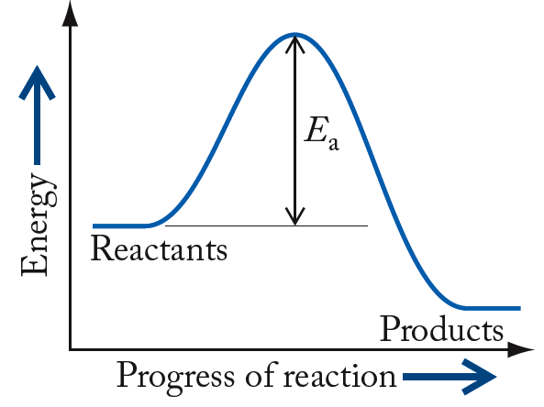
Reaction Energy Profile
High-energy transition state (“activated complex”)
Activation
energy (E_{a})

Slide 36
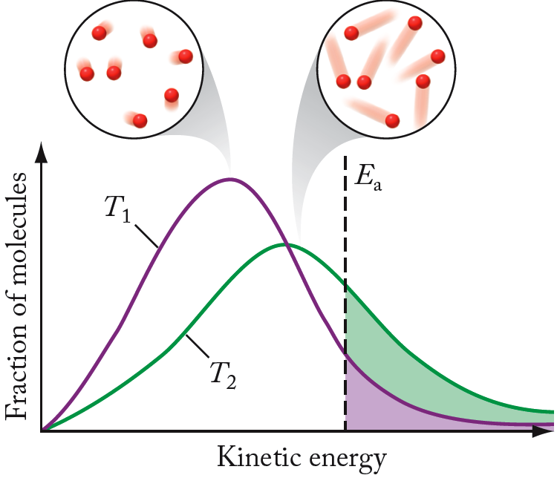
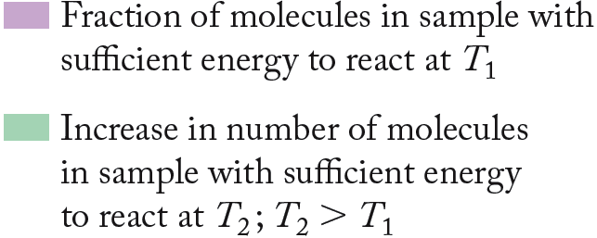
Effect of Temperature

Slide 37
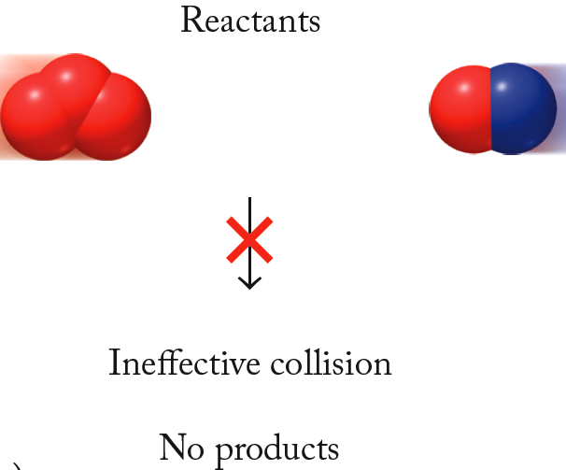
Molecular Orientation
O₃ + NO → O₂ + NO₂

Slide 38
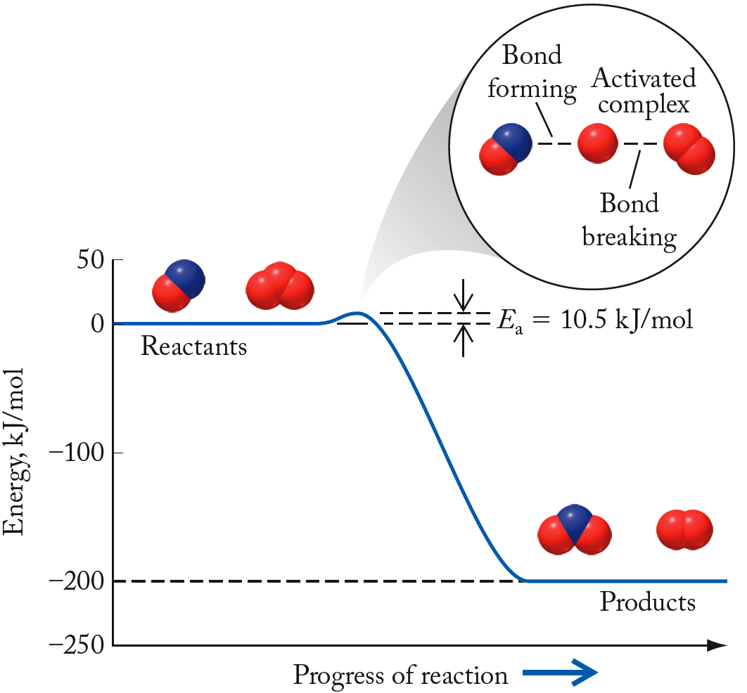
Energy Profiles
O₃ + NO → O₂ + NO₂
Low E_{a} = large k, fast-forward reaction

Slide 39
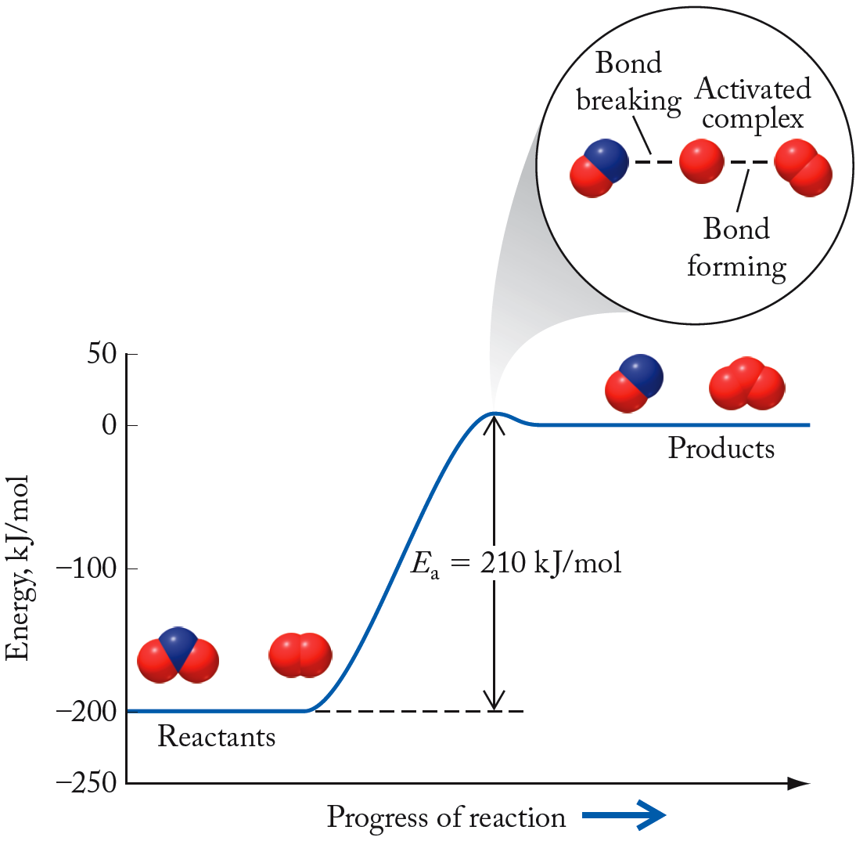
Energy Profiles
O₃ + NO ← O₂ + NO₂
High E_{a} = small k, slow-reverse reaction

Slide 40
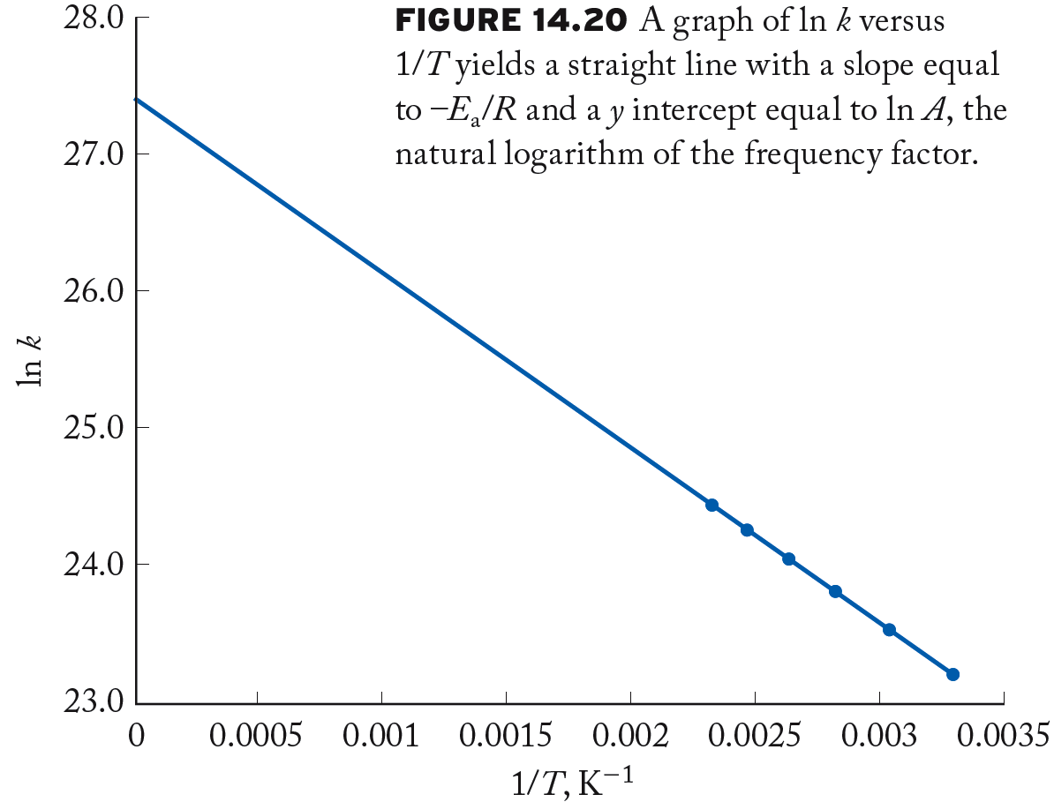
Graphical Determination of E_{a}
Slope = -E_{a}/R
Intercept = ln A

Slide 41
Mathematical Determination of E_{a}
Consider determination of k from two different T:
By subtraction:

Slide 42
Chapter Outline
13.1 Cars, trucks, and Air Quality
13.2 Reaction Rates
13.3 Effect of Concentration on Reaction Rates
13.4 Reaction Rates, Temperature, and the Arrhenius
Equation
13.5 Reaction Mechanisms
13.6 Catalysts

Slide 43
Reaction Mechanisms
Reaction Mechanism: A set of steps that describe how a reaction occurs at the molecular level; must be consistent with the rate law for the reaction
Elementary Step: Molecular-level view of a single process taking place in a chemical reaction
Intermediate: Species produced in one step of a reaction and consumed in a subsequent step
Molecularity: The number of ions, atoms, or molecules involved in an elementary step in a reaction

Slide 44
Reaction Mechanisms
Consider the reaction:
2 NO₂ (g) → 2 NO(g) + O₂(g)
Observed rate law: Rate = k[NO₂]²
Proposed mechanism:
Step 1: 2NO₂(g) → NO(g) + NO₃(g) Rate = ?
Step 2: NO₃(g) → NO(g) + O₂(g) Rate = ?
Rate law depends on rate determining step (RDS), the slowest step in the mechanism (may involve mathematical substitution!)

Slide 45
Rate Determining Step
2 NO(g) + O₂(g) → 2NO₂(g)
Observed rate law: Rate = k[NO]²[O₂]
Proposed mechanism:
Step 1: NO + O₂ ↔ NO₃ Rate₁ = k₁[NO][O₂]
Step 2: NO₃ + NO → 2NO₂ Rate₂ = k₂[NO₃][NO]
Step 2 is rate determining step; step 1 is fast and reversible:
rate(f) = rate(r); k_{f}[NO][O₂]=k_{r}[NO₃]
by rearrangement: [NO₃]* = (k_{f}/k_{r})[NO][O₂]
*Substitute into Rate₂= k₂ {(k_{f}/k_{r})[NO][O₂]}[NO]
= k’[NO]²[O₂]

Slide 46
Mechanisms: Zero-Order
Reaction: NO₂(g) + CO₂(g) → NO(g) + CO₂(g)
Observed rate law: Rate = k[NO₂]²
Mechanism:
2 NO₂(g) → NO(g) + NO₃(g) Rate = k₁[NO₂]²
NO₃(g) + CO(g) → NO₂(g) + CO₂(g) Rate = k₂[NO₃][CO]
NO₂(g) + CO(g) → NO(g) + CO₂(g)
Sum of elementary steps = balanced reaction
Rate law from RDS (step 1): Rate = k[NO₂]²
Zeroth order in [CO], because not involved in RDS

Slide 47
Practice: Reaction Mechanisms
For the reaction 2NO₂ + O₃ → N₂O₅ + O₂
the experimentally determined rate law is
rate = k[NO₂][O₃]. Identify the RDS in the proposed two-step mechanism:
NO₂ + O₃ → NO₃ + O₂ (1)
NO₃ + NO₂ → N₂O₅ (2)
Collect and Organize:
Analyze:
Solve:
Think about It:

Slide 48
Chapter Outline
13.1 Cars, trucks, and Air Quality
13.2 Reaction Rates
13.3 Effect of Concentration on Reaction Rates
13.4 Reaction Rates, Temperature, and the Arrhenius
Equation
13.5 Reaction Mechanisms
13.6 Catalysts

Slide 49
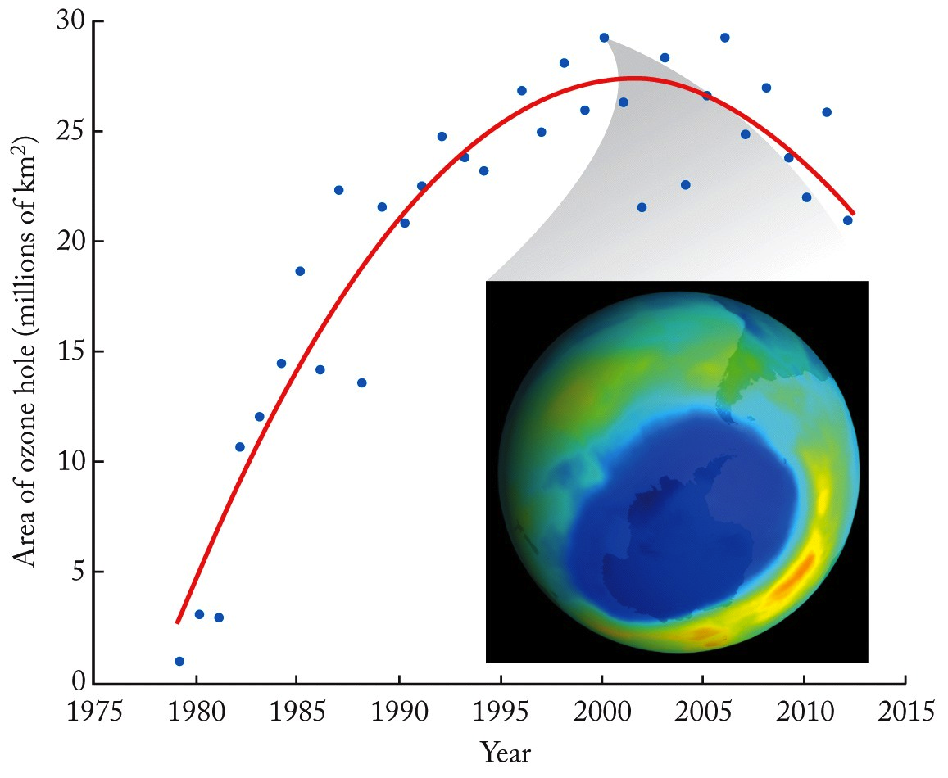
Catalysts and the Ozone Layer

Slide 50
Ozone Layer
Natural Photodecomposition of Ozone:
Mechanism:
(1)
(2)
Net: 2 O₃(g) → 3 O₂(g)
E_{a} for step 2 = 17.7 kJ/mol (slow step)

Slide 51
CFC Emissions and Ozone
Clorofluorocarbons (CFC)
CCl₂F₂, CCl₃F, CClF₃ – stable!
CFCs in stratosphere:
(1)
(2)
Net: 2 O₃(g) → 3 O₂(g)
E_{a} for Cl-catalyzed reaction = 2.2 kJ/mol

Slide 52
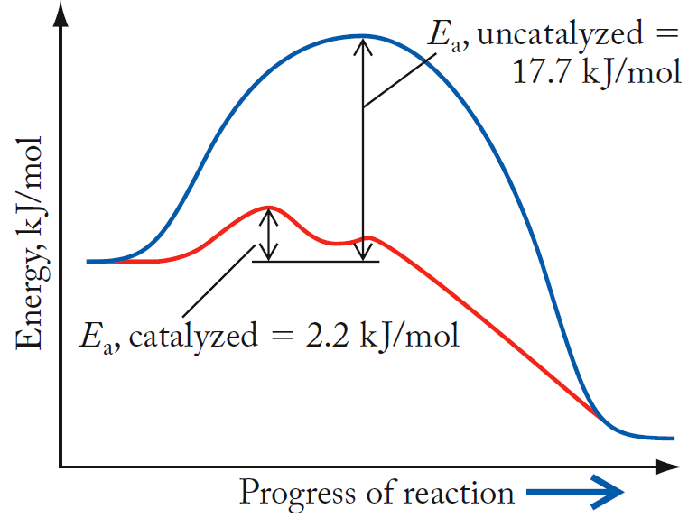
Energy Profiles for O₃ Decomposition
Cl atom:
- Not consumed during the reaction
- Homogeneous catalyst

Slide 53
Types of Catalysts
Homogeneous Catalyst:
One in the same phase as the reactants
Heterogeneous Catalyst:
One in a different phase from the reactants

Slide 54
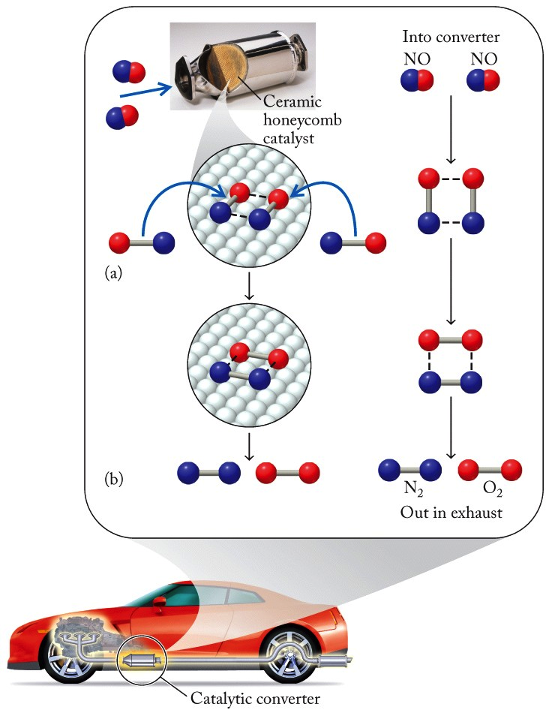
Catalytic Converters
2 NO → N₂ + O₂
Metal surface speeds up conversion of NO to N₂/O₂, reduces smog-producing emissions
Heterogeneous catalyst

Slide 55
ChemTours: Chapter 13
Click here to launch the ChemTours website

Slide 56
This concludes the Lecture PowerPoint presentation for Chapter 13

