Slide 1
Ch. 8: Nomenclature
Naming of compounds

Slide 2
Metals and non-metals combine to form ionic compounds
Non-metals and non-metals combine to form molecular compounds

Slide 3
Binary Compounds – composed of only two elements, though may have more than two atoms:
NaCl, KF, CaCl₂, CO, CO₂, H₂O, C₆H₁₄, HCl, …

Slide 4
Naming Ions:
●Cation (metal) – name is the same as the element, + 'ion'
●Fixed charge cations – metals that only form one cation (such as Group 1 and 2 metals):
Li⁺¹ → lithium ion, Ca⁺² → calcium ion
●Variable charged cations – metals that may form different cations (most transition metals).
Use Roman numerals to show the charge:
Fe⁺² → iron (II) ion
Fe⁺³ → iron (III) ion

Slide 5
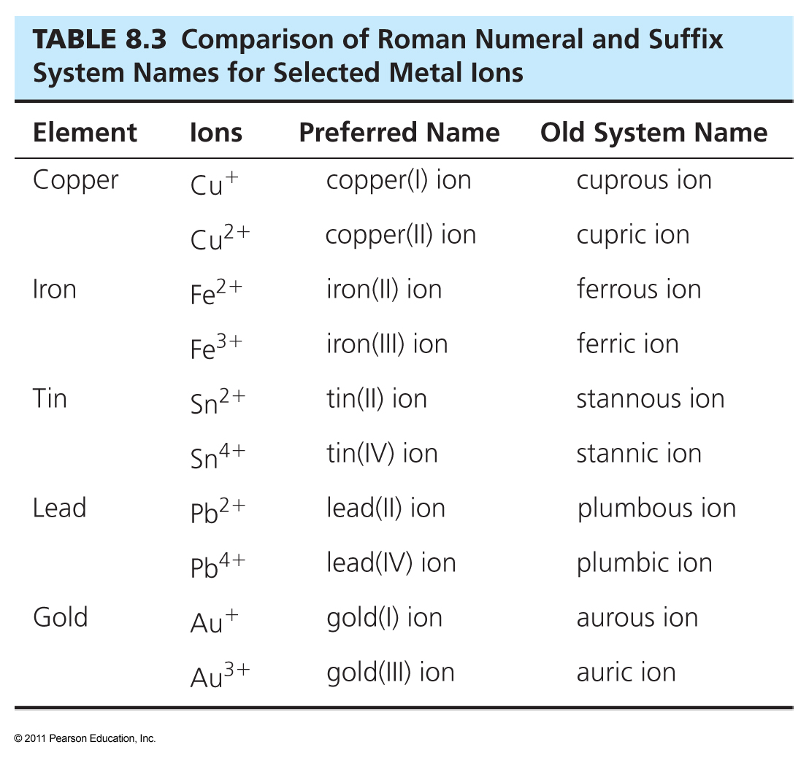

Slide 6
●Anion (non-metal) – use the root of the element name, change the ending to 'ide', + 'ion':
S → S⁻²
sulfur → sulfide ion
N → N⁻³
nitrogen → nitride ion
O → O⁻²
oxygen → oxide ion

Slide 7
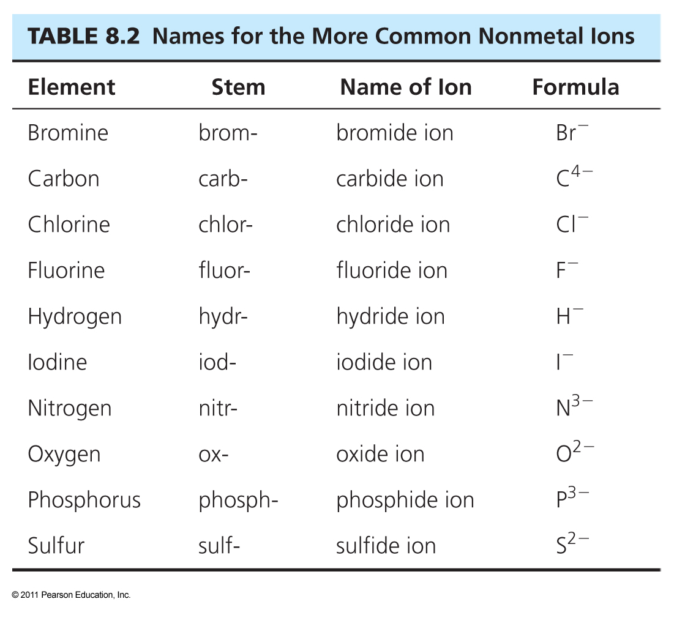

Slide 8
Naming Binary Ionic Compounds:
●List the cation first, then the anion
●Do not include 'ion' in the name
●Names must be distinctive, in order to distinguish between similar compounds, such as with variable-charged metals
NaCl – sodium chloride
CaF₂ – calcium fluoride
FeI₂ – iron (II) iodide
FeI₃ – iron (III) iodide

Slide 9
For variable charged ionic compounds:
●Basically, all metals are variable charged, except for:
Group 1, Group 2, Ag⁺¹, Zn⁺², Cd⁺², Al⁺³, Ga⁺³
●For all other metals, the Stock System (Roman Numerals) must be used:
Cu2O – copper (I) oxide
CuO – copper (II) oxide

Slide 10
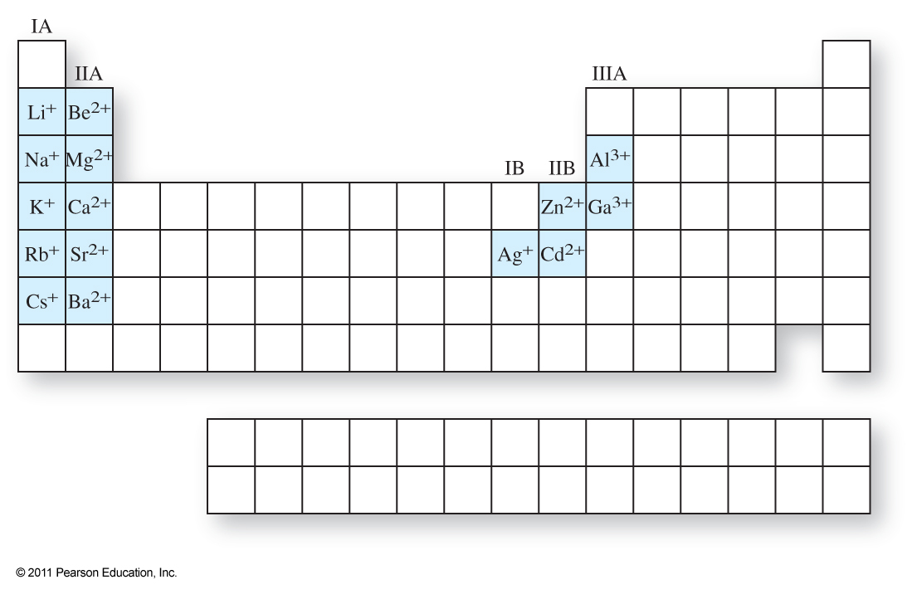

Slide 11
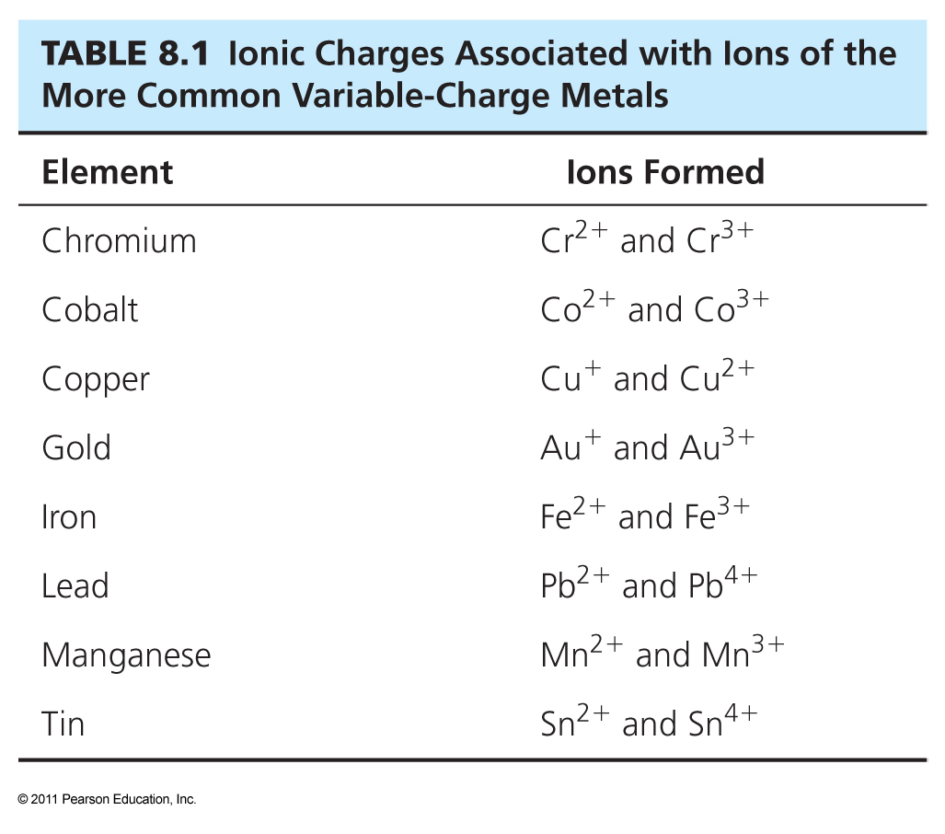

Slide 12
To determine the charge on a variable charge cation, treat the formula as an algebraic expression:
To determine the iron charge in Fe₂O₃
●let Fe = x and O = y (x and y are ionic charges)
●the charges of the ions must add up to the overall charge, which is 0 in this case, so
2x + 3y = 0
●we know that y = -2 (oxide ion)
2x + 3 (-2) = 0
x = +3
●so Fe₂O₃ is named iron (III) oxide

Slide 13
Writing formulas for binary ionic compounds:
●The formula shows a ratio of one ion to the other.
●The ionic charges must cancel out so that the overall charge is neutral
●Always list the metal first, then the non-metal
●Select subscripts to balance charges
●Reduce subscripts if needed to obtain the lowest whole number ratio between ions

Slide 14
Polyatomic Ions
These are covalently bonded atoms with an overall charge (an ionic molecule):
NO₃⁻¹ – nitrate ion
ClO₃⁻¹ – chlorate ion
C₂H₃O₂⁻¹ – acetate ion
OH⁻¹ – hydroxide ion
SO₄⁻² – sulfate ion
CO₃⁻² – carbonate ion
PO₄⁻³ – phosphate ion
H₃O⁺¹ – hydronium ion
NH₄⁺¹ – ammonium ion (NH3 – ammonia)

Slide 15
Oxyions
Polyatomic ions containing oxygen and another non-metal
Most common forms end in 'ate'
One less oxygen ends in 'ite'
Two less oxygens, 'hypo' prefix and 'ite' suffix
One more oxygen, 'per' prefix and 'ate' suffix
ClO⁻¹ – hypochlorite ion
ClO₂⁻¹ – chlorite ion
ClO₃⁻¹ – chlorate ion
ClO₄⁻¹ – perchlorate ion

Slide 16
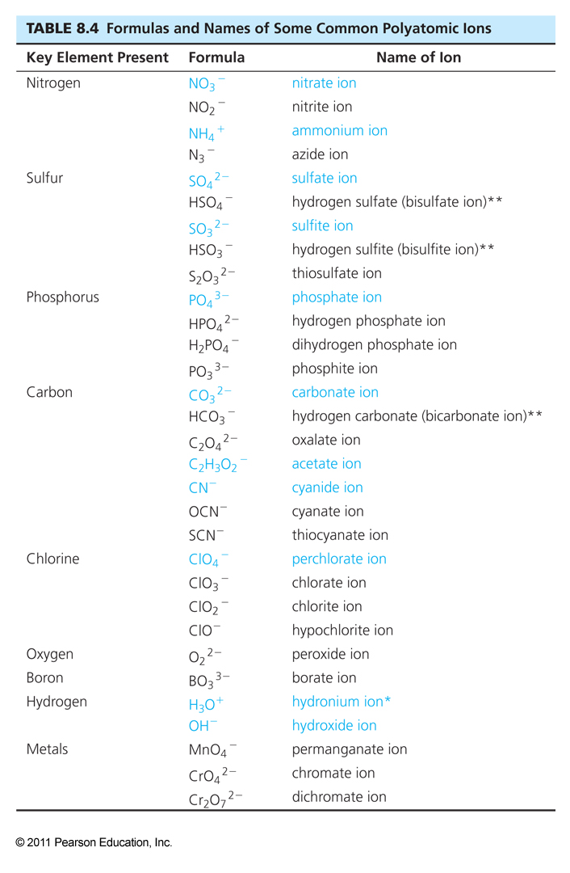

Slide 17
Naming Binary Molecular Compounds
●For the first element, use the elemental name
●For the second, change the ending to 'ide'
●To determine which element is listed first:
  Lower group first
  If both elements are in the same group, then the largest number period is first
    Exceptions:
    Hydrogen goes between groups 15 and 16
    Oxygen is between F and Cl, for naming order

Slide 18


Slide 19
●The formula name must indicate the subscripts
●use prefixes to show subscripts
●The prefix 'mono' is not used on the first element listed
●Remember that molecules have fixed numbers of atoms linked together, so DO NOT reduce coefficients to lower ratios

Slide 20
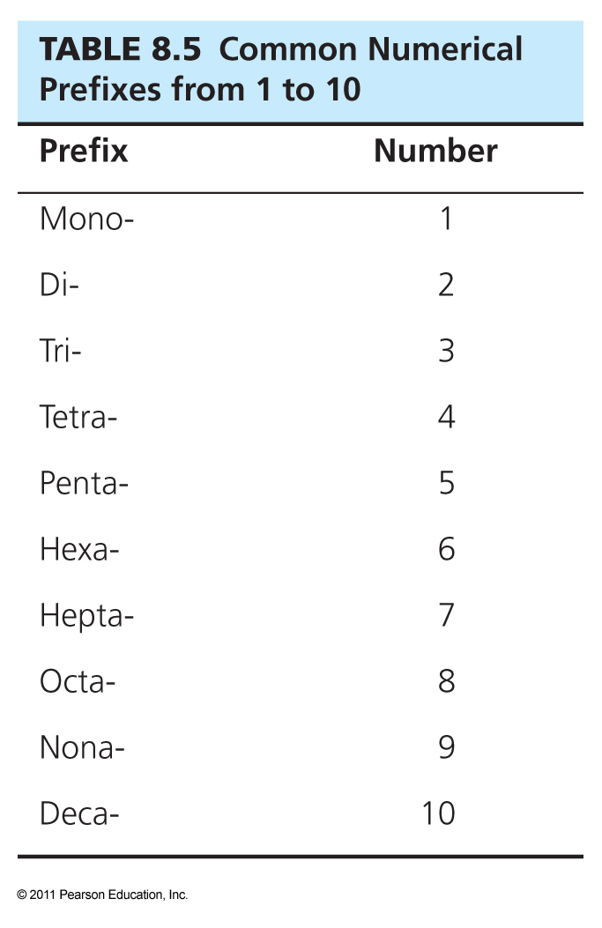

Slide 21
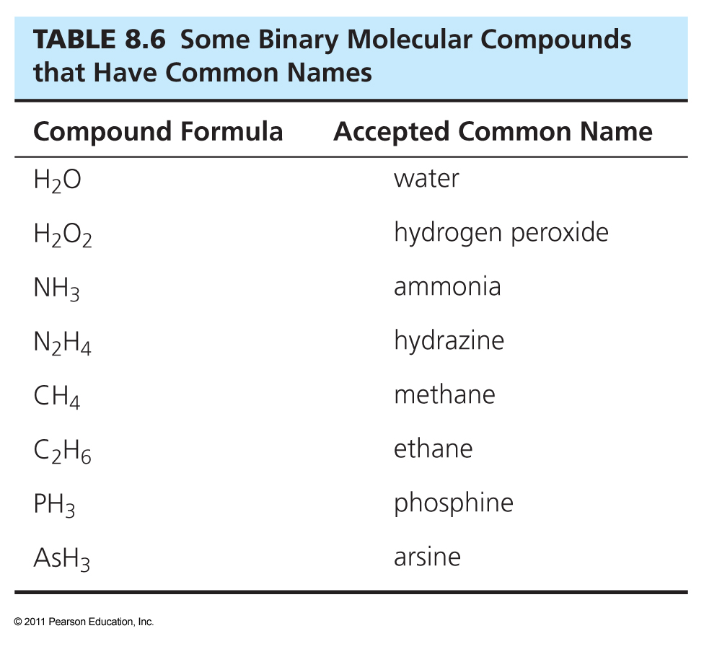

Slide 22
Naming Acids
Acids are molecules that split apart in water to form H⁺¹ (H₃O⁺¹) ions and an anion
The acidic H(s) is usually listed first in the formula
If the name of the anion formed:
  ends in 'ide'
    'hydro' + stem of anion + 'ic' + 'acid'
    HCl → hydrochloric acid
  ends in 'ate'
    stem of anion + 'ic' + 'acid'
    HClO₃ → chloric acid
  ends in 'ite'
    stem of anion + 'ous' + 'acid'
    HClO₂ → chlorous acid

Slide 23


