Slide 1
Energy and Environment Solar Energy

Slide 2
Introduction of Terms and Units
Speed:
Velocity:
Acceleration:
Mass:
Force:
Work:
Power:
Energy: Types and Transformations
SI units:
Activity: Walking and running up steps

Slide 3
Electricity
Voltage (V), Current (I) and Resistance (R)
Electric current is a flow of electrons. Electron flow is in the opposite direction of current flow.
Ohm’s law: V=IR
Electric Power = P = IV
https://phet.colorado.edu/en/simulations/category/new

Slide 4
Generating Electricity
Hand-held generator: Faraday’s law
Nuclear Power Plant
Solar Power Plant
Hydropower plant
Coal-Burning power plant
Coal and Air pollution

Slide 5
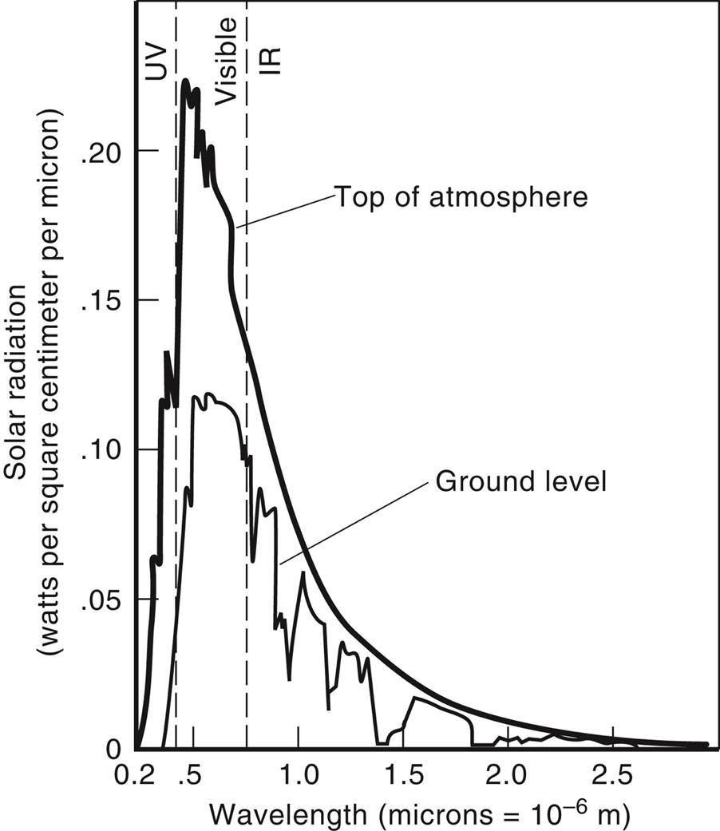
Incident Solar Energy
About the Sun
The predominant Nuclear reaction in the sun responsible for the solar energy is the fusion of Hydrogen nuclei into helium nuclei.
4 billions kilograms of matter per second is released as matter converted into energy.

Slide 6
Mass loss of Sun
The sun radiates electromagnetic energy at the rate of 3.85 x 10²⁶ W (Luminosity).
(a) What is the change in the sun's mass during each second that it is radiating energy?
(b) The mass of the sun is 1.99 x 10³⁰kg. What fraction of the sun's mass is lost during a human lifetime of 75 years?

Slide 7
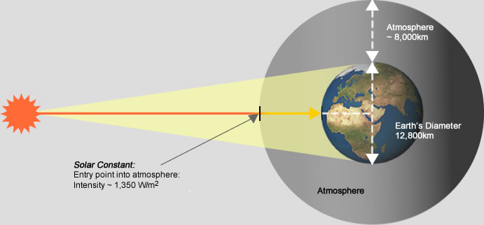
About the Sun: Solar Constant
The fraction of light reflected from the earth and its atmosphere is called albedo
19% of the radiation received is absorbed by the clouds and other gases.
“Solar constant” = the rate at which solar energy reaches top of Earth’s atmosphere.
1354W/m² perpendicular to the rays.
Image: http://www.greenrhinoenergy.com/solar/radiation/images/solar-constant.jpg

Slide 8
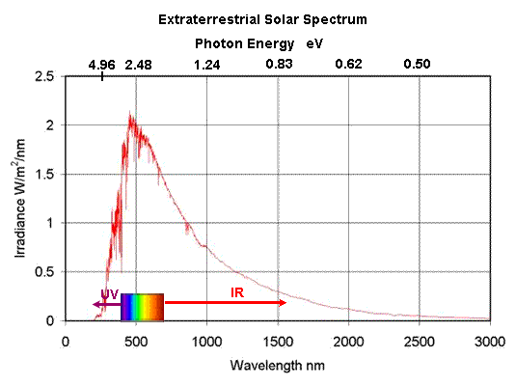
Solar Radiation
http://www.mpoweruk.com/solar_power.htm
Sunlight comes in many colors, combining low-energy infrared photons (1.1 eV) with high-energy ultraviolet photons (3.5 eV) and all the visible-light photons in between.
The graph above shows the spectrum of the solar energy impinging on a plane, directly facing the sun, outside the Earth's atmosphere at the Earth's mean distance from the Sun. The area under the curve represents the total energy in the spectrum. Known as the "Solar Constant" G₀, it is equal to 1367 W/m².

Slide 9
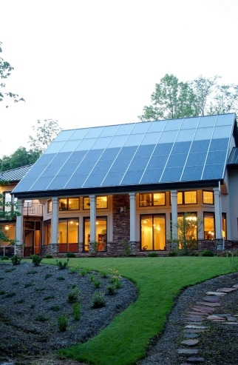
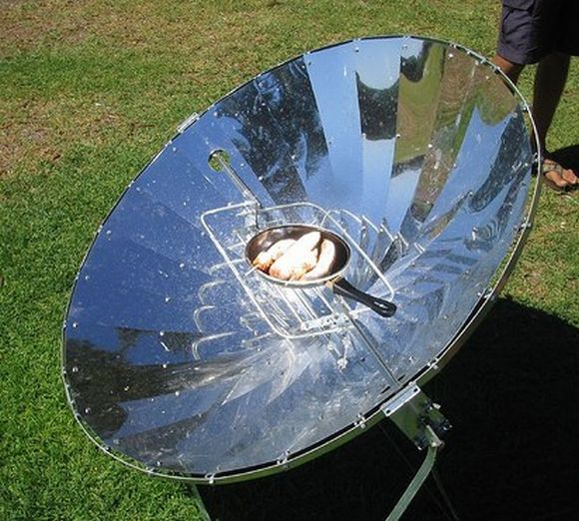
Passive Solar Heating & Solar Cooker
http://energy.gov/energysaver/passive-solar-home-design
http://trendsupdates.com/ram%E2%80%99s-project-surya-replaces-biomass-fuels-with-solar-cookers/
http://www.azsolarcenter.org/tech-science/solar-for-consumers/passive-solar-energy/passive-solar-design-manual-consumer/passive-solar-design-manual-heating.html

Slide 10
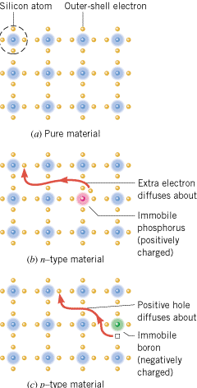
n-TYPE AND p-TYPE SEMICONDUCTORS
A silicon crystal that is (a) undoped, or pure,
(b) doped with phosphorus to produce an n-type material, and
(c) doped with boron to produce a p-type material.

Slide 11
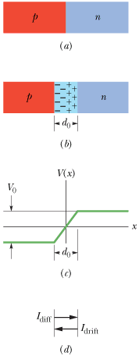
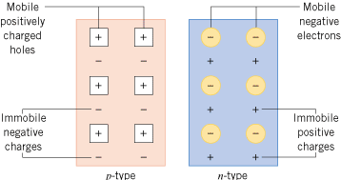
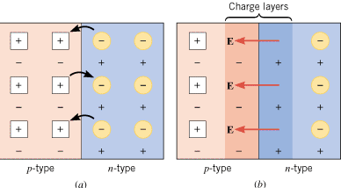
THE SEMICONDUCTOR DIODE
A p-n junction diode is a device formed from a p-type semiconductor and an n-type semiconductor. The p-n junction between the two materials is of fundamental importance to the operation of diodes and transistors.

Slide 12
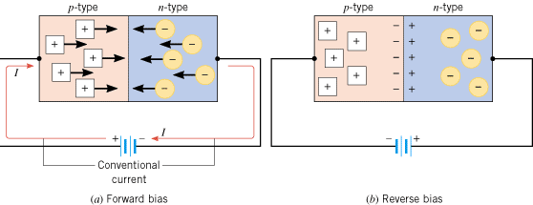
Forward and Reverse Bias
(a) There is an appreciable current through the diode when the diode is forward biased. (b) Under a reverse bias condition, there is almost no current through the diode.

Slide 13
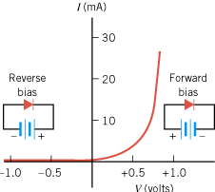
The current-versus-voltage characteristics of a typical p-n junction diode
https://www.youtube.com/watch?v=MVy_MG0X2h4

Slide 14
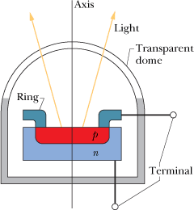
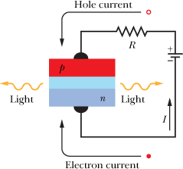
LED, light-emitting diode
A forward-biased p-n junction, showing electrons being injected into the n-type material and holes into the p-type material. Light is emitted from the narrow depletion zone each time an electron and a hole combine .
For an LED, the longer lead is positive.

Slide 15
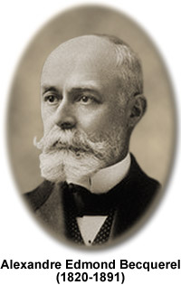
The photovoltaic effect
Discovered in 1839 by A. Edmond Becquerel:
Son of physicist Antoine-César
Father of physicist [Antoine-]Henri Becquerel, co-discoverer of radioactivity [Nobel Prize, 1903].
Sunlight + semiconductor → electricity
Image: http://micro.magnet.fsu.edu/optics/timeline/people/antiqueimages/becquerel.jpg

Slide 16
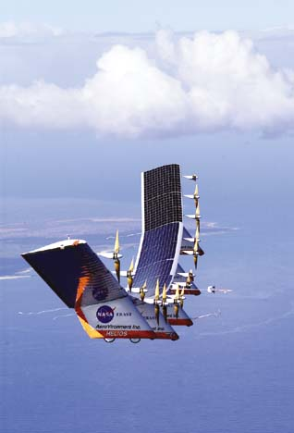
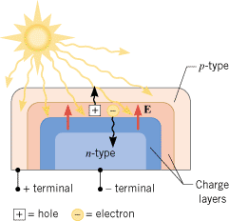
SOLAR CELLS
Solar cells use p-n junctions to convert sunlight directly into electricity.
The sunlight causes the solar cell to develop negative and positive terminals, much like the terminals of a battery.

Slide 17
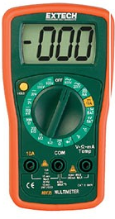
Digital Multimeter
Introduction
Sample measurements

Slide 18
Measuring the properties of a solar panel
Voltage
Current
Power

Slide 19
Applications
World Solar Challenge
Mars Rover
Humanity From Space

