Slide 1
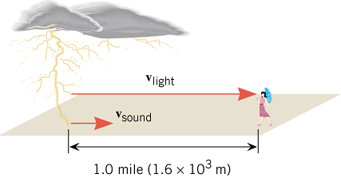
Light and Electricity
Standard 4-5: The student will demonstrate an understanding of the properties of light and electricity. (Physical Science)
4-5.1 Summarize the basic properties of light (including brightness and colors).
4-5.2 Illustrate the fact that light, as a form of energy, is made up of many different colors. (Use a diffraction grating)
4-5.3 Summarize how light travels: Evidence for light to travel through vacuum.
http://amazing-space.stsci.edu/resources/explorations/light/ems-frames.html

Slide 2
Light and Electricity
Standard 4-5: The student will demonstrate an understanding of the properties of light and electricity. (Physical Science)
4-5.5 Explain how electricity, as a form of energy, can be transformed into other forms of energy (including light, heat, and sound).
Turn on a light in a dark room and show what happens?
Explain using the following: 1. Use energy transformations…..light, heat, etc.. 2. Do a demo with light bulb, wire, and a battery to light a bulb.
Bouncing Ball Experiment:

Slide 3
ENERGY
Energy Transformations
Energy comes in many forms. Write down forms of Energy below:
Process/Device | Initial form of energy | Final form of energy
Falling object
Photosynthesis
Light bulb
Electric motor
Electric generator
Solar still
Photovoltaic cell (solar cell)
During friction
Using a battery
Charging a battery
In a microphone
In a loudspeaker
In a nuclear reactor

Slide 4
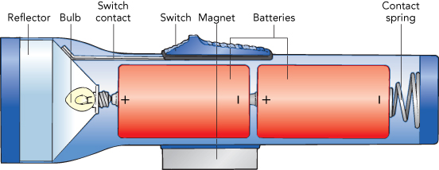
Light and Electricity
Standard 4-5: The student will demonstrate an understanding of the properties of light and electricity. (Physical Science)
4-5.6 Summarize the functions of the components of complete circuits (including wire, switch, battery, and light bulb).
4-5.7 Illustrate the path of electric current in series and parallel circuits.
4-5.8 Classify materials as either conductors or insulators of electricity.

Slide 5
Useful Websites
http://www.discoveryeducation.com/search/page/k-5/science/-/-/index.cfm?campaign=flyout_teachers_k5_science
http://www.strangematterexhibit.com/
http://faculty.washington.edu/chudler/chsense.html
http://www.mcps.k12.mt.us/portal/Staff/Libraries/K5ScienceResources/tabid/323/Default.aspx
Vendors:
http://www.mpja.com/ http://www.cynmar.com/home.aspx http://www.freyscientific.com/ http://www.pasco.com/
http://www.sargentwelch.com/ http://www.a3bs.com/
http://www.teachersource.com/ http://www.arborsci.com/ http://www.carolina.com

