Slide 1
Algebra and Physics Connections
Program for TEA fellows 2015
Feb. 19 & March 5, 9:30 – 11:30 AM, Sims 207
BY
Zachary Abernathy, PhD
Mathematics
Dept of Mathematics
Winthrop University
Rock Hill SC 29733
Ph: 803-323-4605
http://faculty.winthrop.edu/abernathyz/
Ponn Maheswaranathan, PhD
Physics
Dept of Chem/Physics/Geol
Winthrop University
Rock Hill SC 29733
Ph: 803-323-4940
Fax: 803-323-2246
http://bohr.winthrop.edu/faculty/mahes/ link_to_webpages/personal/mahes.html

Slide 2
Useful Websites
http://www.ptable.com/
Solid State Chemistry at MIT
https://www.khanacademy.org/
http://www.hippocampus.org/
http://ocw.mit.edu/index.htm
http://sprott.physics.wisc.edu/wop.htm
https://phet.colorado.edu/
http://www.colorado.edu/physics/2000/applets/
http://www.falstad.com/mathphysics.html

Slide 3
Atomic Bonding
https://www.youtube.com/watch?v=jBSHhtzZeSA
Primary Bonding:
Ionic Bonding, non-directional
Metallic Bonding, non-directional
Covalent Bonding: strong, localized, and directional
Secondary Bonding (or Van der Waals bonding):
Induced dipole/induced dipole
Permanent/induced dipole
Permanent/Permanent dipole
Hydrogen bonding

Slide 4
Metallic Crystal Structures
• Tend to be densely packed.
• Reasons for dense packing:
- Typically, only one element is present, so all atomic
radii are the same.
- Metallic bonding is not directional.
- Nearest neighbor distances tend to be small in
order to lower bond energy.
- Electron cloud shields cores from each other
• Have the simplest crystal structures.
We will examine two such structures...

Slide 5
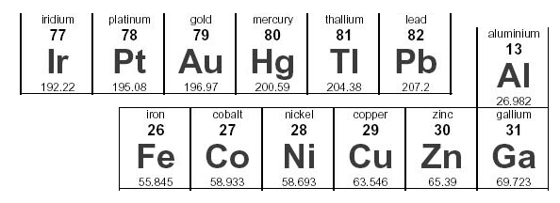
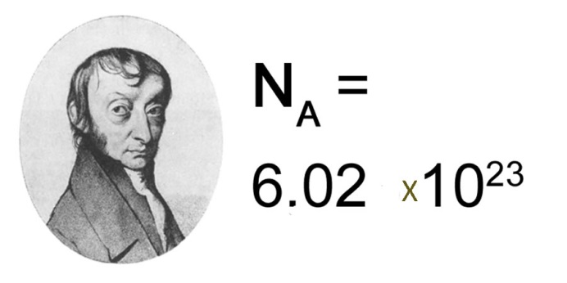
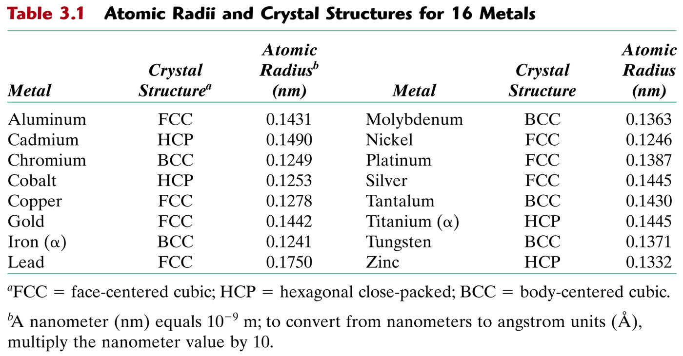
table_03_01
Visit this vernier web site and learn how to use a vernier caliper. http://www.youtube.com/watch?v=4hlNi0jdoeQ

Slide 6
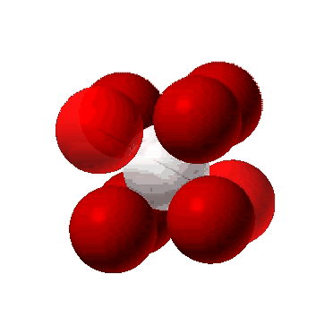
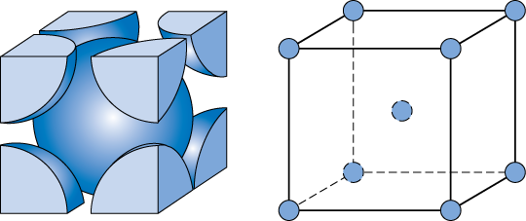
Body Centered Cubic Structure (BCC)
https://www.youtube.com/watch?v=CsnNbuqxGTk
• Atoms touch each other along cube diagonals.
--Note: All atoms are identical; the center atom is shaded
differently only for ease of viewing.
ex: Cr, W, Fe (α), Tantalum, Molybdenum
• Coordination # = 8
Adapted from Fig. 3.2,
Callister & Rethwisch 8e.
Click once on image to start animation
(Courtesy P.M. Anderson)
2 atoms/unit cell: 1 center + 8 corners x 1/8

Slide 7
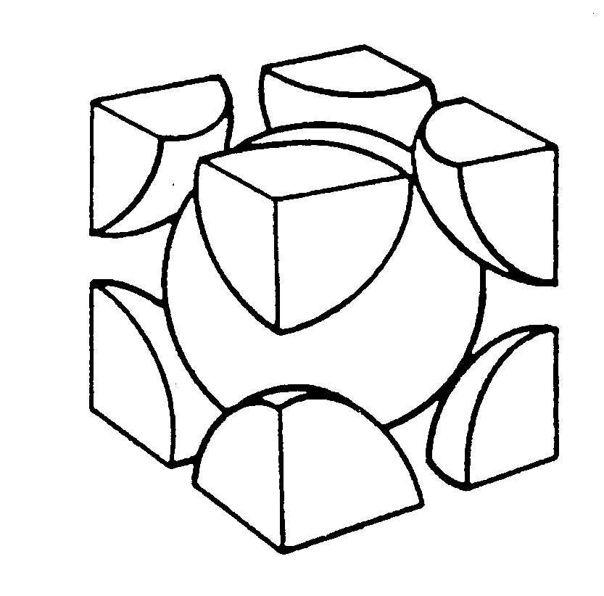
Density: BCC
3
a
a
2
a
R
Close-packed directions:
a
Adapted from
Fig. 3.2(a), Callister & Rethwisch 8e.
length = 4R =
3 a

Slide 8
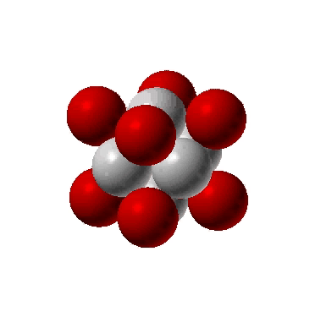
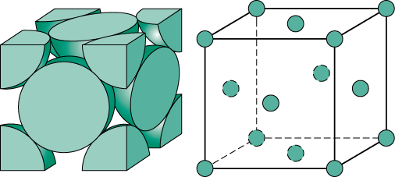
Face Centered Cubic Structure (FCC)
• Atoms touch each other along face diagonals.
--Note: All atoms are identical; the face-centered atoms are shaded
differently only for ease of viewing.
ex: Al, Cu, Au, Pb, Ni, Pt, Ag
• Coordination # = 12
Adapted from Fig. 3.1, Callister & Rethwisch 8e.
Click once on image to start animation
4 atoms/unit cell: 6 face x 1/2 + 8 corners x 1/8
(Courtesy P.M. Anderson)

Slide 9
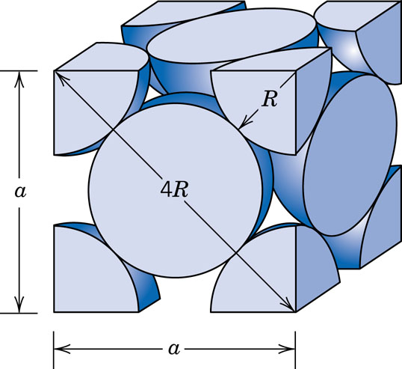
Density: FCC
Close-packed directions:
length = 4R =
2 a
Unit cell contains:
6 x 1/2 + 8 x 1/8
=
4 atoms/unit cell
Adapted from
Fig. 3.1(a),
Callister & Rethwisch 8e.

