Slide 1
Energy Forms and Transformations
Kinetic Energy
Potential Energy: Gravitational & Elastic
Pendulum Motion
Energy Transformations
Human body
Automobile
Pole Vault and Bungee jumping
Nuclear power station
Conservation of Energy

Slide 2
Kinetic Energy
Kinetic energy is the energy of motion. The word “kinetic” originated from the Greek word kinetikos, meaning “motion”.
If an object of mass, m moves with a velocity v, then the kinetic energy, KE is given by the following equation,
Kinetic energy is a scalar quantity. It also has the same unit as work, joule (J).
1 J = 1 kg.m²/s².

Slide 3
Gravitational Potential Energy
Gravitational potential energy, GPE is the energy stored in an object as a result of its height. It can be calculated using weight, which is mass times gravity, and height. It is given by the following equation,
Gravitational potential energy is a scalar quantity.
The SI unit for it is also joule, J.

Slide 4
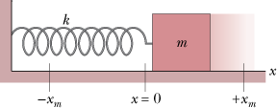
Elastic Potential energy
Elastic potential energy is the energy stored in elastic materials as the result of their stretching or compressing.
How shock absorbers work?
http://www.youtube.com/watch?v=8abzpXCjyjA

Slide 5
Energy Transformations
Q: Give an example where gravitational potential energy is converted into kinetic energy?
A: Falling object.

Slide 6
Conservation of Energy
The swing of the pendulum demonstrates the principle of conservation of energy.
Mechanical energy = KE + PE
In the absence of friction and air drag, the total mechanical energy of a system remains a constant.
http://www.youtube.com/watch?v=BVxEEn3w688
http://www.youtube.com/watch?v=mhIOylZMg6Q&feature=related

Slide 7
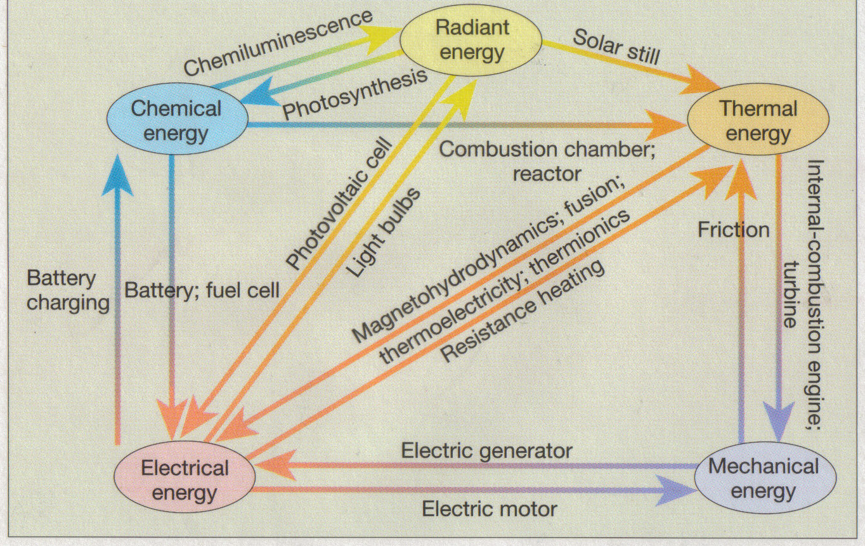
Forms of Energy and Transformations

Slide 8
Energy Transformations
Process/Device | Initial form of energy | Final form of energy
Photosynthesis
Light bulb
Electric motor
Electric generator
Solar still
Photovoltaic cell (solar cell)
During friction
Using a battery
Charging a battery
In a microphone
In a loudspeaker
In a nuclear reactor

Slide 9
Energy Transformations in the Human body
Part of the chemical energy stored in food is transformed into the kinetic energy of physical activities and into the thermal energy needed to keep our bodies at a temperature near 98.6 °F.
Energy Transformations in an Automobile
In an automobile chemical energy of gasoline is converted into thermal energy, and then into kinetic energy, as well as electrical energy (to operate the radio, headlights, and air conditioner), and heat.

Slide 10
Energy Transformations in Pole Vault
http://www.youtube.com/watch?v=7vK8katSGvo&feature=related
Forms of Energy:
Energy Transformations:

Slide 11
Bungee-Jumping
http://www.youtube.com/watch?v=CVE5eqel5-M&feature=related
Identify the energy transformations during a bungee-jumping:

Slide 12
Hydroelectic Power - How it Works
http://www.youtube.com/watch?v=cEL7yc8R42k

Slide 13
Energy Transformations in a Nuclear Power Station

Slide 14
The CONSERVATION OF ENERGY
Whenever energy is transformed from one form to another, it is found that no energy is gained or lost in the process; the total of all the energies before the process is equal to the total of the energies after the process. This observation leads to the conservation of energy:
Energy can neither be created nor destroyed, but can only be converted from one form to another.
Learning how to convert energy from one form to another more efficiently is one of the main goals of modern science and technology.

