Slide 1
Theoretical Density, ρ
Chapter 3: The Structure of Crystalline Solids
Mass
of
Atoms
in
Unit
Cell
Density = ρ =
Total
Volume
of
Unit
Cell
n A
ρ =
V_{C} N_{A}
where n = number of atoms/unit cell
A = atomic weight
V_{C} = Volume of unit cell = a³ for cubic
N_{A} = Avogadro’s number
= 6.022 x 10²³ atoms/mol

Slide 2
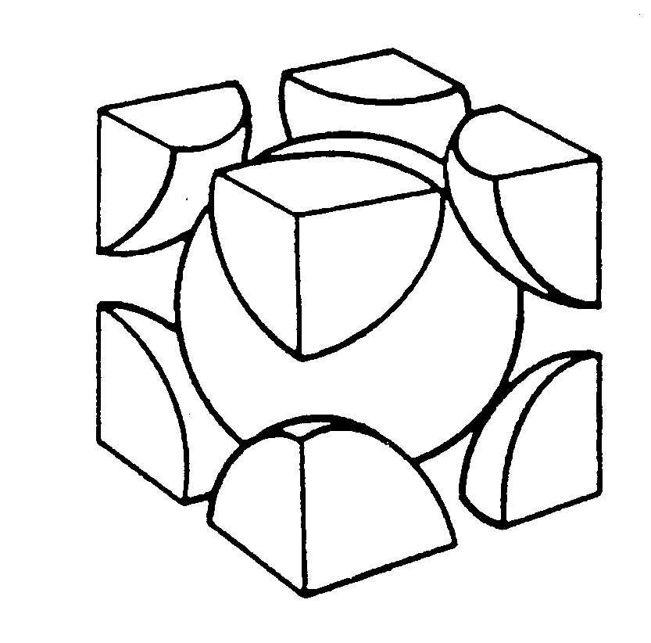
Theoretical Density, ρ
Ex: Cr (BCC)
A = 52.00 g/mol
R = 0.125 nm
n = 2 atoms/unit cell
R
a = 4R/ 3 = 0.2887 nm
Adapted from
Fig. 3.2(a), Callister & Rethwisch 8e.
a
atoms
g
unit cell
2
52.00
ρ_{theoretical}
mol
= 7.18 g/cm³
ρ =
ρ_{actual}
= 7.19 g/cm³
a³
6.022 x 10²³
volume
atoms
unit cell
mol

Slide 3
Densities of Material Classes
In general
Metals/
Graphite/
Composites/
ρ
>
ρ
>
ρ
Ceramics/
Polymers
metals
ceramics
polymers
Alloys
Semicond
fibers
Why?
30
Platinum
B
ased on data in Table B1, Callister
2
0
*GFRE, CFRE, & AFRE are Glass,
Metals have...
• close-packing
(metallic bonding)
• often large atomic masses
Gold, W
Carbon, & Aramid Fiber-Reinforced
Tantalum
Epoxy composites (values based on
60% volume fraction of aligned fibers
10
Silver, Mo
in an epoxy matrix).
Cu,Ni
Steels
Tin, Zinc
Zirconia
Ceramics have...
• less dense packing
• often lighter elements
3
5
4
Titanium
Al oxide
(g/cm )
Diamond
3
Si nitride
Aluminum
Glass
-
soda
Glass fibers
Concrete
PTFE
ρ
2
Silicon
GFRE*
Polymers have...
• low packing density
(often amorphous)
• lighter elements (C,H,O)
Magnesium
Carbon
fibers
G
raphite
Silicone
CFRE
*
PVC
A
ramid fibers
PET
AFRE
*
1
PC
H
DPE, PS
PP, LDPE
0.5
Composites have...
• intermediate values
Wood
0.4
0.3
Data from Table B.1, Callister & Rethwisch, 8e.

Slide 4
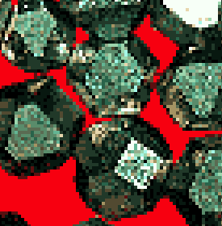
Crystals as Building Blocks
• Some engineering applications require single crystals:
-- diamond single
crystals for abrasives
-- turbine blades
Fig. 8.33(c), Callister & Rethwisch 8e. (Fig. 8.33(c) courtesy of Pratt and Whitney).
(Courtesy Martin Deakins,
GE Superabrasives, Worthington, OH. Used with permission.)
• Properties of crystalline materials
often related to crystal structure.
-- Ex: Quartz fractures more easily along some crystal planes than others.
(Courtesy P.M. Anderson)

Slide 5
Polycrystals
Anisotropic
• Most engineering materials are polycrystals.
Adapted from Fig. K, color inset pages of Callister 5e.
(Fig. K is courtesy of Paul E. Danielson, Teledyne Wah Chang Albany)
1 mm
Isotropic
• Nb-Hf-W plate with an electron beam weld.
• Each "grain" is a single crystal.
• If grains are randomly oriented,
overall component properties are not directional.
• Grain sizes typically range from 1 nm to 2 cm
(i.e., from a few to millions of atomic layers).

Slide 6
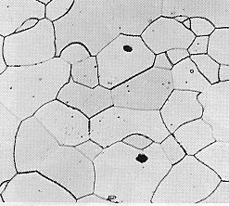
Single vs Polycrystals
• Single Crystals
E (diagonal) = 273 GPa
-Properties vary with
direction: anisotropic.
Data from Table 3.3, Callister & Rethwisch 8e. (Source of data is R.W. Hertzberg, Deformation and Fracture Mechanics of Engineering Materials, 3rd ed., John Wiley and Sons, 1989.)
-Example: the modulus
of elasticity (E) in BCC iron:
E (edge) = 125 GPa
• Polycrystals
-Properties may/may not
vary with direction.
-If grains are randomly
oriented: isotropic.
(E_{poly iron} = 210 GPa)
-If grains are textured,
anisotropic.
200 μm
Adapted from Fig. 4.14(b), Callister & Rethwisch 8e.
(Fig. 4.14(b) is courtesy of L.C. Smith and C. Brady, the National Bureau of Standards, Washington, DC [now the National Institute of Standards and Technology, Gaithersburg, MD].)

Slide 7
Polymorphism
Two or more distinct crystal structures for the same material.
Allotropy-when found in elemental solids. titanium
α, β-Ti
carbon
diamond, graphite
iron system
liquid
1538ºC
BCC
δ-Fe
1394ºC
FCC
γ-Fe
Allotropy of iron
912ºC
BCC
α-Fe

Slide 8
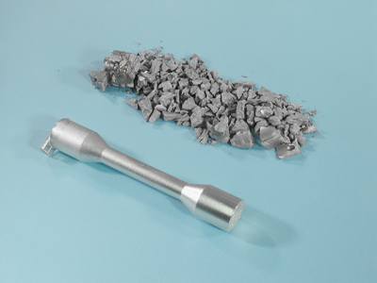
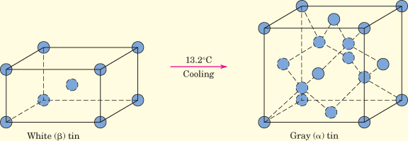
Tin (Its Allotropic Transformation)
White (or beta) tin, having a body-centered tetragonal crystal structure at room temperature, transforms, at 13.2°C (55.8°F), to gray (or alpha) tin, which has a crystal structure similar to diamond.
The rate at which this change takes place is extremely slow; however, the lower the temperature (below 13.2°C) the faster the rate.
This transformation results in: Increase in volume (27 %), and, a decrease in density (from 7.30 g/cm³ to 5.77 g/cm³). Consequently, this volume expansion results in the disintegration of the white tin metal into a coarse powder of the gray allotrope. This produced some rather dramatic results in 1850 in Russia. The winter that year was particularly cold, and record low temperatures persisted for extended periods of time. The uniforms of some Russian soldiers had tin buttons, many of which crumbled because of these extreme cold conditions, as did also many of the tin church organ pipes. This problem came to be known as the “tin disease.”

Slide 9
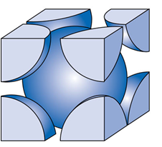
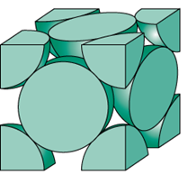
3.7 Iron has a BCC crystal structure, an atomic radius of 0.124 nm, and an atomic weight of 55.85 g/mol. Compute and compare its theoretical density with the experimental value found inside the front cover.
3.8 Calculate the radius of an iridium atom, given that Ir has an FCC crystal structure, a density of 22.4 g/cm³, and an atomic weight of 192.2 g/mol.

