Slide 1
Scanning Probe Microscopes
John Toby
Phys 321
20 April 2010

Slide 2
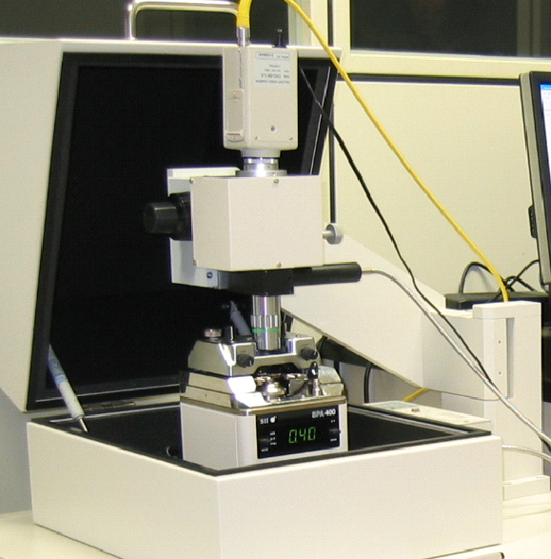
http://chem.skku.ac.kr/~skkim/research/SPM1.jpg

Slide 3
History
1590: Hans Janssen and Hans Lippershey credited with first microscope.
1676: Leeuwenhoek improves microscope and sees red blood cells and “wee beasties”.
1981: First type of scanning probe microscope used.

Slide 4
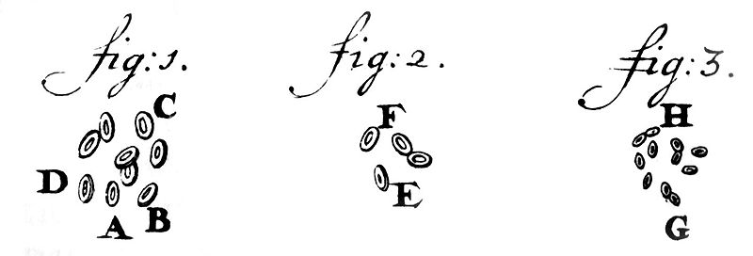
\\asdfdsafdsasdfsafasdfas\
http://www.google.com/imgres?imgurl=http://upload.wikimedia.org/wikipedia/commons/3/39/Leeuwenhoek1719RedBloodCells.jpg&imgrefurl=http://commons.wikimedia.org/wiki/File:Leeuwenhoek1719RedBloodCells.jpg&usg=__DrgUf8ST_SvRCkScoDfOi0Hsyss=&h=489&w=1440&sz=55&hl=en&start=2&sig2=kJ55wkh-oy-QbtPFc5KQ1Q&itbs=1&tbnid=nezUPrelvRRCYM:&tbnh=51&tbnw=150&prev=/images%3Fq%3Dleeuwenhoek%2Bred%2Bblood%2Bcell%26hl%3Den%26sa%3DG%26gbv%3D2%26tbs%3Disch:1&ei=D53NS9iIE8L-8AbFnZkz

Slide 5
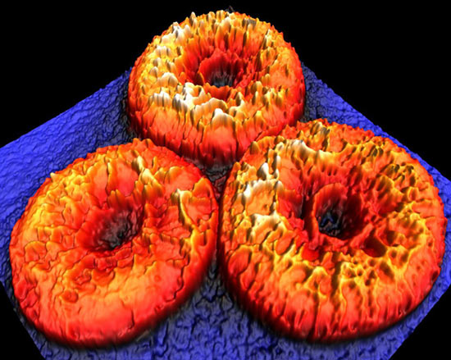
dvice.com/archives/2009/01/nanoscale-imagi.php

Slide 6
Advantages
Resolution is not impeded by diffraction but is controlled by probe size.
Specimen does not have to be a vacuum.
The method can make small structures

Slide 7
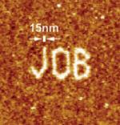
Example:
http://www.azom.com/work/Scanning%20Probe%20Microscopy%20and%20Atomic%20Force%20Microscopy,%20Recent%20Updates%20and%20an%20Overview%20of%20The%20Technol_files/image022.jpg

Slide 8
Disadvantages
Maximum image size is smaller
Can’t read liquids.
Rate of scanning is slow.
Specimen’s height can throw off the detail of scan if tall.

Slide 9
Questions?

Slide 10
Sources
“Microscope.” Wikipedia: The Free Encyclopedia. Wikimedia Foundation, Inc. Web. 12 April 2010. <http://en.wikipedia.org/wiki/Microscope>.
“Scanning probe microscopy.” Wikipedia: The Free Encyclopedia. Wikimedia Foundation, Inc. Web. 12 April 2010. <http://en.wikipedia.org/wiki/Scanning_probe_microscope >.
Sources for images are posted along with the image.

