Slide 1
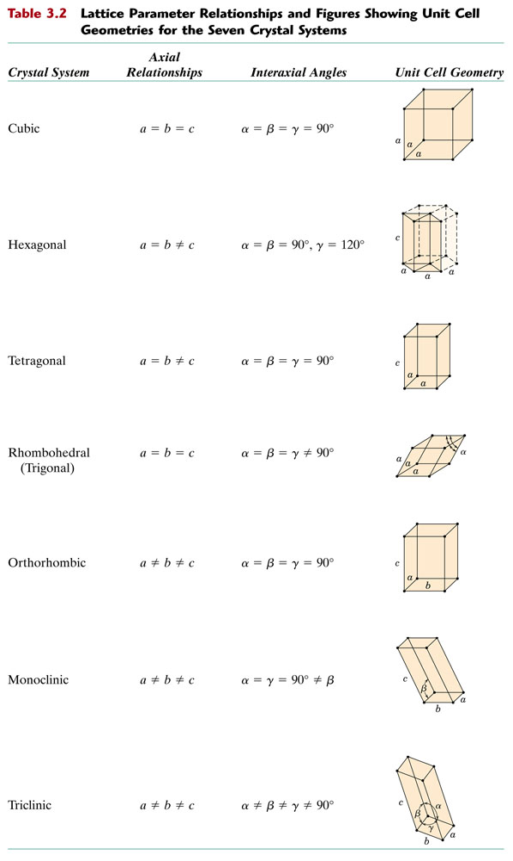
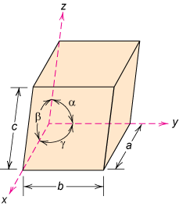
Crystal Systems
Unit cell: smallest repetitive volume which contains the complete lattice pattern of a crystal.
Fig. 3.4, Callister & Rethwisch 8e.
a, b, and c are the lattice constants.

Slide 2
Crystal Structure and Crystal System
Q. What is the difference between crystal structure and crystal system?
A: A crystal structure is described by both the geometry of, and atomic arrangements within, the unit cell, whereas a crystal system is described only in terms of the unit cell geometry. For example, face-centered cubic and body-centered cubic are crystal structures that belong to the cubic crystal system.

Slide 3
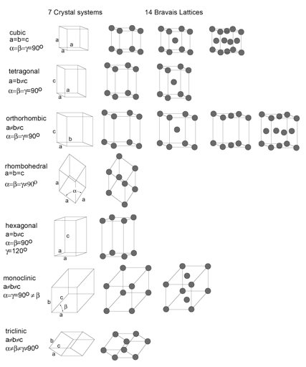
Crystal Systems & Bravais Lattices

Slide 4
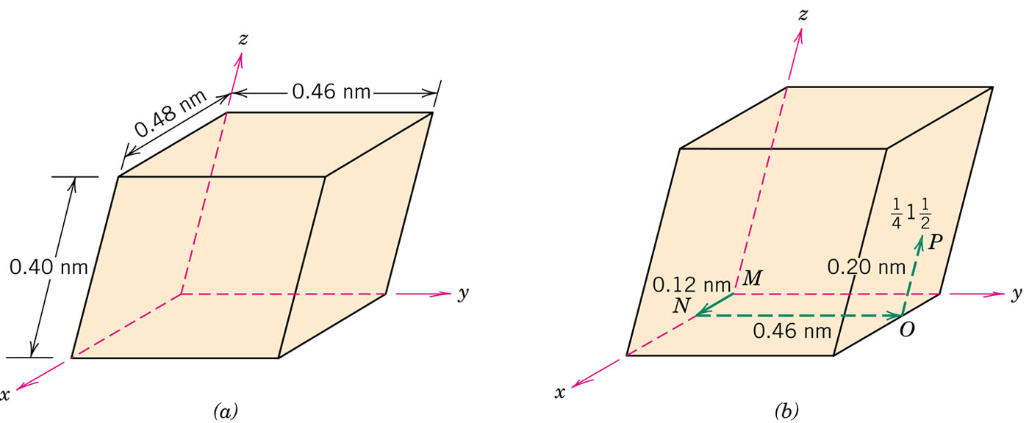
Point Coordinates
z
Point coordinates for unit cell center are
a/2, b/2, c/2 ½ ½ ½
Point coordinates for unit cell corner are 111
111
c
y
a
000
b
x

Slide 5
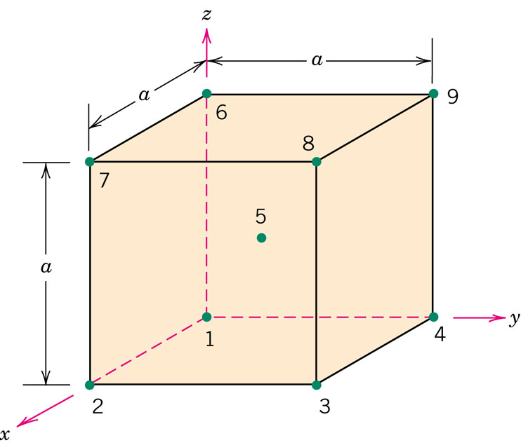
Point coordinates for all atom positions for a BCC unit cell

Slide 6
Crystallographic Directions
z
Algorithm
1. Vector repositioned (if necessary) to pass
through origin. 2. Read off projections in terms of unit cell dimensions a, b, and c 3. Adjust to smallest integer values 4. Enclose in square brackets, no commas
[uvw]
y
x
ex: 1, 0, ½
=> 2, 0, 1
=> [ 201 ]
-1, 1, 1
=>
[ 111 ]
where overbar represents a negative index
Notes:
Lecture 2 ended here

Slide 7
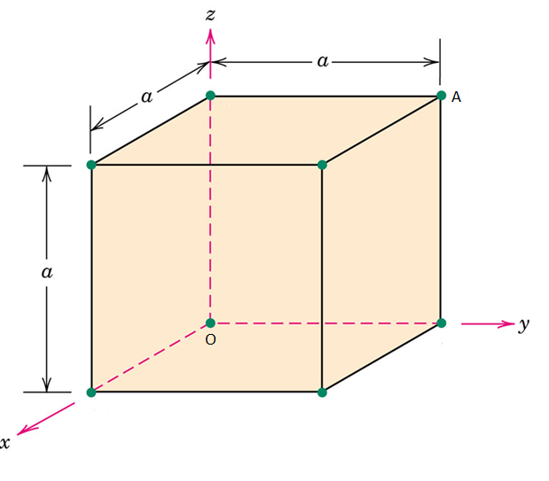
Crystallographic Directions
OA
AO
families of directions <uvw>
All cell edges:
All face diagonals:
All body diagonals:

Slide 8
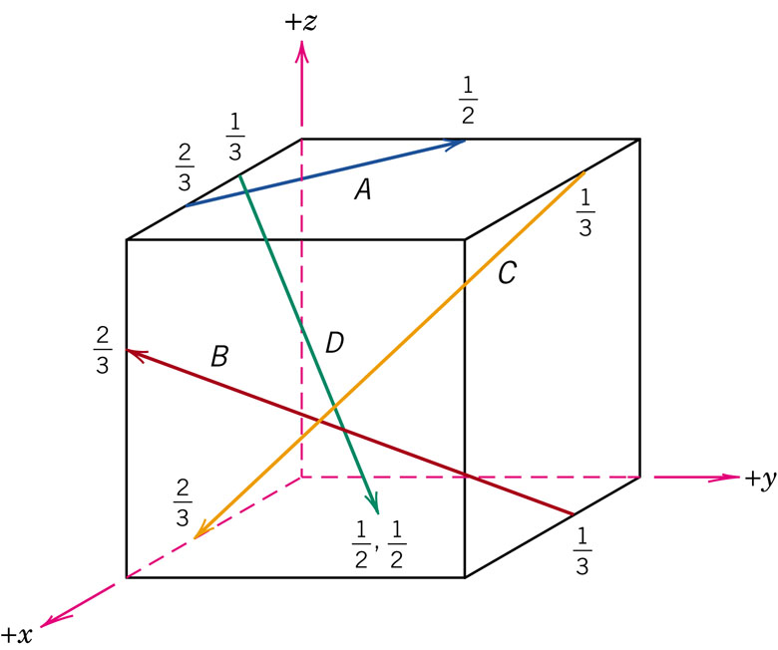
Problem 3.32
3.32 Determine the indices for the directions shown in the following cubic unit cell:

