Slide 1
Crystal Lattice Imperfections
There are four types of crystal lattice imperfections :
1. Zero-dimension point defects
2. One-dimension or line defects (dislocations)
3. Two-dimension defects which include external surfaces, grain boundaries, phase boundaries, twin boundaries, and staking faults.
4. Three-dimension bulk defects--- pores, cracks, and foreign inclusions.
1. One-dimension or line defects (dislocations)
Cause lattice distortion around a line.
Created--- during the solidification process, by the permanent or plastic deformation of crystalline solids, by vacancy condensation, and by atomic mismatch in solid solutions.
3 main types: 1. Edge dislocation
2. Screw dislocation
3. Combination of the two--- Mixed dislocation.

Slide 2
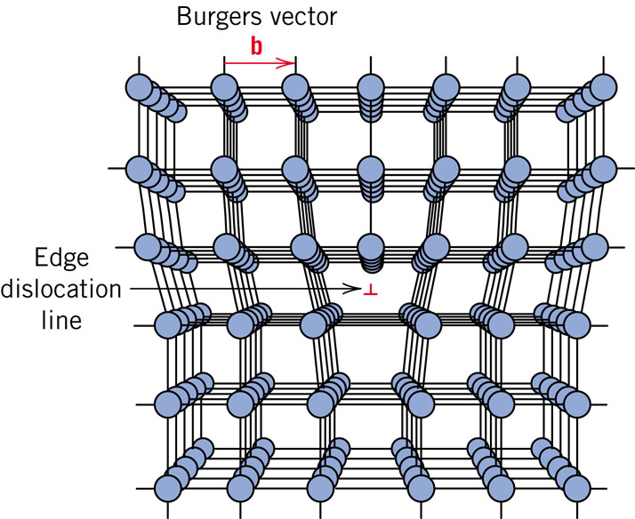
Edge Dislocation
  Extra half-plane of atoms inserted in a crystal structure.
  Burgers vector, b perpendicular (⊥) to dislocation line.
Burger’s vector, b: measure of lattice distortion
https://www.youtube.com/watch?v=-t6btGjGKYU

Slide 3
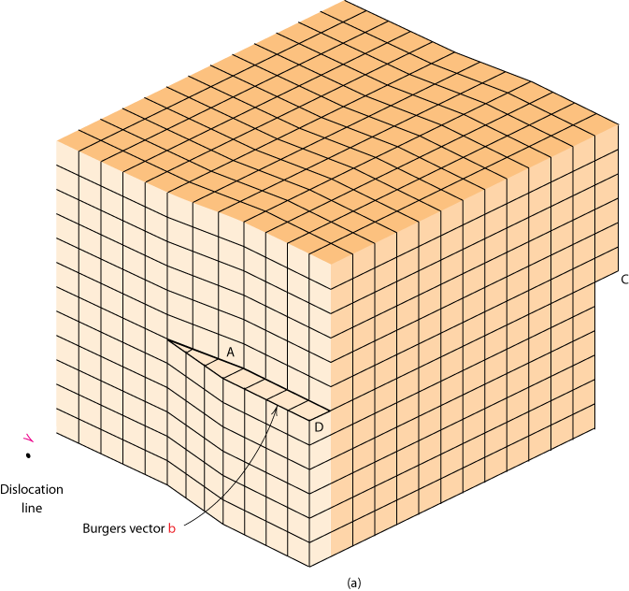
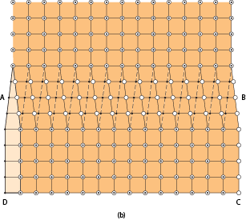
Screw Dislocation
  spiral planar ramp resulting from shear deformation.
  b parallel (||) to dislocation line.
Screw Dislocation
Dislocation
line
b
Burgers vector b
(b)
(a)
https://www.youtube.com/watch?v=TxJOP3hA6To
The screw dislocation in (a) as viewed from above.
The dislocation line extends along line AB. Atom
positions above the slip plane are open circles and those
Below are solid circles.

Slide 4
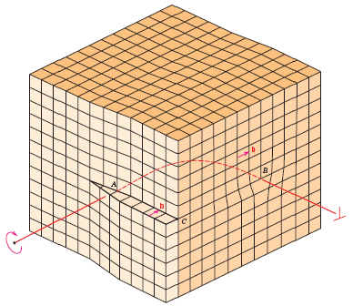
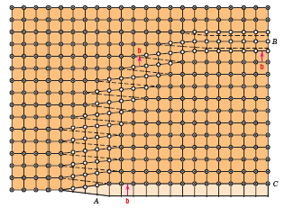
Edge, Screw, and Mixed Dislocations
Mixed
Edge
Screw
Adapted from Fig. 4.5, Callister & Rethwisch 8e.

Slide 5
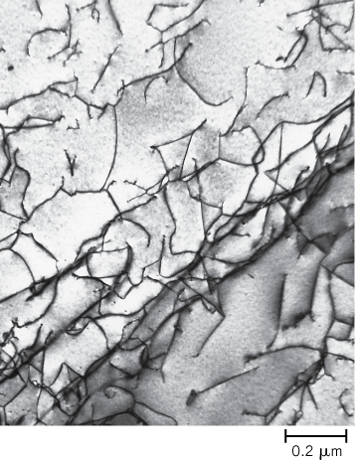
Imperfections in Solids
Dislocations are visible in electron micrographs
Fig. 4.6, Callister & Rethwisch 8e.

Slide 6
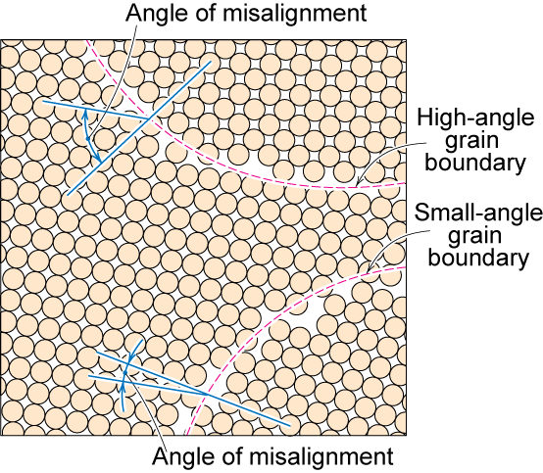
Grain Boundaries
https://www.youtube.com/watch?v=uG35D_euM-0
regions between crystals
transition from lattice of one region to that of the other
slightly disordered
low density in grain boundaries
  high mobility
  high diffusivity
  high chemical reactivity
http://en.wikipedia.org/wiki/Grain_boundary
Adapted from Fig. 4.7, Callister & Rethwisch 8e.

Slide 7
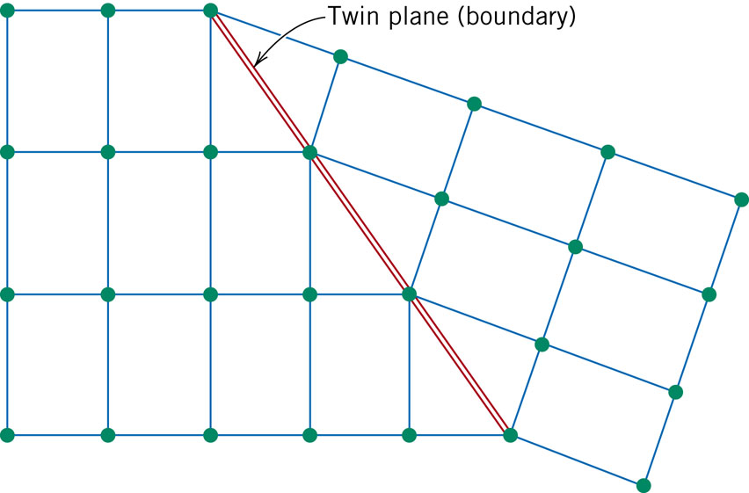
TWIN BOUNDARIES
http://en.wikipedia.org/wiki/Crystal_twinning
Twin boundary is a special type of grain boundary across which there is a specific mirror lattice symmetry.
Two Types:
Mechanical twins: Result from atomic displacements that are produced from applied mechanical shear forces. Found in BCC & HCP metals.
Annealing twins: Result during annealing heat treatments following deformation. Found in FCC metals.

Slide 8
Microscopic Examination
Crystallites (grains) and grain boundaries vary considerably in size. Can be quite large.
  ex: Large single crystal of quartz or diamond or Si
  ex: Aluminum light post or garbage can - see the individual grains
Crystallites (grains) can be quite small (mm or less) – necessary to observe with a microscope.

Slide 9
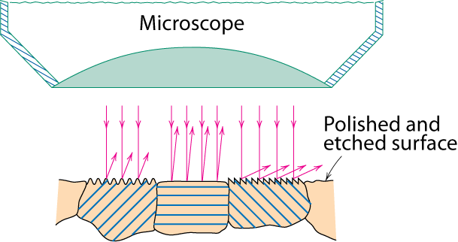
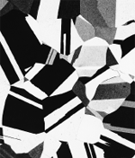
Optical Microscopy
•Only the surface is observed, reflecting mode.
Useful up to 2000X magnification.
• Polishing removes surface features (e.g., scratches)
• Etching changes reflectance, depending on crystal
orientation.
crystallographic planes
Adapted from Fig. 4.13(b) and (c), Callister & Rethwisch 8e. (Fig. 4.13(c) is courtesy
of J.E. Burke, General Electric Co.)
Micrograph of
brass (a Cu-Zn alloy)
0.75mm

Slide 10
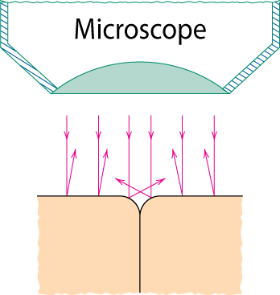
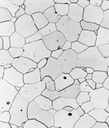
Optical Microscopy
Grain boundaries...
• are imperfections,
• are more susceptible
to etching,
• may be revealed as
dark lines,
• change in crystal
orientation across
boundary.
polished surface
surface groove
grain boundary
(a)
Adapted from Fig. 4.14(a) and (b), Callister & Rethwisch 8e.
(Fig. 4.14(b) is courtesy
of L.C. Smith and C. Brady, the National Bureau of Standards, Washington, DC [now the National Institute of Standards and Technology, Gaithersburg, MD].)
ASTM grain
size number
N
= 2
n
-1
Fe-Cr alloy
number of grains/in²
at 100x
(b)
magnification

Slide 11
Microscopy
Optical resolution: 10⁻⁷ m = 0.1 μm = 100 nm
For higher resolution need higher frequency
  X-Rays? Difficult to focus.
  Electrons
According to quantum mechanics, a high-velocity electron becomes wavelike, having a wavelength that is inversely proportional to its velocity.
    Wavelength: 3 pm (0.003 nm)
      (Magnification - 1,000,000X)
    Atomic resolution possible
    Electron beam focused by magnetic lenses.

Slide 12
Electron Microscopy
Transmission Electron Microscope (TEM)
  Electron beam passes through the specimen
  Specimen must be a very thin foil
  Magnifications 1,000,000 X
Scanning Electron Microscope (SEM)
  Surface is scanned with an electron beam
  Surface must be electrically conductive
  Magnifications 10-50,000 X
  Elemental composition of very localized surface areas are possible
http://www.youtube.com/watch?v=5qcJySNLs84&feature=related
http://www.youtube.com/watch?v=VH5H6uSQUFE

Slide 13
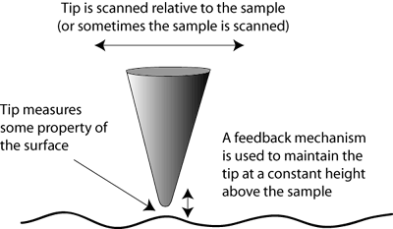
Scanning Probe
Microscopy (SPM)
http://www.teachnano.com/education/tech-overview.html
Scanning Probe Microscopy has enabled researchers to image surfaces at the nanometer scale.
Rather than using a beam of light or electrons, SPM uses a fine probe that is scanned over a surface (or the surface is scanned under the probe).
By using such a probe, researchers are no longer restrained by the wavelength of light or electrons.
The resolution obtainable with this technique can resolve atoms, and true 3-D maps of surfaces are possible.
Scanning Probe Microscopy is a general term, used to describe a growing number of techniques that use a sharp probe to scan over a surface and measure some property of that surface.
Examples are STM (scanning tunneling microscopy), AFM (atomic force microscopy), and NSOM (Near-Field Scanning Optical Microscopy).

Slide 14
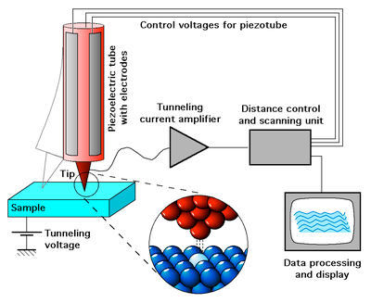
Scanning Tunneling
Microscopy (STM)
Neither light nor electrons are used to form an image.
Scanning Tunneling Microscopy (STM) measures a weak electrical current flowing between tip and sample as they are held at nanometer apart.
Examination on the nanometer scale and Magnifications as high as 10⁹ x.
Can be operated in a variety of environments (vacuum, air, liquid, etc).
Atomic Force Microscopy STM - can only image conducting or semiconducting surfaces.
The AFM, however, has the advantage of imaging almost any type of surface, including polymers, ceramics, composites, glass, and biological samples.
AFM) measures the interaction force between the tip and surface. The tip may be dragged across the surface, or may vibrate as it moves. The interaction force will depend on the nature of the sample, the probe tip and the distance between them.
Near-Field Scanning Optical Microscopy (NSOM) scans a very small light source very close to the sample. Detection of this light energy forms the image. NSOM can provide resolution below that of the conventional light microscope.

Slide 15
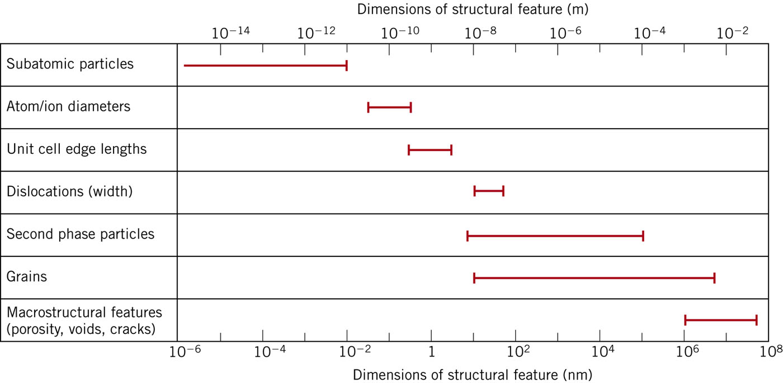
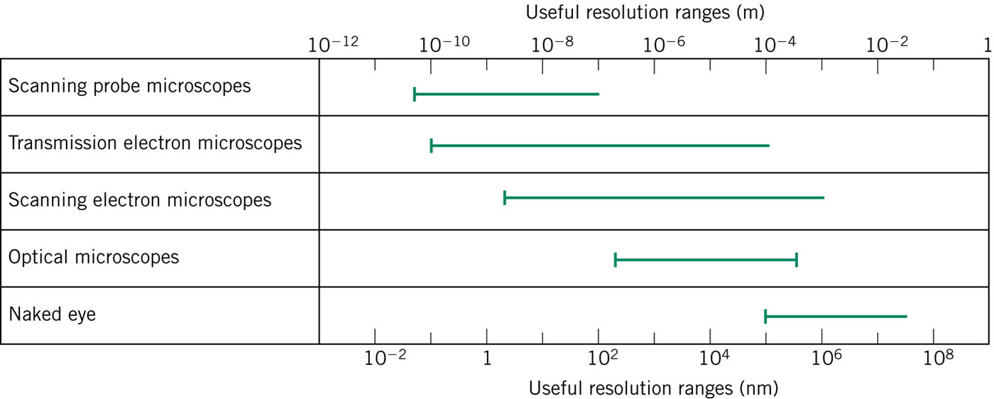

Slide 16
Grain Size Determination
(a) Determine the ASTM grain size number of a metal specimen if 45 grains per square inch are measured at a magnification of 100X?
(b) For this same specimen, how many grains per square inch will there be at a magnification of 85X?
ASTM grain
size number
N
= 2
n
-1
number of grains/in²
at 100x
magnification

Slide 17
4.D1 Aluminum–lithium (Al-Li) alloys have been developed by the aircraft industry to reduce the weight and improve the performance of its aircraft. A commercial aircraft skin material having a density of 2.47 g/cm3 is desired.
Compute the concentration of Li (in wt%) that is required.

Slide 18
4.D2 Copper (Cu) and platinum (Pt) both have the FCC crystal structure, and Cu forms a substitutional solid solution for concentrations up to approximately 6 wt% Cu at room temperature. Determine the concentration in weight percent of Cu that must be added to Pt to yield a unit cell edge length of 0.390 nm.

