Slide 1
CH-4: Imperfections in Solids
So far we have seen perfect crystals:
X-ray diffraction and Bragg’s law
Imperfections or defects are covered in ch-4.
Defects in crystals make them interesting
2 major types of defects:
Chemical – Impurities or Alloying elements Atomic arrangement- Structure
Real materials are not perfect
Good Chemical Imperfections: dopants & alloying element
Atomic arrangements: missing atom, extra atom, differently oriented unit cells, etc…

Slide 2
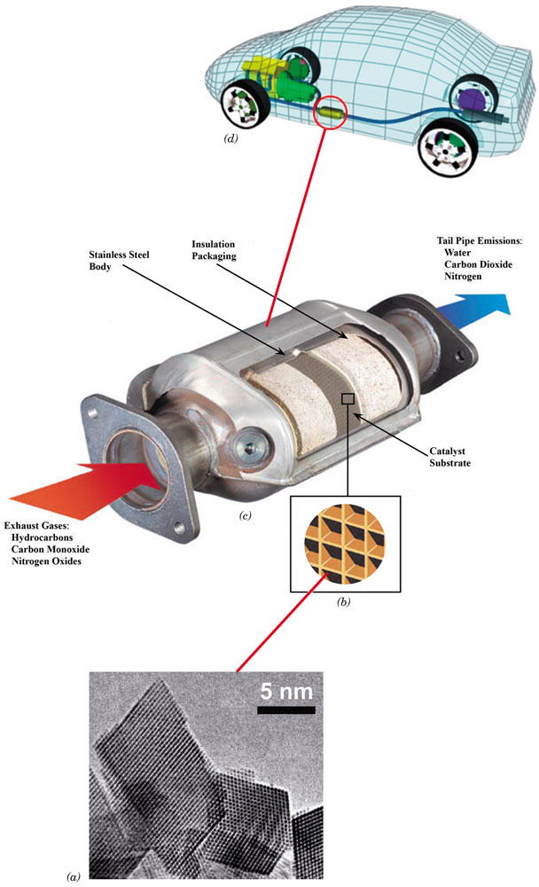
Why STUDY Imperfections in Solids?
Many of the important properties of materials are due to the presence of imperfections.
Pure metals experience significant alterations when alloyed:
Sterling silver: 92.5% Ag & 7.5% Cu.
Cartridge brass: 70% Cu & 30% Zn.
Impurities play important roles in semiconductors.
Steel (composition ) and (making)
Atomic defects are responsible for reducing gas pollutant emissions in automobiles:
Molecules of pollutant gases become attached to surface defects of crystalline metallic materials ((Ce_{0.5}Zr_{0.5})O₂) in the catalytic converter. While attached to these sites, chemical reactions convert them into other non- or less-polluting substances.

Slide 3
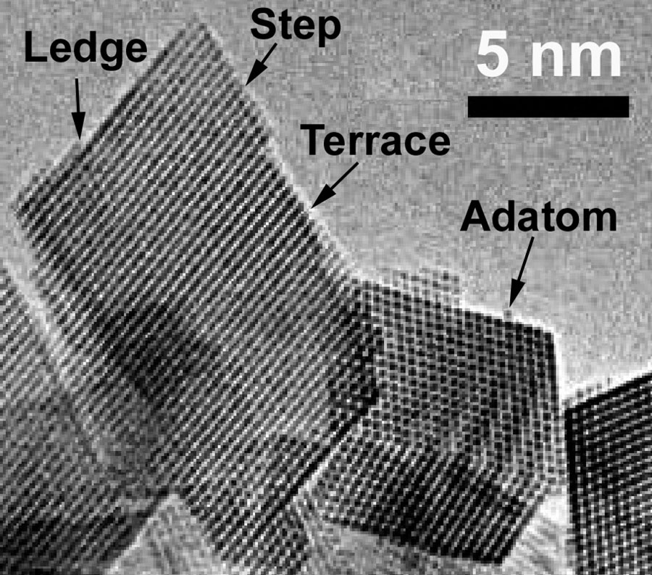
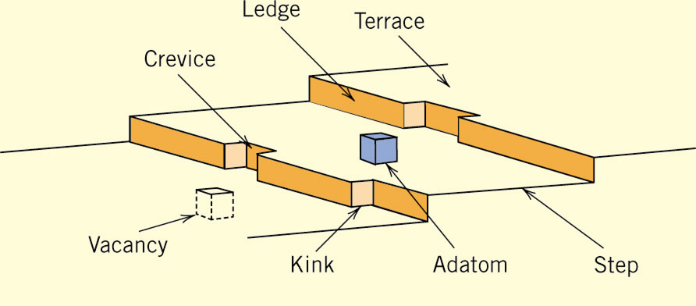
Catalyst: (Ce_{0.5}Zr_{0.5})O₂
Catalyst is a substance that speeds up the rate of a chemical reaction without participating in the reaction itself.
Catalyst adsorbs on its surface gas pollutants (CO and NO_{X}) and molecules of unburned hydrocarbons, which are converted to CO₂ and H₂O.
Active sites on catalysts are normally surface defects
Schematic representation of surface defects that are potential adsorption sites for catalysts.
High-resolution transmission electron micrograph of single crystal (Ce_{0.5}Zr_{0.5})O_{2,}which is used in Catalytic Converters.

Slide 4
Types of Imperfections
• Vacancy atoms
• Interstitial atoms
• Substitutional atoms
Point defects
• Dislocations
Line defects
• Grain Boundaries
Area defects

Slide 5
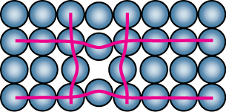
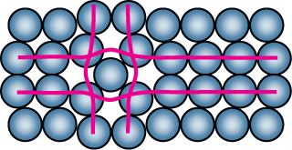
Point Defects in Metals
• Vacancies:
-vacant atomic sites in a structure.
Vacancy
distortion
of planes
• Self-Interstitials:
-"extra" atoms positioned between atomic sites.
self-
interstitial
distortion
of planes

Slide 6
Equilibrium Concentration:
Point Defects
• Equilibrium concentration varies with temperature!
No. of defects
Activation energy
N
⎛
−
Q
⎞
v
=
exp
⎜
v
⎟
No. of potential
N
⎝
k
T
⎠
defect sites
Temperature
Boltzmann's constant
-23
(1.38 x 10
J/atom-K)
x
10
-5
eV/atom-K)
(8.62
Each lattice site
is a potential
vacancy site

Slide 7
Measuring Activation Energy
• We can get Q_{v} from
an experiment.
N
⎛
−
Q
⎞
v
=
exp
⎜
v
⎜
⎟
N
⎝
k
T
⎠
• Measure this...
• Replot it...
N
v
N
slope
v
ln
N
N
-
Q
v
/k
exponential
dependence!
T
1/
T
defect concentration

Slide 8
Estimating Vacancy Concentration
• Find the equil. # of vacancies in 1 m³ of Cu at 1000°C.
• Given:
ρ
= 8.4 g
/
cm
3
A
= 63.5 g/mol
Cu
Q
v
= 0.9 eV/atom
N
= 6.02 x 10²³
atoms/mol
A
0.9 eV/atom
⎛
−
⎞
N
v
⎜
Q
v
=
exp
⎜
⎟
= 2.7 x 10⁻⁴
N
⎝
k
T
⎠
1273 K
8.62 x 10⁻⁵
eV/atom-K
N
_{A}
For 1 m³
, N =
ρ
x
x
1 m³
= 8.0 x 10²⁸ sites
A
_{Cu}
• Answer:
N
v
=
(2.7 x 10⁻⁴)(8.0 x 10²⁸) sites = 2.2 x 10²⁵ vacancies

Slide 9

4.1 Calculate the fraction of atom sites that are vacant for lead at its melting temperature of 327°C (600 K) and at RT (298K). Assume an energy for vacancy formation of 0.55 eV/atom. (k = 8.62 x 10⁻⁵ eV/K)
4.3 Calculate the activation energy for vacancy formation in aluminum, given that the equilibrium number of vacancies at 500°C (773 K) is 7.57 × 10²³ m⁻³. The atomic weight and density (at 500°C) for aluminum are, respectively, 26.98 g/mol and 2.62 g/cm³. (k = 8.62 x 10⁻⁵ eV/K)

Slide 10
Impurities in Solids
A pure metal consisting of only one type of atom just isn’t possible. Even with sophisticated techniques, it is difficult to refine metals to a purity in excess of 99.9999%.
Very few metals are used in the pure or nearly pure state:
1. Electronic wires- 99.99% purity Cu; Very high electrical conductivity.
2. 99.99% purity Al (super-pure Al) is used for decorative purposes-- Very bright metallic surface finish.
Most engineering metals are combined with other metals or nonmetals to provide increased strength, higher corrosion resistance, etc.
Cartridge brass: 70% Cu & 30% Zn.
Sterling silver: 92.5% Ag & 7.5% Cu.
Inconel 718, Ni-base super-alloy, used for jet engine parts, has 10 elements.
Steel is an alloy of iron and carbon, and sometimes other elements.

Slide 11
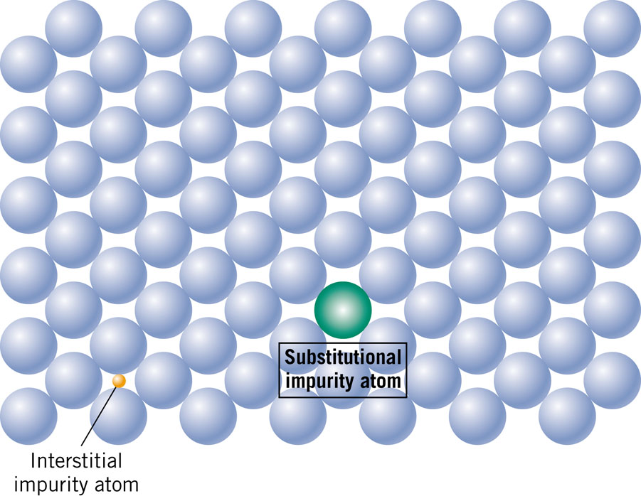
Solid Solutions
Simplest type of alloy is that of solid solution.
Two types: 1. Substitution Solid Solution
2. Interstitial Solid Solution.

Slide 12
Conditions for Solid Solubility
Conditions for substitutional solid solution (S.S.)
W. Hume – Rothery rule
  1. Δr (atomic radius) < 15%
  2. Proximity in periodic table
    i.e., similar electronegativities
  3. Same crystal structure for pure metals
  4. Same Valency
An example of a substitutional solid solution is found for copper and nickel. These
two elements are completely soluble in one another at all proportions.
The atomic radii for copper and nickel are 0.128 and 0.125 nm, respectively; both have the FCC crystal structure; their electronegativities are 1.9 and 1.8 and their valences match.

Slide 13
Application of Hume–Rothery rules – Solid Solutions
Element Atomic Crystal Electro- Valence
Radius Structure nega-
(nm) tivity
Cu 0.1278 FCC 1.9 +2
C 0.071
H 0.046
O 0.060
Ag 0.1445 FCC 1.9 +1
Al 0.1431 FCC 1.5 +3
Co 0.1253 HCP 1.8 +2
Cr 0.1249 BCC 1.6 +3
Fe 0.1241 BCC 1.8 +2
Ni 0.1246 FCC 1.8 +2
Pd 0.1376 FCC 2.2 +2
Zn 0.1332 HCP 1.6 +2
Pt 0.1387 FCC 2.2 +2
4.4: Which of these elements would you expect to form the following with copper:
(a) A substitutional solid solution having complete solubility
(b) A substitutional solid solution of incomplete solubility
(c) An interstitial solid solution

Slide 14
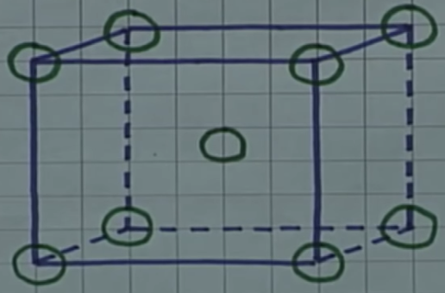
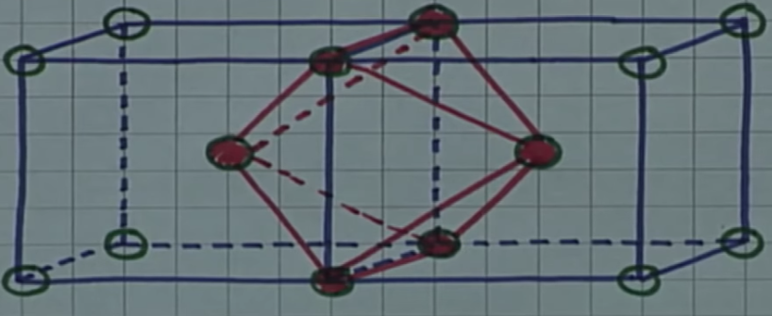
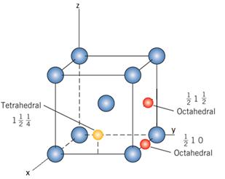
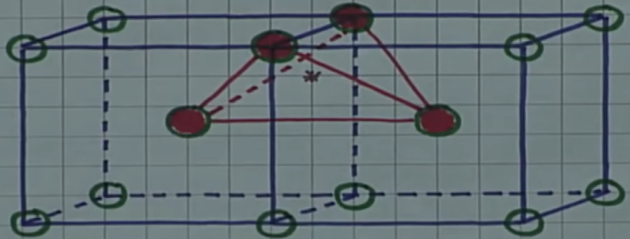
BCC Interstitial Sites: Octahedral & Tetrahedral
How many octahedral interstitial atoms inside the unit cell? 6
How many tetrahedral interstitial atoms inside the unit cell? 12

Slide 15
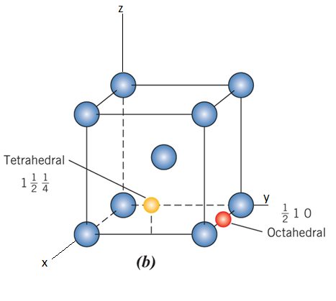
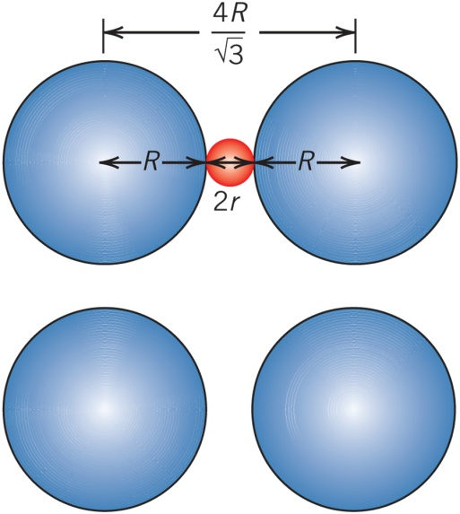
Computation of Radius of BCC Octahedral Interstitial Site
Compute the radius r of an impurity atom that just fits into a BCC octahedral site in terms of the atomic radius R of the host atom (without introducing lattice strains).

Slide 16
Computation of Radius of BCC Tetrahedral Interstitial Site
Compute the radius r of an impurity atom that just fits into a BCC tetrahedral interstitial site in terms of the atomic radius R of the host atom (without introducing lattice strains).

Slide 17
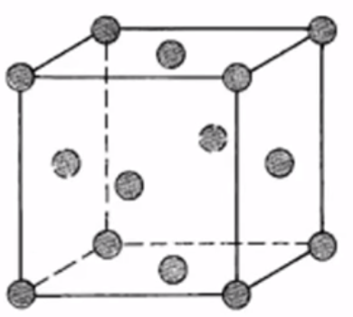
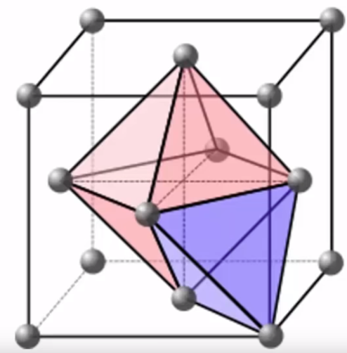
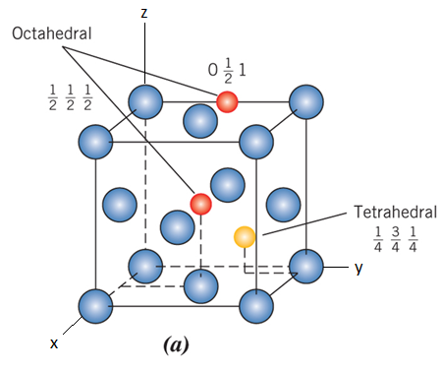
FCC Interstitial Sites: Octahedral & Tetrahedral
How many octahedral interstitial atoms inside the unit cell? 4
How many tetrahedral interstitial atoms inside the unit cell? 8

Slide 18
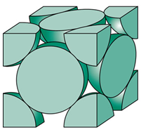
Computation of Radius of FCC Octahedral Interstitial Site
Compute the radius r of an impurity atom that just fits into a FCC octahedral site in terms of the atomic radius R of the host atom (without introducing lattice strains).

Slide 19
Summary of Interstitial Site Radii
 | FCC | BCC
Octahedral | 0.414 R | 0.155 R
Tetrahedral | 0.225 R | 0.291 R
4.10 (a) Compute the radius of an octahedral interstitial site in FCC iron.
(b) On the basis of this result, explain why a higher concentration of carbon will dissolve in FCC iron than in iron that has a BCC crystal structure.
Radius of Fe = 0.124 nm, Radius of C = 0.071 nm.

Slide 20
P 4.11
 | FCC | BCC
Octahedral | 0.414 R | 0.155 R
Tetrahedral | 0.225 R | 0.291 R
4.11 (a) For BCC iron, compute the radius of a tetrahedral interstitial site.
(b) Lattice strains are imposed on iron atoms surrounding this site when carbon atoms occupy it. Compute the approximate magnitude of this strain by taking the difference between the carbon atom radius and the site radius and then dividing this difference by the site radius. Radius of Fe = 0.124 nm, Radius of C = 0.071 nm.

