Slide 1
Ch:19 Thermal Conductivity
The ability of a material to transport heat.
Fourier’s Law
temperature
gradient
heat flux
(J/m²-s)
thermal conductivity (J/m-K-s)
T₁
T₂
T₂ > T₁
x₁
heat flux
x₂
• Atomic perspective: Atomic vibrations and free electrons in hotter regions transport energy to cooler regions.
19.14 (a) Calculate the heat flux through a sheet of steel 10 mm (0.39 in.) thick if the temperatures at the two faces are 300 and 100°C (572 and 212°F); assume steady-state heat flow. (b) What is the heat loss per hour if the area of the sheet is 0.25 m² (2.7 ft²)? (c) What will be the heat loss per hour if soda–lime glass instead of steel is used? (d) Calculate the heat loss per hour if steel is used and the thickness is increased to 20 mm (0.79 in.).

Slide 2
Mechanisms of Heat Conduction
Heat is transported in solid materials by both lattice vibration waves (phonons) and free electrons. A thermal conductivity is associated with each of these mechanisms, and the total conductivity is the sum of the two contributions, or
k= k_{l} + k_{e}
where k_{l} and k_{e} represent the lattice vibration and electron thermal conductivities, respectively; usually one or the other predominates. The thermal energy associated with phonons or lattice waves is transported in the direction of their motion. The k_{l} contribution results from a net movement of phonons from high- to low-temperature regions of a body across which a temperature gradient exists. The relative contribution of k_{e} to the total thermal conductivity increases with increasing free electron concentrations.

Slide 3
Metals: Wiedemann–Franz law
In high-purity metals, the electron mechanism of heat transport is much more efficient than the phonon contribution because electrons are not as easily scattered as phonons and have higher velocities.
Because free electrons are responsible for both electrical and thermal conduction in pure metals, theoretical treatments suggest that the two conductivities should be related according to the Wiedemann–Franz law:
where σ is the electrical conductivity, T is the absolute temperature, and L is a constant. The theoretical value of L, 2.44 × 10⁻⁸ Ω·W/(K)², should be independent of temperature and the same for all metals if the heat energy is transported entirely by free electrons. See Table 19.1.

Slide 4
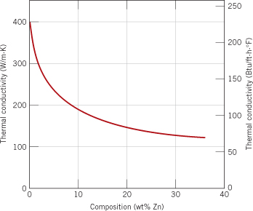
Alloys
Alloying metals with impurities results in a reduction in the thermal conductivity, for the same reason that the electrical conductivity is diminished; namely, the impurity atoms, especially if in solid solution, act as scattering centers, lowering the efficiency of electron motion.
A plot of thermal conductivity versus composition for copper–zinc alloys.

Slide 5
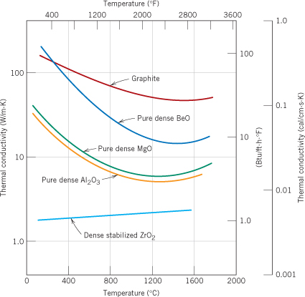
Ceramics
The scattering of lattice vibrations becomes more pronounced with rising temperature; hence, the thermal conductivity of most ceramic materials normally diminishes with increasing temperature, at least at relatively low temperatures .
The conductivity begins to increase at higher temperatures, which is due to radiant heat transfer: significant quantities of infrared radiant heat may be transported through a transparent ceramic material. The efficiency of this process increases with temperature.
Porosity in ceramic materials: Increasing the pore volume will, under most circumstances, result in a reduction of the thermal conductivity. In fact, many ceramics that are used for thermal insulation are porous. Heat transfer across pores is ordinarily slow and inefficient. Internal pores normally contain still air.

Slide 6
Polymers
As noted in Table 19.1, thermal conductivities for most polymers are on the order of 0.3 W/m·K. For these materials, energy transfer is accomplished by the vibration and rotation of the chain molecules. The magnitude of the thermal conductivity depends on the degree of crystallinity; a polymer with a highly crystalline and ordered structure will have a greater conductivity than the equivalent amorphous material. This is due to the more effective coordinated vibration of the molecular chains for the crystalline state.
Polymers are often used as thermal insulators because of their low thermal conductivities. As with ceramics, their insulative properties may be further enhanced by the introduction of small pores, which are ordinarily introduced by foaming (Section 15.18). Foamed polystyrene is commonly used for drinking cups and insulating chests.

Slide 7
Thermal Conductivity: Comparison
Energy Transfer Mechanism
Material
k (W/m-K)
• Metals
Aluminum
247
atomic vibrations and motion of free electrons
Steel
52
Tungsten
178
Gold
315
• Ceramics
Magnesia (MgO)
38
Alumina (Al₂O₃)
39
atomic vibrations
increasing k
Soda-lime glass
1.7
Silica (cryst. SiO₂)
1.4
• Polymers
Polypropylene
0.12
Polyethylene
0.46-0.50
vibration/rotation of chain molecules
Polystyrene
0.13
Teflon
0.25
Selected values from Table 19.1, Callister & Rethwisch 8e.

Slide 8
Thermal Stresses
• Occur due to:
-- restrained thermal expansion/contraction
-- temperature gradients that lead to differential dimensional changes
Thermal stress
= σ
Upon heating, the stress is compressive (σ < 0), because rod expansion has been constrained.
Upon cooling, the stress is tensile (σ > 0).
Ex-Prob 19.1: A brass rod is stress-free at room temperature (20ºC). It is heated up, but prevented from lengthening. At what temperature does the stress reach -172 MPa? (For brass, assume a modulus of elasticity of 100 GPa and the coef. Linear thermal exp. = 20x10⁻⁶ (C⁰)⁻¹)

Slide 9
Thermal Shock Resistance
• Occurs due to: nonuniform heating/cooling
• Ex: Assume top thin layer is rapidly cooled from T₁ to T₂
rapid quench
σ
T₂
Tension develops at surface
tries to contract during cooling
resists contraction
T₁
Temperature difference that
can be produced by cooling:
Critical temperature difference
for fracture (set σ = σ_{f})
set equal
•
• Large TSR when is large

Slide 10
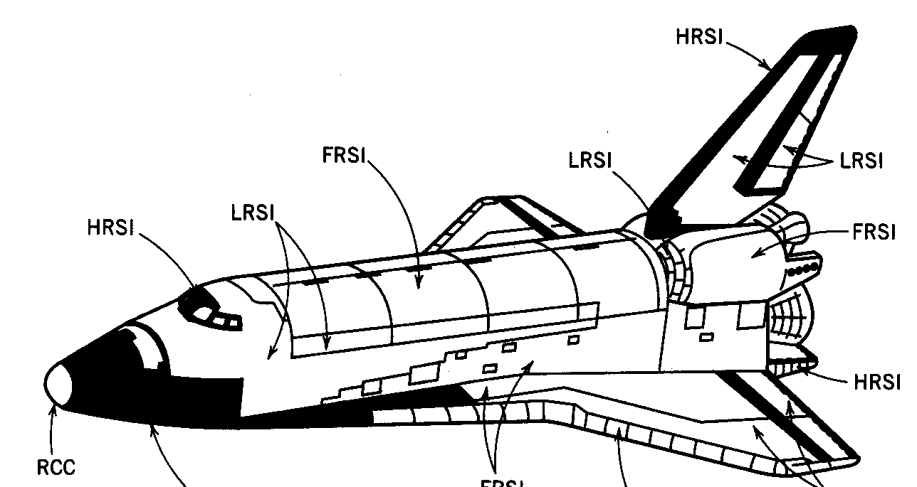
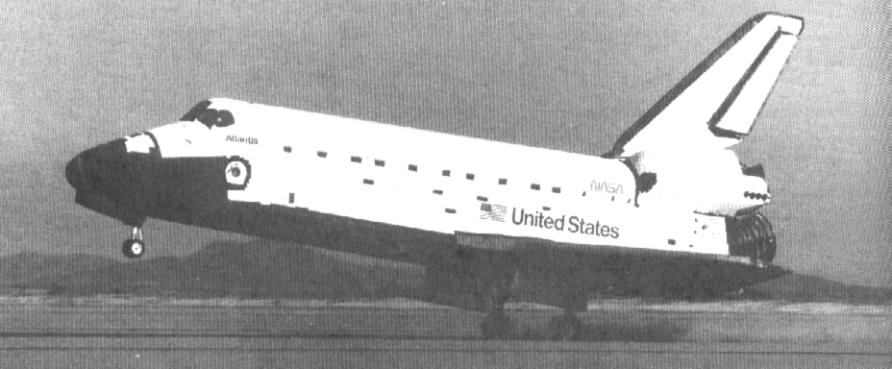
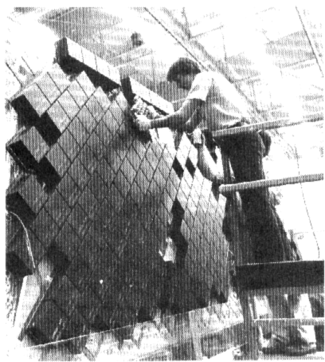
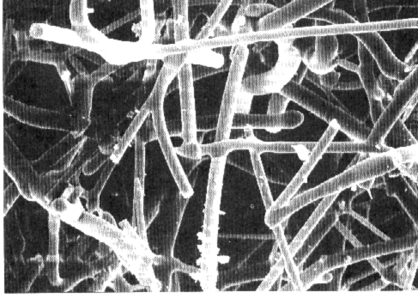
Thermal Protection System
Re-entry T
• Application:
Distribution
Space Shuttle Orbiter
reinf C-C
silica tiles
nylon felt, silicon rubber
Chapter-opening photograph, Chapter 23, Callister 5e (courtesy of the National Aeronautics and Space Administration.)
(1650ºC)
(400-1260ºC)
coating (400ºC)
Fig. 19.2W, Callister 6e. (Fig. 19.2W adapted from L.J. Korb, C.A. Morant, R.M. Calland, and C.S. Thatcher, "The Shuttle Orbiter Thermal Protection System", Ceramic Bulletin, No. 11, Nov. 1981, p. 1189.)
• Silica tiles (400-1260ºC):
-- large scale application
-- microstructure:
~90% porosity!
Si fibers
bonded to one
another during
heat treatment.
100 μm
Fig. 19.3W, Callister 5e. (Fig. 19.3W courtesy the National Aeronautics and Space Administration.)
Fig. 19.4W, Callister 5e. (Fig. 219.4W courtesy Lockheed Aerospace Ceramics
Systems, Sunnyvale, CA.)

Slide 11
Summary
The thermal properties of materials include:
• Heat capacity:
-- energy required to increase a mole of material by a unit T
-- energy is stored as atomic vibrations
• Coefficient of thermal expansion:
-- the size of a material changes with a change in temperature
-- polymers have the largest values
• Thermal conductivity:
-- the ability of a material to transport heat
-- metals have the largest values
• Thermal shock resistance:
-- the ability of a material to be rapidly cooled and not fracture
-- is proportional to

Slide 12
