Slide 1
Chapter 2: Atomic Structure & Interatomic Bonding
ISSUES TO ADDRESS...
• What promotes bonding?
• What types of bonds are there?
• What properties are inferred from bonding?

Slide 2
Gecko’s toe pads
Extremely large number of microscopically small hairs
gecko-inspired bandage
http://web.mit.edu/newsoffice/2008/adhesive-0218.html
http://robotics.eecs.berkeley.edu/~ronf/Gecko/index.html

Slide 3
Atomic Structure (Freshman Chem.)
atom – electrons – 9.11 x 10⁻³¹ kg protons neutrons
atomic number = # of protons in nucleus of atom = # of electrons of neutral species
A [=] atomic mass unit = amu = 1/12 mass of ¹²C Atomic wt = wt of 6.022 x 10²³ molecules or atoms 1 amu/atom = 1g/mol
C 12.011 H 1.008 etc.
} 1.67 x 10⁻²⁷ kg

Slide 4
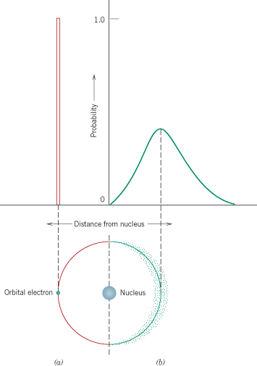
Atomic Structure
Valence electrons determine all of the following properties
Chemical
Electrical
Thermal
Optical

Slide 5
Electronic Structure
Electrons have wavelike and particulate properties.
This means that electrons are in orbitals defined by a probability.
Each orbital at discrete energy level is determined by quantum numbers. Quantum # Designation
n = principal (energy level-shell) K, L, M, N, O (1, 2, 3, etc.)
l = subsidiary (orbitals) s, p, d, f (0, 1, 2, 3,…, n -1)
m_{l} = magnetic 1, 3, 5, 7 (-l to +l)
m_{s} = spin ½, -½

Slide 6
Electron Energy States
Electrons...
• have discrete energy states
• tend to occupy lowest available energy state.
4d
4p
N-shell n = 4
3d
4s
Energy
3p
M-shell n = 3
3s
Adapted from Fig. 2.4, Callister & Rethwisch 8e.
2p
L-shell n = 2
2s
1s
K-shell n = 1

Slide 7
SURVEY OF ELEMENTS
• Most elements: Electron configuration not stable.
Element
Atomic #
Electron configuration
Hydrogen
1
1s
1
Helium
2
1s
2
(stable)
Lithium
3
1s
2
2s
1
Beryllium
4
1s
2
2s
2
Boron
5
1s
2
2s
2
2p
1
Adapted from Table 2.2, Callister & Rethwisch 8e.
Carbon
6
1s
2
2s
2
2p
2
...
...
Neon
10
1s
2
2s
2
2p
6
(stable)
Sodium
11
1s
2
2s
2
2p
6
3s
1
Magnesium
12
1s
2
2s
2
2p
6
3s
2
Aluminum
13
1s
2
2s
2
2p
6
3s
2
3p
1
...
...
Argon
18
1s
2
2s
2
2p
6
3s
2
3p
6
(stable)
...
...
...
Krypton
36
1s
2
2s
2
2p
6
3s
2
3p
6
3d
10
4s
2
4p
6
(stable)
• Why? Valence (outer) shell usually not filled completely.

Slide 8
Electron Configurations
Valence electrons – those in unfilled shells
Filled shells more stable
Valence electrons are most available for bonding and tend to control the chemical properties
example: C (atomic number = 6)
1s² 2s² 2p²
valence electrons

Slide 9
Electronic Configurations
26
1s² 2s² 2p⁶ 3s² 3p⁶
3d ⁶ 4s²
ex: Fe - atomic # =
4d
4p
N-shell n = 4
valence
electrons
3d
4s
Energy
3p
M-shell n = 3
3s
Adapted from Fig. 2.4, Callister & Rethwisch 8e.
2p
L-shell n = 2
2s
1s
K-shell n = 1

Slide 10
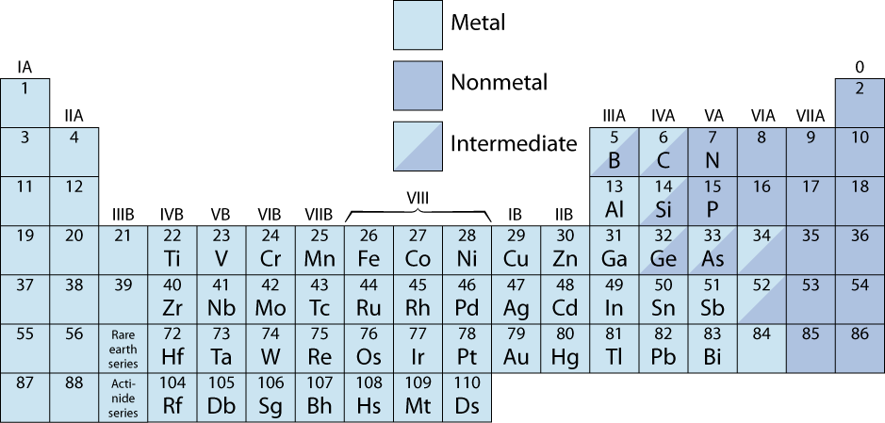
The Periodic Table
• Columns: Similar Valence Structure
give up 1e⁻
inert gases
give up 2e⁻
accept 2e⁻
accept 1e⁻
H
give up 3e⁻
He
Li
Be
O
F
Ne
Na
Mg
S
Cl
Ar
Adapted from Fig. 2.6, Callister & Rethwisch 8e.
K
Ca
Sc
Se
Br
Kr
Rb
Sr
Y
Te
I
Xe
Cs
Ba
Po
At
Rn
Fr
Ra
Electropositive elements:
Readily give up electrons
to become + ions.
Electronegative elements:
Readily acquire electrons
to become - ions.

Slide 11
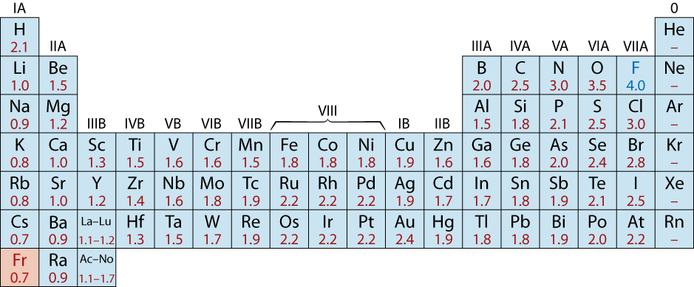
Electronegativity
• Ranges from 0.7 to 4.0,
• Large values: tendency to acquire electrons.
Smaller electronegativity
Larger electronegativity
Adapted from Fig. 2.7, Callister & Rethwisch 8e. (Fig. 2.7 is adapted from Linus Pauling, The Nature of the Chemical Bond, 3rd edition, Copyright 1939 and 1940, 3rd edition. Copyright 1960 by Cornell University.

Slide 12
Ionic bond – metal + nonmetal
donates accepts electrons electrons
Dissimilar electronegativities
ex: MgO Mg 1s² 2s² 2p⁶ 3s² O 1s² 2s² 2p⁴
[Ne] 3s²
Mg²⁺ 1s² 2s² 2p⁶ O²⁻ 1s² 2s² 2p⁶
[Ne] [Ne]

Slide 13
Ionic Bonding
• Occurs between + and - ions.
• Requires electron transfer.
• Large difference in electronegativity required.
• Example: NaCl
Na (metal)
Cl (nonmetal)
unstable
unstable
electron
Na (cation)
+
-
Cl (anion)
stable
Coulombic
stable
Attraction

Slide 14
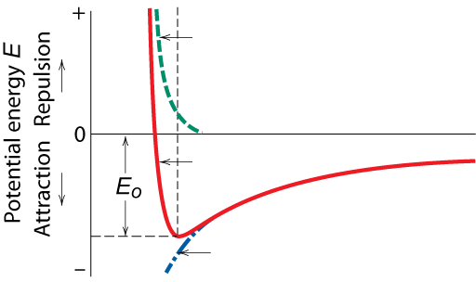
Ionic Bonding
Energy – minimum energy most stable
Energy balance of attractive and repulsive terms
A
B
E_{N} = E_{A} + E_{R} =
−
+
r
r
n
Repulsive energy E_{R}
Interatomic separation r
Net energy E_{N}
Adapted from Fig. 2.8(b), Callister & Rethwisch 8e.
Attractive energy E_{A}

Slide 15
Examples: Ionic Bonding
• Predominant bonding in Ceramics
NaCl
MgO
CaF
2
CsCl
Give up electrons
Acquire electrons
Adapted from Fig. 2.7, Callister & Rethwisch 8e. (Fig. 2.7 is adapted from Linus Pauling, The Nature of the Chemical Bond, 3rd edition, Copyright 1939 and 1940, 3rd edition. Copyright 1960 by Cornell University.

Slide 16
Covalent Bonding
similar electronegativity ∴ share electrons
bonds determined by valence – s & p orbitals dominate bonding
Example: CH₄
shared electrons
C: has 4 valence e⁻,
needs 4 more
H
from carbon atom
CH
4
H: has 1 valence e⁻,
needs 1 more
H
C
H
shared electrons
Electronegativities
are comparable.
from hydrogen
H
atoms
Adapted from Fig. 2.10, Callister & Rethwisch 8e.

Slide 17
Primary Bonding
Metallic Bond -- delocalized as electron cloud
Ionic-Covalent Mixed Bonding
% ionic character =
where X_{A} & X_{B} are Pauling electronegativities
x
(
100
%)
Ex: MgO X_{Mg} = 1.2 X_{O} = 3.5

Slide 18
SECONDARY BONDING
Arises from interaction between dipoles
• Fluctuating dipoles
asymmetric electron
ex: liquid H
2
clouds
H
2
H
2
+
-
+
-
H
H
H
H
secondary
secondary
bonding
Adapted from Fig. 2.13, Callister & Rethwisch 8e.
bonding
• Permanent dipoles-molecule induced
-general case:
+
-
secondary
+
-
bonding
Adapted from Fig. 2.15,
Callister & Rethwisch 8e.
-ex: liquid HCl
H
Cl
secondary
H
Cl
bonding
-ex: polymer
secondary bonding
secondary bonding

Slide 19
Summary: Bonding
Type
Bond Energy
Comments
Ionic
Large!
Nondirectional (ceramics)
Covalent
Variable
Directional
(semiconductors, ceramics
polymer chains)
large-Diamond
small-Bismuth
Metallic
Variable
large-Tungsten
Nondirectional (metals)
small-Mercury
Secondary
smallest
Directional
inter-chain (polymer)
inter-molecular

Slide 20
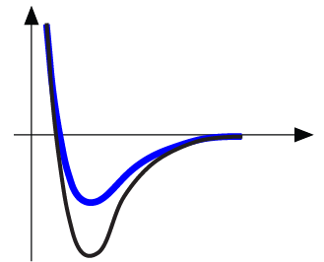
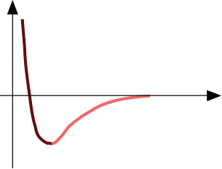
Properties From Bonding: T_{m}
• Bond length, r
• Melting Temperature, T_{m}
Energy
r
• Bond energy, E_{o}
r
o
r
Energy
smaller T_{m}
unstretched length
larger T_{m}
r
o
r
E_{o}
=
T_{m} is larger if E_{o} is larger.
“bond energy”

Slide 21
Properties From Bonding : α
• Coefficient of thermal expansion, α
length,
L
o
coeff. thermal expansion
unheated, T
1
Δ
L
Δ
L
=
α
(
T
-
T
)
L
2
1
heated, T
2
o
• α ~ symmetric at r_{o}
Energy
unstretched length
r
o
r
α is larger if E_{o} is smaller.
larger α
E_{o}
E_{o}
smaller α

Slide 22
Summary: Primary Bonds
Ceramics
Large bond energy
large T_{m}
large E
small α
(Ionic & covalent bonding):
Metals
Variable bond energy
moderate T_{m}
moderate E
moderate α
(Metallic bonding):
Polymers
Directional Properties
Secondary bonding dominates
small T_{m}
small E
large α
(Covalent & Secondary):
secondary bonding

Slide 23
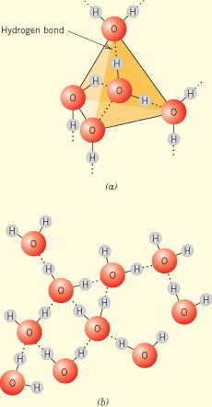
Water (Its Volume Expansion Upon Freezing)

Slide 24
ANNOUNCEMENTS
Reading: Chapter-2
Self-Assessment Exercise for Chap-2
Homework for Chap-2: 1,4,7,8,14,19.

