Slide 1
Chapter 12: Structures & Properties of Ceramics
Ceramics is from Greek keramikos, from keramos ‘pottery’.
Compounds between metallic and non-metallic elements with ionic or covalent inter-atomic bonds.
Metals, ceramics, and polymers are the most important engineering materials.
Applications

Slide 2
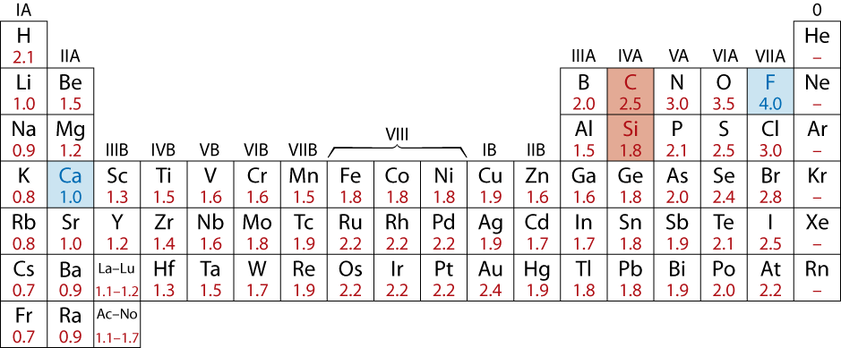
Atomic Bonding in Ceramics
• Bonding:
-- Can be ionic and/or covalent in character.
-- % ionic character increases with difference in
electronegativity of atoms.
• Degree of ionic character may be large or small:
CaF₂: large
SiC: small
Adapted from Fig. 2.7, Callister & Rethwisch 8e. (Fig. 2.7 is adapted from Linus Pauling, The Nature of the Chemical Bond, 3rd edition, Copyright 1939 and 1940, 3rd edition. Copyright 1960 by
Cornell University.)

Slide 3
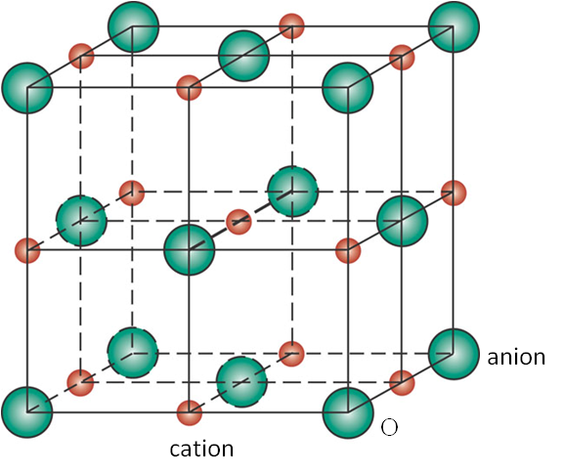
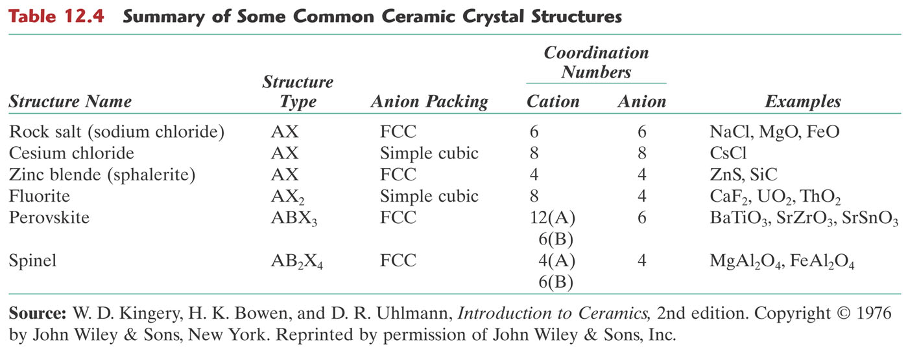
Ceramic Crystal Structures
Oxide structures:
1. Anions are larger than cations.
2. Close packed oxygen in a lattice (usually FCC).
3. Cations fit into interstitial sites among anions. (Octahedral)

Slide 4
Factors that Determine Crystal Structure
1. Relative sizes of ions – Formation of stable structures:
--maximize the # of oppositely charged ion neighbors.
-
-
-
-
-
-
+
+
+
Adapted from Fig. 12.1, Callister & Rethwisch 8e.
-
-
-
-
-
-
unstable
stable
stable
2. Maintenance of
Charge Neutrality :
--Net charge in ceramic
should be zero.
--Reflected in chemical
formula:
F
-
Ca
2+
CaF
2
:
+
anions
cation
F
-
A
m
X
p
m, p values to achieve charge neutrality

Slide 5
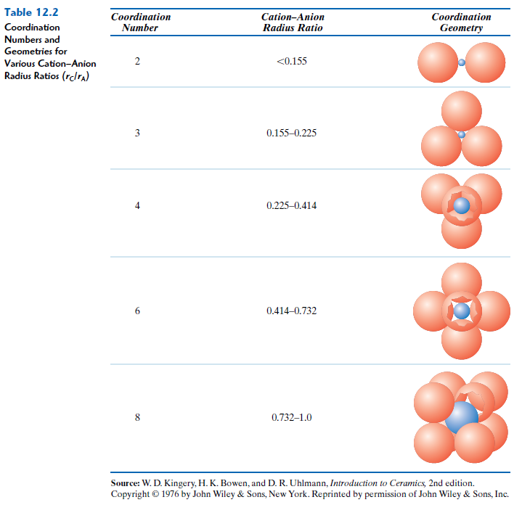

Slide 6
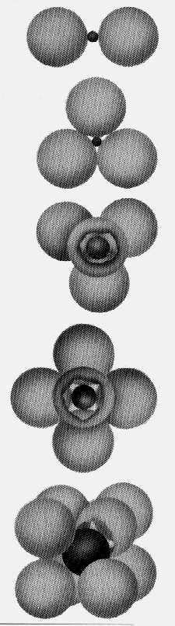
Coordination # and Ionic Radii
r
cation
• Coordination # increases with
r
anion
To form a stable structure, how many anions can
surround around a cation?
r
cation
Coord
#
ZnS
r
anion
(zinc blende)
< 0.155
2
linear
Adapted from Fig. 12.4, Callister & Rethwisch 8e.
0.155 - 0.225
3
triangular
NaCl
(sodium
0.225 - 0.414
4
tetrahedral
chloride)
Adapted from Fig. 12.2, Callister & Rethwisch 8e.
0.414 - 0.732
6
octahedral
CsCl
(cesium
chloride)
0.732 - 1.0
8
cubic
Adapted from Fig. 12.3, Callister & Rethwisch 8e.
Adapted from Table 12.2, Callister & Rethwisch 8e.

Slide 7
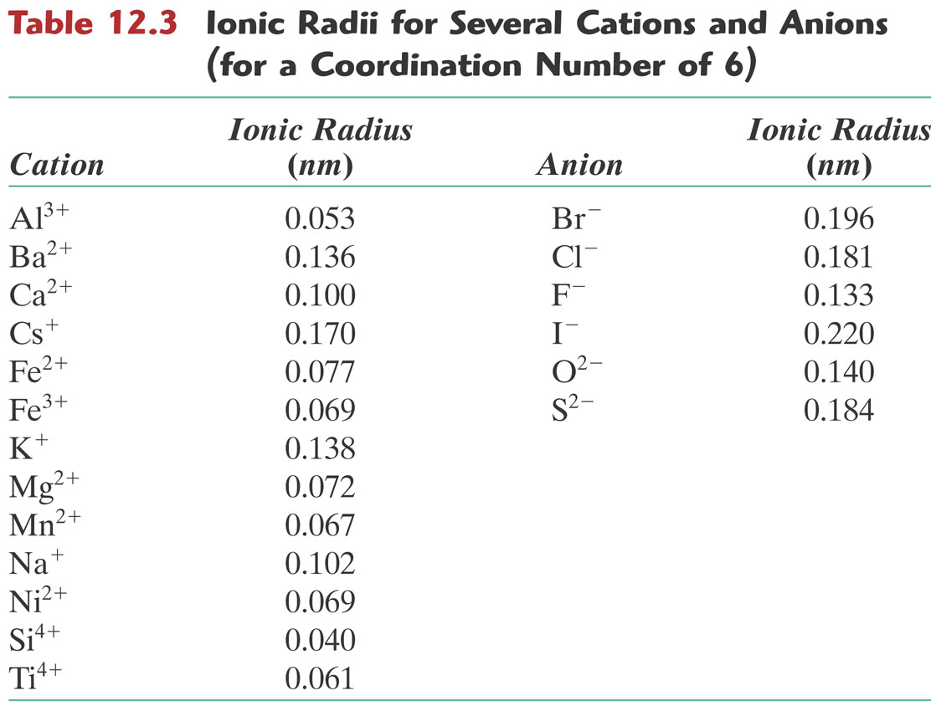
The most common coordination numbers for ceramic materials are 2, 4, and 6.

Slide 8
Computation of Minimum Cation-Anion Radius Ratio
Determine minimum r_{cation}/r_{anion} for an octahedral site (C.N. = 6)
a = 2r_{anion}

Slide 9
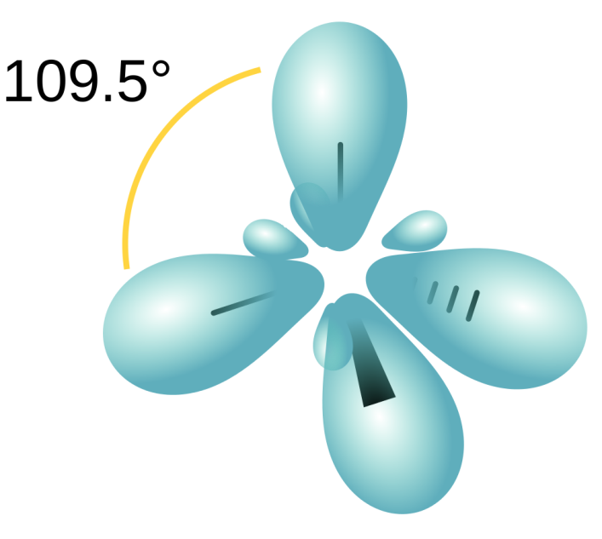
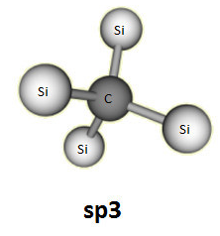
Bond Hybridization
Bond Hybridization is possible when there is significant covalent bonding
  hybrid electron orbitals form
  For example for SiC
    X_{Si} = 1.8 and X_{C} = 2.5
    ~ 89% covalent bonding
    Both Si and C prefer sp³ hybridization
    Therefore, for SiC, Si atoms occupy
    tetrahedral sites

Slide 10
Example Problem: Predicting the Crystal Structure of FeO
• On the basis of ionic radii, what crystal structure
would you predict for FeO?
Cation
Ionic radius (nm)
• Answer:
Al
3+
0.053
Fe
2
+
0.077
Fe
3+
0.069
Ca
2+
0.100
based on this ratio,
-- coord # = 6 because
0.414 < 0.550 < 0.732
-- crystal structure is NaCl
Anion
O
2-
0.140
Cl
-
0.181
F
-
0.133
Data from Table 12.3, Callister & Rethwisch 8e.

Slide 11
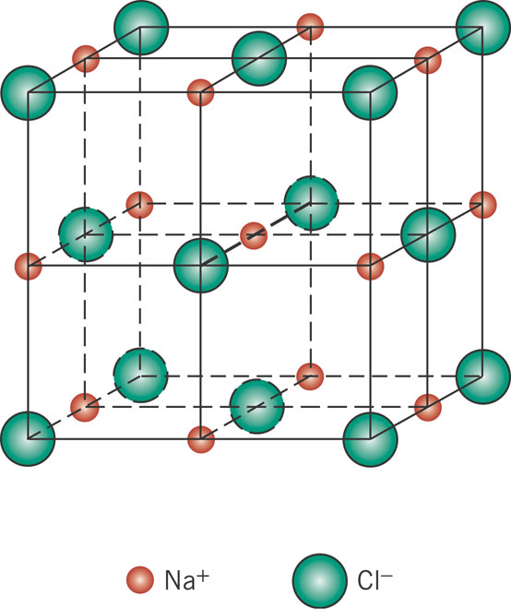
Rock Salt Structure
Same concepts can be applied to ionic solids in general.
Example: NaCl (rock salt) structure
r_{Na} = 0.102 nm
r_{Cl} = 0.181 nm
r_{Na}/r_{Cl} = 0.564
cations (Na⁺) prefer octahedral sites
Compute the theoretical density for NaCl.

Slide 12
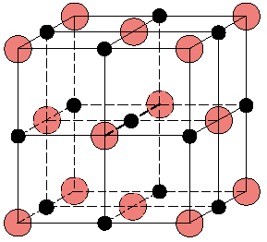

MgO and FeO
MgO and FeO also have the NaCl structure
O²⁻ r_{O} = 0.140 nm
Mg²⁺ r_{Mg} = 0.072 nm
r_{Mg}/r_{O} = 0.514
cations prefer octahedral sites
Adapted from Fig. 12.2, Callister & Rethwisch 8e.
So each Mg²⁺ (or Fe²⁺) has 6 neighbor oxygen atoms

Slide 13
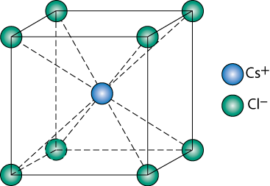
AX Crystal Structures
AX–Type Crystal Structures include NaCl, CsCl, and zinc blende
Cesium Chloride structure:
∴ Since 0.732 < 0.939 < 1.0,
cubic sites preferred
So each Cs⁺ has 8 neighbor Cl⁻
Adapted from Fig. 12.3, Callister & Rethwisch 8e.

Slide 14
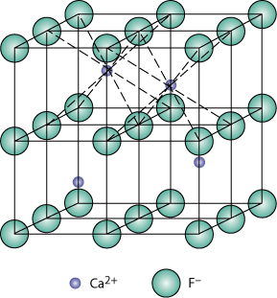
AX₂ Crystal Structures
Fluorite structure
Calcium Fluorite (CaF₂)
Cations in cubic sites
UO_{2,} ThO₂, ZrO₂, CeO₂
Antifluorite structure –
positions of cations and
anions reversed
Adapted from Fig. 12.5, Callister & Rethwisch 8e.

Slide 15
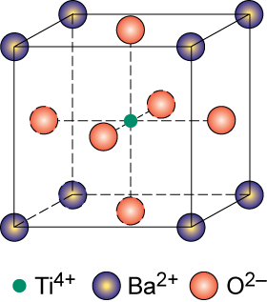
ABX₃ Crystal Structures
Perovskite structure
Ex: complex oxide
BaTiO₃
P. Calculate the Density of BaTiO₃

Slide 16
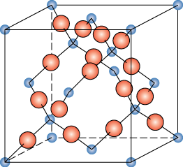
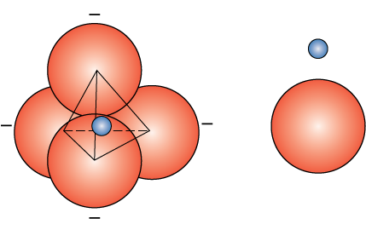
Silicate Ceramics
Most common elements on earth are Si & O
SiO₂ (silica) polymorphic forms are quartz, crystobalite, & tridymite
The strong Si-O bonds lead to a high melting temperature (1710ºC) for this material
Si⁴⁺
O²⁻
Adapted from Figs. 12.9-10, Callister & Rethwisch 8e
crystobalite

Slide 17
Glass Structure
• Basic Unit:
Glass is noncrystalline (amorphous)
• Fused silica is SiO₂ to which no
impurities have been added
• Other common glasses contain
impurity ions such as Na⁺, Ca²⁺,
Al³⁺, and B³⁺
4-
Si0
4
tetrahedron
Si
4+
O
2
-
• Quartz is crystalline
SiO2:
Na
+
Si
4+
O
2
-
(soda glass)
Adapted from Fig. 12.11, Callister & Rethwisch 8e.

Slide 18
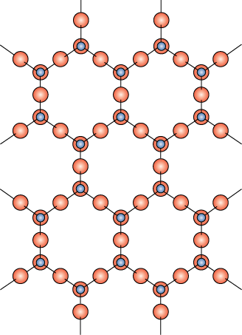
Layered Silicates
Layered silicates (e.g., clays, mica, talc)
  SiO₄ tetrahedra connected
  together to form 2-D plane
A net negative charge is associated with each (Si₂O₅)²⁻ unit
Negative charge balanced by
adjacent plane rich in positively charged cations
Adapted from Fig. 12.13, Callister & Rethwisch 8e.

Slide 19
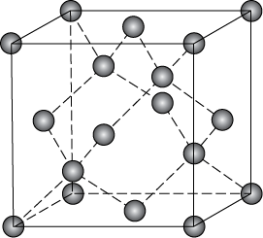
Polymorphic Forms of Carbon
Diamond
  tetrahedral bonding of carbon
    hardest material known
    very high thermal conductivity
  large single crystals – gem stones
  small crystals – used to grind/cut other materials
  diamond thin films
    hard surface coatings – used for cutting tools, medical devices, etc.

Slide 20
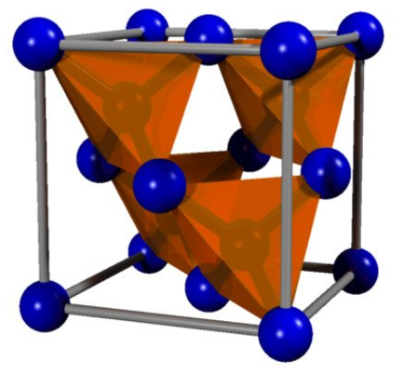
12.15 Compute the theoretical density of diamond given that the C—C distance and bond angle are 0.154 nm and 109.5°, respectively.
How does this value compare with the measured density (3.51 g/cm³)?

Slide 21
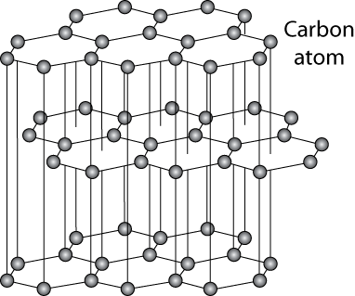
Polymorphic Forms of Carbon (cont)
Graphite
  layered structure – parallel hexagonal arrays of carbon atoms
  weak van der Waal’s forces between layers
  planes slide easily over one another -- good lubricant
Adapted from Fig. 12.17, Callister & Rethwisch 8e.

Slide 22
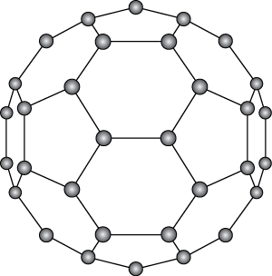
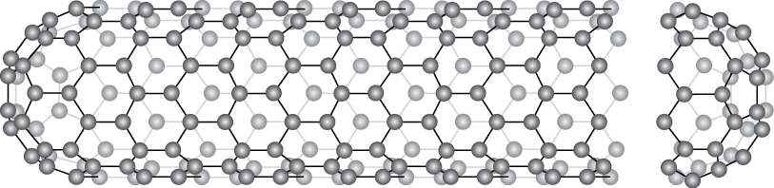
Polymorphic Forms of Carbon (cont)
Fullerenes and Nanotubes
Fullerenes – spherical cluster of 60 carbon atoms, C₆₀
  Like a soccer ball
Carbon nanotubes – sheet of graphite rolled into a tube
  Ends capped with fullerene hemispheres
Adapted from Figs. 12.18 & 12.19, Callister & Rethwisch 8e.

