Slide 1
By: Stephanie Davis
Materials Science and Its Impact on Recycling

Slide 2
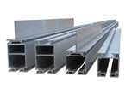
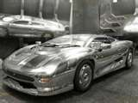
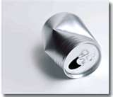
Aluminum
Used widely today

Slide 3
Properties
Aluminum is a strongly electropositive and extremely reactive metal
Abundant in Earth’s atmosphere

Slide 4
Before the 1960’s
Two important developments in the 1880s helped to greatly increase the availability of aluminum.
Very Expensive

Slide 5
1960’s and above
Recycling was a low-profile activity until the late 1960s
Recycling involves melting the scrap but left dross as a waste product

Slide 6
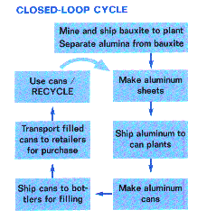
Life Cycle of Aluminum Cans

Slide 7
Video on Recycling
Aluminum is called the perfectly recyclable material.

Slide 8
Sources
"What's In a Cycle?" Peace Corps Outreach Materials on Waste and Recycling, 1995, pages 3-4.
"Let's Reduce and Recycle: Curriculum for Solid Waste Awareness," Environmental Protection Agency, 1990, pages 40-41.
The Aluminum Association. Aluminum. The Aluminum Association, 2009. Web. 12 Apr. 2010. <http://www.aluminum.org/>.
Thomas Jefferson National Accelerator-Office of Science Education. "Its Elemental- The Element Aluminum." The Periodic Table of Elements. Ed. Steve Gagnon. Web. 13 Apr. 2010. <http://education.jlab.org/itselemental/ele013.html>.

