Slide 1
Alternating Current Circuits

Slide 2
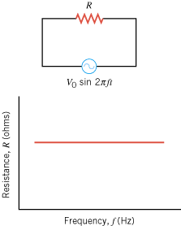
Resistance

Slide 3
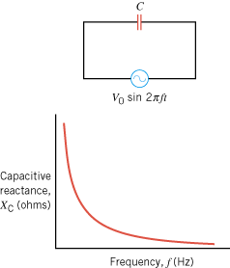
Capacitive Reactance, X_{C}

Slide 4
Example 1 A Capacitor in an AC Circuit
For the circuit above, the capacitance of the capacitor is 1.50 μF, and the rms voltage of the generator is 25.0 V. What is the rms current in the circuit when the frequency of the generator is 5.00 × 10³ Hz?

Slide 5
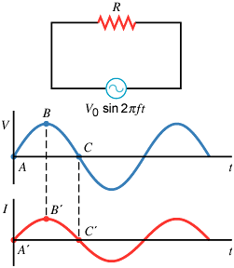
Resistive Circuit

Slide 6
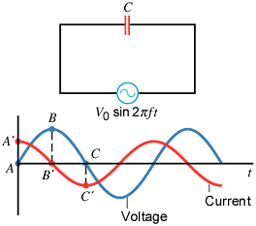
Current and Voltage in a Capacitive Circuit
In a circuit containing only a capacitor, the instantaneous voltage and current are not in phase. Instead, the current leads the voltage by one-quarter of a cycle or by a phase angle of 90°.

Slide 7
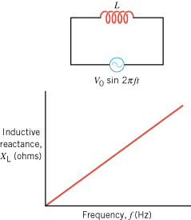
Inductance

Slide 8
Inductive Reactance, X_{L}

Slide 9
Example 2 An Inductor in an AC Circuit
The circuit in Figure 23.6 contains a 3.60-mH inductor. The rms voltage of the generator is 25.0 V. Find the rms current in the circuit when the generator frequency is 5.00 × 10³ Hz.

Slide 10
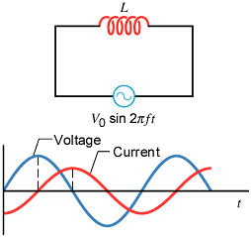
Current and Voltage in an Inductive Circuit
The instantaneous voltage and current in a circuit containing only an inductor are not in phase. The current lags behind the voltage by one-quarter of a cycle or by a phase angle of 90°.

Slide 11
A Comparison: Capacitive versus Inductive
The current leads the voltage by one-quarter of a cycle or by a phase angle of 90°.
The current lags behind the voltage by one-quarter of a cycle or by a phase angle of 90°.

Slide 12
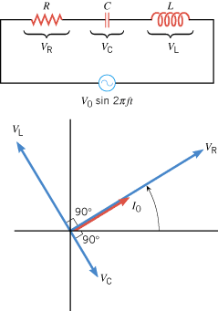
23.3. Circuits Containing Resistance, Capacitance, and Inductance

Slide 13
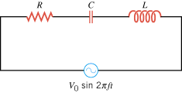
Impedance,z for a Series RCL Circuit

Slide 14
Resonant Frequency

Slide 15
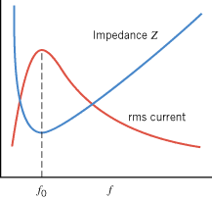
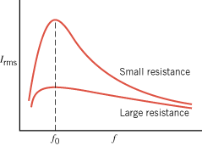
Impedance and RMS Current

Slide 16
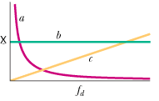
Question
In the above Reactance VS. frequency diagram, identify them as that of a capacitor, inductor, and resistor.

