Slide 1
Review of Waves
Waves are of three main types:
1. Mechanical waves. We encounter these almost constantly.
Examples: sound waves, water waves, and seismic waves.
These waves are governed by Newton’s laws, and they can exist only within a material medium, such as air, water, and rock.
2. Electromagnetic waves.
Examples include visible and ultraviolet light, radio and television waves, microwaves, x rays, and radar waves.
These waves require no material medium to exist. Light waves from stars, for example, travel through the vacuum of space to reach us.
All electromagnetic waves travel through a vacuum at the same speed, 3 x 10⁸ m/s.
3. Matter waves.
These waves are commonly used in modern technology.
These waves are associated with electrons, protons, and other fundamental particles, and even atoms and molecules.
These waves are governed by quantum mechanics.

Slide 2
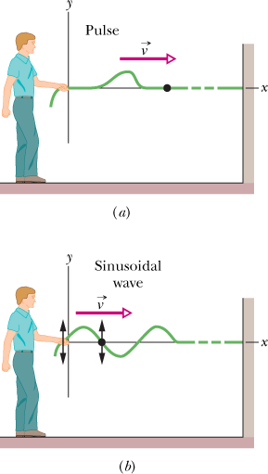
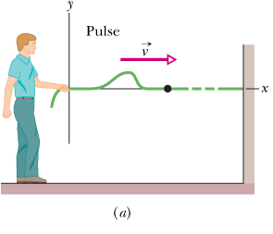
Pulse and Sine Wave
A wave sent along a stretched, taut string is the simplest mechanical wave. If you give one end of a stretched string a single up-and-down jerk, a wave in the form of a single pulse travels along the string. This pulse and its motion can occur because the string is under tension.
If you move your hand up and down in continuous simple harmonic motion, a continuous wave travels along the string. Because the motion of your hand is a sinusoidal function of time, the wave has a sinusoidal shape at any given instant, that is, the wave has the shape of a sine curve or a cosine curve.

Slide 3
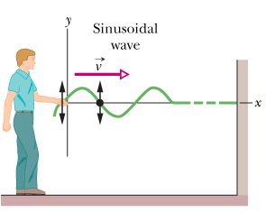
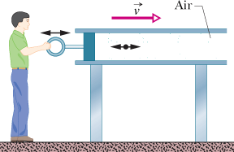
Transverse and Longitudinal Waves
Transverse mechanical waves, like those on a stretched string, are waves in which the particles of the medium oscillate perpendicular to the wave’s direction of travel.
Waves in which the particles of the medium oscillate parallel to the wave’s direction of travel are longitudinal waves.
Both a transverse wave and a longitudinal wave are said to be traveling waves because they both travel from one point to another. Note that it is the wave that moves from end to end, not the material (string or air) through which the wave moves.

Slide 4
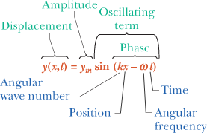
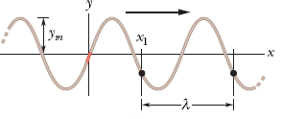
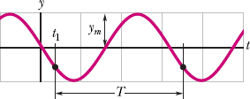
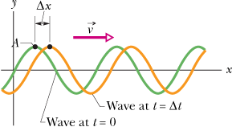
Travelling wave on a String Wavelength, Frequency, and Wave Speed
The amplitude of a wave is the magnitude of the maximum displacement of the elements from their equilibrium positions as the wave passes through them. The phase of the wave is the argument of the sine function.

Slide 5
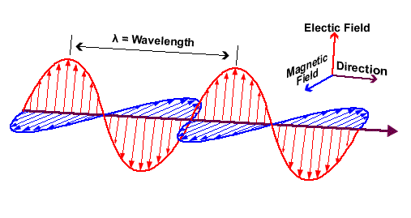
Wave Function
A simple traveling wave of any kind, be it a wave on a string, a sound wave, or a light wave, is described in terms of some quantity that varies in a wave-like fashion.
For light waves, for example, this quantity is the electric field component of the wave. Its observed value at any point depends on the location of that point and on the time at which the observation is made.
What varying quantity should we use to describe a matter wave?
We should expect this quantity, which we call the wave function Ψ(x, y, z, t), to be more complicated than the corresponding quantity for a light wave because a matter wave, in addition to energy and momentum, transports mass and (often) electric charge.
It turns out that Ψ, the uppercase Greek letter psi, usually represents a function that is complex in the mathematical sense; that is, we can always write its values in the form a + ib, in which a and b are real numbers and i² = -1.

Slide 6
Wave Function
$$ψ=ψ_{0}e^{i(kx−ωt)}$$
ω = 2πf, is the angular frequency of the matter wave.
ψ, the lowercase Greek letter psi, represents only the space-dependent part of the complete, time-dependent wave function Ψ.
What does the wave function mean?
It has to do with the fact that a matter wave, like a light wave, is a probability wave. Suppose that a matter wave reaches a particle detector that is small; then the probability that a particle will be detected in a specified time interval is proportional to |ψ|², where |ψ| is the absolute value of the wave function at the location of the detector. Although ψ is usually a complex quantity, |ψ|² is always both real and positive. It is, then, |ψ|², which we call the probability density, and not ψ, that has physical meaning. Speaking loosely, the meaning is this:
The probability (per unit time) of detecting a particle in a small volume centered on a given point in a matter wave is proportional to the value of |ψ|² at that point.

Slide 7
Complex Numbers
Because ψ is usually a complex quantity, we find the square of its absolute value by multiplying ψ by ψ*, the complex conjugate of ψ.
To find ψ* we replace the imaginary number i in ψ with -i, wherever it occurs.)
(a) Let n = a + ib be a complex number, where a and b are real (positive or negative) numbers. Show that the product nn* is always a positive real number. (b) Let m = c + id be another complex number. Show that |nm| = |n| |m|.

Slide 8
Schrödinger's Equation
How do we find the wave function?
Sound waves and waves on strings are described by the equations of Newtonian mechanics.
Light waves are described by Maxwell's equations.
Matter waves are described by Schrödinger's equation, advanced in 1926 by Austrian physicist Erwin Schrödinger.
Many of the situations that we shall discuss involve a particle traveling in the x direction through a region in which forces acting on the particle cause it to have a potential energy U(x). In this special case, Schrödinger's equation reduces to
in which E is the total mechanical energy of the moving particle. (We do not consider mass energy in this non-relativistic equation.)

Slide 9
Derivation of Schrödinger's Equation

Slide 10
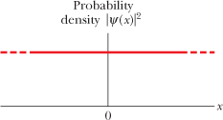
Free Particle moving in the +X direction
The time-dependent wave function Ψ of a free particle traveling in the x direction:

Slide 11
Show that the angular wave number k for a nonrelativistic free particle of mass m can be written as, K is the particle's kinetic energy.

Slide 12
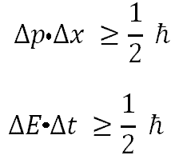
Heisenberg's Uncertainty Principle
https://www.theguardian.com/science/2013/nov/10/what-is-heisenbergs-uncertainty-principle
https://www.youtube.com/watch?v=TQKELOE9eY4
http://plato.stanford.edu/entries/qt-uncertainty/

Slide 13
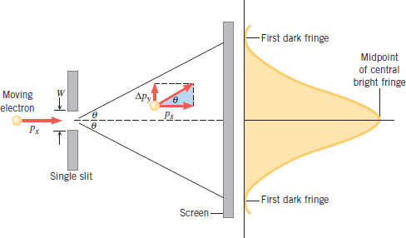
Deducing Uncertainty Principle with Single-Slit Diffraction

Slide 14
Position and momentum of an Electron
Assume that an electron is moving along an x axis and that you measure its speed to be 2.05 × 10⁶ m/s, which can be known with a precision of 0.50%. What is the minimum uncertainty (as allowed by the uncertainty principle in quantum theory) with which you can simultaneously measure the position of the electron along the x axis?

