Slide 1
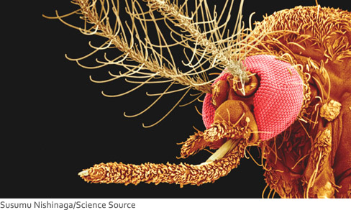
Particles and Waves
This photograph shows a highly magnified view of a female mosquito, made with a scanning electron microscope (SEM).
In the twentieth century, it was discovered that particles could behave like waves.
A wavelength can be associated with a moving particle such as an electron.
The microscope used for the photograph takes advantage of the electron wavelength, which can be made much smaller than that of visible light.
It is this small electron wavelength that is responsible for the exceptional resolution of fine detail in the photograph.

Slide 2
Dual Nature of Light
Newton- Particle
Young- Wave
Einstein- Dual (particle or wave) nature
https://www.youtube.com/watch?v=XB-iLRsq8A8

Slide 3
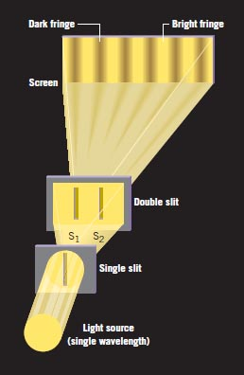
Young's Double-Slit Experiment
In 1801 the English scientist Thomas Young (1773-1829) performed a historic experiment that demonstrated the wave nature of light by showing that two overlapping light waves can interfere with each other.
His experiment was particularly important because he was also able to determine the wavelength of the light from his measurements, the first such determination of this important property.

Slide 4
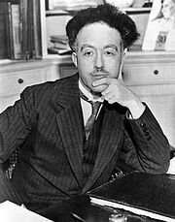
Wavelike Properties of Particles
Louis de Broglie
In 1924, French physicist Louis de Broglie, assigned a wavelength λ to a particle with momentum of magnitude p.
This is Louis de Broglie’s PhD thesis work, also won the Nobel prize in 1927.
De Broglie's prediction of the existence of matter waves was first verified experimentally in 1927, by C. J. Davisson and L. H. Germer of the Bell Telephone Laboratories and by George P. Thomson of the University of Aberdeen in Scotland. Nobel prize in 1937.

Slide 5
Davisson-Germer Experiment
http://hyperphysics.phy-astr.gsu.edu/hbase/quantum/davger2.html

Slide 6
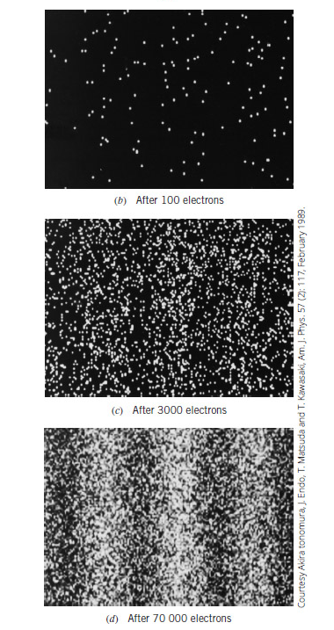
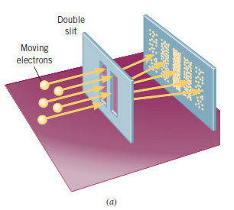
Double-slit experiment with moving electrons
In this electron version of Young's double-slit experiment, the characteristic fringe pattern becomes recognizable only after a sufficient number of electrons have struck the screen.

Slide 7
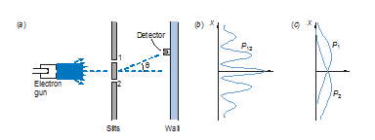
(a) Experimental arrangement for producing a double-slit diffraction pattern with electron waves. The detector can move up and down the wall. (b) The probability distribution P12 measured with both slits open. (c) The probability distributions P1 and P2 measured with only P1 and only P2 open, respectively.

Slide 8
de Broglie Wavelength
Derivation:
Calculations:

Slide 9
A stone is dropped from the top of a building. As the stone falls, does its de Broglie wavelength increase, decrease, or remain the same?
An electron and a neutron have different masses. Is it possible, that they can have the same de Broglie wavelength?

Slide 10
Find the de Broglie wavelength of an electron with a speed of 0.76 C. Take relativistic effects into account.
The de Broglie wavelength of a proton in a particle accelerator is
2.67 x 10⁻¹⁴ m. Determine the kinetic energy (in joules) of the proton.

Slide 11
De Broglie wavelength using Accelerating Potential

Slide 12
De Broglie wavelength using kinetic Energy

Slide 13
Microscopy
Optical resolution: 10⁻⁷ m = 0.1 μm = 100 nm
For higher resolution need higher frequency
X-Rays? Difficult to focus.
Electrons
Wavelength: 3 pm (0.003 nm)
(Magnification - 1,000,000X)
Atomic resolution possible
Electron beam focused by magnetic lenses.
https://www.purdue.edu/ehps/rem/rs/sem.htm

Slide 14
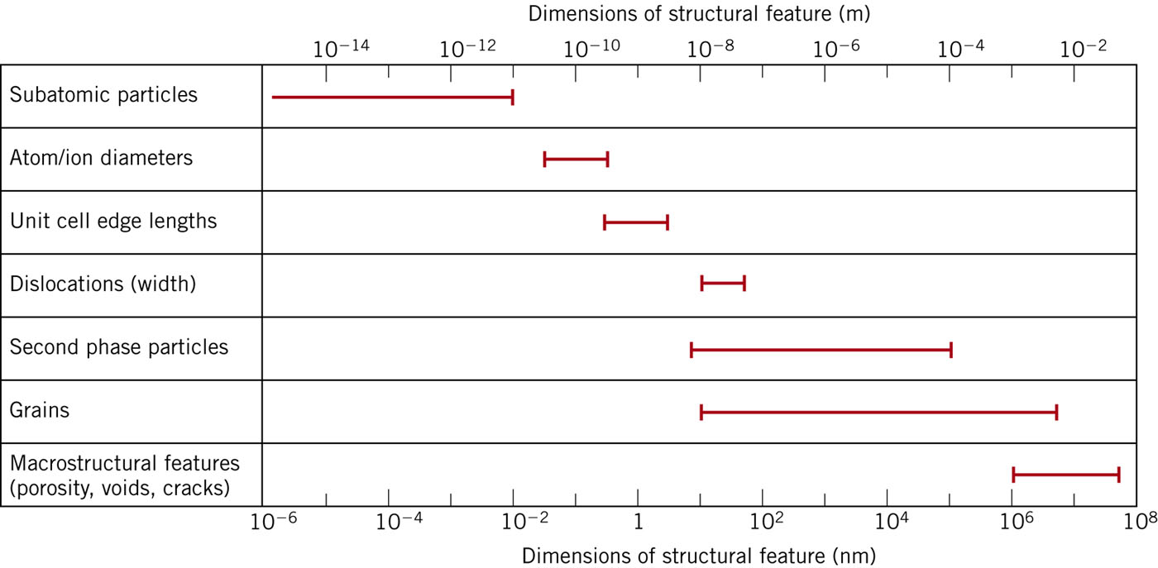
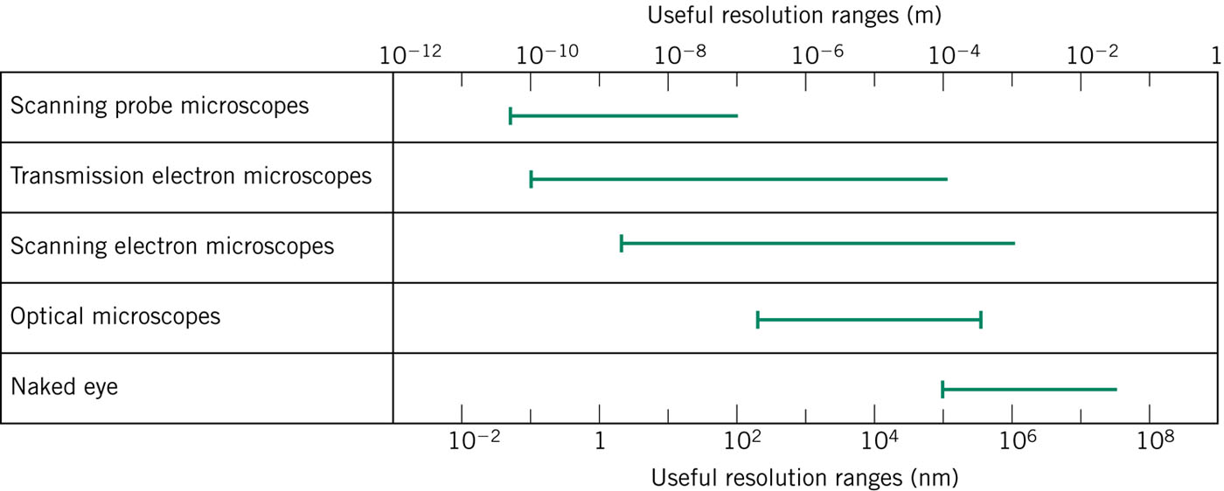

Slide 15
1. The highest achievable resolving power of a microscope is limited only by the wavelength used; that is, the smallest item that can be distinguished has dimensions about equal to the wavelength. Suppose one wishes to “see” inside an atom. Assuming the atom to have a diameter of 100 pm, this means that one must be able to resolve a width of, say, 10 pm. (a) If an electron microscope is used, what minimum electron energy is required? (b) If a light microscope is used, what minimum photon energy is required? (c) Which microscope seems more practical? Why?
2. The existence of the atomic nucleus was discovered in 1911 by Ernest Rutherford, who properly interpreted some experiments in which a beam of alpha particles was scattered from a metal foil of atoms such as gold. (a) If the alpha particles had a kinetic energy of 7.5 MeV, what was their de Broglie wavelength? (b) Explain whether the wave nature of the incident alpha particles should have been taken into account in interpreting these experiments. The mass of an alpha particle is 4.00 u (atomic mass units), and its distance of closest approach to the nuclear center in these experiments was about 30 fm. (The wave nature of matter was not postulated until more than a decade after these crucial experiments were first performed.)
3. A non-relativistic particle is moving three times as fast as an electron. The ratio of the de Broglie wavelength of the particle to that of the electron is 1.813 × 10⁻⁴. By calculating its mass, identify the particle.

