Slide 1
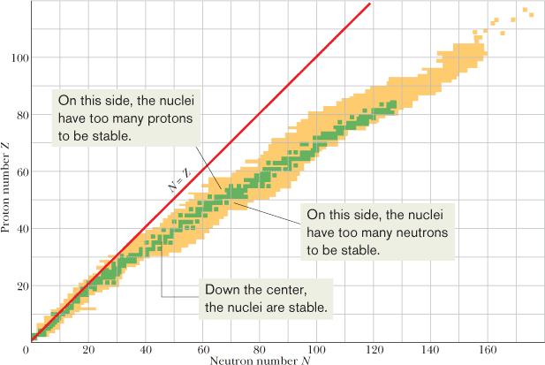
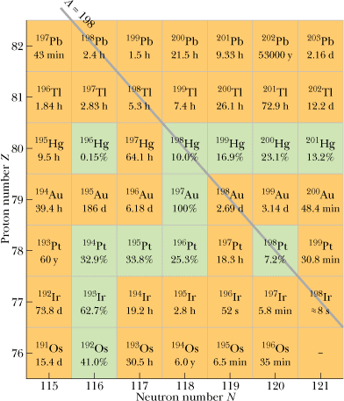
Radioactivity (Discovery)
Most of the nuclides that have been identified are radioactive. A radioactive nuclide spontaneously emits a particle, transforming itself in the process into a different nuclide, occupying a different square on the nuclidic chart.
Radioactive decay provided the first evidence that the laws that govern the subatomic world are statistical.

Slide 2
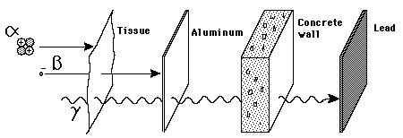
α , β ,and γ rays
When an unstable or radioactive nucleus disintegrates spontaneously, certain kinds of particles and/or high-energy photons are released. These particles and photons are collectively called “rays.” Three kinds of rays are produced by naturally occurring radioactivity: α , β ,and γ.

Slide 3
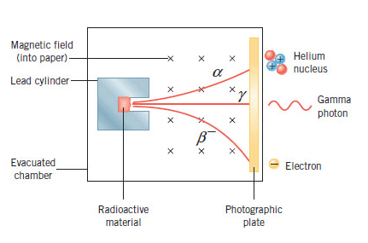
Charge Properties
http://hyperphysics.phy-astr.gsu.edu/hbase/nuclear/radact.html

Slide 4
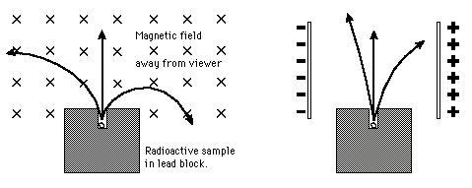
Motion of the particles in magnetic and electric fields
Identify the particles α, β, and γ particles in the figure below:
http://hyperphysics.phy-astr.gsu.edu/hbase/nuclear/radact.html

Slide 5
Decay Constant (λ) and Activity (R)

Slide 6
Half-life and Mean life

Slide 7
Finding the disintegration constant and half-life from a graph
The table that follows shows some measurements of the decay rate of a sample of ¹²⁸I, a radionuclide often used medically as a tracer to measure the rate at which iodine is absorbed by the thyroid gland. Find the disintegration constant λ and the half-life T_{1/2} for this radionuclide.
Time (min) | R (counts/s) | Time (min) | R (counts/s)
4 | 392.2 | 132 | 10.9
36 | 161.4 | 164 | 4.56
68 | 65.5 | 196 | 1.86
100 | 26.8 | 218 | 1.00

Slide 8
Finding the half-life from the activity and mass
A 2.71 g sample of KCl from the chemistry stockroom is found to be radioactive, and it is decaying at a constant rate of 44.90 Bq. The decays are traced to the element potassium and in particular to the isotope ⁴⁰K, which constitutes 0.0117% of normal potassium. Calculate the half-life of this nuclide.

Slide 9
Q value
In a system undergoing a chemical or nuclear reaction, a change in the total mass energy of the system due to the reaction is often given as a Q value. The Q value for a reaction is obtained from the relation:
https://www.youtube.com/watch?v=Retb06SQWMA
Calculate Q-Value of the following reaction
₃Li⁷ + ₁H¹ ——–> 2₂He⁴
Check whether the reaction is exoergic or endoergic
The exact mass of ₃Li⁷ isotope = 7.01601 a.m.u. and that of ₁H¹ = 1.00738 a.m.u. The exact mass of ₂He⁴ = 4.00260 a.m.u.

Slide 10
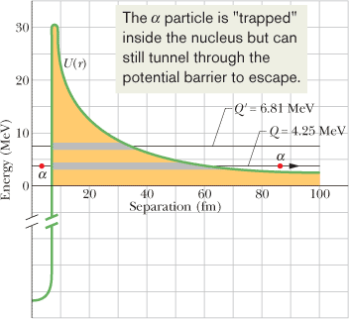
Alpha Decay
When a nucleus undergoes alpha decay, it transforms to a different nuclide by emitting an alpha particle (a helium nucleus, ⁴He). For example, when uranium ²³⁸U undergoes alpha decay, it transforms to thorium ²³⁴Th:
This alpha decay of ²³⁸U can occur spontaneously (without an external source of energy) because the total mass of the decay products ²³⁴Th and ⁴He is less than the mass of the original ²³⁸U.
Radionuclide | Q | Half-Life
²³⁸U | 4.25 MeV | 4.5 × 10⁹ y
²²⁸U | 6.81 MeV | 9.1 min
There is a finite probability that alpha particle can tunnel through an energy barrier that is classically insurmountable. In fact, alpha decay occurs as a result of barrier tunneling, a quantum phenomenon.

Slide 11
Q value for Alpha Decay
Calculate the energy released during the alpha decay of ²³⁸U.
Show that ²³⁸U cannot spontaneously emit a proton; that is, protons do not leak out of the nucleus in spite of the proton-proton repulsion within the nucleus.
If this happened, the decay process would be:

Slide 12
Beta Decay
A nucleus that decays spontaneously by emitting an electron or a positron (a positively charged particle with the mass of an electron) is said to undergo beta decay. Like alpha decay, this is a spontaneous process, with a definite disintegration energy and half-life. Again like alpha decay, beta decay is also a statistical process.
In beta-minus (β⁻) decay, an electron is emitted by a nucleus:
In beta-plus (β⁺) decay, a positron is emitted by a nucleus:
The symbol v represents a neutrino, a neutral particle which has a very small mass, that is emitted from the nucleus along with the electron or positron during the decay process. Neutrinos interact only very weakly with matter and—for that reason—are so extremely difficult to detect that their presence long went unnoticed.
For beta-minus decay, a neutron transforms into a proton within the nucleus:
For beta-plus decay, a proton transforms into a neutron :

Slide 13
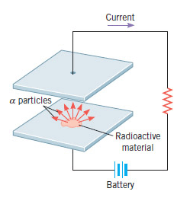
The physics of radioactivity and smoke detectors
One widely used application of α decay is in smoke detectors.
Two small and parallel metal plates are separated by a distance of about one centimeter.
A tiny amount of radioactive material at the center of one of the plates emits particles, which collide with air molecules.
During the collisions, the air molecules are ionized to form positive and negative ions. The voltage from a battery causes one plate to be positive and the other negative, so that each plate attracts ions of opposite charge.
As a result there is a current in the circuit attached to the plates. The presence of smoke particles between the plates reduces the current, since the ions that collide with a smoke particle are usually neutralized.
The drop in current that smoke particles cause is used to trigger an alarm.

Slide 14
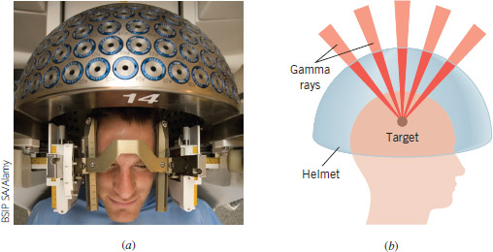
The physics of Gamma Knife radiosurgery
Gamma Knife radiosurgery is becoming a very promising medical procedure for treating certain problems of the brain, including benign and cancerous tumors as well as blood vessel malformations.
The procedure, which involves no knife at all, uses powerful, highly focused beams of γ rays (emitted by a radioactive cobalt-60 source) aimed at the tumor or malformation.
The patient wears a protective metal helmet that is perforated with many small holes. Part b of the figure shows that the holes focus the γ rays to a single tiny target within the brain.
The target tissue thus receives a very intense dose of radiation and is destroyed, while the surrounding healthy tissue is undamaged.
Gamma Knife surgery is a noninvasive, painless, and bloodless procedure that is often performed under local anesthesia. Hospital stays are 70 to 90% shorter than with conventional surgery, and patients often return to work within a few days.

