Slide 1
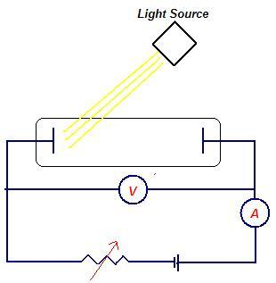
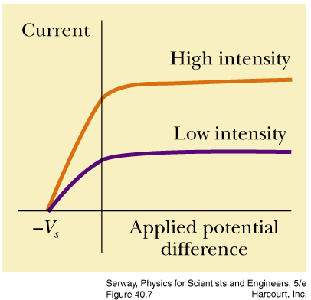
Photoelectric Effect
Maximum kinetic energy of the electron:
$$K_{max}=eV_{S}$$
https://www.youtube.com/watch?v=ubkNGwu_66s

Slide 2
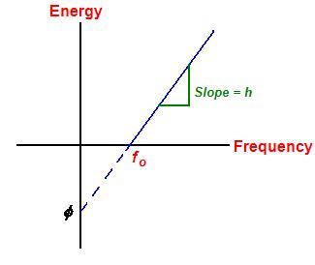
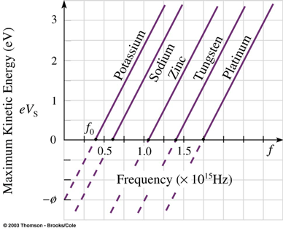
Photoelectric Effect: Equation
$$K_{max}=hf−Φ$$
Work function = φ

Slide 3
Photoelectric Effect
https://www.youtube.com/watch?v=ubkNGwu_66s
https://www.youtube.com/watch?v=wFY9ZvUmM5o (UC Berkeley)
https://www.youtube.com/watch?v=7wF8Jm5Zhvk

Slide 4
Applications
https://www.youtube.com/watch?v=nrCEVbS2oeo

Slide 5
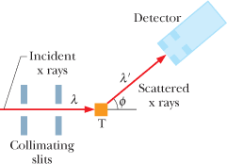
Compton Effect
A quantum of light has linear momentum (Einstein 1916). For a photon with energy hf, the magnitude of that momentum is:
In 1923, Arthur Compton, carried out an experiment that supported the view that both momentum and energy are transferred via photons.
He arranged for a beam of x rays of wavelength λ to be directed onto a target made of carbon, as shown. An x ray is a form of electromagnetic radiation, at high frequency and thus small wavelength. Compton measured the wavelengths and intensities of the x rays that were scattered in various directions from his carbon target.

Slide 6
Compton Shift
Figure below shows his results. Although there is only a single wavelength (λ = 71.1 pm) in the incident x-ray beam, we see that the scattered x rays contain a range of wavelengths with two prominent intensity peaks. One peak is centered about the incident wavelength λ, the other about a wavelength λ′ that is longer than λ by an amount Δλ, which is called the Compton shift. The value of the Compton shift varies with the angle at which the scattered x rays are detected and is greater for a greater angle.
Derivation
The quantity h/mc in is a constant called the Compton wavelength. Its value depends on the rest mass m of the particle from which the x rays scatter.

