Slide 1
Nuclear Physics
Discovery of the nucleus
Nuclear properties
Nuclear binding energies
Radioactivity
Nuclear Models
Nuclear Energy: Fission and Fusion

Slide 2
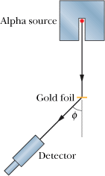
Discovery of the Nucleus
An arrangement (top view) used in Rutherford's laboratory in 1911-1913 to study the scattering of a particles by thin metal foils. The detector can be rotated to various values of the scattering angle φ. The alpha source was radon gas, a decay product of radium. With this simple “tabletop” apparatus, the atomic nucleus was discovered.

Slide 3
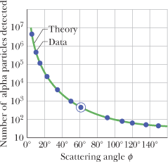
Discovery of the Nucleus
The dots are alpha-particle scattering data for a gold foil, obtained by Geiger and Marsden using the apparatus shown. The solid curve is the theoretical prediction, based on the assumption that the atom has a small, massive, positively charged nucleus. The data have been adjusted to fit the theoretical curve at the experimental point that is enclosed in a circle.

Slide 4
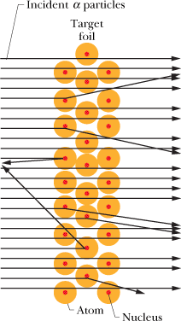
Structure of the atom
Figure shows possible paths taken by typical alpha particles as they pass through the atoms of the target foil.
As we see, most are either undeflected or only slightly deflected, but a few (those whose incoming paths pass, by chance, very close to a nucleus) are deflected through large angles.
From an analysis of the data, Rutherford concluded that the radius of the nucleus must be smaller than the radius of an atom by a factor of about 10⁴.
In other words, the atom is mostly empty space.

Slide 5
Coulomb’s law and Electric Potential Energy

Slide 6
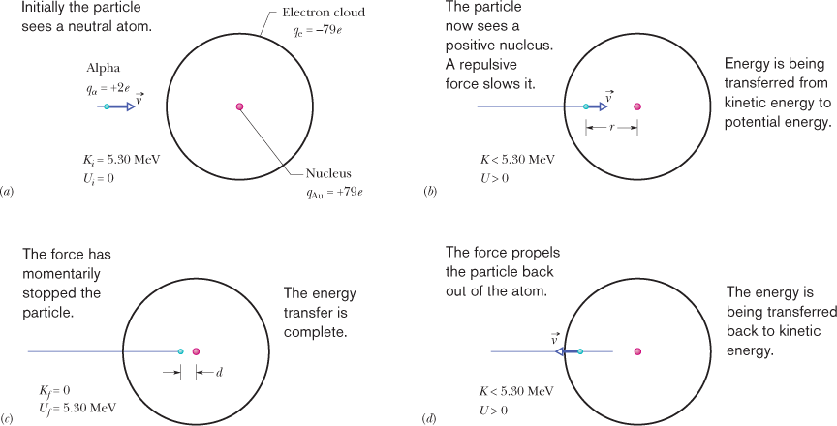
Rutherford scattering
An alpha particle with kinetic energy K_{i} = 5.30 MeV happens, by chance, to be headed directly toward the nucleus of a neutral gold atom (Fig. 42-4a). What is its distance of closest approach d (least center-to-center separation) to the nucleus? Assume that the atom remains stationary.

Slide 7
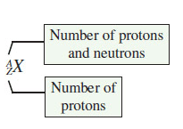
Properties of Atomic Particles
Particle | Charge | Mass (kg) | Mass (u) | Mass (MeV/c²)
Electron | -1.602 x 10⁻¹⁹C | 9.109382 x 10⁻³¹ | 5.485 x 10⁻⁴ | 0.510999
Proton | 1.602 x 10⁻¹⁹C | 1.672622 x 10⁻²⁷ | 1.007276 | 938.27
Neutron | 0 | 1.674927 x 10⁻²⁷ | 1.008665 | 939.57
H-atom | 0 | 1.673534 x 10⁻²⁷ | 1.007825 | 938.783
u | 0 | 1.66053886 x 10⁻²⁷ | 1 | 931.494
The nucleus of an atom consists of neutrons and protons, collectively referred to as nucleons.

Slide 8
Atomic Mass Unit = u
Express the atomic mass unit, u in its rest energy equivalent.

Slide 9
Some Properties of Selected Nuclides
Nuclide | Z | N | A | Stabilityª | Mass^{b} (u) | Spin^{c} | Binding Energy (Me V/nucleon)
¹H | 1 | 0 | 1 | 99.985% | 1.007 825 | 1/2 | —
⁷Li | 3 | 4 | 7 | 92.5% | 7.016 004 | 3/2 | 5.60
³¹P | 15 | 16 | 31 | 100% | 30.973 762 | 1/2 | 8.48
⁸⁴Kr | 36 | 48 | 84 | 57.0% | 83.911 507 | 0 | 8.72
¹²⁰Sn | 50 | 70 | 120 | 32.4% | 119.902 197 | 0 | 8.51
¹⁵⁷Gd | 64 | 93 | 157 | 15.7% | 156.923 957 | 3/2 | 8.21
¹⁹⁷Au | 79 | 118 | 197 | 100% | 196.966 552 | 3/2 | 7.91
²²⁷Ac | 89 | 138 | 227 | 21.8 y | 227.027 747 | 3/2 | 7.65
²³⁹Pu | 94 | 145 | 239 | 24 100 y | 239.052 157 | 1/2 | 7.56

Slide 10
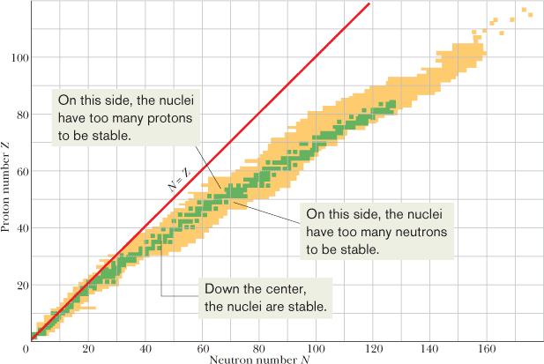
Known Nuclides
The green shading identifies the band of stable nuclides, the beige shading the radionuclides. Low-mass, stable nuclides have essentially equal numbers of neutrons and protons, but more massive nuclides have an increasing excess of neutrons. The figure shows that there are no stable nuclides with Z > 83 (bismuth).

Slide 11
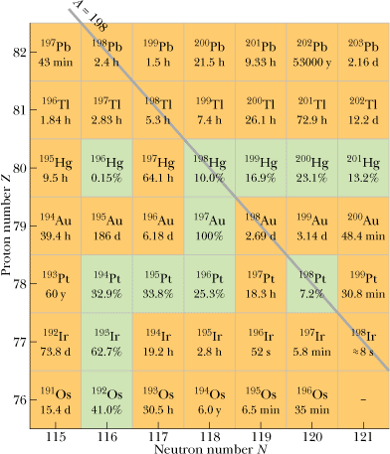
Organizing the Nuclides
The neutral atoms of all isotopes of an element (all with the same Z) have the same number of electrons and the same chemical properties, and they fit into the same box in the periodic table of the elements.
The nuclear properties of the isotopes of a given element, however, are very different from one isotope to another. Thus, the periodic table is of limited use to the nuclear physicist, the nuclear chemist, or the nuclear engineer.
An enlarged and detailed section of the nuclidic chart, centered on ¹⁹⁷Au. Green squares represent stable nuclides, for which relative isotopic abundances are given. Beige squares represent radionuclides, for which half-lives are given. Isobaric lines of constant mass number A slope as shown by the example line for A = 198.

Slide 12
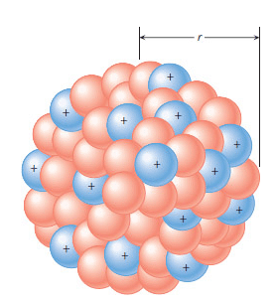
Nuclear Radii and Density
r₀ ≈ 1.2 fm
Density of nuclear matter:

Slide 13
Nuclear Binding Energies
The mass M of a nucleus is less than the total mass Σm of its individual protons and neutrons. That means that the mass energy Mc² of a nucleus is less than the total mass energy Σ(mc²) of its individual protons and neutrons. The difference between these two energies is called the binding energy of the nucleus:
Binding energy is not an energy that resides in the nucleus. Rather, it is a difference in mass energy between a nucleus and its individual nucleons: If we were able to separate a nucleus into its nucleons, we would have to transfer a total energy equal to ΔE_{be} to those particles during the separating process. Although we cannot actually tear apart a nucleus in this way, the nuclear binding energy is still a convenient measure of how well a nucleus is held together, in the sense that it measures how difficult the nucleus would be to take apart.
A better measure is the binding energy per nucleon ΔE_{ben}, which is the ratio of the binding energy ΔE_{be} of a nucleus to the number A of nucleons in that nucleus:
We can think of the binding energy per nucleon as the average energy needed to separate a nucleus into its individual nucleons. A greater binding energy per nucleon means a more tightly bound nucleus.

Slide 14
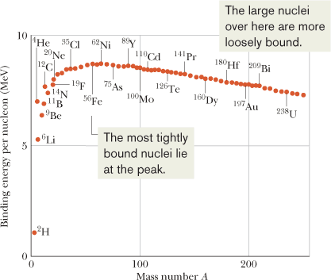
Plot of the binding energy per nucleon ΔE_{ben} versus mass number A
The binding energy per nu-cleon for some representative nuclides. The nickel nuclide ⁶²Ni has the highest binding energy per nucleon (about 8.794 60 MeV/nucleon) of any known stable nuclide. Note that the alpha particle (⁴He) has a higher binding energy per nucleon than its neighbors in the periodic table and thus is also particularly stable.
What is the binding energy per nucleon for ¹²⁰Sn?

