Slide 1
RELATIVITY
Einstein demonstrated that space and time are entangled.
The time between two events depends on how far apart they occur, and vice versa.
Also, the entanglement is different for observers who move relative to each other.
One result is that time does not pass at a fixed rate. Rather, that rate is adjustable: Relative motion can change the rate at which time passes.
Prior to 1905, no one but a few daydreamers would have thought that. Now, engineers and scientists take it for granted because their experience with special relativity has reshaped their common sense.
For example, any engineer involved with the Global Positioning System of the NAVSTAR satellites must routinely use relativity (both special relativity and general relativity) to determine the rate at which time passes on the satellites because that rate differs from the rate on Earth's surface.
Special relativity is not difficult mathematically. However, it is difficult in that we must be very careful about who measures what about an event and just how that measurement is made—and it can be difficult because it can contradict routine experience.

Slide 2
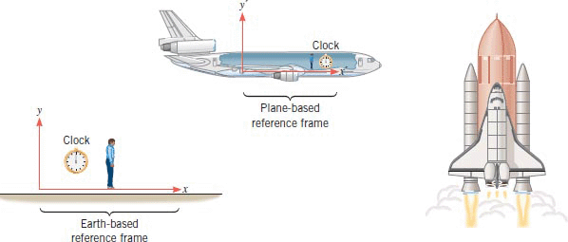
Events and Inertial Reference Frames

Slide 3
The Postulates
The Relativity Postulate: The laws of physics are the same for observers in all inertial reference frames. No one frame is preferred over any other.
Galileo assumed that the laws of mechanics were the same in all inertial reference frames. Einstein extended that idea to include all the laws of physics, especially those of electromagnetism and optics. This postulate does not say that the measured values of all physical quantities are the same for all inertial observers; most are not the same. It is the laws of physics, which relate these measurements to one another, that are the same.
The Speed of Light Postulate: The speed of light in vacuum has the same value c in all directions and in all inertial reference frames.
Light happens to travel at this ultimate speed. However, no entity that carries energy or information can exceed this limit. No particle that has mass can actually reach speed c, no matter how much or for how long that particle is accelerated.
Both postulates have been exhaustively tested, and no exceptions have ever been found.

Slide 4
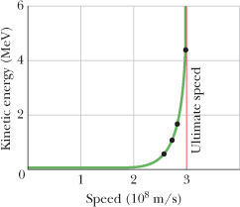
The Ultimate Speed
The dots show measured values of the kinetic energy of an electron plotted against its measured speed. No matter how much energy is given to an electron (or to any other particle having mass), its speed can never equal or exceed the ultimate limiting speed c. (The plotted curve through the dots shows the predictions of Einstein's special theory of relativity.)

Slide 5
Testing the Speed of Light Postulate
The neutral pion (symbol π⁰), an unstable, short-lived particle that can be produced by collisions in a particle accelerator.
It decays (transforms) into two gamma rays.
Gamma rays are part of the electromagnetic spectrum (at very high frequencies) and so obey the speed of light postulate, just as visible light does.
In 1964, physicists at CERN, the European particle-physics laboratory near Geneva, generated a beam of pions moving at a speed of 0.999 75c with respect to the laboratory.
The experimenters then measured the speed of the gamma rays emitted from these very rapidly moving sources. They found that the speed of the light emitted by the pions was the same as it would be if the pions were at rest in the laboratory, namely c.

Slide 6
Spacetime Coordinates
An event is something that happens, and every event can be assigned three space coordinates and one time coordinate.
Among many possible events are (1) the turning on or off of a tiny lightbulb, (2) the collision of two particles, (3) the passage of a pulse of light through a specified point, (4) an explosion, and (5) the sweeping of the hand of a clock past a marker on the rim of the clock.
A certain observer, fixed in a certain inertial reference frame, might, for example, assign to an event the following coordinates: x = 3.5 m, y = 1.3 m, z = 0 m, t = 3.5 s.
Because space and time are entangled with each other in relativity, we can describe these coordinates collectively as spacetime coordinates. The coordinate system itself is part of the reference frame of the observer.

Slide 7
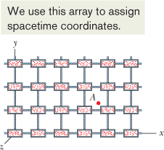
Measuring an Event
The observer's coordinate system fitted with a close-packed, three-dimensional array of measuring rods, one set of rods parallel to each of the three coordinate axes. These rods provide a way to determine coordinates along the axes.
For the time coordinate, we imagine that every point of intersection in the array of measuring rods includes a tiny clock, which the observer can read because the clock is illuminated by the light generated by the event.
The array of clocks must be synchronized properly.

Slide 8
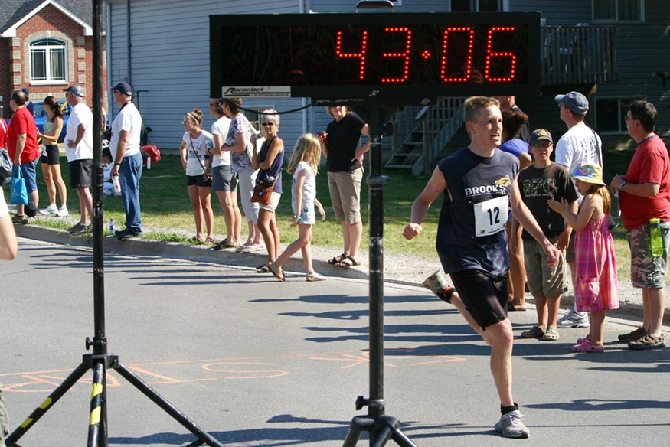
Elapsed time for a foot race
Elapsed time for a foot race is the same for all observers, but at relativistic speeds, elapsed time depends on the relative motion of the observer and the event that is observed. (credit: Jason Edward Scott Bain, Flickr)

Slide 9
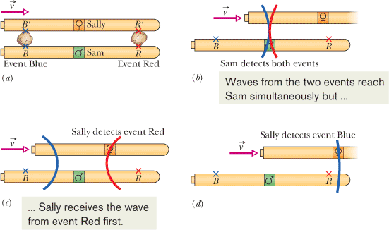
The Relativity of Simultaneity
If two observers are in relative motion, they will not, in general, agree as to whether two events are simultaneous. If one observer finds them to be simultaneous, the other generally will not.

Slide 10
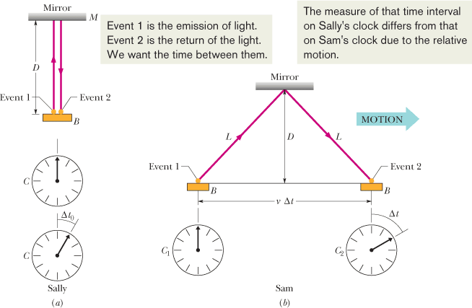
The Relativity of Time
The time interval between two events depends on how far apart they occur in both space and time; that is, their spatial and temporal separations are entangled.
(a) Sally, on the train, measures the time interval Δt₀ between events 1 and 2 using a single clock C on the train. That clock is shown twice: first for event 1 and then for event 2. (b) Sam, watching from the station as the events occur, requires two synchronized clocks, C₁ at event 1 and C₂ at event 2, to measure the time interval between the two events; his measured time interval is Δt.

Slide 11
Derivation of Time Dilation

Slide 12
Proper Time Interval
When two events occur at the same location in an inertial reference frame, the time interval between them, measured in that frame, is called the proper time interval or the proper time. Measurements of the same time interval from any other inertial reference frame are always greater.

Slide 13
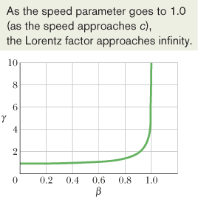
Lorentz Factor, ϒ

Slide 14
Evidence for Time Dilation
1. Microscopic Clocks: See Muon at 17:28-17:30, on the left.
Muons are produced in the upper atmosphere (about 10,000 m above sea level) when cosmic rays bombard earth. The average lifetime of a muon at rest is 2.200 µs. The appearance of them at sea level can be explained using time dilation.
2. Macroscopic Clocks: In October 1971, Joseph Hafele and Richard Keating, flew four portable atomic clocks twice around the world on commercial airlines, once in each direction.
Such macroscopic measurements became possible only because of the very high precision of modern atomic clocks. Hafele and Keating verified the predictions of the theory to within 10%.
Einstein's general theory of relativity, which predicts that the rate at which time passes on a clock is influenced by the gravitational force on the clock, also plays a role in this experiment.
A few years later, physicists at the University of Maryland carried out a similar experiment with improved precision. They flew an atomic clock round and round over Chesapeake Bay for flights lasting 15 h and succeeded in checking the time dilation prediction to better than 1%.

