Slide 1
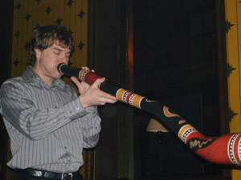
Timbre and Room Acoustics
Jake Mitchell

Slide 2
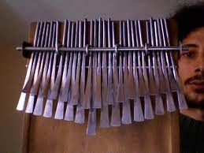
Timbre (or tone quality)
The components that define timbre are:
Amplitudes of harmonics
Attack and decay transients
Inharmonicities
Formants
Vibrato
The Chorus effect

Slide 3
The Timbre of the Classical Piano
-Tension acts as the linear restoring force for SHM.
-Inherent stiffness of the metal also assists as a restoring force.
-The stiffness of the strings causes the resonances of the string
to deviate from an exact, integral relationship. This is known as
Inharmonicity.
-Because of inharmonicity, tuning varies on the piano to
eliminate beats between adjacent octaves.
-Therefore, piano tone quality is
produced by a combination of attack
and decay transients, inharmonicities,
and the tuning relationships that exist
between the strings tuned to the same
note.

Slide 4
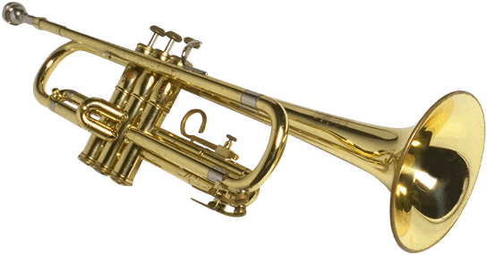
How Can Timbre Be Changed?
Timbre is a difficult concept to understand because it is not measurable. Many factors contribute to the tone quality of an instrument.
Slight variations in the timbre of an instrument can be achieved by the performer. However, it often takes a very good ear to detect these changes.
Even very small differences in how an instrument is designed (i.e. a trumpet versus a flugelhorn) can create dramatic differences in timbre.

Slide 5
Room Acoustics The terms that are associated with room acoustics:
Liveness
Intimacy
Fullness
Clarity
Warmth
Brilliance
Texture
Blend
Ensemble

Slide 6
Liveness-The physically measurable reverberation time.
Intimacy-How close the performing group sounds to the listener.
Fullness-The amount of reflected sound in relation to the direct sound.
Clarity-The opposite of fullness. The intensity of the reflected sound
will be less than the direct sound.
Warmth-Occurs when the reverberation time for low frequency
sounds is less than the reverberation time for high frequency
sounds.
Brilliance-Opposite of warmth. High frequencies will have longer
reverberation time.

Slide 7
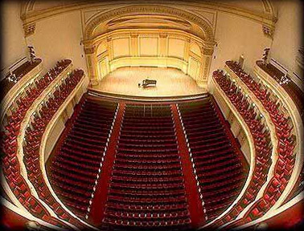
Texture-The temporal pattern of reflections reaching the listener.
Blend-The mixing of sound from all the instruments of the orchestra
or ensemble throughout the audience.
Ensemble-The ability of the members of the performing group to
hear each other during the performance.

Slide 8
References
1st minute, 1st round. (2008). On Token Tales [MP3].
Berg, R. E., & Stork, D. G. (2005). The physics of sound. Upper Saddle River, NJ: Pearson Prentice-Hall.
Buck, P. C. (1918). Acoustics for musicians,. Oxford: The Clarendon press.
Levarie, S., & Levy, E. (1968). Tone, a study in musical acoustics. Kent, OH: Kent State University Press.
Pierce, J. R. (1983). The science of musical sound. New York: Scientific American Library.
Shumba/Oya. (n.d.). On Batambira [MP3].

