Slide 1
The Human Ear and Voice
By: Stephanie Cate

Slide 2
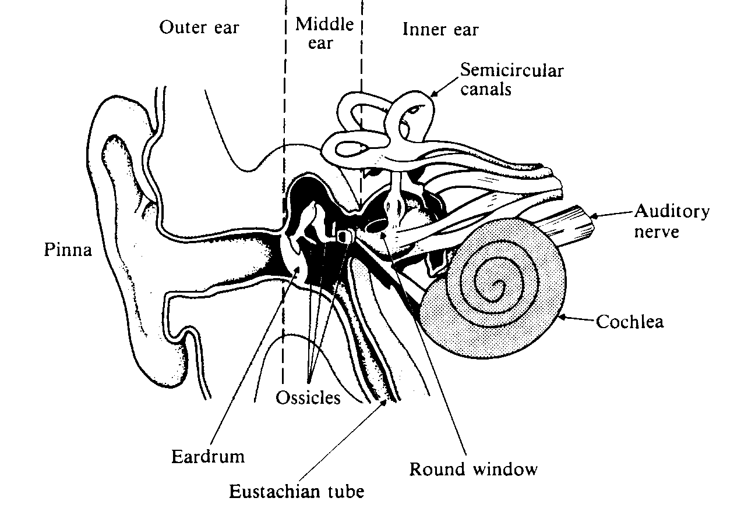
The Human Ear

Slide 3
The Outer Ear
Focuses sound waves onto the ear drum
Two parts
The pinna which concentrates sound waves into the auditory canal.
The auditory canal which transmits the sound waves onto the ear drum and protects it.

Slide 4
The Middle Ear
Made up of 3 ossicles
The Hammer
The Anvil
The Stirrup
These bones convert the small amplitude vibrations of the eardrum into the larger amplitude pressure oscillations required to set up waves in the fluid of the inner ear.

Slide 5
The Inner Ear
The Cochlea contains the nerves that convert the physical vibrations into electrical signals.
The oval window
The scala vestibuli
The helicotrema
The apex of the cochlea
The basilar membrane
The scala tympani
The round window
The base of the cochlea

Slide 6
Place Theory of Hearing
A leading theory of hearing that posits a correlation between frequency and the position of the response along the basilar membrane.

Slide 7
Amplitude Response to the Ear
Threshold for hearing is the intensity of the smallest oscillation that can be perceived by the ear.
Threshold for pain is the intensity at which a wave becomes painful to the ear.
An oscillation does not become painful to the ear until its amplitude reaches about 1 part in 10,000 times atmospheric pressure.

Slide 8
Definitions
Periodicity Pitch-The fundamental frequency perceived by the brain when only harmonics are physically present in the sound.
Fundamental tracking-The ability of the ear to hear fundamentals when a series of waves consisting of higher harmonics is sounded.
Combination Tones-Frequencies created by the nonlinearity of the ear mechanism when two or more notes are sounded simultaneously.

Slide 9
Ohms Law of Hearing
The Principle that the timbre of a complex wave depends only on the amplitudes of its harmonics and not on the phases.

Slide 10
Binaural Effects
Lower frequency sounds are easier to localize
Higher frequency sounds are harder to localize.

Slide 11
Hearing Loss
Can be caused by
Prolonged exposure to loud sounds
Diseases or Infections
Aging
Some Drugs
Damage to the ear itself

Slide 12
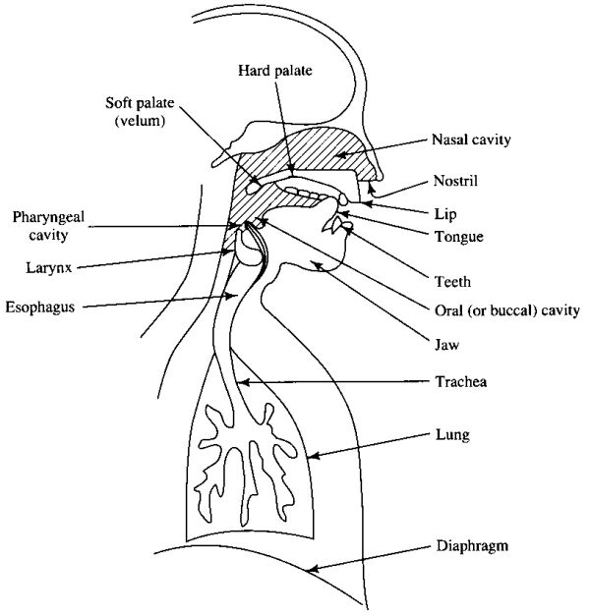
Vocal Tract

