Slide 1
The History and Acoustics of the Piano
by Duncan Singleton

Slide 2
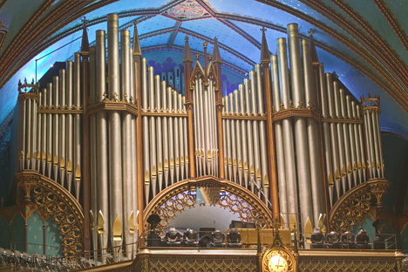
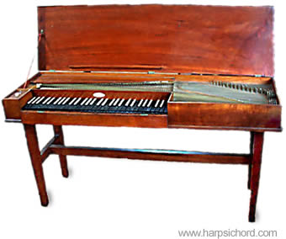
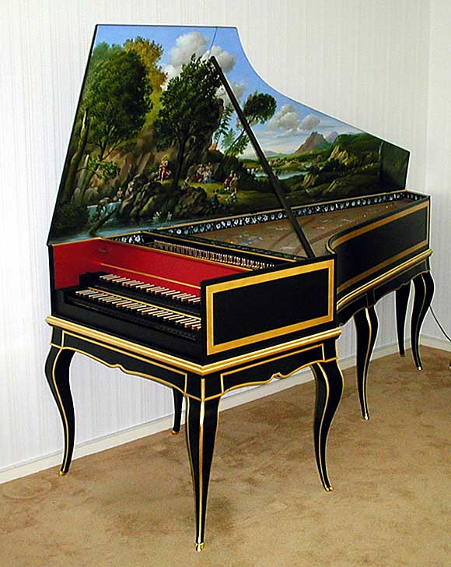
Origins
Pipe organs (2nd Century) – first instrument to have a keyboard
Originated from the harpsichord and the clavichord
These two instruments most closely resemble the modern day piano
Unlike the piano, the harpsichord and clavichord both used a plucking action to make the strings produce sound

Slide 3
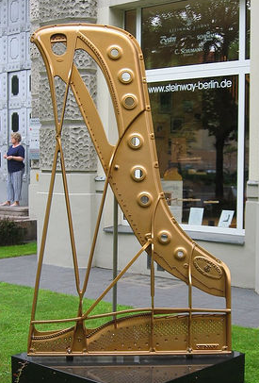
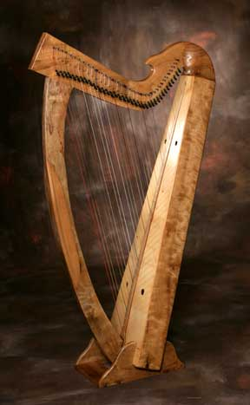
Origins
Harp (from 4000 b.c.) – strings stretched tight across a metal body
This is similar to the soundboard of the piano

Slide 4
The Beginning
The piano also has another name: the pianoforte
One of the first names (given by Bartolomeo Cristofori): Gravicembalo col pian e forte
Italian for “harpsichord with soft and loud”
Notes:
----- Meeting Notes (11/14/10 20:11) -----
Meeting notes

Slide 5
Bartolomeo Cristofori
Bartolomeo Cristofori – harpsichord maker who lived in Florence, Italy
Generally credited with invention of the piano around 1709
First to create first successful hammer-action keyboard
No other system of reliability and sensitivity was made for another 75 years.
Highly complex action of the modern piano – traced directly to his original conception.

Slide 6
Sizes and Styles

Slide 7
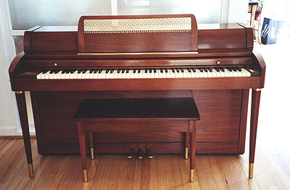
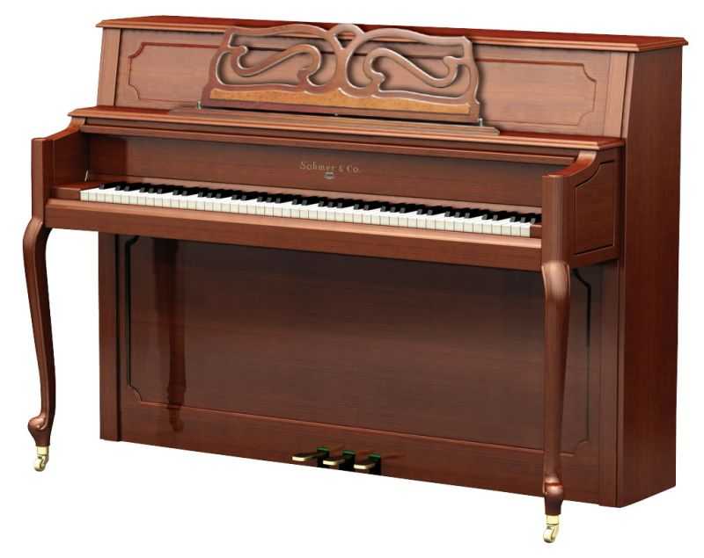
Vertical Pianos
Spinet – smallest piano
36-38 inches tall, approximately 58 inches wide
Limited power and accuracy
Console – slightly larger than the spinet
40-43 inches tall, approximately 58 inches wide
comes in various styles and finishes producing more enhanced tones

Slide 8
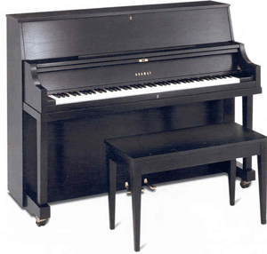
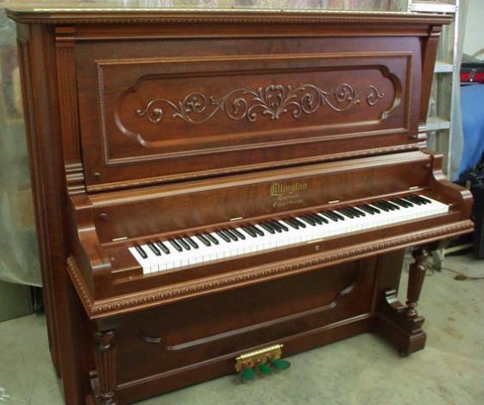
Vertical Pianos
Studio – seen in music schools and music studios
45-48 inches tall, approximately 58 inches wide
Larger soundboard and longer strings produce good tone quality and is very durable.
Upright – tallest among the vertical pianos
50-60 inches tall, approximately 58 inches wide
When cared for properly, it stands the test of time and maintains its rich tone.

Slide 9
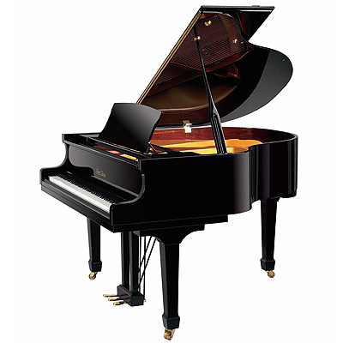
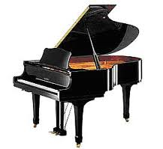
Horizontal Pianos
Petite Grand – smallest of the horizontal pianos
4 feet 5 inches to 4 feet 10 inches
Baby Grand – a very popular type of piano
4 feet 11 inches to 5 feet 6 inches
popular choice because of its sound quality, aesthetic appeal
Medium Grand – larger than the baby grand
5 feet and 7 inches

Slide 10
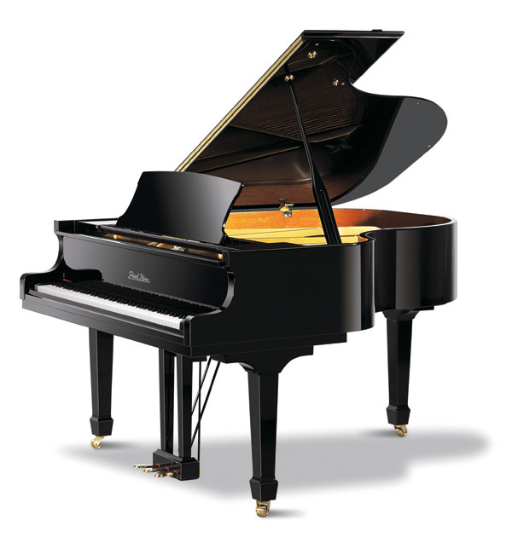
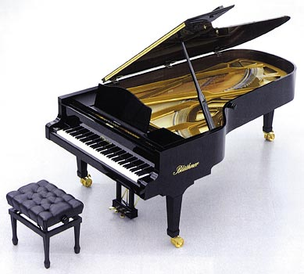
Horizontal Pianos
Parlor Grand – also called living room grand piano
5 feet 9 inches to 6 feet 1 inch
Semiconcert or Ballroom – next size up from the Parlor Grand piano
approximately 7 feet long
Concert Grand – this is the largest of all the grand pianos
9 feet long

Slide 11
Construction of the Piano
Body - made of wood veneer
The soundboard holds the strings tight
Average of 230 strings on a typical grand piano
Over 18 tons of force on the soundboard
Concert grand has nearer to 30 tons of tension
Because of the extreme force, the soundboard is bellied slightly upward
There are 36 black keys and 52 white keys which brings the total number of keys to 88

Slide 12
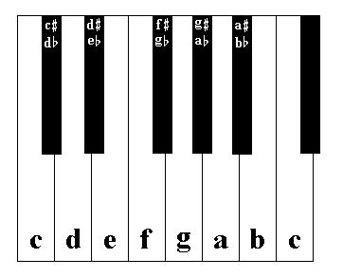
Development of the Keyboard
Current layout (standard in the 15th century) – five raised keys and seven natural keys per octave
One octave on the modern piano is about 6½ inches wide

Slide 13
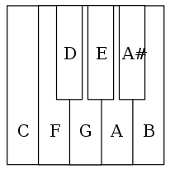
Development of the Keyboard
The “short octave” – concerned only the lowest octave at the bass end of the keyboard
Not all keys actually sounded notes of the expected pitch; their respective strings were tuned to lower notes
A second short octave was developed in which the keyboard began on low B which actually sounded the G below

Slide 14
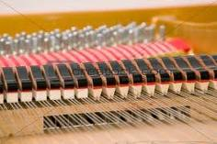
The Keys
The upper 21 keys have no damper
Lower keys have only one string that is very thick
Middle keys have two strings that are not as thick as the lower strings
Upper strings have three strings that are thin

Slide 15
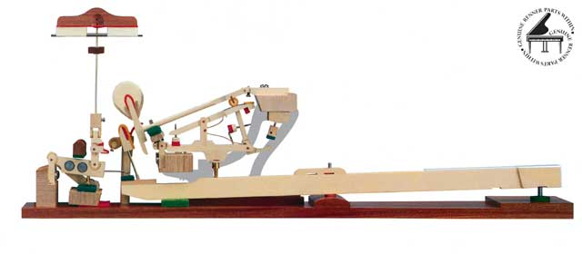
Hammer Time
The clavichord and harpsichord both used a plucking action of the strings like one would do with a guitar to produce their sound
The piano uses a hammer-and-lever action
This “hammer-and-lever action that allows the player to modify the intensity of sound by the stronger or weaker touch of the fingers”

Slide 16
Strings
Pitch – determined by length, tension, and mass per unit length
The tauter and lighter the string, the higher the velocity
Longer string equals longer fundamental period
Range – 27.5 Hz (A0) to 4186 Hz (C8)
Length – can be traded off against mass per unit length to reduce instrument size
This can be seen in the bass section – the strings are wrapped with one or two layers of copper in order to make them heavy and relatively short

Slide 17
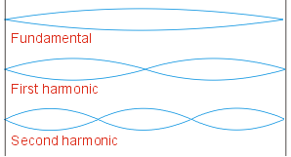
Wrapped string vs. a plain string – the mass can be increased without reducing the flexibility drastically
The stiffness of a string changes its tone
In normal use, (string is either struck, plucked or bowed), all resonances are excited,
Result – a set of simultaneously sounding sine waves, partials, forming a complex tone

Slide 18
Upright Transposing Piano
Irving Berlin was one of the most renowned composers but, he could not read music
Owned by Irving Berlin
It features a clutch that disengages the keyboard from the mechanism, enabling the keyboard to be moved to the left or right with a lever

Slide 19
The Harmonic Overtone Series

Slide 20
References
Berg, Richard E., and David G. Stork. The Physics of Sound. San Francisco: Pearson-Addison Wesley, 2005. Print.
Harmonic Series I [Video]. Retrieved October 20, 2010, from <http://www.youtube.com/watch?v=8n3qMB6AD_0>.
Harmonic Series II [Video]. Retrieved October 20, 2010, from <http://www.youtube.com/watch?v=iDTj6tBnHlA&feature=related>.
"Keyboard Instrument (music) :: Development of the Keyboard." Encyclopedia - Britannica Online Encyclopedia. Web. 1 Nov. 2010. <http://www.britannica.com/EBchecked/topic/315885/keyboard-instrument/53737/Development-of-the-keyboard>.
"The Piano." The Piano. Web. 28 Oct. 2010. <http://hyperphysics.phy-astr.gsu.edu/hbase/music/pianof.html>.
Rodgers, David. "A Lesson in Piano History and Construction." Piano Restoring. 2007. Web. 31 Oct. 2010. <http://www.pianorestoring.com/History_Education/Piano%20History.htm>.
Royal Swedish Academy of Music. “The Acoustics of the Piano: Introduction.” Five Lectures on the Acoustics of the Piano. 1990. Web. 31 Oct. 2010. <http://www.speech.kth.se/music/5_lectures/introd/introd.html>.

