Slide 1
Natural and artificial harmonics
Jessica Elvington

Slide 2
Natural Harmonics
A natural harmonic is the pitch (resultant) that is produced by lightly touching an open, vibrating string (the fundamental) at one of the nodes located at 1/2, 1/3, 1/4, etc. the length of the string.
The tone obtained is very pure and soft.

Slide 3
Artificial Harmonics
An artificial harmonic is a harmonic whose fundamental must be artificially created by stopping (shortening) the string to the desired fundamental.
Artificial harmonics are produced by playing a normal finger-stopped note and simultaneously touching the string with another finger at the 1/2, 1/3, 1/4, etc. length of the stopped string.
http://www.youtube.com/watch?v=iUDNQfePKlQ&feature=player_embedded#!

Slide 4
The Seagull Effect
This is an effect that can be produced on a bass or cello.
An artificial harmonic is produced in a high position
Keeping the thumb (stopping finger) and little finger (lightly touching the string) with the same relative spacing, the hand is slid up along the string. This results on a sequence of short downward glissandos, each lower in pitch, characteristic of the sound of a seagull.
http://www.lunanova.org/CelloET/harmonics.html
http://www.youtube.com/watch?v=r460gq4TJBQ

Slide 5
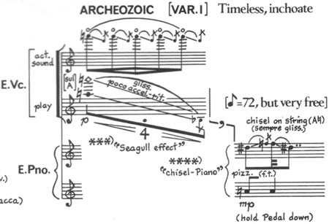
The Seagull Effect

Slide 6
Pinch Harmonics
A pinch harmonic or pick harmonic is a guitar technique pioneered by Roy Buchanan on the 1962 recording of "Potato Peeler”.
The player's thumb or index finger on the picking hand slightly catches the string after it is picked, canceling the fundamental of the string, and letting one of the overtones dominate.
This results in a high pitched squeal.
http://www.5min.com/Video/Pinch-Harmonics---Guitar-Lesson-56498101

Slide 7
Resources
Berg, Richard E., and David G. Stork. The Physics of Sound. 3rd Edition ed. Upper Saddle River, NJ: Pearson Prentice-Hall, 2005. Print.
Campbell, Murray, and Clive Greated. The Musician's Guide to Acoustics. London: Dent, 1987. Print.
"Pinch Harmonics - Guitar Lesson Video â 5min.com." 5min - Find the Best How To, Instructional and DIY Videos â Life Videopedia. Web. 16 Nov. 2010. http://www.5min.com/Video/Pinch-Harmonics--Guitar-Lesson-56498101
"YouTube - George Crumb - Vox Balaenae." YouTube - Broadcast Yourself. Web. 16 Nov. 2010. http://www.youtube.com/watch?v=r460gq4TJBQ
"YouTube - Violin Lesson #55; Artificial Harmonics (SEE DESCRIPTION)." YouTube - Broadcast Yourself. Web. 17 Nov. 2010. <http://www.youtube.com/watch?v=iUDNQfePKlQ&feature=player_embedded#!>.

