Slide 1
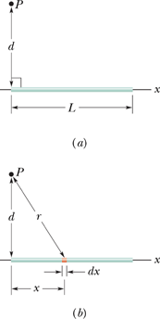
Potential Due to a Continuous Charge Distribution: Line of Charge
In the figure a thin non-conducting rod of length L has a positive charge of uniform linear density, λ. Determine the electric potential V due to the rod at point P, a perpendicular distance d from the left end of the rod.

Slide 2
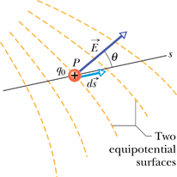
Calculating the Field from the Potential
The component of in any direction is the negative of the rate at which the electric potential changes with distance in that direction.
P 35. The electric potential at points in an xy plane is given by
In unit-vector notation, what is the electric field at the point (3.0 m, 2.0 m)?
Problem 99. (a) Show that the electric potential at a point on the central axis of a thin ring (of charge q and radius R) and at distance z from the ring is,
(b) From this result, derive an expression for E at points on the ring's axis; compare your result with the calculation of E in Section 22-6.

