Slide 1
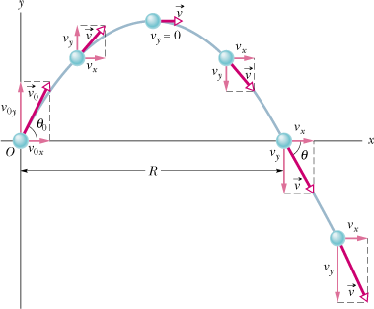
4.5 Projectile Motion
Projectile motion is the motion of an object under the influence of gravity in a vertical plane.
In projectile motion, the horizontal motion and the vertical motion are independent of each other.

Slide 2
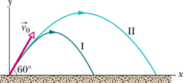
The Effects of the Air (Fly Balls)
 | Path I (Air) | Path II (Vacuum)
Range | 98.5 m | 177 m
Maximum Height | 53.0 m | 76.8 m
Time of flight | 6.6 s | 7.9 s
http://www.youtube.com/watch?v=cxvsHNRXLjw
http://phet.colorado.edu/simulations/sims.php?sim=Projectile_Motion

