Slide 1
Chapter-3 Vectors
Vectors and Scalars:
Physics deals with many physical quantities, which are divided into scalars and vectors.
A scalar quantity is one that can be described by a single number (including any units) giving its size or magnitude.
Examples: Time, volume, mass, temperature, and density.
A quantity that deals with both magnitude and direction is called a vector quantity.
Examples: Force, weight, velocity, and displacement.

Slide 2
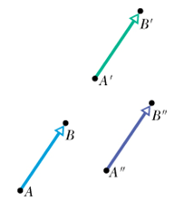
Vector Illustration
The length of the vector arrow is proportional to the magnitude of the vector and the arrow represents the direction.
In the text, bold face is used for vectors and italics is used for scalars. When hand written an arrow is placed above the symbol.
A vector can be shifted without changing its value if its magnitude and direction are not changed.

Slide 3
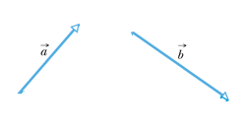
3.3 Adding Vectors Geometrically
Vector Subtraction
P8. A person walks in the following pattern: 3.1 km north, then 2.4 km west, and finally 5.2 km south. (a) Sketch the vector diagram that represents this motion. (b) How far and (c) in what direction would a bird fly in a straight line from the same starting point to the same final point?

Slide 4
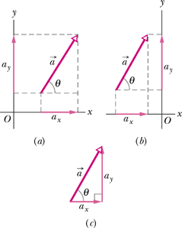
3.4 Components of Vectors
Adding vectors geometrically can be tedious. A neater and easier technique involves components of vectors.
A component of a vector is the projection of the vector on an axis.
Find the +x and +y components of the following displacements:
a. 12.0 m, at 10.0⁰ counterclockwise from +y. b. 8.00 m, at 20.0⁰ clockwise from –y.

