Slide 1
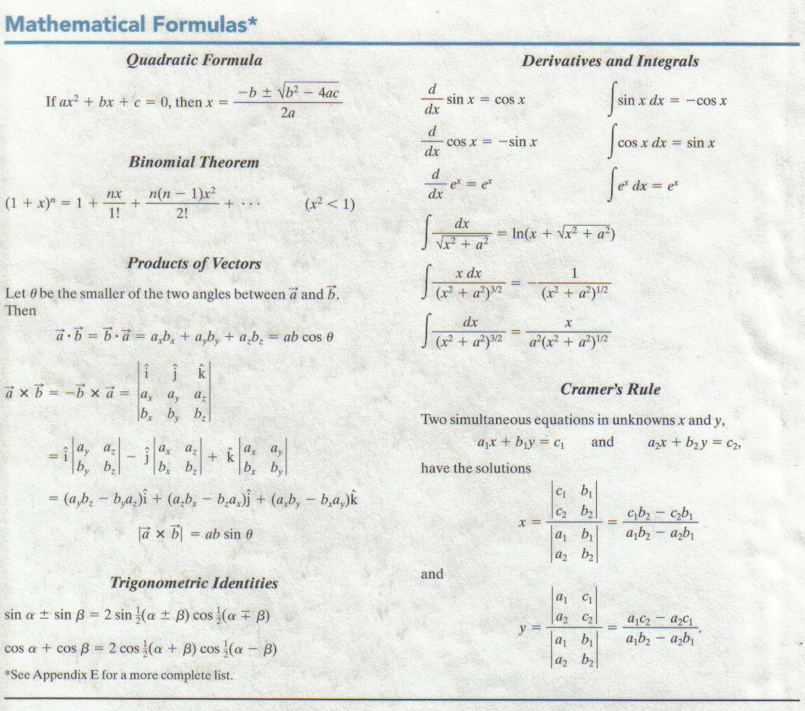
PHYS 211
Mathematical Formulas

Slide 2
How to study physics?
Read the text.
Every chapter starts with the question, “What is physics?”
As you read through the chapter, practice physics by doing/following sample problems and checkpoints.
Pay attention to key ideas and problem-solving tactics.
Try to answer many questions and solve more problems at the end of chapter.
Make use of other resources: textbook website and WileyPlus.
Get help when needed.

Slide 3
Chapter 1
Measurement
In this chapter we will explore the following concepts:
1. Measurement of a physical parameter
2. Units, systems of units
3. Basic units in mechanics
4. Changing units
5. Significant figures

Slide 4
1.2 Measuring Things
We will come across many physical quantities in physics: length, time, speed, area, mass, temperature, pressure, wavelength, electric current, magnetic field, etc.
We measure each physical quantity in its own units, by comparison with a standard. The unit is a unique name we assign to measures of that quantity—for example, meter (m) for the quantity length.
Rulers, which approximate our length standard, give us one such procedure for measuring length. However, many of our comparisons must be indirect. You cannot use a ruler, for example, to measure the radius of an atom or the distance to a star.

Slide 5
1.3 The International System of Units
SI Base Units
SI Derived Units
Prefixes for SI Units
http://physics.nist.gov/cuu/Units/index.html
1.4 Changing Units

