Slide 1
Units
Units are necessary during measurement and expressing physical quantities.
Topics:
Systems of units.
SI base units.
Defining Constants for SI units.
Derived units.
Unit conversion

Slide 2
Units of Measurement
There are three systems of units: SI, cgs, and BE/USC.
 | System
Quantity | SI | CGS | BE/USC
Length | meter (m) | centimeter (cm) | foot (ft)
Mass | kilogram (kg) | gram (g) | slug (sl)
Time | second (s) | second (s) | second (s)
SI – International System of Units.
CGS - centimeter (cm), gram (g), and second.
BE/USC - British Engineering/US Customary.

Slide 3
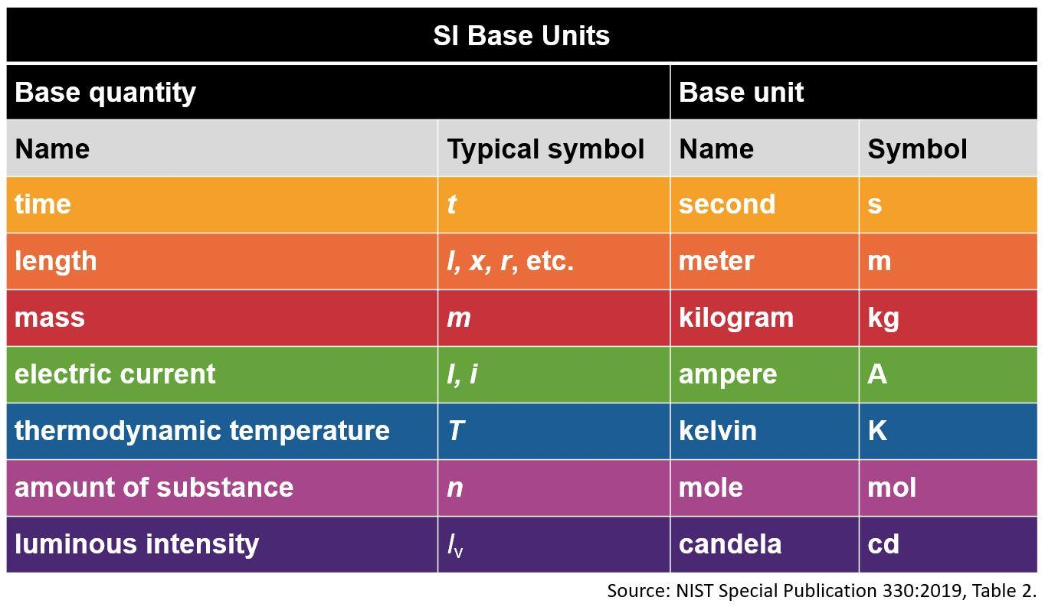
SI Units
https://www.nist.gov/pml/owm/metric-si/si-units
There are seven base units.
Units named after people are capitalized.

Slide 4
Seven Defining Constants of SI
https://www.bipm.org/en/measurement-units/si-defining-constants
the cesium hyperfine frequency, Δν_{Cs} = 9 192 631 770 Hz
the speed of light in vacuum, c = 299 792 458 m/s
the Planck constant, h = 6.626 070 15 x 10^{–34} J.s
the elementary charge, e = 1.602 176 634 x 10^{–19} C
the Boltzmann constant, k = 1.380 649 x 10^{–23} J/K
the Avogadro constant, N_{A} = 6.022 140 76 x 10²³ mol⁻¹
the luminous efficacy of a defined visible radiation, K_{cd} = 683 lm/W

Slide 5
The graphic shows the seven base SI units and the constants used to define them. Go to the website and Click on each of the SI units (outer boxes) to see which constants (inner boxes) define them.
https://www.nist.gov/si-redefinition/meet-constants

Slide 6
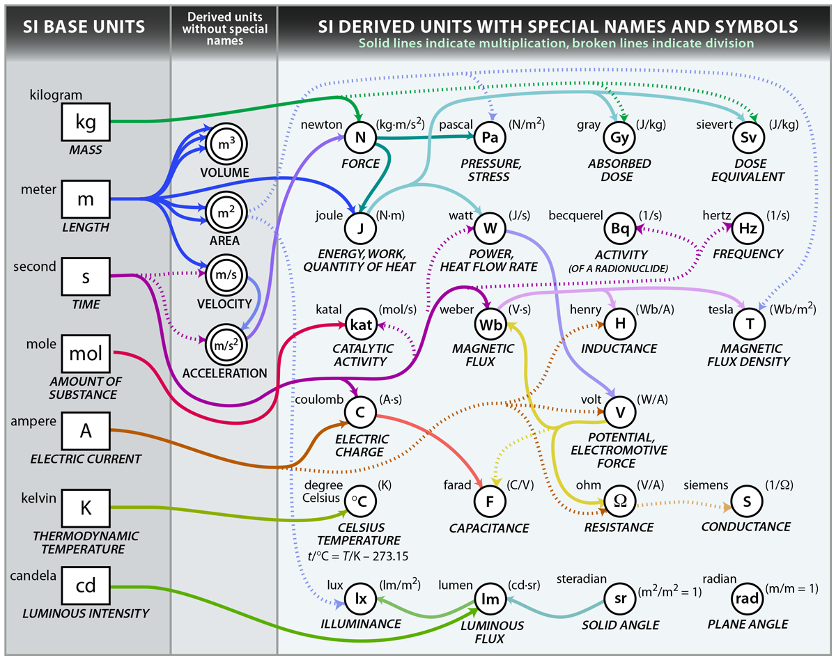
SI Derived Units (There are many of them)
https://www.nist.gov/si-redefinition/kilogram-focus-history

Slide 7
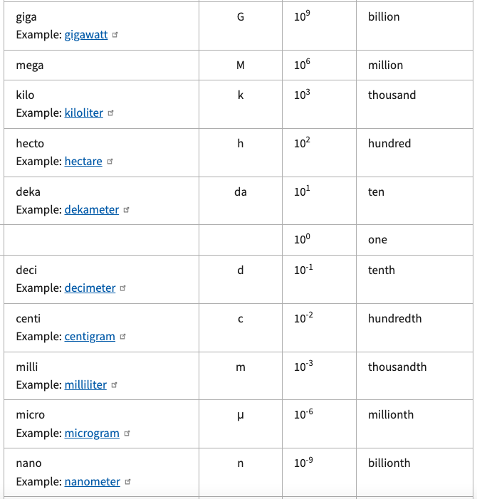
Metric (SI)
Prefixes
Prefixes are used to express very big and very small quantities.
For example, 1000 g = 1 kg.
Go to this website to view all prefixes.

Slide 8
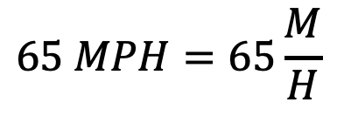
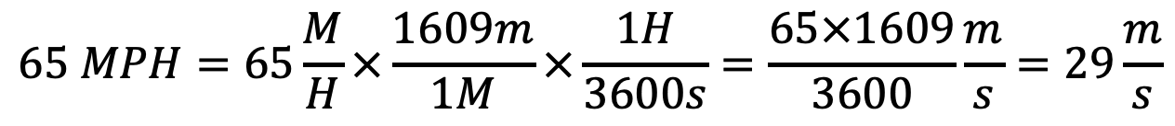
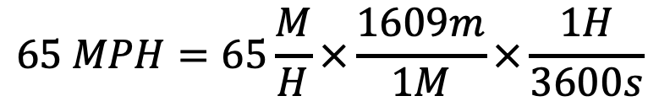
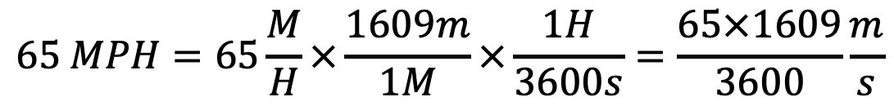
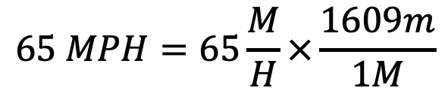
Unit Conversion
Express the speed limit 65 MPH in m/s.
(Useful conversion factors: 1 M = 1609 m, 1 H = 3600 s)
$$65 MPH=65\frac{M}{H}$$
$$65 MPH=65\frac{M}{H}×\frac{1609m}{1M}$$
$$65 MPH=65\frac{M}{H}×\frac{1609m}{1M}×\frac{1H}{3600s}$$
$$65 MPH=65\frac{M}{H}×\frac{1609m}{1M}×\frac{1H}{3600s}=\frac{65×1609}{3600}\frac{m}{s}$$
$$65 MPH=65\frac{M}{H}×\frac{1609m}{1M}×\frac{1H}{3600s}=\frac{65×1609}{3600}\frac{m}{s}=29\frac{m}{s}$$

Slide 9
Unit Conversion
What is your height in ft and inches? ________
Convert this height to meter, m?
(Use the following conversion factors:
1 ft = 12 inches, 1 inch = 2.54 cm, 1m = 100 cm)

Slide 10
Approximation
On many occasions, physicists, other scientists, and engineers need to make approximations or “guesstimates” for a particular quantity.
These approximations allow us to rule out certain scenarios or unrealistic numbers. Approximations also allow us to challenge others and guide us in our approaches to our scientific world.
How long will it take to drive down to a place?
How tall is a 30-story building?

Slide 11
Dimensional Analysis OR
Unit Analysis
What are the dimensions of density, which is mass per volume?

Slide 12
The speed v of an object is given by the equation
v = At³ - Bt, where t refers to time. (a) What are the
dimensions of A and B? (b) What are the SI units for the
constants A and B?

Slide 13
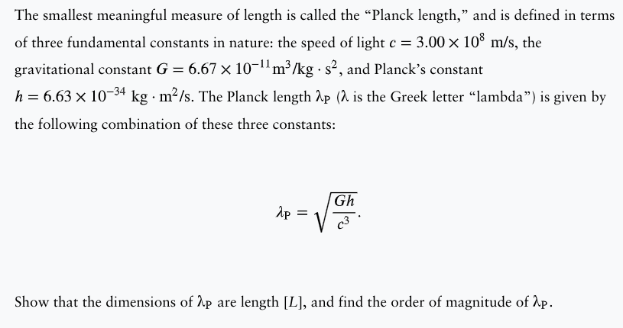

Slide 14
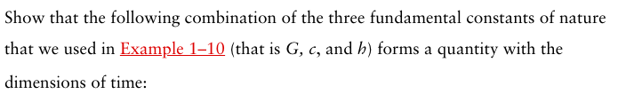

Homework:
a. Express the area 1750 cm² in m².
(Useful conversion factor: 1 m = 100 cm)
b. Express the density 2.7 g/cm³ in kg/m³.
(Useful conversion factors: 1 kg = 1000 g, 1 m = 100 cm)
c. A textbook of 1200 pages has a thickness of 5 cm. Calculate the thickness of a single page in mm?
38.

