Slide 1
Pre-Requisite Knowledge
Algebra
Trigonometry
Calculus
Calculator use

Slide 2
Chapter 1a
The nature of physics
Models, Theories, and Laws
Uncertainty in measurements
Accuracy and Precision
Significant figures

Slide 3
The Nature of Physics
The word physics comes from Greek, meaning nature. The study of nature came to be called “natural philosophy.”
Physics is the study of the fundamental laws of nature.
Physics deals with the behavior and structure of matter.
Physics is very fundamental and the most basic of the sciences.
Physics can predict how nature will behave in one situation on the basis of experimental data obtained in another similar situation.

Slide 4
Models, Theories, and Laws
A model is an analogy or mental image of the phenomena in terms of something we are familiar with.
Usually a model is relatively simple and provides a structural similarity to the phenomena being studied.
A theory is broader, more detailed, and can give quantitatively testable predictions, often with great precision.
Scientists give the title law to certain concise but general statements about how nature behaves (that energy is conserved, for example).
To be called a law, a statement must be found experimentally valid over a wide range of observed phenomena.
For less general statements, the term principle is often used (such as Archimedes’ principle).

Slide 5
Uncertainty & Percent Uncertainty

Slide 6
Uncertainties in Calculations
Adding or Subtraction: add the uncertainties
a = 3.0 ± 0.1, b = 2.2 ± 0.02;
a + b = 5.2 ± 0.12
a - b = 0.8 ± 0.12
Multiplication or Division: add the percent uncertainties,
A = length x width

Slide 7

What is the percent uncertainty in the surface area of a spherical beach ball of radius r = 0.64 $±$ 0.04 m?

Slide 8

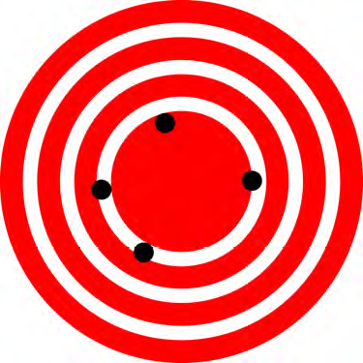
Accuracy and Precision
Accuracy is how close a measurement is to the correct value for that measurement.
The precision of a measurement system is refers to how close the agreement is between repeated measurements.
Low precision and high accuracy
High precision and low accuracy

Slide 9
Significant Figures
Expressing the significant figures: 239 (3), 34520 (4), 3.4520E4 (5)
0.07 (1), 7.0E-2 (2), 250 (2), 250. (3), 0.0035200 ?
In Calculations:
For multiplication and division: The result should have the same number of significant figures as the quantity having the least significant figures entering into the calculation.
3.1 x 4.72 = 14.6 = 15
For addition and subtraction: The answer can contain no more decimal places than the least precise measurement.
5.123 + 1.63 = 6.753 = 6.75
In this class you will always express numbers with more than the minimum significant figures, unless asked specifically for a particular problem/question.

Slide 10


Homework

