Slide 1
C H A P T E R 15 Thermodynamics

Slide 2
15.7 The Second Law of Thermodynamics
Heat flows spontaneously from a substance at a higher temperature to a substance at a lower temperature and does not flow spontaneously in the reverse direction.

Slide 3
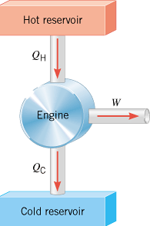
15.8 Heat Engines
A heat engine is any device that uses heat to perform work. It has three essential features:
1. Heat is supplied to the engine at a relatively high temperature, hot reservoir.
2. Part of the input heat is used to perform work by the working substance of the engine, which is the material within the engine that actually does the work.
3. The remainder of the input heat is rejected at a temperature lower than the input temperature to a place called the cold reservoir.
Q_{H} = Q_{C} + W

Slide 4
Efficiency,e of a Heat Engine
Q_{H} = Q_{C} + W
Q_{H} - Q_{C} = W
$$e=\frac{W}{Q_{H}}=\frac{Q_{H}−Q_{C}}{Q_{H}}=1−\frac{Q_{C}}{Q_{H}}$$

Slide 5
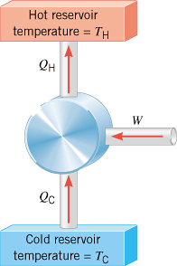
15.10 Refrigerators and Air Conditioners
In a refrigeration process, work W is used to remove heat Q_{C} from the cold reservoir and deposit heat Q_{H} into the hot reservoir.

Slide 6
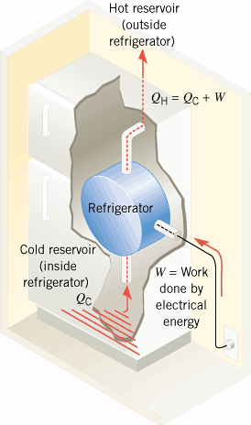
Refrigerator

Slide 7
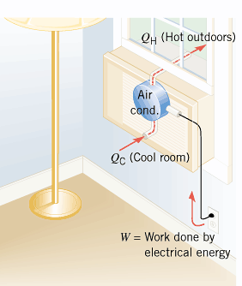
Air Conditioner

Slide 8
Coefficient of Performance
For a refrigerator or air-conditioner, the coefficient of performance is given by,

Slide 9
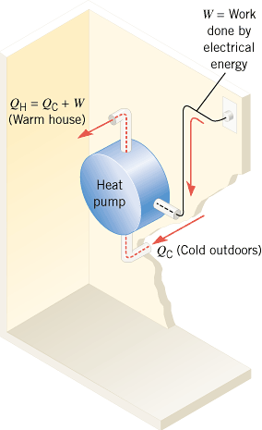
Heat Pump

Slide 10
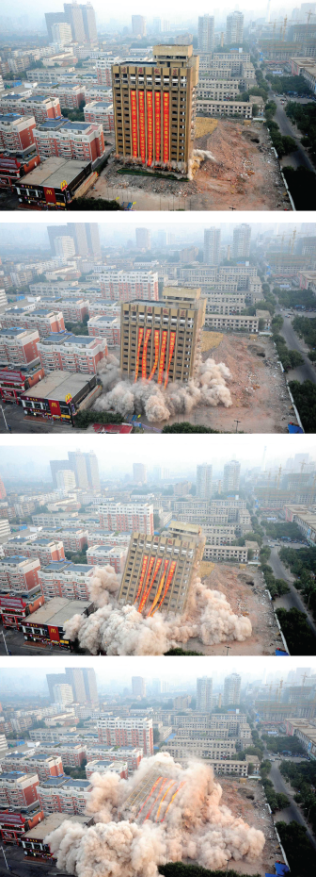
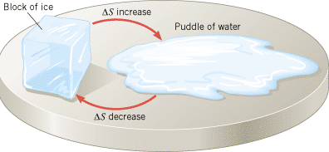
15.11 Entropy, S
A thermodynamic quantity representing the unavailability of a system's thermal energy for conversion into mechanical work.
A degree of disorder or randomness in the system.
Change in entropy is defined as follows,

Slide 11
15.12 The Third Law of Thermodynamics
It is not possible to lower the temperature of any system to absolute zero in a finite number of steps.

