Slide 1
C H A P T E R 15 Thermodynamics
Thermodynamics is the branch of physics that is built upon the fundamental laws that heat and work obey.
Topics to be covered
Laws of thermodynamics: Zeroth law, First law, Second law, and Third law
Thermal Processes: Isobaric, Isochoric, adiabatic, and Isothermal
Heat engines, Refrigerators, Air-conditioners, and Heat pumps.
Entropy.

Slide 2
Systems and Surroundings
In thermodynamics the collection of objects upon which attention is being focused is called the system, while everything else in the environment is called the surroundings.
Example 1: An automobile engine
System ---- the burning gasoline/air mixture
Surroundings----would include the pistons, the exhaust system, the radiator, and the outside air
Example 2: Hot air balloon
System ---- the hot air
Surroundings----everything else

Slide 3
Diathermal and Adiabatic Walls
The system and its surroundings are separated by walls of some kind.
Walls that permit heat to flow through them, such as those of the engine block, are called diathermal walls.
Perfectly insulating walls that do not permit heat to flow between the system and its surroundings are called adiabatic walls.

Slide 4
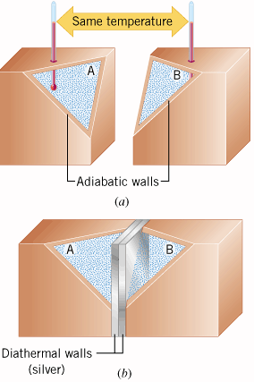
The Zeroth Law of Thermodynamics
Consider three systems A, B, & T.
If system A is in thermal equilibrium with system T and system B is in thermal equilibrium with system T, then systems A and B are in thermal equilibrium with each other.
https://www.youtube.com/watch?v=PE_zpk-EznQ&list=PLbnrZHfNEDZxmZmL3fZHPTeoUO8amBox2&index=1

Slide 5
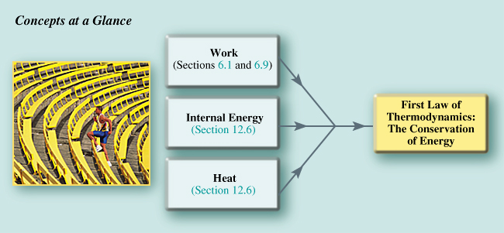
15.1 The First Law of Thermodynamics
https://www.youtube.com/watch?v=1OFlW8OXN64&list=PLbnrZHfNEDZxmZmL3fZHPTeoUO8amBox2&index=2

Slide 6
The First Law of Thermodynamics
The internal energy of a system changes from an initial value U_{i} to a final value of U_{f} due to heat Q and work W:
ΔU = Q - W
Sign Convention:
Q is positive when the system gains heat and negative when it loses heat.
W is positive when work is done by the system and negative when work is done on the system.

Slide 7
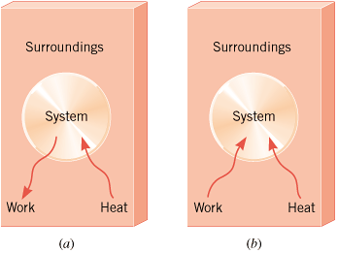
Positive and Negative Work
Figure shown illustrates a system and its surroundings. In part a, the system gains 1500 J of heat from its surroundings, and 2200 J of work is done by the system on the surroundings. In part b, the system also gains 1500 J of heat, but 2200 J of work is done on the system by the surroundings. In each case, determine the change in the internal energy of the system.

Slide 8
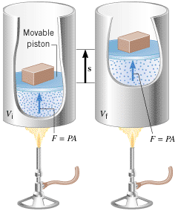
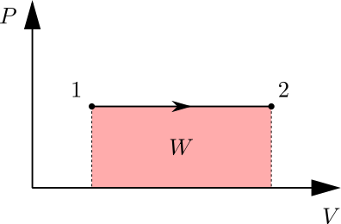
Thermal Processes
Isobaric Process: An isobaric process is one that occurs at constant pressure.
Work Done:

Slide 9
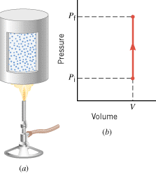
Isochoric Process
Isochoric process is a thermodynamic process that occurs at constant volume.
Work Done = 0.

Slide 10
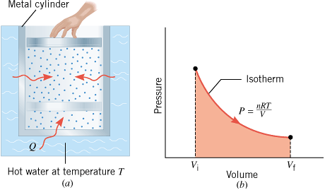
Isothermal Expansion
Isothermal, same temperature, ΔU =0.
Applying First law of TD (ΔU = Q – W): Q = W
Work Done:

Slide 11
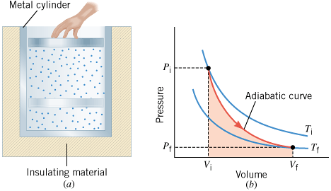
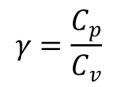
Adiabatic Expansion
Adiabatic: no heat transfer, Q = 0.
Applying First law of TD (ΔU = Q – W): ΔU = - W
For monatomic: U = 3/2 nRT, ΔU = 3/2 nR(Tf-Ti)
ΔU is negative, W is positive.
$$γ=\frac{C_{p}}{C_{v}}$$
$${PV}^{γ}=constant$$
$$P_{1}V_{1}^{γ}=P_{2}V_{2}^{γ}$$

Slide 12
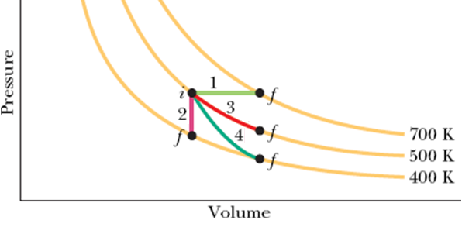
Summary of Thermal Processes
Path | Constant Quantity | Process Type | Work Done | First Law of Thermodynamics

