Slide 1
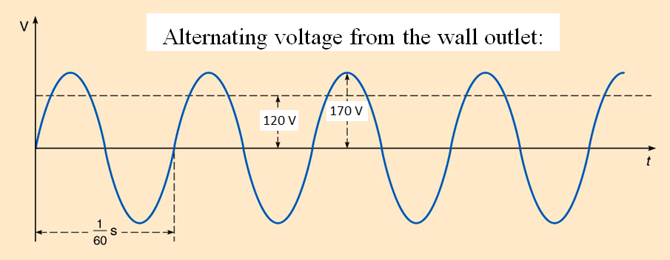
Chapter-23 Alternating Current Circuits

Slide 2
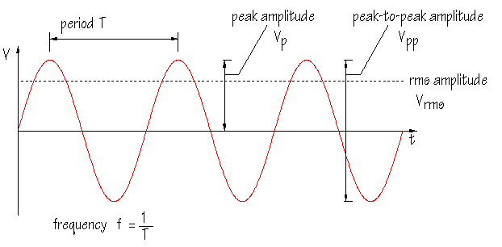
Alternating Signal
The rms amplitude is the DC voltage which will deliver the same average power as the AC signal.

Slide 3
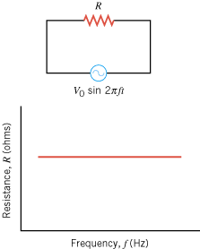
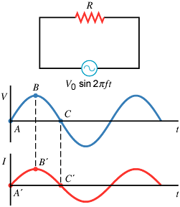
Resistance

Slide 4
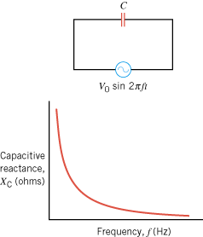
Capacitive Reactance, X_{C}

Slide 5
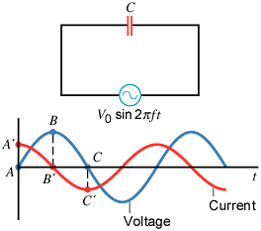
Current and Voltage in a Capacitive Circuit
In a circuit containing only a capacitor, the instantaneous voltage and current are not in phase. Instead, the current leads the voltage by one-quarter of a cycle or by a phase angle of 90°.

Slide 6
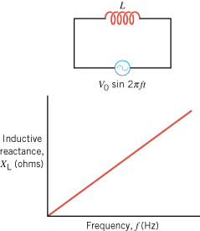
Inductive Reactance, X_{L}

Slide 7
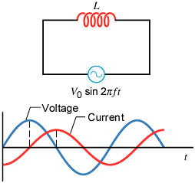
Current and Voltage in an Inductive Circuit
The instantaneous voltage and current in a circuit containing only an inductor are not in phase. The current lags behind the voltage by one-quarter of a cycle or by a phase angle of 90°.

Slide 8
A Comparison: Capacitive versus Inductive
The current leads the voltage by one-quarter of a cycle or by a phase angle of 90°.
The current lags behind the voltage by one-quarter of a cycle or by a phase angle of 90°.

Slide 9
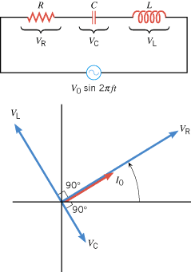
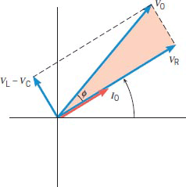
23.3. Circuits Containing Resistance, Capacitance, and Inductance

Slide 10
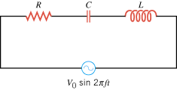
Impedance,z for a Series RCL Circuit

Slide 11
Resonant Frequency

Slide 12
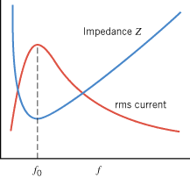
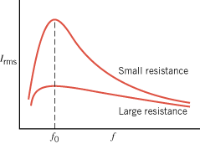
Impedance and RMS Current

Slide 13
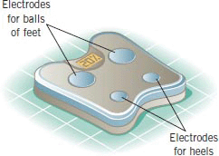
The physics of body-fat scales
When you stand barefoot on the scale, electrodes beneath your feet send a small ac current through your lower body that allows the body's electrical impedance to be measured. This impedance is correlated with the percentage of fat in the body.
The bioelectrical impedance is largely determined by resistance and capacitive reactance. Capacitance enters the picture because cell membranes can act like tiny capacitors.
Bioelectric impedance analysis provides the basis for the determination of body-fat percentage by the body-fat scales.

Slide 14
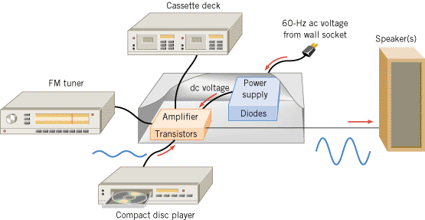
23.5. Semiconductor Devices
In a typical audio system, diodes are used in the power supply to create a dc voltage from the ac voltage present at the wall socket. This dc voltage is necessary so the transistors in the amplifier can perform their task of enlarging the small ac voltages originating in the compact disc player, etc.

Slide 15
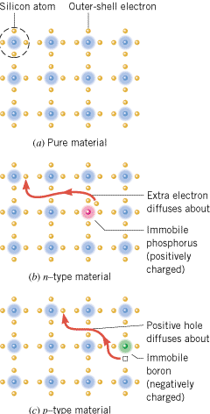
n-TYPE AND p-TYPE SEMICONDUCTORS
A silicon crystal that is (a) undoped, or pure,
(b) doped with phosphorus to produce an n-type material, and
(c) doped with boron to produce a p-type material.

Slide 16
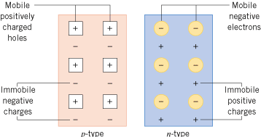
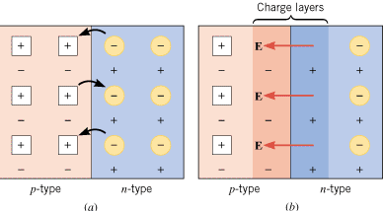
THE SEMICONDUCTOR DIODE
A p-n junction diode is a device formed from a p-type semiconductor and an n-type semiconductor. The p-n junction between the two materials is of fundamental importance to the operation of diodes and transistors.

Slide 17
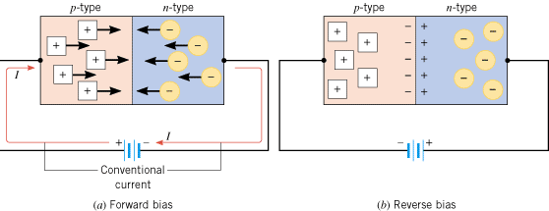
Forward and Reverse Bias
(a) There is an appreciable current through the diode when the diode is forward biased. (b) Under a reverse bias condition, there is almost no current through the diode.

Slide 18
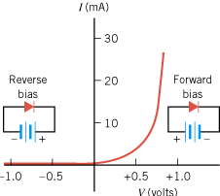
The current-versus-voltage characteristics of a typical p-n junction diode

Slide 19
LED, light-emitting diode
DEMO

Slide 20
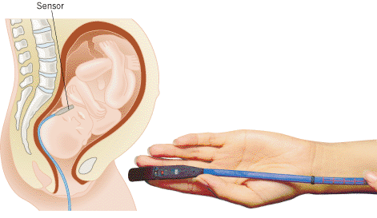
Fetal oxygen monitor
A fetal oxygen monitor uses LEDs to measure the level of oxygen in a fetus’s blood.
A sensor is inserted into the mother’s uterus and positioned against the cheek of the fetus. Two light-emitting diodes are located within the sensor, and each shines light of a different wavelength (or color) into the fetal tissue. The light is reflected by the oxygen-carrying red blood cells and is detected by an adjacent photodetector. Light from one of the LEDs is used to measure the level of oxyhemoglobin in the blood, and light from the other LEDis used to measure the level of deoxyhemoglobin. From a comparison of these two levels, the oxygen saturation in the blood is determined.

Slide 21
Rectifier Circuits
Because diodes are unidirectional devices, they are commonly used in rectifier circuits, which convert an ac voltage into a dc voltage.
A half-wave rectifier circuit, together with a capacitor and a transformer (not shown), constitutes a dc power supply because the rectifier converts an ac voltage into a dc voltage.

Slide 22
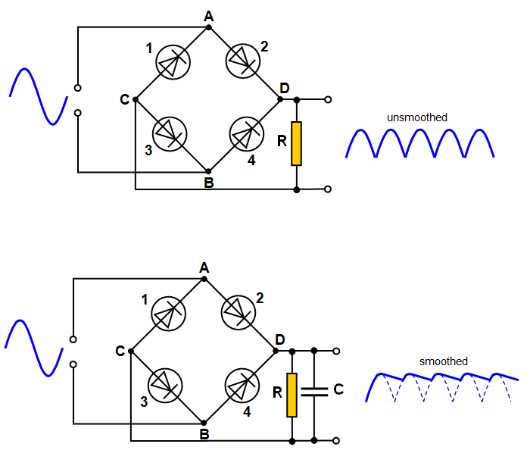
Full-Wave Rectifier

Slide 23
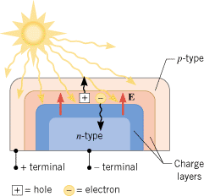
SOLAR CELLS
Solar cells use p-n junctions to convert sunlight directly into electricity.
The sunlight causes the solar cell to develop negative and positive terminals, much like the terminals of a battery.

Slide 24
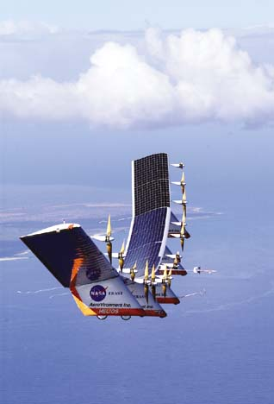
The Helios Prototype flying wing
The current that a single solar cell can provide is small, so applications of solar cells often use many of them mounted to form large panels.

Slide 25
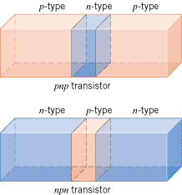
TRANSISTORS
A number of different kinds of transistors are in use today. One type is the bipolar junction transistor, which consists of two p-n junctions formed by three layers of doped semiconductors.
There are two kinds of bipolar junction transistors, pnp and npn.

Slide 26
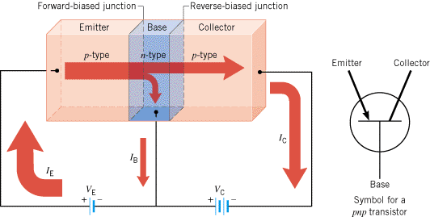
PNP-Transistor

Slide 27
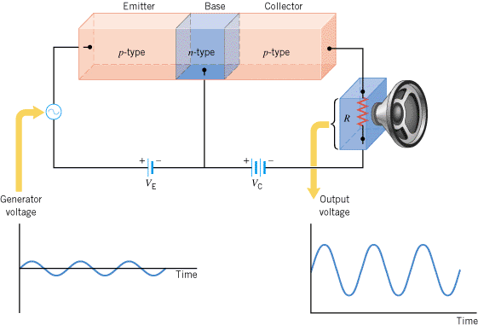
The basic pnp transistor amplifier

Slide 28
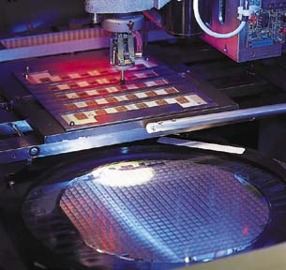
Integrated circuit (IC) chips
Today it is possible to combine arrays of tens of thousands of transistors, diodes, resistors, and capacitors on a tiny chip of silicon that usually measures less than a centimeter on a side. These arrays are called integrated circuits (ICs) and can be designed to perform almost any desired electronic function.
Integrated circuits have revolutionized the electronics industry and lie at the heart of computers, cellular phones, digital watches, and programmable appliances.

