Slide 1
Chapter 13 Temperature and Heat
Temperature
Thermometers
Thermal Expansion
Heat: Specific Heat & Latent Heat

Slide 2
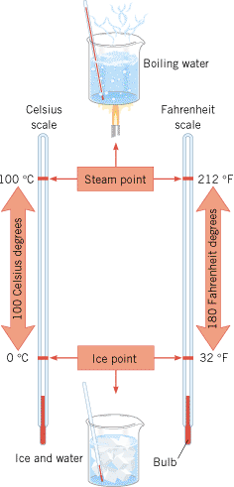
Common Temperature Scales
Fahrenheit scale
Celsius scale
Boiling point
212
100
Unknown
T_{f}
T_{c}
Freezing point
32
0

Slide 3
⁰C and C⁰
Q: What is the difference between degrees Celsius ( ⁰C) and Celsius degrees (C⁰)?
A: Temperature is expressed in degrees Celsius ( ⁰C) and temperature difference is expressed in Celsius degrees (C⁰).

Slide 4
Converting Temp Differences
$$K=C^{0}$$
Unit for Coefficient of Thermal Expansion: (C°)⁻¹
Unit for Specific Heat Capacity:

Slide 5
Thermometers
Thermometers make use of the change in some physical property with temperature, thermometric property.
Thermometer | Thermometric Property
Liquid (mercury) thermometer | Expansion of the liquid column
Constant-volume gas thermometer | Pressure of the gas
Thermocouple | Voltage (potential difference)
Thermogram or Ear thermometer | Infrared radiation
Resistance Thermometer (RTD) | Resistance

Slide 6
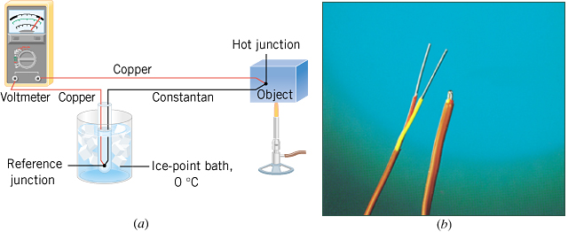
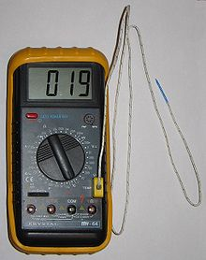
Thermocouple

Slide 7
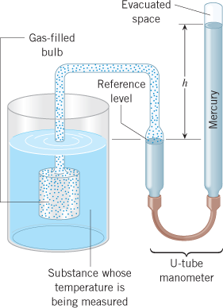
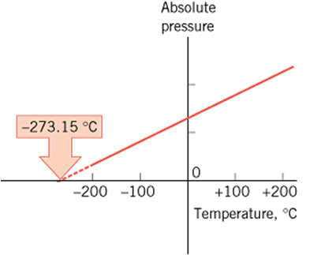
The Constant-Volume Gas Thermometer
The temperature at which the absolute pressure of the gas is zero, is the absolute temperature. It is found to be –273.15⁰C or 0 K.

Slide 8
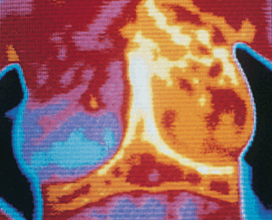
Thermography
The breast in this thermograph has an invasive carcinoma (cancer) and registers colors from red to yellow/white, indicating markedly elevated temperatures.
Breast Thermography
This thermogram shows the 1997/98 El Niño, a region (red) of the Pacific Ocean that had abnormally high temperatures.
Thermographic Inspections of Homes

Slide 9
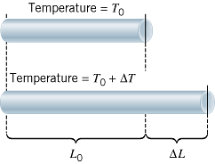
Linear Thermal Expansion
α = the coefficient of linear expansion.

Slide 10
Area Expansion
The area A₀ of an object changes by an amount ΔΑ when its temperature changes by an amount ΔT:
where α is the coefficient of linear expansion.

Slide 11
Volume Expansion
The volume V₀ of an object changes by an amount ΔV when its temperature changes by an amount ΔT:
where β (=3α, for solids) is the coefficient of volume expansion.

Slide 12
TABLE 12.1
Coefficients of Thermal Expansion for Solids and Liquidsª
Coefficient of Thermal Expansion, (C°)⁻¹
Substance
Linear (α)
Volumetric (β)
Solids
Aluminum
23 × 10⁻⁶
69 × 10⁻⁶
Brass
19 × 10⁻⁶
57 × 10⁻⁶
Concrete
12 × 10⁻⁶
36 × 10⁻⁶
Copper
17 × 10⁻⁶
51 × 10⁻⁶
Glass (common)
8.5 × 10⁻⁶
26 × 10⁻⁶
Glass (Pyrex)
3.3 × 10⁻⁶
9.9 × 10⁻⁶
Gold
14 × 10⁻⁶
42 × 10⁻⁶
Iron or steel
12 × 10⁻⁶
36 × 10⁻⁶
Lead
29 × 10⁻⁶
87 × 10⁻⁶
Nickel
13 × 10⁻⁶
39 × 10⁻⁶

Slide 13
Volumetric Thermal Expansion Coefficient (C°)⁻¹
Liquids^{b}
Benzene
—
1240 × 10⁻⁶
Carbon tetrachloride
—
1240 × 10⁻⁶
Ethyl alcohol
—
1120 × 10⁻⁶
Gasoline
—
950 × 10⁻⁶
Mercury
—
182 × 10⁻⁶
Methyl alcohol
—
1200 × 10⁻⁶
Water
—
207 × 10⁻⁶

Slide 14
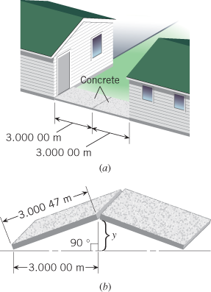
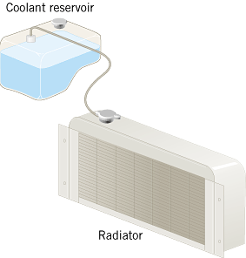
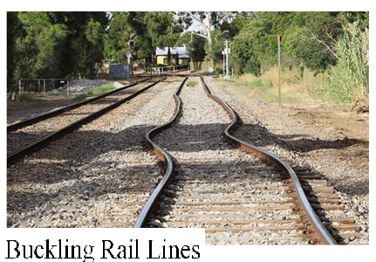
Consequences of Thermal Expansion
Example 3: Buckling of a Sidewalk
Example 8: Overflow of Coolant in an Automobile Radiator

Slide 15
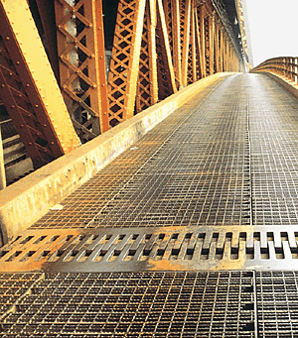
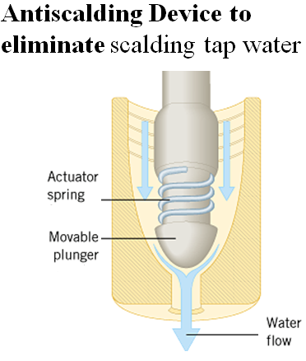
Expansion Joint in a Bridge

Slide 16
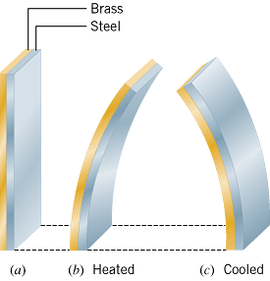
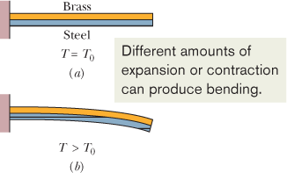
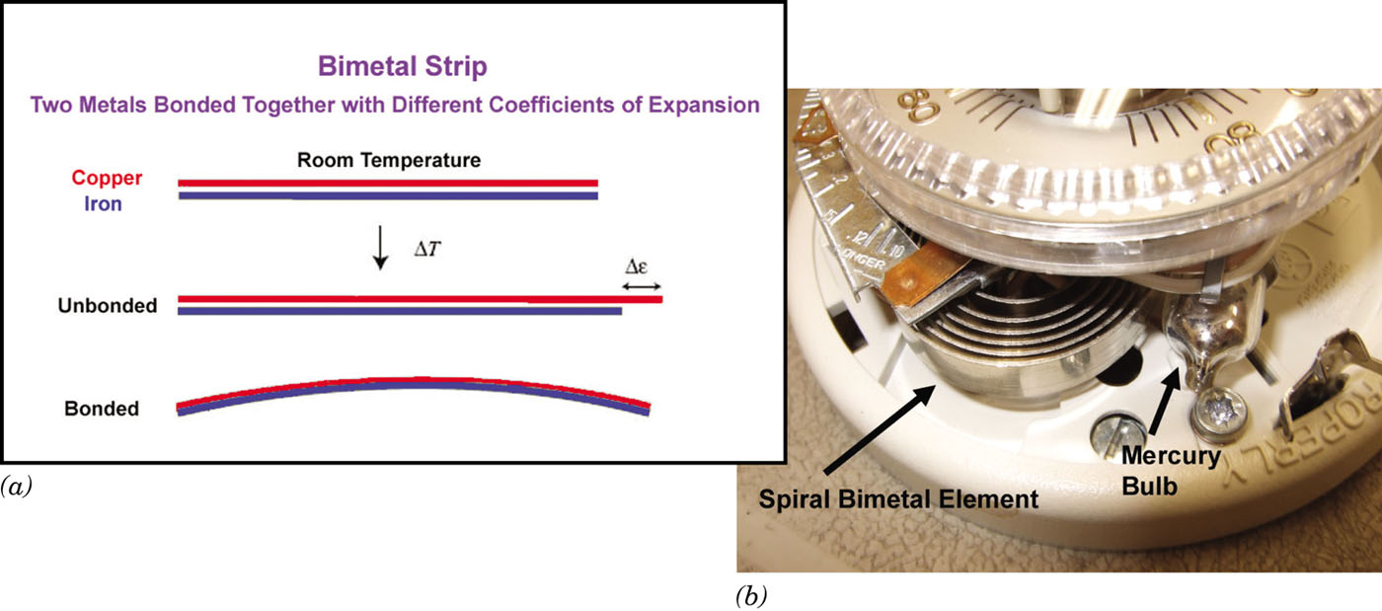
The Bimetallic Strip

Slide 17
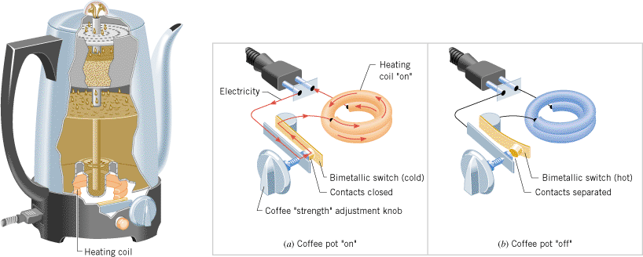
Bimetallic Switch
A bimetallic strip controls whether this coffee pot is (a) “on” (strip cool, straight) or (b) “off” (strip hot, bent).

Slide 18
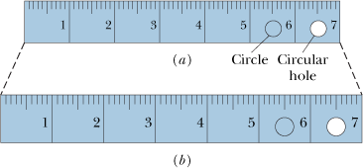
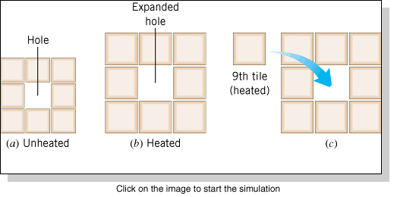
The Expansion of Holes
Do Holes Expand or Contract When the Temperature Increases?
Answer: Expand.

Slide 19
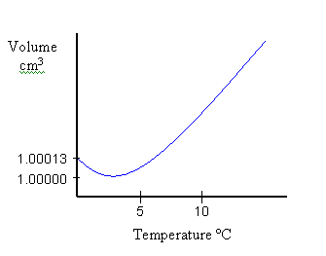
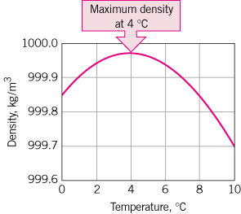
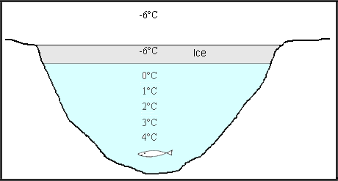
Unusual Expansion of Water
Most substances contract upon cooling. But, water expands while cooling from 4 ⁰C until it freezes.

Slide 20
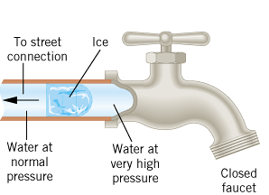
Bursting Water Pipes
As water freezes and expands, enormous pressure is applied to the liquid water between the ice and the faucet.
https://www.youtube.com/watch?v=4i5r65QGUpw

