Slide 1
14 Heat, Specific heat, and Latent heat

Slide 2
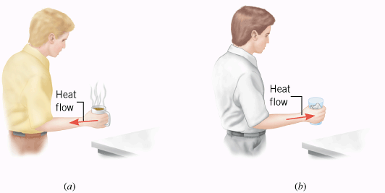
Heat
Heat is energy that flows from a higher-temperature object to a lower-temperature object because of the difference in temperatures.
SI Unit of Heat: joule (J).

Slide 3
Units
SI unit for heat is the joule, J.
Calorie is another unit for heat. It comes with a lower case and an upper case.
Nutritionists use the word “Calorie,” with a capital C, to specify the energy content of foods. For example, a regular 12-oz can of soda has about 140 Calories.
The cgs unit of heat is the calorie, with a lower case. One calorie (1 cal) is defined as the amount of heat needed to raise the temperature of one gram of water by one Celsius degree.
1 food Calorie = 1000 calories = 1 kcal
1 calorie = 4.186 J.
British thermal unit, Btu. 1 Btu = 1055 J.

Slide 4
14.2 Specific Heat Capacity
The heat Q that must be supplied or removed to change the temperature of a substance of mass m by an amount ΔT is,
where c is the specific heat capacity of the substance.
Unit for Specific Heat Capacity:
SI: J/(kg · C°)
cgs: cal/(g. C°)

Slide 5
TABLE 12.2
Specific Heat Capacitiesª of Some Solids and Liquids
Substance
Specific Heat Capacity, c, J/(kg · C°)^{b}
Solids
Aluminum
9.00 × 10²
Copper
387
Glass (common)
840
Human body (37 °C, average)
3500
Ice (-15 °C)
2.00 × 10³
Iron or steel
452
Lead
128
Silver
235
Liquids
Benzene
1740
Ethyl alcohol
2450
Glycerin
2410
Mercury
139
Water (15 °C)
4186

Slide 6
Calorimetry
An experimental technique in heat that uses the conservation of energy principles.
In calorimetry some things will loose heat and others will gain heat.
According to the conservation of energy,
Heat loss = Heat gain

Slide 7
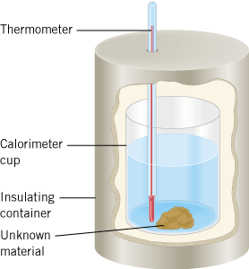
Calorimeter

Slide 8
Measuring the Specific Heat Capacity
A calorimeter cup is made from 0.15 kg of aluminum and contains 0.20 kg of water. Initially, the water and the cup have a common temperature of 18.0 °C. A 0.040-kg mass of unknown material is heated in boiling water (100.0 °C) and then added to the water. The temperature of the water, the cup, and the unknown material is 22.0 °C after thermal equilibrium is re-established. Ignoring the heat loss to the environment and the thermometer, find the specific heat capacity of the unknown material.

Slide 9
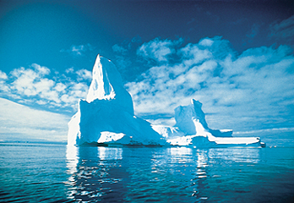
14.3 Heat and Phase Change: Latent Heat
The three phases of water: ice is floating in liquid water while (invisible) water vapor is present in the air.

Slide 10
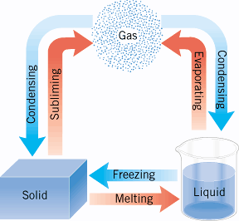
Phase Changes
Example of sublimation:
Solid carbon dioxide (CO₂), dry ice → gaseous CO₂

Slide 11
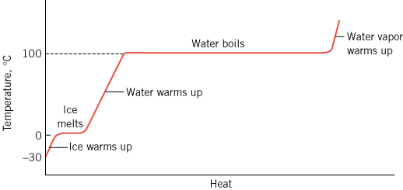
Phase Changes

Slide 12
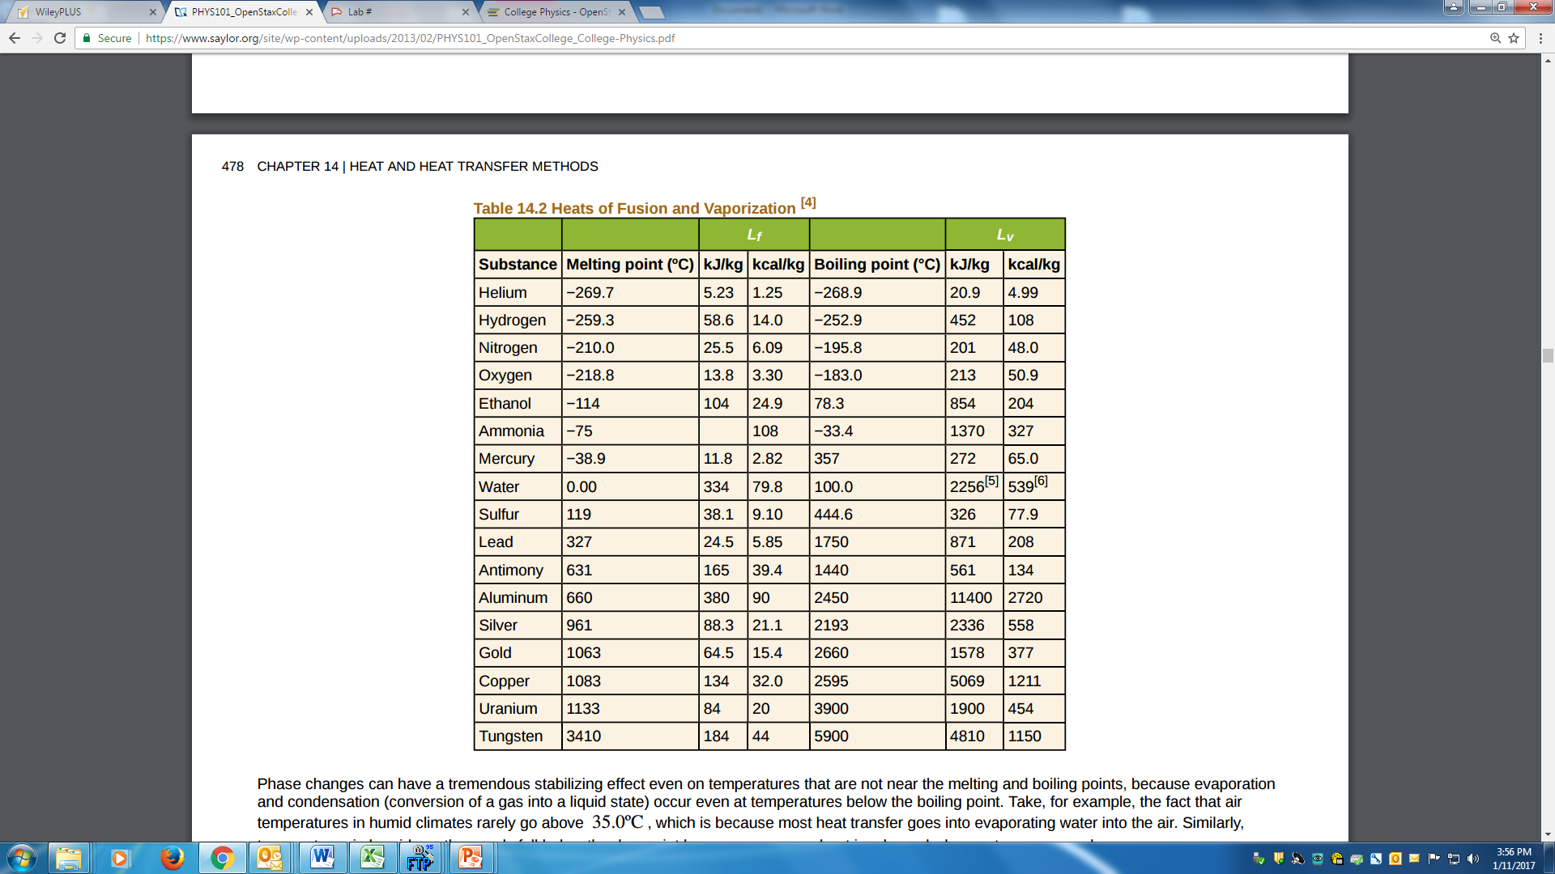
Table 14.2 Heats of Fusion and Vaporization

Slide 13
Example 14.4
Cooling Soda with Ice Cubes: Three ice cubes are used to chill a soda of mass 0.25 kg, at 20ºC. The ice is at 0ºC and each ice cube has a mass of 6.0 g. Assume that the soda is kept in a foam container so that heat loss can be ignored. Assume the soda has the same heat capacity as water. Find the final temperature when all ice has melted.

Slide 14
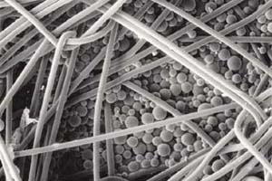
phase-change material (PCM)
This highly magnified image shows a fabric that has been coated with microscopic balls of heat-resistant plastic. The balls contain a substance known as a “phase-change material,” the melting and freezing of which absorbs and releases heat. Clothing made from such fabrics can automatically adjust itself in reaction to your body heat and help maintain a constant temperature next to your skin.

