Slide 1
Chapter 7 Impulse and Momentum

Slide 2
Impulse, J
The impulse J of a force is the product of the average force and the time interval Δt during which the force acts:
Impulse is a vector quantity and has the same direction as the average force.
SI Unit of Impulse: newton · second = (N · s) = kg. m/s

Slide 3
Momentum, p
The linear momentum p of an object is the product of the object’s mass m and velocity v:
Linear momentum is a vector quantity that points in the same direction as the velocity.
SI Unit of Linear Momentum:
kilogram · meter/second = (kg · m/s)
Impulse and momentum, both have the same unit.

Slide 4
IMPULSE–MOMENTUM THEOREM
When a net force acts on an object, the impulse of the net force is equal to the change in momentum of the object:

Slide 5
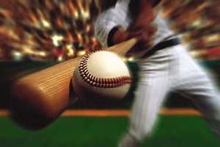
Impulse and Momentum in Sports
Impulse and momentum play important roles in sports.

Slide 6
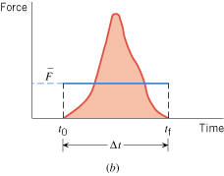
Hitting a baseball
Q: How can we determine the impulse?
Method-1: Knowing the average force ( ) and contact time (Δt), Impulse =
Method-2: Impulse = Area under the Force versus Time graph.

Slide 7
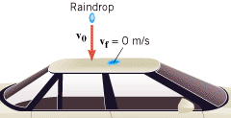
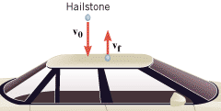
Hailstones Versus Raindrops
Unlike rain, hail usually does not come to rest after striking a surface. Instead, the hailstones bounce off the roof of the car. If hail fell instead of rain, would the force on the roof be smaller than, equal to, or greater?
Answer: Greater

Slide 8
Example
A baseball (m = 0.14 kg) has an initial velocity of v₀ = –38 m/s as it approaches a bat. We have chosen the direction of approach as the negative direction. The bat applies an average force that is much larger than the weight of the ball, and the ball departs from the bat with a final velocity of v_{f} = +38 m/s. Determine the impulse applied to the ball by the bat.

Slide 9
Definitions of Terms
Internal forces Forces that the objects within the system exert on each other.
External forces Forces exerted on the objects by agents that are external to the system.
An isolated system is one for which the vector sum of the external forces acting on the system is zero.

Slide 10
7.2 The Principle of Conservation of Linear Momentum
The total linear momentum of an isolated system remains constant (is conserved).

Slide 11
EXAMPLE 5 Assembling a Freight Train
A freight train is being assembled in a switching yard, and Figure 7.10 shows two boxcars. Car 1 has a mass of m₁ = 65×10³ kg and moves at a velocity of v₀₁ = +0.80 m/s. Car 2, with a mass of m₂ = 92×10³ kg and a velocity of v₀₂ = +1.3 m/s, overtakes car 1 and couples to it. Neglecting friction, find the common velocity v_{f} of the cars after they become coupled.

Slide 12
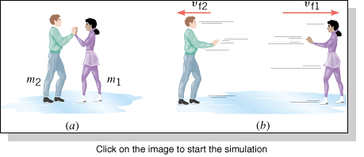
EXAMPLE 6 Ice Skaters
Starting from rest, two skaters “push off” against each other on smooth level ice, where friction is negligible. As Figure 7.11a shows, one is a woman (m₁ = 54 kg), and one is a man (m₂ = 88 kg). Part b of the drawing shows that the woman moves away with a velocity of v_{f1} = +2.5 m/s. Find the “recoil” velocity v_{f2} of the man.

Slide 13
Collisions
Collisions are often classified according to whether the total kinetic energy changes during the collision:
1.Elastic collision—One in which the total kinetic energy of the system after the collision is equal to the total kinetic energy before the collision.
2.Inelastic collision—One in which the total kinetic energy of the system is not the same before and after the collision; if the objects stick together after colliding, the collision is said to be completely inelastic.

Slide 14
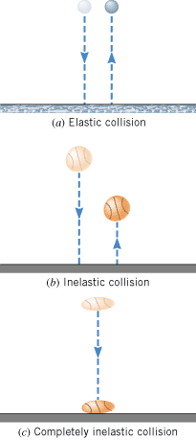

Slide 15
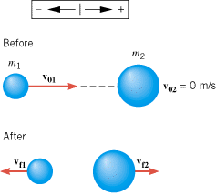
Collisions in One Dimension
Apply the conservation of momentum.
If the collision is elastic, apply the conservation of energy.

