Slide 1
6-4: Conservative and Non-conservative Forces
A force is a conservative force if the net work it does on a particle moving around any closed path, from an initial point and then back to that point, is zero.
Equivalently, a force is conservative if the net work it does on a particle moving between two points does not depend on the path taken by the particle.
A force is non-conservative if the net work it does on a particle moving between two points does depend on the path taken by the particle.

Slide 2
Examples
Conservative Forces
Gravitational force (Ch. 4)
Elastic spring force (Ch. 10)
Electric force (Ch. 18, 19)
Nonconservative Forces
Static and kinetic frictional forces
Air resistance
Tension
Normal force
Propulsion force of a rocket

Slide 3
6.5 The Conservation of Mechanical Energy

Slide 4
THE PRINCIPLE OF CONSERVATION OF MECHANICAL ENERGY
The total mechanical energy (E = KE + PE) of an object remains constant as the object moves, provided that the net work done by external nonconservative forces is zero.

Slide 5
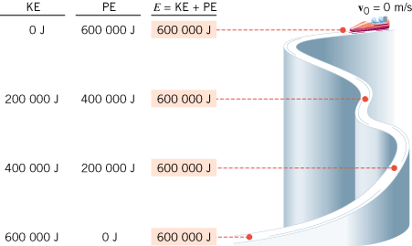
Conservation of Mechanical Energy
If friction and wind resistance are ignored, a bobsled run illustrates how kinetic and potential energy can be interconverted, while the total mechanical energy remains constant.

Slide 6
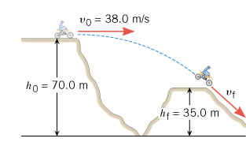
A Daredevil Motorcyclist
A motorcyclist is trying to leap across the canyon shown in Figure 6.16 by driving horizontally off the cliff at a speed of 38.0 m/s. Ignoring air resistance, find the speed with which the cycle strikes the ground on the other side.

Slide 7
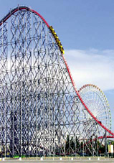
Roller Coaster (Ideal)
The ride includes a vertical drop of 93.5 m. The coaster has a speed of 3.0 m/s at the top of the drop. Neglect friction and find the speed of the riders at the bottom.

Slide 8
6.6 Nonconservative Forces and the Work–Energy Theorem
In the roller coaster example, we ignored nonconservative forces, such as friction. In reality, however, such forces are present when the roller coaster descends. The actual speed of the riders at the bottom is 41.0 m/s. Assuming again that the coaster has a speed of 3.0 m/s at the top, find the work done by nonconservative forces on a 55.0-kg rider during the descent.

