Slide 1
C H A P T E R 5 Dynamics of Uniform Circular Motion

Slide 2
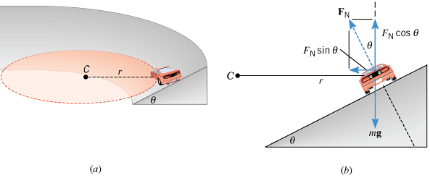
5.4 Banked Curves
Q: Why exit ramps in highways are banked?
A: To increase the centripetal force for the higher exit speed.
F_{N} cosθ = mg

Slide 3
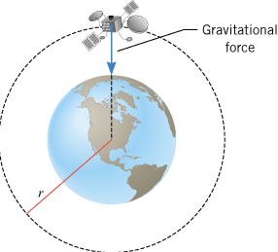
5.5 Satellites in Circular Orbits

Slide 4
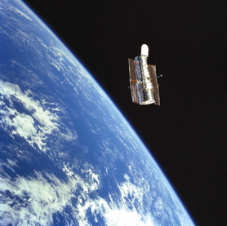
Orbital Speed of the Hubble Space Telescope
Determine the speed of the Hubble Space Telescope orbiting at a height of 598 km above the earth’s surface.

Slide 5
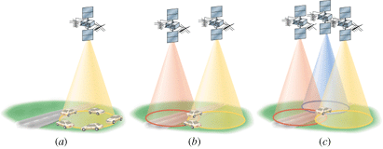
Global Positioning System (GPS)
A network of 24 satellites, which can be used to determine the position of an object to within 15 m or less.

Slide 6
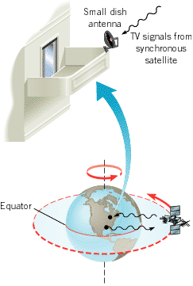
Synchronous Satellites
These satellites move around their orbits in a way that is synchronized with the rotation of the earth.
A synchronous satellite orbits the earth once per day on a circular path that lies in the plane of the equator.
Digital satellite system television uses such satellites as relay stations for TV signals.

Slide 7
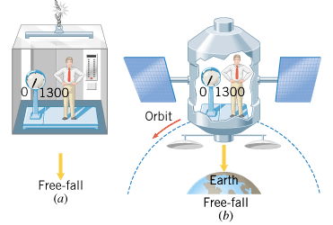
5.6 Apparent Weightlessness
Figure 5.18 shows a person on a scale in a freely falling elevator and in a satellite in a circular orbit. In each case, what apparent weight is recorded by the scale?
Answer: 0

Slide 8
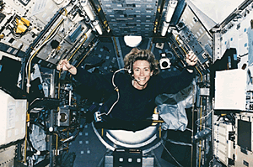
As she orbits the earth, this NASA astronaut floats around in a state of apparent weightlessness.

Slide 9
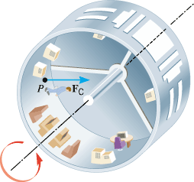
Artificial Gravity

Slide 10
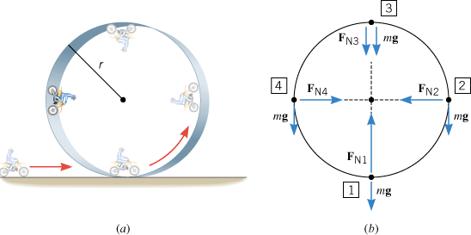
5.7 Vertical Circular Motion

