Slide 1
The Principle of Linear Superposition and Interference Phenomena
CHAPTER 17
Interference
Constructive and Destructive Interference: BEATS
Standing Waves:
Transverse-Stringed Instruments
and
Longitudinal-Wind Instruments.
Diffraction
Speakers

Slide 2
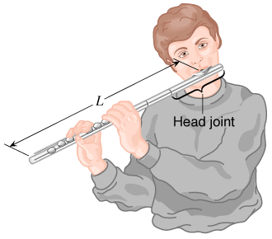
17.6 Longitudinal Standing Waves
Musical instruments in the wind family depend on longitudinal standing waves in producing sound.
Since wind instruments (trumpet, flute, clarinet, pipe organ, etc.) are modified tubes or columns of air, it is useful to examine the standing waves that can be set up in such tubes.

Slide 3
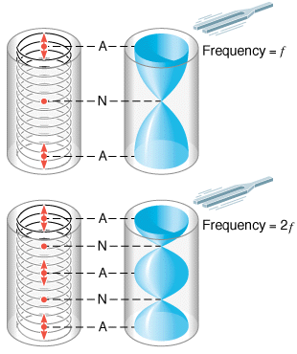
Open tube of air
A pictorial representation of longitudinal standing waves on a Slinky (left side) and in a tube of air (right side) that is open at both ends (A, antinode; N, node).

Slide 4
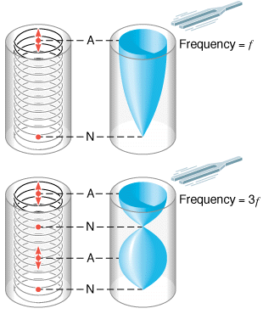
Closed tube of air
A pictorial representation of the longitudinal standing waves on a Slinky (left side) and in a tube of air (right side) that is open only at one end (A, antinode; N, node).

Slide 5
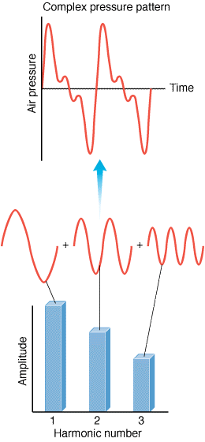
17.7 Complex Sound Waves
The sound wave corresponding to a note produced by a musical instrument or a singer is called a complex sound wave.
It consists of a mixture of the fundamental and harmonic frequencies.
http://phet.colorado.edu/en/simulation/fourier

Slide 6
Spectrum Analyzer
A microphone detects a complex sound wave, and a spectrum analyzer determines the amplitude and frequency of each harmonic present in the wave.

Slide 7
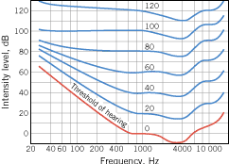
P41: Sound enters the ear, travels through the auditory canal, and reaches the eardrum. The auditory canal is approximately a tube open at only one end. The other end is closed by the eardrum. A typical length for the auditory canal in an adult is about 2.9 cm. The speed of sound is 343 m/s. What is the fundamental frequency of the canal? (Interestingly, the fundamental frequency is in the frequency range where human hearing is most sensitive.)
The Sensitivity of the Human Ear

