Slide 1
The Principle of Linear Superposition and Interference Phenomena
CHAPTER 17
Interference
Constructive and Destructive Interference: BEATS
Standing Waves:
Transverse-Stringed Instruments
and
Longitudinal-Wind Instruments.
Diffraction
Speakers

Slide 2
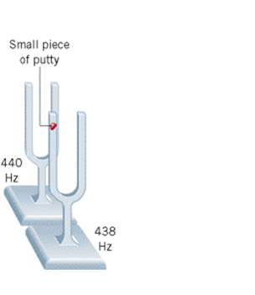
Beats with tuning forks

Slide 3
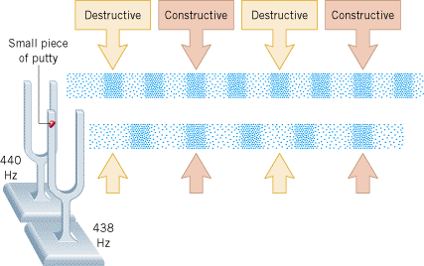
Beats with tuning forks
http://bcs.wiley.com/he-bcs/Books?action=mininav&bcsId=6799&itemId=0470879521&assetId=268608&resourceId=26543&newwindow=true

Slide 4
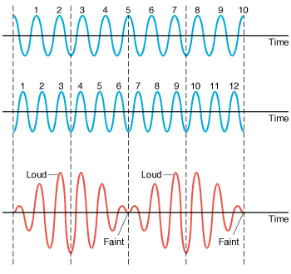
Beat Wave Pattern
A 10-Hz sound wave and a 12-Hz sound wave, when added together, produce a wave with a beat frequency of 2 Hz. The drawings show the pressure patterns (in blue) of the individual waves and the pressure pattern (in red) that results when the two overlap.

Slide 5
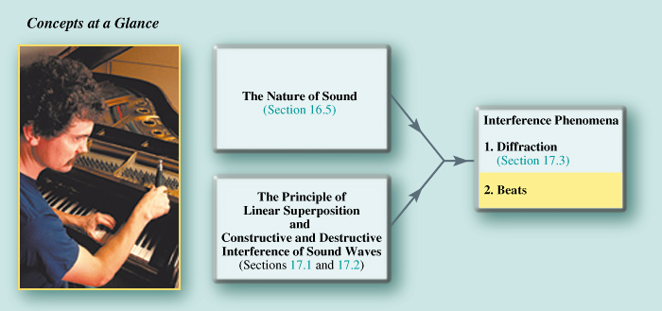
Piano Tuning
Musical instruments are tuned by listening to the beat frequency. For instance, a piano tuner listens to the beats produced between the string and a source with the correct frequency. The piano tuner adjusts the tension in the string until the beats vanish, ensuring that the string is vibrating at the correct frequency.

Slide 6
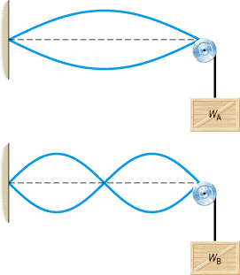
17.5 Transverse Standing Waves
A standing wave is an interference effect that can occur when two waves overlap.
Standing waves can arise with transverse waves, such as those on a guitar string, and also with longitudinal sound waves, such as those in a flute.
In any case, the principle of linear superposition provides an explanation of the effect, just as it does for diffraction and beats.
http://bcs.wiley.com/he-bcs/Books?action=mininav&bcsId=6799&itemId=0470879521&assetId=268608&resourceId=26543&newwindow=true

Slide 7
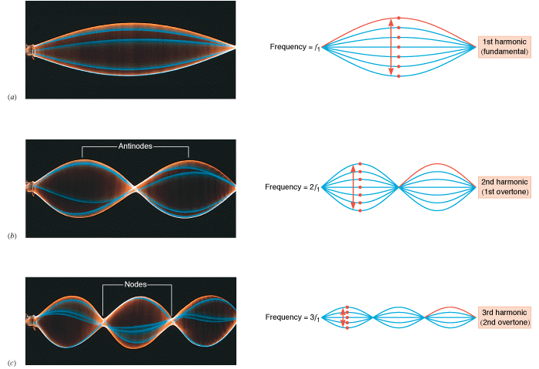
Standing wave patterns

